Slide 1
Function approximation
Nisheeth
31st January 2019

Slide 2
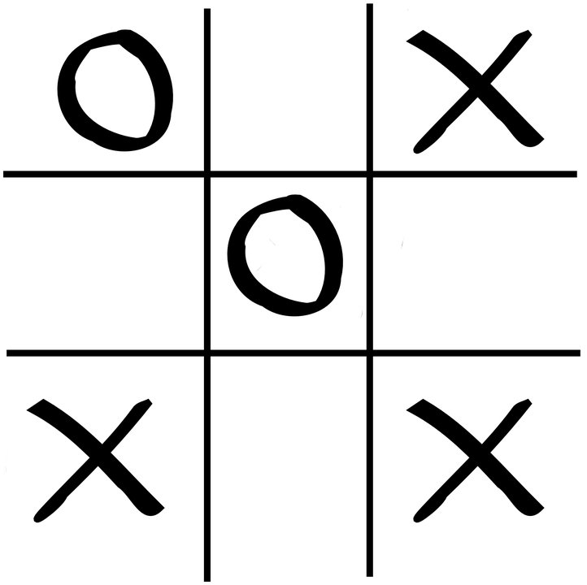
The state space problem in model-free RL
Number of states quickly becomes too large
Even for trivial applications
Learning becomes too dependent on right choice of exploration parameters
Explore-exploit tradeoffs become harder to solve
State space = 765 unique states

Slide 3
Solution approach
Cluster states
Design features to stand in for important situation elements
Close to win
Close to loss
Fork opp
Block fork
Center
Corner
Empty side

Slide 4
What’s the basis for your evaluation?
Use domain knowledge to spell out what is better
φ₁(s) → self center, opponent corner
φ₂(s) → opponent corner, self center
φ₃(s) → self fork, opponent center
φ₄(s) → opponent fork, self center
… as many as you can think of
These are basis functions

Slide 5
Value function approximation
RL methods have traditionally approximated the state value function using linear basis functions
w is a k valued parameter vector, where k is the number of features that are part of the function φ
Implicit assumption: all features contribute independently to evaluation

Slide 6
Function approximation in Q-learning
Approximate the Q table with linear basis functions
Update the weights
Where δ is the TD term
More details in next class

Slide 7
Non-linear approximations
Universal approximation theorem – a neural network with even one hidden layer can approximately represent any continuous-valued function
Neural nets were always attractive for their representation generality
But were hard to train
That changed with the GPU revolution ten years ago

Slide 8
The big idea
Approximate Q values using non-linear function approximation
Where θ are the parameters of the neural network and f(x) is the output of the network for input x
Combines both association and reinforcement principles
Association buys us state inference
Reinforcement buys as action policy learning
https://www.nature.com/articles/nature14236

Slide 9
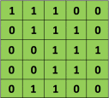
Conv nets basics
Image patch
Filter
Convolution
https://ujjwalkarn.me/2016/08/11/intuitive-explanation-convnets/

Slide 10
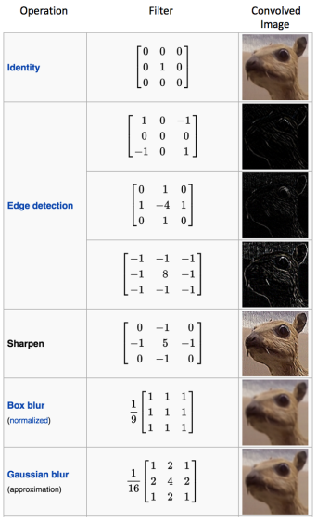
Discriminability from diverse filtering

Slide 11
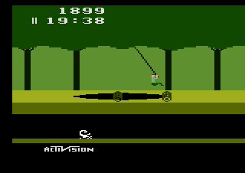
The Atari test bench
A very popular RL test bench
Limited space of actions
Non-stop reward feedback
Free to use
Earlier methods used features handcrafted for each game

Slide 12
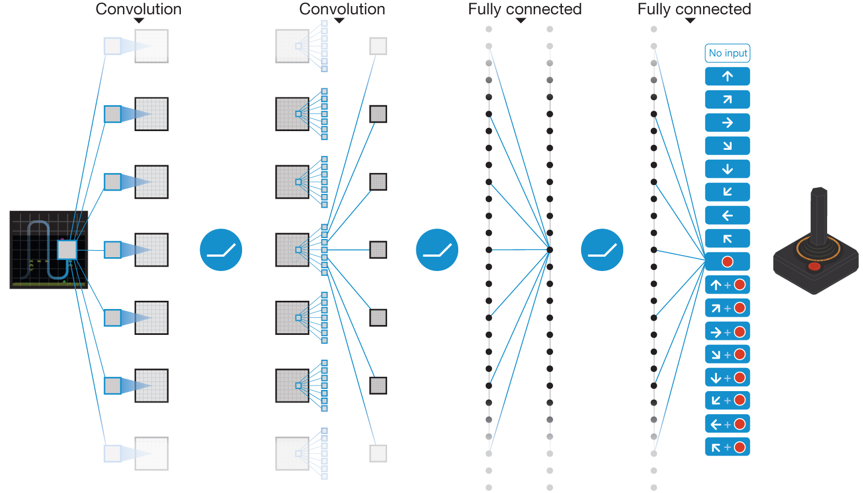
Schematic illustration of the convolutional neural network.
V Mnih et al. Nature 518, 529-533 (2015) doi:10.1038/nature14236

Slide 13
Deep Q network
Basic Q learning algorithm augmented a bunch of different ways
Use of experience replay
Use of batch learning
Use of non-linear function approximation

Slide 14
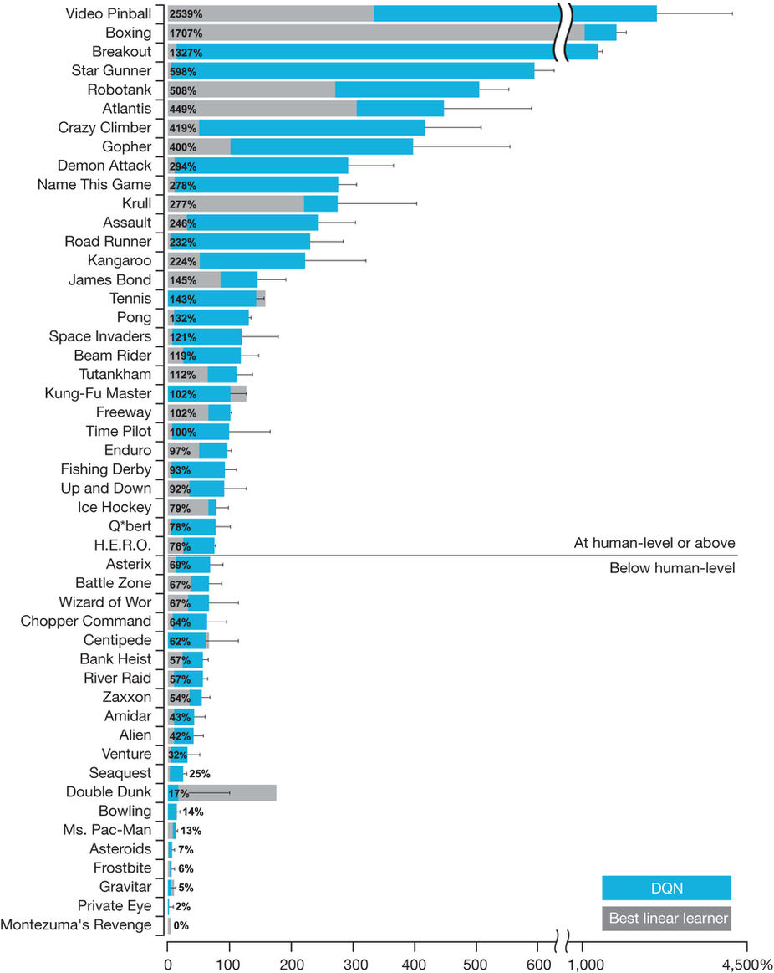

Slide 15
AlphaZero
Figure 1: Training AlphaZero for 700,000 steps. Elo ratings were computed from evaluation games between different players when given one second per move. a Performance of AlphaZero in chess, compared to 2016 TCEC world-champion program Stockfish. b Performance of AlphaZero in shogi, compared to 2017 CSA world-champion program Elmo. c Performance of AlphaZero in Go, compared to AlphaGo Lee and AlphaGo Zero (20 block / 3 day) (29).

Slide 16
Secret ingredient
Some algorithmic innovations
MCTS
Mostly, just lots and lots of computation
5000 TPUs to generate game-play
64 TPUs to train the DQN
This work closes a long chapter in game-based AI research
And brings research in RL to a dead end!
https://www.quora.com/Is-reinforcement-learning-a-dead-end

Slide 17
Summary
Deep reinforcement learning is the cognitive architecture of the moment
Perhaps of the future also
Beautifully combines the cognitive concepts of association and reinforcement
Excellent generalizability across toy domains
Limitations exist: timing, higher-order structure, computational complexity etc.

Slide 18
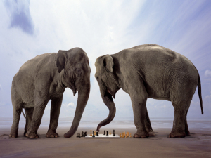
RL is as intelligent as a railway engine
You tell it what to do
Shape behavior using reward signals
It does what you tell it to do
After tons of cost-free simulations
Can work in specific toy domains
Does not work as a model of real real-time learning
https://www.sciencedirect.com/science/article/pii/S0921889005800259

Slide 19
Where do rewards/labels come from?
To get a shi-fei (this-not-that discrimination) from the xin (heart-mind) without its having been constructed there is like going to Yue today and arriving yesterday, like getting something from nothing
Zhuangzi Yinde, 4th century B.C.
Preferences are constructed (Slovic, 1995; Gilboa & Schmeidler, 2000)
From past experience (Srivastava & Schrater, 2015)

Slide 20
Elephants don’t play chess
The world as its own model
Subsumption architecture
Don’t try to model the world with states and rewards
Give individual robot components their own (simple, maybe hardwired) goals
Tweak components until you get behavior that looks reasonable
Big success
Roomba!
https://en.wikipedia.org/wiki/BEAM_robotics
http://cid.nada.kth.se/en/HeideggerianAI.pdf

Slide 21
Summary
Principles of association and reinforcement are being used prominently in existing ML methods
They work well for specific applications
But not as general models of learning to be in the world
Much remains to be learned about
Internal representations
Processes controlling internal representations
Embodied priors
How embodied priors interact with processes controlling internal representations
We will start talking about how this is currently being done computationally beginning next class
No class Feb 1

