Slide 1
Efficient Management of LLCs in GPUs for 3D Scene Rendering Workloads
Jayesh Gaur (Intel)
Raghuram Srinivasan (Ohio State)
Sreenivas Subramoney (Intel)
Mainak Chaudhuri (IIT, Kanpur)

Slide 2
Sketch
Talk in one slide
Result highlights
Understanding the potential
Reuses in 3D graphics data
Our policy proposals
Evaluation methodology
Simulation results
Summary

Slide 3
Sketch
Talk in one slide
Result highlights
Understanding the potential
Reuses in 3D graphics data
Our policy proposals
Evaluation methodology
Simulation results
Summary

Slide 4
Talk in One Slide
3D scene rendering pipeline generates accesses to different types of data
Vertex, vertex index, depth, hierarchical depth, stencil, render targets (same as pixel colors), and textures for sampling
GPUs include small render caches for each such data type and more recently read/write last-level caches (LLCs) shared by all such data streams
Our proposal: graphics stream-aware probabilistic caching (GSPC) for GPU LLC
Learns inter- and intra-stream reuse probabilities from a few sample LLC sets and modulates insertion/promotion in other sets

Slide 5
Result highlights
Three increasingly better policies coupled with uncached displayable color data
Baseline: two-bit DRRIP
Workloads: 52 DirectX frames selected from eight game titles and four benchmark applications using Direct3D 10 and 11 APIs
LLC miss saving: up to 29.6% and on average 13.1% with an 8 MB 16-way LLC
Frame rate improvement: up to 18.2% and on average 8.0%; with increasing LLC capacity, it gets even better (11.8% with a 16 MB LLC)
More important as GPUs get more aggressive

Slide 6
Sketch
Talk in one slide
Result highlights
Understanding the potential
Reuses in 3D graphics data
Our policy proposals
Evaluation methodology
Simulation results
Summary

Slide 7
Characterization framework
Functional LLC model
8 MB 16-way 64-byte blocks
Digests LLC access traces collected from a detailed timing simulator of a high-end GPU
Load/Store trace collection
52 frames are selected from twelve DirectX applications that use Direct3D 10 and 11 APIs
Eight games and four benchmark applications
All Direct3D APIs are intercepted in each frame and replayed through the detailed simulator
All LLC accesses are logged in a trace
The modeled LLC is non-inclusive/non-exclusive

Slide 8
GPU last-level cache interface
RENDERING PIPELINE
Z
GPU LLC
STC
HIZ
Large potential for improving system bandwidth, power, and performance
RT/CLR
DRAM
VTX IDX
TEX
VTX
Belady’s optimal policy projects a 36.6% average saving in LLC misses compared to two-bit DRRIP

Slide 9
LLC accesses
LLC accesses arise due to misses in the GPU render caches
For example, a sampler request comes to the LLC only if the access has missed in all levels of the texture cache hierarchy of the GPU
The LLC accesses can be partitioned based on the source of the request
Each such partition will be referred to as a 3D graphics stream
We consider eight streams: Vertex, HiZ, Z, render target (RT), texture sampler (TEX), stencil (STC), displayable color, and the rest (shader code, constants, etc.)

Slide 10
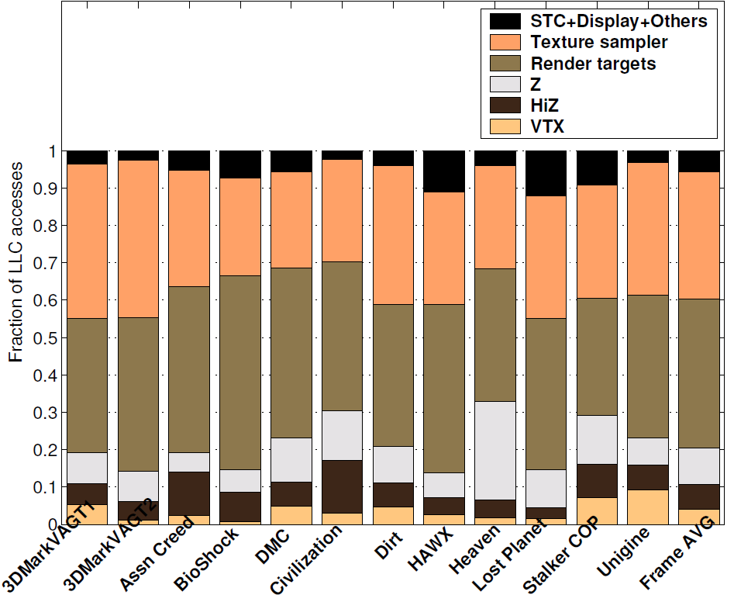
LLC access traffic
Which 3D graphics streams are important?
REST 5%
Most LLC accesses touch texture sampler data, render targets (pixel colors), and depth
TEX 34%
RT 40%
Z 10%
HiZ 7%
VTX 4%

Slide 11
LLC read hit rates (8 MB 16-way)
Texture sampler data
Belady’s optimal: 53.4%
Two-bit DRRIP: 22.0%
Single-bit NRU: 18.4%
Render targets
Belady’s optimal: 59.8%
Two-bit DRRIP: 50.1%
Single-bit NRU: 41.5%
Depth
Belady’s optimal: 77.1%
Two-bit DRRIP: 58.0%
Single-bit NRU: 58.0%
LLC hits arise from render to texture reuses and intra-stream texture reuses
Texture sampler data presents the largest opportunity for improvement
LLC hits arise from intra-stream render target blend ops
LLC hits arise from intra-stream depth reuses

Slide 12
Sketch
Talk in one slide
Result highlights
Understanding the potential
Reuses in 3D graphics data
Our policy proposals
Evaluation methodology
Simulation results
Summary

Slide 13
LLC reuse study#1: Texture
LLC hits enjoyed by the texture samplers come from two sources
Inter-stream reuses
A previously created render target block is consumed by the texture samplers from the LLC
Arises from a technique called render to texture, very popular for generating dynamic textures that need to be updated on a per-frame basis
Examples include waves, moving clouds, foliage, fluttering cloth, smoke, fire, and many more
Intra-stream reuses
A texture block, previously used by the samplers, is reused by the samplers from the LLC

Slide 14
LLC reuse study#1: Texture
Distinguishing inter-stream reuses from intra-stream reuses
Attach one bit with each LLC block; call it RT bit
All LLC blocks accessed/filled by the render target stream have the RT bit set
A texture sampler access that consumes an LLC block with the RT bit set is identified as an inter-stream reuse; the RT bit gets reset at this point
All other texture sampler hits in the LLC are classified as intra-stream reuses

Slide 15
LLC reuse study#1: Texture
Out of all LLC hits enjoyed by the texture sampler accesses in Belady’s optimal policy
Inter-stream: 55%, Intra-stream: 45% averaged over 52 frames drawn from twelve DirectX apps
Inter-stream reuses
Out of all LLC blocks with the RT bit set, 51% are consumed by the texture samplers in Belady’s optimal policy
DRRIP and NRU: 16%, 13%
With Belady’s optimal policy, each of the twelve applications has at least one-third RT blocks consumed by the texture samplers

Slide 16
LLC reuse study#1: Texture
Inter-stream reuse: take-away
Retaining RT blocks in the LLC is important for improving texture sampler throughput
Without driver assistance, it is difficult to identify the render targets that will be used as textures
In this work, we consider all render targets to be potential source for dynamic textures and refine this set based on render to texture reuse probability learned at run-time
Why DRRIP falls so much short of optimal
Fills 25% of the RT blocks with RRPV three
Level of protection for RT fills must be decided from the render to texture reuse probability

Slide 17
LLC reuse study#1: Texture
Intra-stream reuses
The goal is to understand how a dead texture block in the LLC can be identified and evicted creating room for other live graphics data
Divide the life of a texture block in the LLC into epochs demarcated by hits
Sampler access misses LLC and fills a texture block B OR sampler consumes an RT block B
E₀
Time
E₁
Sampler access hits block B in LLC
E₂
E₃
LLC evicts block B
Intra-stream reuses

Slide 18
LLC reuse study#1: Texture
Intra-stream reuses
All texture blocks residing in the LLC at any point in time can be partitioned into disjoint sets based on their epochs
Clearly, the set E_{k+1} is a subset of the set E_{k} for all k≥0
Define death ratio of epoch E_{k} as (|E_{k}| – |E_{k+1}|)/|E_{k}|
Define reuse probability of epoch E_{k} as |E_{k+1}|/|E_{k}|
Goal of a good policy should be to attach a high victimization priority to the epochs with low reuse probability

Slide 19
LLC reuse study#1: Texture
How many epochs are statistically significant
When the LLC runs Belady’s optimal policy, 79% of all texture sampler hits come from the E₀ epoch, 15% from the E₁ epoch, 4% from the E₂ epoch, and 2% from the E_{≥3} epoch
It is enough to keep track of the E₀, E₁, and E_{≥2} epochs for a texture block
Average reuse probability of these epochs
E₀: 0.19 (at most 0.3 across the twelve apps)
E₁: 0.27 (varies a lot across applications: 0.6 to nearly zero)
E₂: 0.47 (can be assumed to be mostly live)

Slide 20
LLC reuse study#1: Texture
Intra-stream reuse: take-away
Need to track the epoch membership of a texture block (one among E₀, E₁, E_{≥2})
Need to learn the reuse probabilities of the E₀ and E₁ epochs dynamically
Texture blocks entering the E_{≥2} epoch will be assumed to be live unconditionally
Why DRRIP falls so much short of optimal
DRRIP fills slightly over a third of the texture blocks with RRPV three in the LLC
Need to eliminate more dead texture blocks
Cannot always promote to RRPV zero on hit

Slide 21
LLC reuse study#2: Depth
Only intra-stream reuses from the LLC
Generated depth buffer values are consumed for further depth tests
Use the same epoch-based formalism
Reuse probabilities of the first three epochs
E₀: 0.39, E₁: 0.62, E₂: 0.74
Very different from the texture epochs
Only the E₀ blocks have low reuse probability and the E_{≥1} blocks are practically live
We will decide the insertion RRPV of the Z blocks by estimating the aggregate reuse probability of all Z blocks and won’t consider epochs

Slide 22
LLC reuse: Render target
Render targets source two types of LLC hits
Texture sampler hits for render to texture
Render target blending (also known as texture blending), where an already created render target is blended with another render target being created currently (transparency modeling)
We do not implement any policy for improving render target blending
DRRIP is within 10% of optimal in hit rate
Some of the lost LLC hits in blending operations can be recovered by eliminating dead textures
Our render target hit rates are close to optimal

Slide 23
Sketch
Talk in one slide
Result highlights
Understanding the potential
Reuses in 3D graphics data
Our policy proposals
Evaluation methodology
Simulation results
Summary

Slide 24
Graphics stream-aware policies
Basic framework
LLC accesses are partitioned into four streams based on the source: texture samplers (TEX), render targets (RT), depth (Z), and the rest
All policies modulate the two-bit RRPV of an LLC block on insertion and promotion based on reuse probabilities
A larger RRPV corresponds to a smaller probability of reuse; the blocks with RRPV three are potential victim candidates
The reuse probabilities are estimated by maintaining fill and hit counters for a few sampled LLC sets that always use SRRIP [ISCA’10]

Slide 25
Graphics stream-aware policies
Policy#1: Graphics stream-aware probabilistic Z and texture caching (GSPZTC)
LLC
Inc. on Z fills to samples
FILL(Z)
HIT(Z)
SRRIP samples
Inc. on Z hits to samples
Sets
Inc. on RT to TEX and TEX fills to samples
FILL(TEX)
HIT(TEX)

Slide 26
Graphics stream-aware policies
GSPZTC policy for non-sample sets
The insertion RRPV of a block depends on the reuse probability of the stream it belongs to
Z fill: RRPV ← (FILL(Z) > t.HIT(Z)) ? 3:2
The reuse probability threshold of 1/(t+1) is determined empirically; we use t=8
TEX fill: RRPV ← (FILL(TEX) > t.HIT(TEX)) ? 3:0
RT fill: RRPV ← 0 (highest protection)
All other fills: RRPV ← 2 (like SRRIP)
All hits: RRPV ← 0 (like any RRIP)
Each LLC block has an RT bit to identify RT to TEX reuse

Slide 27
Graphics stream-aware policies
Policy#2: GSPZTC with texture sampler epochs (GSPZTC+TSE)
Each LLC block has two state bits to keep track of E₀, E₁, and E_{≥2} epochs for texture blocks; the fourth state serves the functionality of the RT bit
The FILL(TEX) and HIT(TEX) counters are replaced by FILL(E₀, TEX), FILL(E₁, TEX), HIT(E₀, TEX), and HIT(E₁, TEX)
Recall: enough to estimate the reuse probabilities of the E₀ and E₁ epochs
Recall: the E_{≥2} blocks are unconditionally live (assumed to have high reuse probability)

Slide 28
Graphics stream-aware policies
Policy#2: GSPZTC with texture sampler epochs (GSPZTC+TSE)
Sampler access misses LLC and fills a texture block B OR sampler consumes an RT block B
E₀
Texture reuse
E₁
HIT(E₀, TEX)++
FILL(E₁, TEX)++
FILL(E₀, TEX)++
Texture reuse
Texture reuse
E_{≥2}
HIT(E₁, TEX)++

Slide 29
Graphics stream-aware policies
Policy#2: GSPZTC+TSE for non-sample sets
TEX fill or RT to TEX reuse: RRPV ← (FILL(E₀, TEX) > t.HIT(E₀, TEX)) ? 3:0
TEX hit to a block in epoch E₀: RRPV ← (FILL(E₁, TEX) > t.HIT(E₁, TEX)) ? 3:0
TEX hit to a block in epoch E₁: RRPV ← 0
Other rules are same as GSPZTC
Observe that both GSPZTC and GSPZTC+TSE offer the highest protection to the newly filled render target blocks
Unnecessarily wastes cache space if the likelihood of RT to TEX reuse is low
The next policy addresses this problem

Slide 30
Graphics stream-aware policies
Policy#3: GSPZTC+TSE + RT insertion policy
Our final proposal: graphics stream-aware probabilistic caching (GSPC)
Incorporates two new counters PROD and CONS
PROD is incremented on an RT fill to a sample set; left untouched on RT blending hits
Approximately tracks the number of unique RT blocks mapping to the sample sets
CONS is incremented on RT to TEX reuses in the sample sets
One increment for every consumed RT block
The block enters the E₀ state after this
Inter-stream reuse probability is CONS/PROD

Slide 31
Graphics stream-aware policies
Policy#3: GSPC for non-sample sets
RT fill: If PROD > 16.CONS then RRPV ← 3
[[Low inter-stream reuse probability]]
Else if 16.CONS ≥ PROD > 8.CONS then
RRPV ← 2
[[Medium inter-stream reuse probability]]
Else RRPV ← 0
[[High inter-stream reuse probability]]
RT hit (blending): RRPV ← 0
RT to TEX reuse: as in GSPZTC+TSE
All other rules are same as GSPZTC+TSE

Slide 32
Graphics stream-aware policies
Hardware overhead of GSPC on top of two RRPV bits per LLC block
Two new state bits per LLC block
Eight short counters per LLC bank: reuse probabilities are de-centralized and maintained per bank to avoid counter hotspots
HIT(Z), FILL(Z), HIT(E₀, TEX), FILL(E₀, TEX), HIT(E₁, TEX), FILL(E₁, TEX), PROD, CONS: eight bits each
A seven-bit counter to maintain the interval at which the above counters are halved: probabilities are computed on exponentially averaged estimates
Overall, less than 0.5% of all LLC data bits

Slide 33
Sketch
Talk in one slide
Result highlights
Understanding the potential
Reuses in 3D graphics data
Our policy proposals
Evaluation methodology
Simulation results
Summary

Slide 34
Evaluation methodology
Detailed timing model of a high-end GPU
Eight thread contexts per shader core
Two threads can issue one four-wide vector operation (including MAD) each per cycle
One texture sampler for every eight shader cores
Two configs: 64 and 96 shader cores @ 1.6 GHz
Peak shader throughput: 1.6 TFLOPS and 2.5 TFLOPS
512 and 768 thread contexts
LLC configs: 8 MB and 16 MB 16-way 4 GHz
2 MB per bank, non-inclusive/non-exclusive
DRAM configs: Dual-channel DDR3-1600 15-15-15 8-way banked
52 frames from twelve DirectX applications

Slide 35
Sketch
Talk in one slide
Result highlights
Understanding the potential
Reuses in 3D graphics data
Our policy proposals
Evaluation methodology
Simulation results
Summary

Slide 36
Total volume of LLC misses
Config: 768 shader contexts, 12 texture samplers, 8 MB LLC
DRRIP
1.06
NRU
1.00
SHiP-mem
The best policy proposal saves 13% LLC misses on average (1.7% to 29.6%)
0.97
GS-DRRIP
0.95
GSPZTC
0.89
GSPZTC+TSE
0.88
GSPC
0.87
GSPC+UCD
1.00
DRRIP+UCD
0.80
0.84
0.88
0.92
0.96
1.00
1.04
1.08

Slide 37
RT to TEX reuse through LLC
Config: 768 shader contexts, 12 texture samplers, 8 MB LLC
16.3%
DRRIP
13.1%
NRU
RT to TEX reuse through LLC offered by the best proposal is close to optimal (51%)
14.6%
SHiP-mem
20.0%
GS-DRRIP
30.4%
GSPZTC
42.3%
GSPZTC+TSE
38.7%
GSPC
40.4%
GSPC+UCD
16.6%
DRRIP+UCD
10%
15%
20%
25%
30%
35%
40%
45%

Slide 38
LLC hit rate: Texture sampler
Config: 768 shader contexts, 12 texture samplers, 8 MB LLC
22.0%
DRRIP
18.4%
NRU
The best proposal still lags significantly behind the optimal (53.4%)
21.5%
SHiP-mem
23.8%
GS-DRRIP
27.8%
GSPZTC
33.3%
GSPZTC+TSE
32.2%
GSPC
33.5%
GSPC+UCD
22.2%
DRRIP+UCD
15%
18%
21%
24%
27%
30%
33%
36%

Slide 39
LLC hit rate: RT accesses
Config: 768 shader contexts, 12 texture samplers, 8 MB LLC
50.1%
DRRIP
41.5%
NRU
The best proposal offers nearly optimal (59.8%) RT hit rate
49.3%
SHiP-mem
51.1%
GS-DRRIP
50.8%
GSPZTC
53.1%
GSPZTC+TSE
57.7%
GSPC
58.3%
GSPC+UCD
50.0%
DRRIP+UCD
36%
40%
44%
48%
52%
56%
60%

Slide 40
Frame rate improvement
Config: 768 shader contexts, 12 texture samplers, 8 MB LLC, DDR3-1600 15-15-15
Config: All identical except 16 MB LLC
DRRIP+UCD
0.93
NRU+UCD
1.01
GS-DRRIP+UCD
Frame rate improvements in GSPC gracefully scale with LLC capacity
1.08
GSPC+UCD
0.90
0.94
0.98
1.02
1.06
1.10
1.14
DRRIP+UCD
0.97
NRU+UCD
1.04
GS-DRRIP+UCD
1.12
GSPC+UCD
0.90
0.94
0.98
1.02
1.06
1.10
1.14

Slide 41
Sensitivity to shader thread count
Config: 768 shader contexts, 12 texture samplers, 8 MB LLC, DDR3-1600 15-15-15
Config: All identical except 512 shader contexts
DRRIP+UCD
0.93
NRU+UCD
Our proposal gains in importance as the GPU puts more pressure on the memory system with more threads
1.08
GSPC+UCD
0.90
0.94
0.98
1.02
1.06
1.10
1.14
DRRIP+UCD
0.95
NRU+UCD
1.06
GSPC+UCD
0.90
0.94
0.98
1.02
1.06
1.10
1.14

Slide 42
Sketch
Talk in one slide
Result highlights
Understanding the potential
Reuses in 3D graphics data
Our policy proposals
Evaluation methodology
Simulation results
Summary

Slide 43
Summary
Graphics processor’s LLC is shared by different data structures used in 3D scene rendering applications
Render targets (same as pixel colors), textures, and depth buffer contribute most to the LLC access traffic
We propose reuse probability-based algorithms to efficiently manage the GPU LLC
Our best proposal saves 13.1% LLC misses and speeds up rendering by 8% on average in a GPU with an 8 MB LLC
Speedup improves to 11.8% for a 16 MB LLC

Slide 44
Where do we lose against optimal
Render target to texture reuse
Optimal: 51%, GSPC+UCD: 40.4%
Render target blending hit rate
Optimal: 59.8%, GSPC+UCD: 58.1%
Texture sampler hit rate
Optimal: 53.4%, GSPC+UCD: 33.5%
Z hit rate
Optimal: 77.1%, GSPC+UCD: 59%
Need a better model for intra-stream texture and Z reuses that can construct partitions more useful than reuse count-based epochs
About 10%
About 2%
About 20%
About 18%

Slide 45
Nothing clears up a case so much
as stating it to another person.
-Sir Arthur Conan Doyle
[Silver Blaze (1892)]
Thank you

