Slide 1
Zero Inclusion Victim (ZIV): Isolating Core Caches from Inclusive Last-level Cache Evictions
Mainak Chaudhuri
Indian Institute of Technology Kanpur
ISCA 2021

Slide 2
Sketch
ZIV LLC in brief
Result highlights
Introduction
ZIV LLC design
Finding relocation sets
Replacement policy in relocation sets
Managing relocated blocks
Simulation infrastructure
Simulation results
Summary and future work

Slide 3
Sketch
ZIV LLC in brief
Result highlights
Introduction
ZIV LLC design
Finding relocation sets
Replacement policy in relocation sets
Managing relocated blocks
Simulation infrastructure
Simulation results
Summary and future work

Slide 4
ZIV LLC in brief
C0
C1
C2
C3
IV
IV
Private
Cache(s)
B2
B1
B1
B3
INV
Perf. loss is a function of private cache capacity and LLC policy; LLC policies approaching Belady’s MIN suffer most
IVs make LLC eviction-based timing side channel attacks much less noisy because IVs can be used to control private cache contents of cores through LLC eviction
IVs rule out the use of large private caches, particularly large private L2 caches
IVs are not fundamental to the inclusion property, but arise due to the way the inclusive LLC contents are managed
Inclusion victims (IVs) increase private cache and LLC misses, degrade performance, inflate traffic
INV
Can we design an inclusive LLC that is guaranteed to never generate IVs?
Zero Inclusion Victim (ZIV) LLC
INV
Interconnection Network
Eviction
B2
Shared LLC Bank
Shared LLC Bank
E2
E1
E3
Sparse
Directory Slice
Sparse
Directory Slice
B3
B1

Slide 5
ZIV LLC in brief
C0
C1
C2
C3
Private
Cache(s)
B2
B1
B1
ZIV LLC is the first inclusive LLC design that guarantees freedom from IVs and isolates core caches from inclusive LLC evictions
Key goals: (i) perf. close to non-inclusive LLC, (ii) large L2 cache with inclusive LLC, (iii) energy- and area-efficient relocation
Such a relocation set is guaranteed to exist because inclusive LLC capacity is more than aggregate private cache capacity
Challenge#2: Efficiently manage accesses to and replacement of relocated blocks
Challenge#3: Efficiently find a “good” relocation set to make global victim choices high-performance (performant ZIV)
B3
Challenge#1: Efficiently find a relocation set (RS) that has at least one block with no privately cached copy (basic ZIV)
Interconnection Network
Eviction
Relocate
B2
Shared LLC Bank
Shared LLC Bank
RS
E2
PTR
E1
PTR
E3
RS
Sparse
Directory Slice
Relocate
Sparse
Directory Slice
B3
B1

Slide 6
Result highlights
Evaluated on 8-core/128-core CMPs with multi-threaded and multi-programmed workloads
ZIV LLC performs close to a non-inclusive LLC for different types of LLC replacement policies
We study LRU and Hawkeye policies
ZIV LLC gracefully supports private L2 caches with capacity up to half the LLC capacity
ZIV LLC comfortably outperforms related proposals such as QBS [MICRO 2010] and SHARP [ISCA 2017]
Performance lead grows with increasing L2 cache capacity

Slide 7
Result highlights
ZIV LLC retains all benefits of an inclusive LLC
Much simpler cache coherence than non-inclusive cache hierarchy
With ZIV LLC, private cache contents cannot be manipulated through LLC evictions
No inclusion victim

Slide 8
Sketch
ZIV LLC in brief
Result highlights
Introduction
ZIV LLC design
Finding relocation sets
Replacement policy in relocation sets
Managing relocated blocks
Simulation infrastructure
Simulation results
Summary and future work

Slide 9
Why inclusive LLC
Significantly simplified cache coherence in a chip-multiprocessor with inclusive LLC
Private cache miss request
Sparse
Directory
Slice
Last-level Cache Bank
The fourth case can arise in non-inclusive designs, is far more complex than the other three cases, and introduces new transient states and new protocol races
Hit
Hit
Coher. prot.
Miss
Hit
LLC resp.
Miss
Miss
Socket resp.
Not possible
Hit
Miss

Slide 10
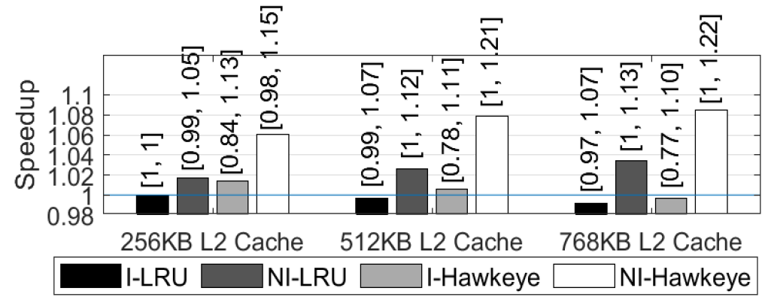
Performance loss in inclusive LLC
Evaluated on 8-core CMP with 72 multi-prog. workloads
Normalized to I-LRU (LLC policy) with 256 KB L2 cache
I-LRU vs. NI-LRU: Perf. gap increases with increasing L2 cache capacity due to increasing volume of IVs
Performance loss increases steeply as LLC replacement policy approaches Belady’s MIN
I-Hawkeye vs. NI-Hawkeye: Much bigger perf. gap; very big perf. loss in some of the workloads with I-Hawkeye

Slide 11
Sketch
ZIV LLC in brief
Result highlights
Introduction
ZIV LLC design
Finding relocation sets
Replacement policy in relocation sets
Managing relocated blocks
Simulation infrastructure
Simulation results
Summary and future work

Slide 12
Block relocation flow
Sparse Dir.
Slice
Target LLC set
New LLC fill
Evict
Consult on-chip dir.
Relocation FIFO
LLC fill port
arbiter
Y
Has privately cached copies?
N
Next relocation set
Evict & STOP
nextRS
LLC victim with no
privately cached copy

Slide 13
Finding relocation sets
Relocation sets need to satisfy certain properties
Two such properties are: Does the set have an invalid way? Does the set have a valid block with no privately cached copy?
Invalid property and NotInPrC property
Attach property bits to each LLC set to identify such sets
Any invalid way?
LLC set
NotInPrC
Invalid
Any block with no
privately cached copy?

Slide 14
Finding relocation sets
nextRS
Property
Vectors (PVs)
LLC set
NotInPrC PV
Invalid PV
nextRS
Register nextRS of each PV points to the next round-robin position (with wrap-around) in PV with a set bit
If Invalid PV is not empty, use its nextRS as the reloc. set index; otherwise use nextRS of NotInPrC PV

Slide 15
Efficiently computing nextRS
It is possible to efficiently compute decoded nextRS from the decoded current RS and PV
00000000001000000
Decoder
nextRS
Wordlines
We will directly compute decoded nextRS from a given PV and decoded RS
Decoded nextRS

Slide 16
Efficiently computing nextRS
00000000001000000
11111111110000000
00101101001110010
00101101000000000
11010011000000000
00000001000000000
Gen.
mask
& mask
&
Decoded
RS
mask
PV
upperPV
2’s compl.
upperPV
Decoded
nextRS

Slide 17
Efficiently computing nextRS
00000000001000000
00000000000111111
00000000001110010
00000000000110010
11111111111001110
00000000000000010
Gen.
mask
& mask
&
Decoded
RS
PV
upperPV=0
lowerPV
2’s compl.
lowerPV
Decoded
nextRS
mask

Slide 18
Finding “good” relocation sets
Invalid and NotInPrC properties may not offer “good” relocation sets
Need to combine with locality-centric properties
LRUNotInPrC property: a set in which the LRU block does not have any privately cached copy (applicable if LLC policy is LRU)
Needs a third PV in addition to Invalid and NotInPrC PVs to find a relocation set
If Invalid PV is not empty, use its nextRS
If Invalid PV is empty and LRUNotInPrC PV is not empty, use the nextRS of LRUNotInPrC PV
Use the nextRS of NotInPrC PV if other two PVs empty

Slide 19
Finding “good” relocation sets
MaxRRPVNotInPrC property: a set in which the block with max RRPV does not have any privately cached copy (applicable if LLC policy uses RRPV or other non-LRU age)
Needs a third PV in addition to Invalid and NotInPrC PVs to find a relocation set
Algorithm to find relocation sets is similar to LRUNotInPrC

Slide 20
Finding “good” relocation sets
LikelyDeadNotInPrC property: a set having a likely dead block with no privately cached copy
Agnostic to LLC policy, but needs to identify likely dead blocks having no privately cached copies
Appeals to Cache Hierarchy-aware Replacement (CHAR) proposal [PACT 2012]
Infers liveness of blocks evicted from private caches
See paper for details
Needs a third PV for LikelyDeadNotInPrC
Priority order of nextRS: Invalid PV, LikelyDeadNotInPrC PV, NotInPrC PV

Slide 21
Finding “good” relocation sets
MaxRRPVLikelyDeadNotInPrC property: LikelyDeadNotInPrC property applied to LLC employing RRPV-based policy
Needs four PVs: Invalid, NotInPrC, LikelyDeadNotInPrC, MaxRRPVNotInPrC
Priority order for nextRS: Invalid, MaxRRPVNotInPrC, LikelyDeadNotInPrC, NotInPrC
Reduce the number of relocations
In all cases, at each priority level, the original LLC set is checked to see if it satisfies the property of that level; if yes, no relocation

Slide 22
Critical path and area estimates
RTL synthesis of decoded nextRS computation using 45 nm TSMC process
Critical path meets a 0.75 ns timing target for a fully combinational implementation
Three-cycle latency and repeat interval @ 4 GHz clock frequency
Area overhead per LLC bank
Properties requiring two PVs: 0.045 mm²
Properties requiring three PVs: 0.078 mm²
Properties requiring four PVs: 0.099 mm²

Slide 23
Sketch
ZIV LLC in brief
Result highlights
Introduction
ZIV LLC design
Finding relocation sets
Replacement policy in relocation sets
Managing relocated blocks
Simulation infrastructure
Simulation results
Summary and future work

Slide 24
Replacement policy in RS
A relocation set is found by following a certain priority order among the set properties
Replacement policy in a relocation set follows the same priority order to identify the victim
Consider the LikelyDeadNotInPrC property
Implemented using three PVs with priority order (highest to lowest): Invalid, LikelyDeadNotInPrC, NotInPrC
Replacement policy in the RS evicts an invalid way (if any), next the likely dead block closest to the LRU position, and finally the NotInPrC block closest to the LRU position

Slide 25
Sketch
ZIV LLC in brief
Result highlights
Introduction
ZIV LLC design
Finding relocation sets
Replacement policy in relocation sets
Managing relocated blocks
Simulation infrastructure
Simulation results
Summary and future work

Slide 26
Managing relocated blocks
Each LLC block has a new Relocated state to identify the relocated blocks
LLC hit = valid && !Relocated && tag match
Each sparse directory entry also has a new Relocated state in addition to a pointer field for recording the location of a relocated block
Pointer field records (bank id, LLC set, LLC way)

Slide 27
Accessing a relocated block
Private cache miss request
LLC tag
PTR
R
Miss
Sparse Dir.
Slice
LLC data
Critical path length = max (dir. array, LLC tag array) + LLC data array
Data block
Baseline critical path length = LLC tag array + LLC data array
ZIV LLC latency is 1-3 cycles higher for relocated block access

Slide 28
Storage overhead
Three new state bits per LLC block
Relocated, NotInPrC, LikelyDead
6 KB per 1 MB LLC bank
One new state bit and a pointer per sparse directory entry
18 KB, 36 KB, 54 KB per LLC bank in a 2x directory for 256 KB, 512 KB, 768 KB L2 cache configurations
Overall, 24 KB to 60 KB per 1 MB LLC
Under 6% overhead

Slide 29
Sketch
ZIV LLC in brief
Result highlights
Introduction
ZIV LLC design
Finding relocation sets
Replacement policy in relocation sets
Managing relocated blocks
Simulation infrastructure
Simulation results
Summary and future work

Slide 30
Simulation infrastructure
CPU cores
8 out-of-order issue dynamically scheduled x86 cores clocked at 4 GHz (private L1$, L2$)
32 KB 8-way L1 caches
256 KB 8-way, 512 KB 8-way, 768 KB 12-way L2 cache
L2 cache lookup latency: 4, 5, 6 cycles
L3 cache
1 MB/2 MB 16-way per bank, 64B blocks, LRU or Hawkeye, 7/8 cycles lookup latency
Main memory
Two single-channel DDR3-2133 controllers
See paper for 128-core evaluation of TPC-E

Slide 31
Sketch
ZIV LLC in brief
Result highlights
Introduction
ZIV LLC design
Finding relocation sets
Replacement policy in relocation sets
Managing relocated blocks
Simulation infrastructure
Simulation results
Summary and future work

Slide 32
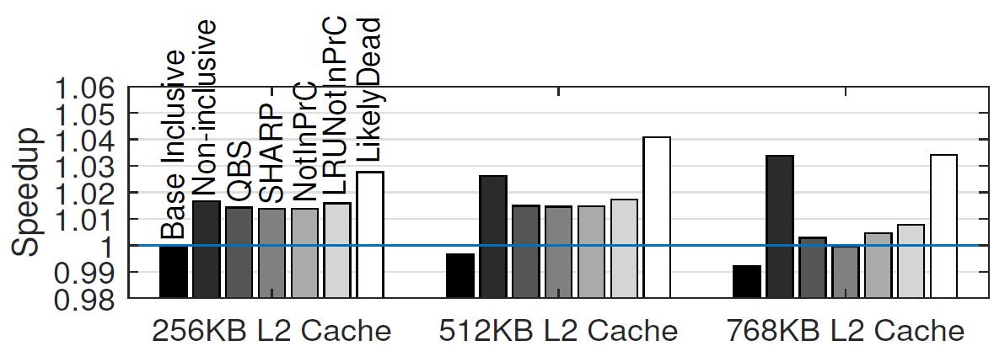
Simulation results: LRU policy
1 MB LLC/core
The ZIV LLC design using the LikelyDead property surpasses or meets the NI LLC perf.
QBS, SHARP, and the basic ZIV LLC designs fail to scale up perf. with L2 cache capacity
Quality of global victims grows in importance for ZIV LLC perf. with increasing L2$ capacity

Slide 33
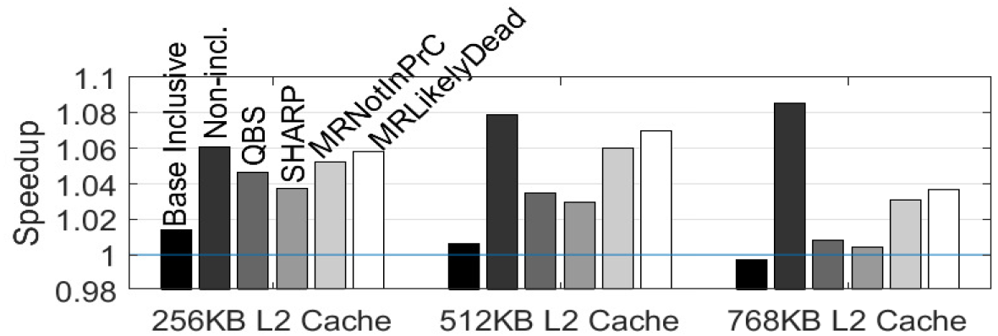
Simulation results: Hawkeye policy
1 MB LLC/core
The ZIV LLC design using the LikelyDead property comes close to the NI LLC perf. and scales gracefully up to 512 KB L2 cache size

Slide 34
Simulation results: Bigger LLC
2 MB LLC/core, 1 MB L2 cache/core
The ZIV LLC design using the LikelyDead property continues to offer performance close to the NI LLC design

Slide 35
Simulation results: Reloc. stats
LRU policy
Hawkeye policy
Hawkeye policy experiences more number of shorter inter-relocation intervals
A negligible fraction of inter-relocation intervals has length less than 5 cycles

Slide 36
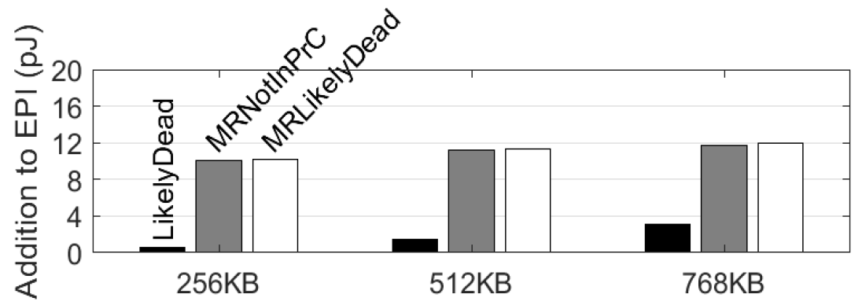
Simulation results: EPI
Average EPI contribution is at most 12 pJ arising from block relocation and wider dir.
This EPI addition is more than compensated by savings in the cache hierarchy and DRAM

Slide 37
Sketch
ZIV LLC in brief
Result highlights
Introduction
ZIV LLC design
Finding relocation sets
Replacement policy in relocation sets
Managing relocated blocks
Simulation infrastructure
Simulation results
Summary and future work

Slide 38
Summary and future work
Inclusive LLC
No inclusion victim
Performance close to non-inclusive LLC
Simplicity of cache coherence as in inclusive hierarchy
A happy family of on-chip caches
Big core caches
ZIV LLC
Future work: better global victim selection, security analysis

Slide 39
Zero Inclusion Victim (ZIV): Isolating Core Caches from Inclusive Last-level Cache Evictions
Thank you
Mainak Chaudhuri
Indian Institute of Technology Kanpur
ISCA 2021
Celebrating half a century of microprocessors

