Slide 1


Bypass and Insertion Algorithms for Exclusive Last-level Caches
Jayesh Gaur¹, Mainak Chaudhuri², Sreenivas Subramoney¹
¹Intel Architecture Group,
Intel Corporation, Bangalore, India
²Department of Computer Science and Engineering,
Indian Institute of Technology Kanpur, India
International Symposium on Computer Architecture (ISCA), June 6th, 2011

Slide 2
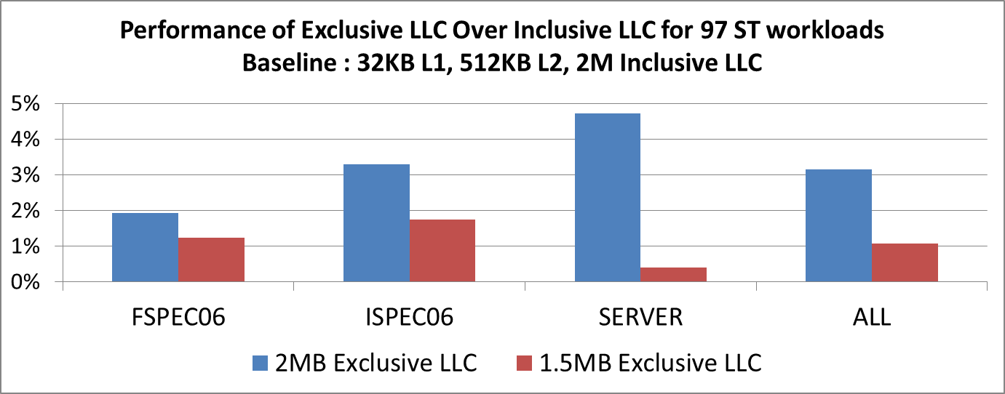
Motivation
Inclusive Last-level Caches (LLC) are popular choice
  Simplified Cache coherency
  Inclusion wastes Cache capacity
  Back-Invalidations in L1/L2 by LLC replacement
ISO-Area
ISO-$
As L2 size grows, need exclusive LLC

Slide 3
What is an Exclusive LLC ?
Exclusive LLC (L3) serves as a victim cache for the L2 cache
  Data is filled into the L2
  On L2 eviction, data is filled into LLC
  On LLC hit, Cache line is invalidated from LLC and moved to L2
Coherence Directory
DRAM
Load
L2 Miss
Load
LLC Miss
Load
Core
+
L1
LLC
L2
Fill
2 MB
32 KB
512 KB
Evict
LLC Hit
Invalidate from LLC
This talk is about replacement and bypass policies for exclusive caches

Slide 4
Agenda
Related work
Oracle Analysis (Belady’s optimal)
Characterizing Dead and Live $ lines
Basic Algorithm
Results
Conclusions and Future Work

Slide 5
Related Work
LRU and its variants are used for inclusive LLC
  Rely on access recency
Do we know access recency in exclusive caches ?
  Cache line gets de-allocated on a hit
Other related Inclusive LLC policies
  DRRIP(ISCA’10), PE-LIFO(MICRO‘09)
  Rely on the history of hit information in the LLC
LRU
MRU
Ways
0
1
2
3
4
LRU
stack
1
3
0
4
2
Hit to
Way 2
0
1
2
3
4
0
2
4
3
1
LRU
MRU
We need to think beyond LRU for exclusive caches

Slide 6
Oracle Analysis
Incoming Line
NRF not an oracle, but baseline
15
NRF
Victimize way 3
LLC
Pick victim that was not recently filled
0
1
2
3
4
15
Belady
Victimize way 0
13
11
8
4
2
Pick victim with furthest future reuse distance
Belady +
Bypass
4
3
2
0
1
15
Bypass
Bypass if fill candidate has farther reuse distance
Future Reuse
Fill Order
NRF +
Bypass
10
Bypass
LLC way

Slide 7
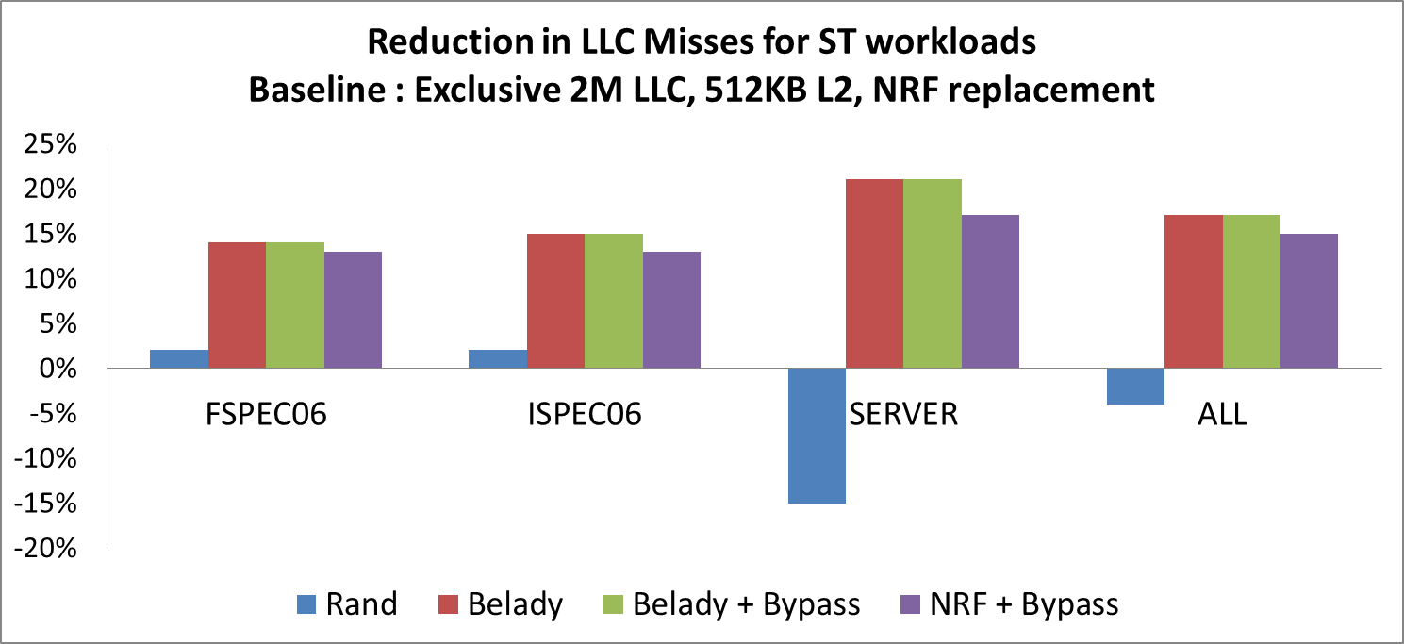
Oracle Analysis : Results
70% of all allocations to LLC are dead (useless), optimal replacement alone gives good gains

Slide 8
Characterizing Dead and Live $ Lines
Dead allocation to LLC
  Cache line filled into LLC, but evicted before being recalled by L2
Live allocation to LLC
  Cache line filled into LLC and sees a hit in LLC
Trip Count (TC) :
  # times $ line makes trips between LLC and L2 cache, before eviction
TC = 0
TC= 1
L2
L2
Eviction
From LLC
DRAM
LLC
LLC
TC captures the reuse distance between two clustered uses of a cache line

Slide 9
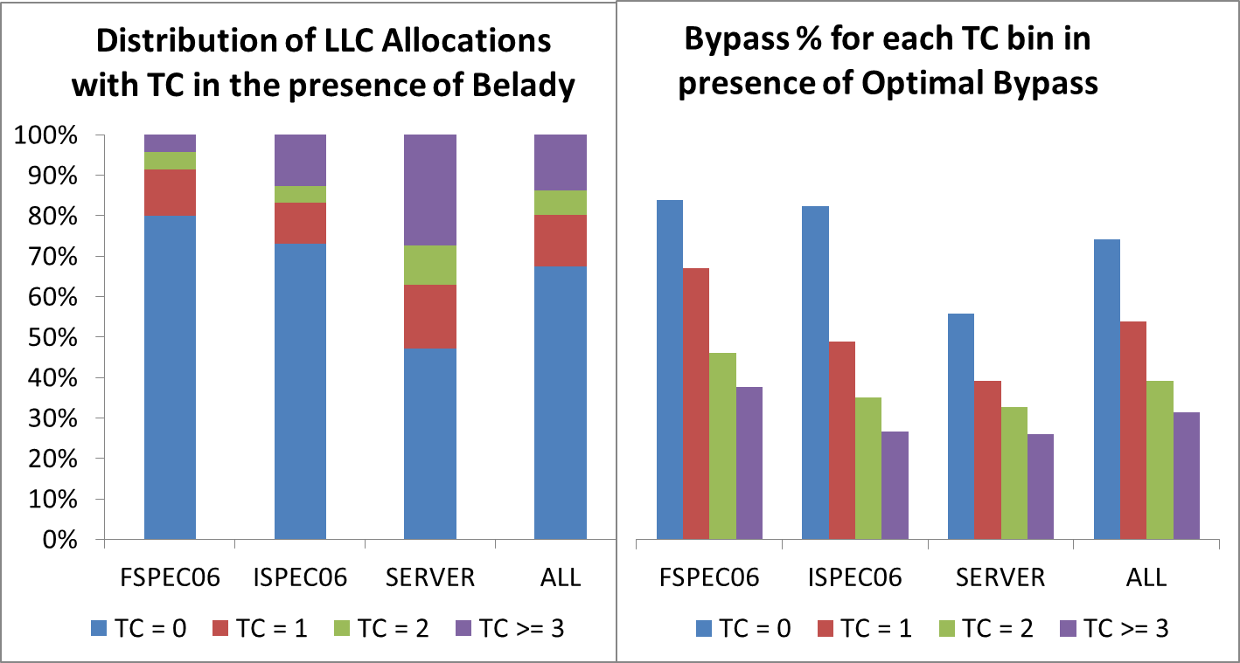
Oracle Analysis : Trip Count
Only 1 bit TC is required for most applications: either TC = 0 or TC >= 1
Can we use the liveness information from TC to design insertion/bypass policies ?

Slide 10
TC-based Insertion Age
TC -AGE policy (Analogous to SRRIP, ISCA 2010)
DIP + TC-AGE policy (Analogous to DRRIP, ISCA 2010)
  If TC = 1, fill LLC with age = 3
  If TC = 0, duel between age = 0 and age = 1
L2 $ Fill
1 bit per $ line
LLC Fill
2 bits per $ line
LLC Eviction
LLC Hit ?
TC = 1 ?
Maintain relative age order
N
Y
N
Y
Choose least age as victim
TC = 0
TC = 1
Age
1
Age
3
TC enables us to mimic the inclusive replacement policies on exclusive caches
However, TC is insufficient to enable bypass. All cache lines start at TC = 0

Slide 11
Use Count
Use count (UC) is the number of times a cache line is hit in L2 Cache due to demand requests
  For cache lines brought by prefetches, UC >= 0
  For cache lines brought by demand requests, UC >=1
We need only 2 bits for learning UC (See paper)
X hits
Y hits
TC = 0 UC = X
TC= 1,
UC = Y
L2
L2
Eviction
From LLC
DRAM
LLC
LLC
Refer to paper that shows <TC,UC> pair can best approximate Belady victim selection

Slide 12
TCxUC-based Algorithms
Send <TC,UC> information for every L2 eviction
Bin all L2 evictions into 8 <TC,UC> bins
Learn the dead and live distributions in these bins
Identify bins that have more dead blocks than live
Online learning
  Keep 16 sets in LLC as observers per 1K sets
  Periodically halve the counters to check phase changes
L(tc,uc) = ∑Hits(tc,uc) Live counter
D-L (tc,uc) = ∑Fills(tc,uc)- 2×L(tc,uc) Dead – Live counter
More details in paper

Slide 13
Basic Hardware
Line
TC, UC
Line
TC, UC
O3 | Line | Line | Line
O2 | Line | Line | Line
O1 | Line | Line | Line
O0 | Line | Line | Line
Line
TC, UC
Line
TC, UC
For every eviction from L2 cache – read value of counters for evict (TC,UC)
L2
3Bits
16 sets in LLC are chosen as “observers”
TC,UC
D-L
L
Way0
Way1
<0,00>
O3
Line
TC, UC
Line
TC, UC
<0,01>
O2
Line
TC, UC
Line
TC, UC
<0,10>
O1
Line
TC, UC
Line
TC, UC
<0,11>
<1,00>
O0
Line
TC, UC
Line
TC, UC
<1,01>
<1,10>
LLC
<1,11>
Update D_L counter on “observer” evict. Update live counter on “observer” fill

Slide 14
Learning Dead/Live Distribution
Line
TC, UC
Line
Line
0, 3
1, 1
O3 | Line | Line | Line
O2 | Line | Line | Line
O1 | Line | Line | Line
O0 | Line | Line | Line
Line
TC, UC
Line
TC, UC
Evict Line with TC,UC = (0,3)
Select Victim
(0,3)
L2
Fill line into L2
TC,UC
D-L
L
Way0
Way1
<0,00>
O3
Line
TC, UC
Line
0, 2
<0,01>
O2
Line
TC, UC
Line
TC, UC
<0,10>
-2
+1
<0,11>
+1
O1
Line
0, 3
Line
TC, UC
<1,00>
O0
Line
TC, UC
Line
TC, UC
<1,01>
<1,10>
LLC
<1,11>
Demand Fill Request from L2 hits O3 set

Slide 15
Experimental Methodology
  SPEC 2006 and SERVER categories
97 single-threaded (ST) traces
35 4-way multi-programmed (MP) workloads
Cycle-accurate execution-driven simulation based on x86 ISA and core i7 model
  Three level cache hierarchy
  32KB L1 Caches
  2 MB LLC for ST and 8 MB LLC for MP(four banks, 16-way)
  512 KB 8-way L2 cache per core

Slide 16
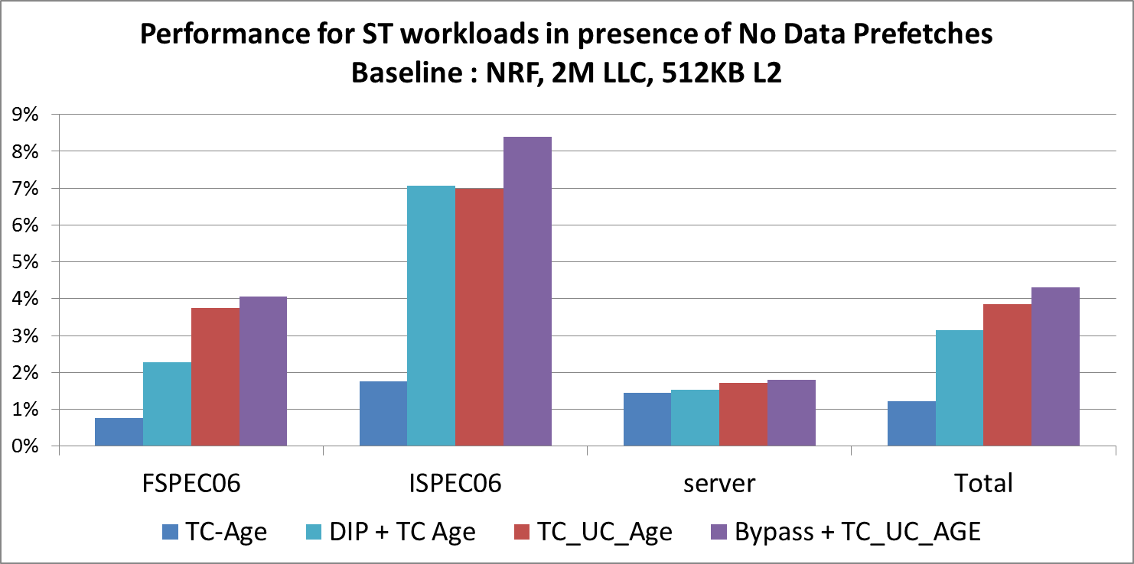
Policy Evaluation for ST Workloads
For more policy variants, see paper
Overall, Bypass + TC_UC_AGE is the best policy

Slide 17
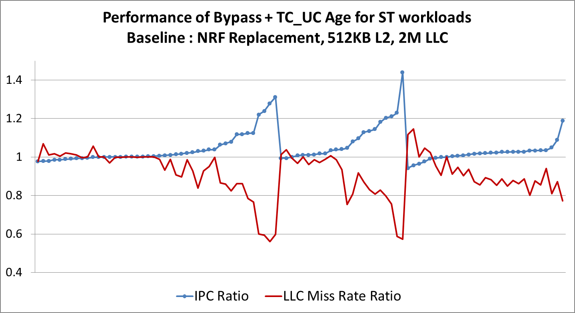
ST Details w/o Data Prefetches
(mcf)
(sphinx)
(wrf)
(xalanc)
(gems)
(tpce)
(zeus)
(specjbb)
FSPEC06
ISPEC06
SERVER
Healthy correlation between LLC miss reduction and IPC improvement

Slide 18
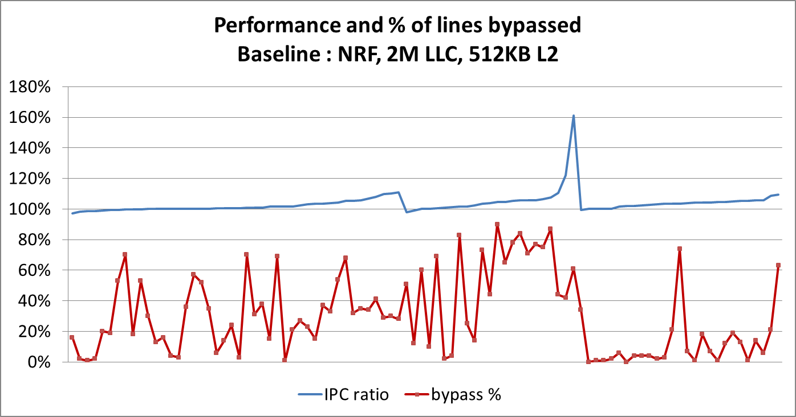
ST Results with Prefetches
In the presence of prefetches, the best policy shows 3.4% geomean gain
Bypass rate is nearly 32% - This can have significant power and bandwidth reduction

Slide 19
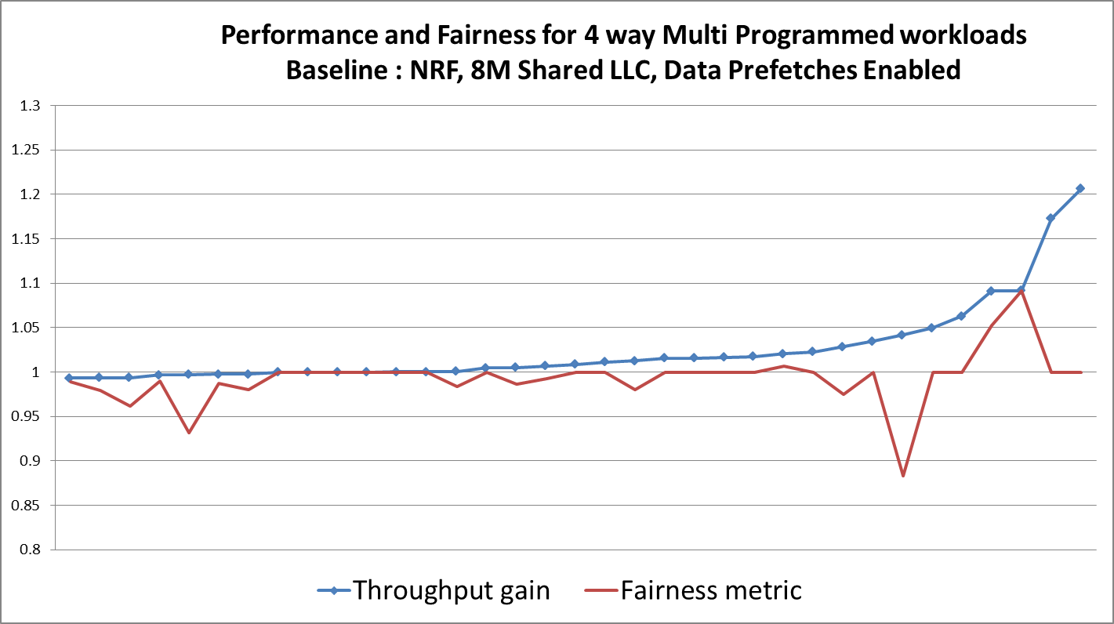
Multi-programmed (MP) Workloads
Throughput = ∑ IPC_{i} _{Policy} /∑ IPC_{i} _{base} Fairness = min (IPC_{i Policy}/ IPC_{i} _{base})
Geomean throughput gain for our best proposal is 2.5%

Slide 20
Conclusions & Future Work
For large L1/L2 caches, exclusive LLC(L3) is more meaningful
LRU and related inclusive cache replacement schemes don’t work for exclusive LLC
We presented several insertion/bypass schemes for
exclusive caches
  Based on trip count and use count
  For ST workloads, we gain 3.4% higher average IPC
  For MP workloads, we gain 2.5% average throughput
Future work
  Our algorithms do not directly apply to shared blocks and we leave this to future exploration
  We have not quantified power and bandwidth benefits of bypassing

Slide 21

Thank you
Questions ?

Slide 22
BACKUP

Slide 23
Set dueling and multi-programming
  Set dueling used for online learning of algorithm performance (ISCA 2007)
    We use TC-AGE in our observers
    Competing proposed policy is exercised by another 16 sample sets
    Bypassing is exercised only if it wins duel against TC-AGE
    If bypassing loses duel, continue to exercise static TC, UC-based insertion
  Multi-programming
    Maintain D_L and L counters per thread
    Thread-aware dueling (PACT 2008)
16 Observer Sets
TC_Age
16 Sample Sets
Policy
Remaining Sets
Best of
TC_Age or
Policy
Refer to paper on how the sample sets / observer sets are distributed across LLC banks

Slide 24
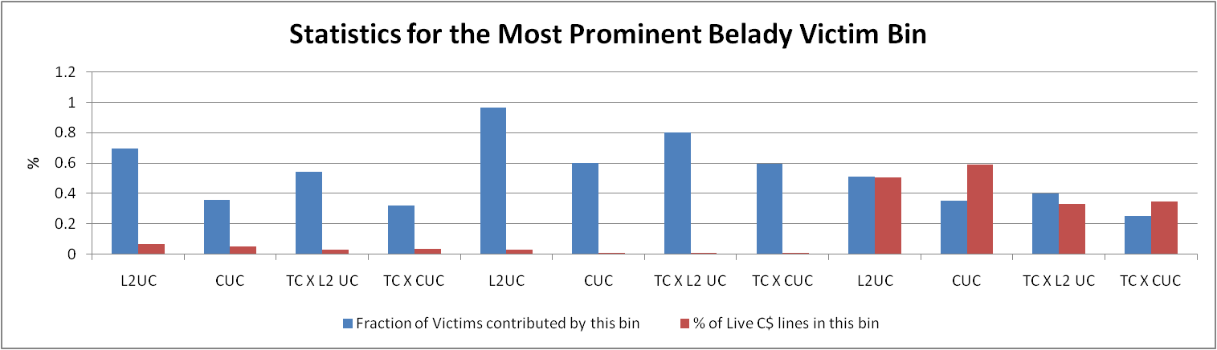
UC in the presence of optimal
Our analysis shows that only two bits are required for UC (See paper)
We run Belady’s optimal replacement and divide the LLC victims into bins based on the following four possibilities
  Only L2UC : total 4 bins (will be referred to as UC)
  Only CUC : total 16 bins
  UCxTC : total 8 bins (TC is 1 bit only)
  CUCxTC : total 32 bins
FSPEC06
ISPEC06
SERVER
Blue bar tells us the number of victims contributed by the most prominent Belady bin
If we approximate Belady by selecting victims from only this bin, the red bar tells us the penalty we pay
TC X L2 UC gives us the best possible estimator – smallest red bar and high blue bar

Slide 25
Algorithm details
An LLC fill belonging to <TC, UC> bin will be bypassed if
  D_L(tc, uc) > (MIN(D_L(tc, uc)) + MAX(D_L(tc, uc))/2) && L(tc, uc) < (MIN(L(tc, uc) + MAX(L(tc, uc))/2
  OR if D_L(tc, uc) > ¾ ∑D_L(tc, uc)
  If invalid slot present in the target LLC set, then convert bypass into fill with insertion age = 0
If no bypass, then insert with following age :
  If (L(tc, uc) > ¾ ∑L(tc, uc), uc>0), age = 3
  (D(tc, uc) – xL(tc, uc) > 0), age = 0
    Bin hit rate < 1/(x+1).
    x = 8 gives the best results
  If tc >= 1, insertion age = 3; else age = 1
We call this
Bypass + TC_UC_AGE_x8
policy
More details in the paper

