Slide 1
Dynamic Reuse Probability in LLC Management for CPU-GPU Heterogeneous Processors
Siddharth Rai, Mainak Chaudhuri
Indian Institute of Technology Kanpur

Slide 2
Sketch
Talk in one slide
Result highlights
Simulation infra-structure
Motivation
Our proposal
Reuse probability estimation using sampling
LLC management policies
Simulation results
Summary

Slide 3
Sketch
Talk in one slide
Result highlights
Simulation infra-structure
Motivation
Our proposal
Reuse probability estimation using sampling
LLC management policies
Simulation results
Summary

Slide 4
Talk in One Slide
Memory system interference between co-running CPU and GPU applications can degrade the performance of both severely
Our proposal: employs dynamic reuse probability of different data streams to manage the LLC shared by CPU and GPU
We architect a small (few tens of KB) working set sample cache that keeps the tags of a few selected blocks in a few selected pages for long enough to estimate the true reuse probability of the CPU and GPU data streams
We use this probability estimate to modulate the ages of the LLC blocks on reads and writes

Slide 5
Result highlights
1C1G, 2C1G, and 4C1G configurations
Baseline LLC: two-bit SRRIP + some basic write bypass relevant to GPU workloads
Workloads: 14 DirectX and OpenGL multi-frame game sequences and 4 GPGPU applications coupled with 1C, 2C, 4C SPEC CPU2006 mixes
LLC miss saving: 13%, 12%, 13% average in 1C1G, 2C1G, 4C1G with a 16 MB 16-way LLC
Performance improvement: for GPU, 8%, 9%, 12% in 1C1G, 2C1G, 4C1G configurations; for co-running CPU mixes, 2%, 4%, 7%

Slide 6
Sketch
Talk in one slide
Result highlights
Simulation infra-structure
Motivation
Our proposal
Reuse probability estimation using sampling
LLC management policies
Simulation results
Summary

Slide 7
Simulation infra-structure
Heterogeneous CMP model including CPU cores, detailed GPU pipeline, uncore interconnect, shared LLC, DRAM modules
CPU cores
Modeled using Multi2Sim
1, 2, 4 out-of-order issue dynamically scheduled 4 GHz cores
iL1 cache: 32 KB, 8-way, 64B blocks, LRU
dL1 cache: 32 KB, 8-way, 64B blocks, LRU
L2 cache: 256 KB, 8-way, 64B blocks, LRU

Slide 8
Simulation infra-structure
Graphics GPU
Modeled using a significantly upgraded Attila simulator
1 TF shader throughput, 128 GTexel/second texture throughput, 64 GPixel/second ROP throughput
Three-level non-inclusive texture cache hierarchy
L0: 2 KB fully-associative per sampler, 64B blocks
L1: 64 KB 16-way shared by 128 samplers, 64B blocks
L2: 384 KB 48-way shared by 128 samplers, 64B blocks

Slide 9
Simulation infra-structure
Graphics GPU
Each of 16 ROP units has L1 color and depth caches (2 KB fully associative, 256B blocks)
L2 color and depth caches: 32 KB 32-way shared by all ROP units, 64B blocks
Vertex cache: 16 KB fully associative
HiZ cache: 16 KB 16-way
Shader instruction cache: 32 KB 8-way
GPGPU model
Modeled using MacSim
144 GFLOP shader throughput, six shaders
4 KB 8-way instruction cache, 32 KB 8-way data cache, 16 KB shared memory per shader core

Slide 10
Simulation infra-structure
LLC
16 MB 16-way, 64B blocks, 10 cycles per bank
Inclusive for CPU, non-inclusive for GPU: no back-inval to GPU on eviction
Makes GPU fill bypass a possible option
Main memory
Two single-channel DDR3-2133 controllers, FR-FCFS scheduling
DRAM modules are modeled using DRAMSim2
One rank/channel, eight banks/rank, x8 devices, BL=8, 1 KB row/bank/device, 14-14-14
On-die interconnect
Bidirectional ring, single-cycle hop

Slide 11
Simulation infra-structure
Workloads
Three sets corresponding to 1C1G (S1-S18), 2C1G (D1-D18), 4C1G (Q1-Q18)
Each set has 18 heterogeneous mixes
S1-S14, D1-D14, Q1-Q14
GFX (DirectX/OpenGL) + SPEC CPU2006
S15-S18, D15-D18, Q15-Q18
GPGPU (Rodinia/CUDA SDK) + SPEC CPU2006

Slide 12
Sketch
Talk in one slide
Result highlights
Simulation infra-structure
Motivation
Our proposal
Reuse probability estimation using sampling
LLC management policies
Simulation results
Summary

Slide 13
Motivation
How harmful is the interference?
Performance when CPU and GPU co-execute compared to standalone execution
What are the potential savings in LLC misses?
Important for understanding reuses in LLC
Can LLC miss saving bring GPU speedup?
Important question given that GPUs can hide inefficiencies in the memory system
How effective is GPU fill bypass?
This is one possible way of creating LLC space for CPU provided the GPU can tolerate extra misses

Slide 14
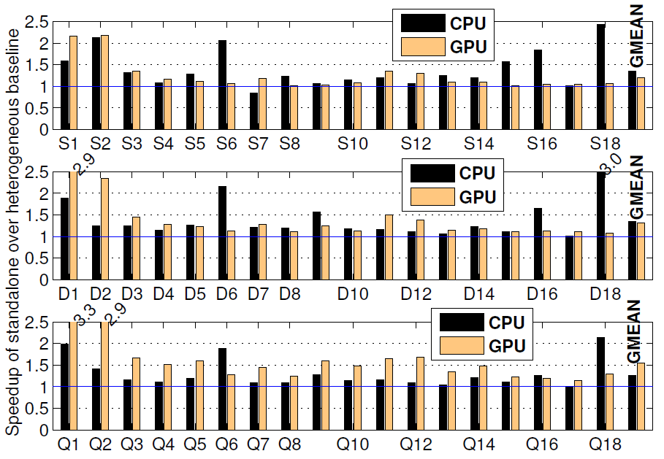
How harmful is the interference
35%
21%
Large losses in performance compared to standalone execution
35%
32%
Loss in GPU performance increases quickly with increasing CPU core count
26%
54%

Slide 15
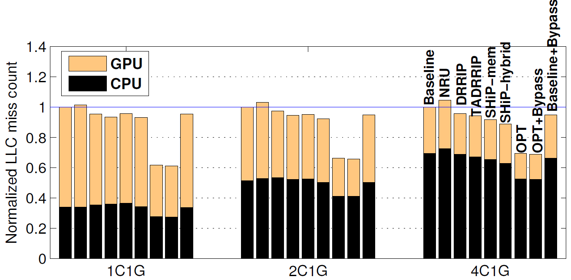
Potential LLC miss savings
Large volume of reuses can be extracted from the LLC, if it is managed well
Potential for improving GPU reuses in the LLC is much more than the CPU
SHiP-hybrid saves 7%, 8%, and 11% LLC misses
OPT saves 38%, 34%, and 30% LLC misses
Bigger opportunity for saving GPU misses
Optimal bypass is ineffective

Slide 16
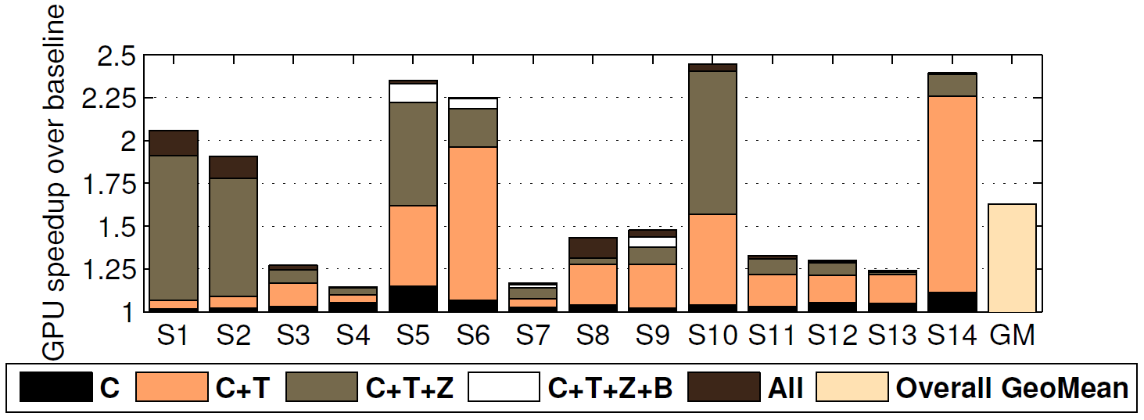
Potential speedup from ideal LLC
GPU performance can be improved significantly by managing the LLC better
15% to 145% speedup averaging at 63%
Texture and depth streams offer the biggest opportunity
GPGPU: 22%, 12%, 26%, 182% speedup (shader stream)

Slide 17
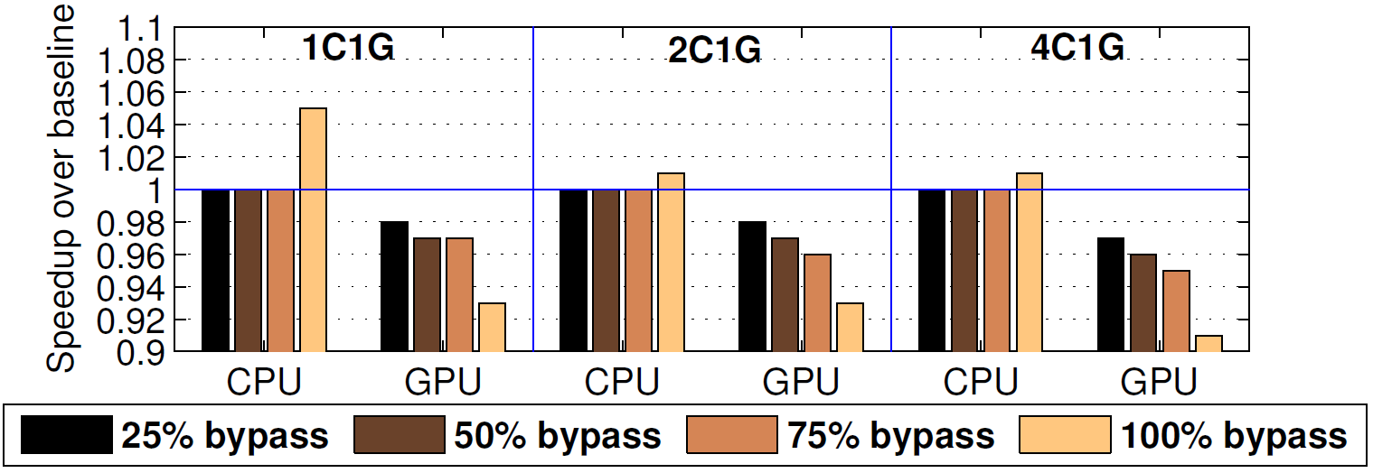
Impact of GPU fill bypass
Large GPU fill bypass rate creates LLC space for CPU, but increases GPU LLC misses taking away precious DRAM bandwidth
Latency-hiding capability of a GPU depends on DRAM bandwidth
Under constrained bandwidth, LLC reuses must be honored

Slide 18
Motivation
How harmful is the interference?
Large performance degradation due to a combined effect of LLC interference and higher DRAM bandwidth demand
What are the potential savings in LLC misses?
Large opportunity, particularly for GPU misses
Points to good amount of potential LLC reuses
Can LLC miss saving bring GPU speedup?
Large speedup for GPU across the board
How effective is aggressive GPU fill bypass?
Mostly negative due to lost LLC reuses for GPU leading to large wasted DRAM bandwidth

Slide 19
Sketch
Talk in one slide
Result highlights
Simulation infra-structure
Motivation
Our proposal
Reuse probability estimation using sampling
LLC management policies
Simulation results
Summary

Slide 20
Working set sample (WSS) cache
Central idea
Different streams access the LLC
GPU: color, texture sampler (dynamic and static texture), depth, blitter, shader, the rest
CPU: different cores
In 4C1G environment, LLC sees eleven streams
The blocks within a stream typically show more or less similar behavior
Mostly true for GPU streams
Approximate for CPU streams
Can we estimate the true reuse probabilities of the collection of blocks in a stream at run-time?
Same as the average dynamic hit rate of a stream
Important to make it independent of LLC policies

Slide 21
Working set sample (WSS) cache
Central idea
Sample parts of the dynamic working set
Retain the samples long enough (reasonably long to cover the LLC reach) in a separate working set sample (WSS) cache
Make sure that the WSS cache has enough representative samples of a stream
Use the observed reuses to the samples of a stream to estimate the stream-wise reuse probabilities
Challenge: the WSS cache must be small, yet it must capture a reasonable approximation of the true reuse probability of a stream

Slide 22
Working set sample (WSS) cache
Central idea
WSS cache is a set-associative cache with each entry tracking a few blocks of a sampled page
Sample every k^{th} block in a sampled page
For each block, maintain valid (V), written to but yet to be consumed (W), and stream id (SID)
Page tag
Entry valid
Sampled block states

Slide 23
Working set sample (WSS) cache
WSS cache logistics
Each stream maintains a population counter recording the number of WSS page tag allocations done by a stream
Conditions for invoking WSS cache replacement
An access misses the WSS cache
Stream’s population counter is below a threshold T
No invalid entry in the target WSS cache set
Random replacement if all conditions are met
Bypass WSS cache, if conditions are not met
ID of the accessing stream comes with the access or derived in the case of dynamic texture
Contents recycled every 512K LLC read accesses

Slide 24
Working set sample (WSS) cache
Estimation of reuse probability per stream
Write-to-read (WR) and read-to-read (RR) reuses are detected on a WSS cache hit
W bit is reset on a write-to-read reuse
Each stream maintains four counters
Write accesses (WA), read accesses (RA), write-to-read reuses (WR), and read-to-read reuses (RR)
Static and dynamic texture streams do not need the WA and WR counters (these are read-only streams)
WR reuse probability of stream S = WR[S]/WA[S]
RR reuse probability of stream S = RR[S]/RA[S]
All counters are halved on epoch boundaries (512K LLC read accesses)

Slide 25
LLC policies
Four sub-policies
Read miss, write miss, write hit, read hit
Read miss sub-policy
Synthesized from the existing insertion policies
SHiP-hybrid is a promising option, but suffers from counter table interference due to large GPU working set
We use SHiP-PC for CPU and DRRIP for GPU read misses
Idea is to borrow insertion policies from existing work and exploit the reuse probabilities to design good retention policies
Baseline policy is SRRIP

Slide 26
LLC policies
Write miss sub-policy
Writes from CPU never miss in the LLC (inclusion)
Writes from GPU may miss in the LLC
Shader, color, blitter write misses are allocated in LLC
Depth write misses are selectively bypassed based on a set-sample-based dueling
All other write misses bypass LLC
Goal of the write miss sub-policy is to retain the streams that have high WR reuse
Selectively pins blocks with very high WR reuse probability
When the RRPV of a pinned block attains a value of 3, the pin state and the RRPV both get reset to zero
Pinned blocks get a second chance to stay in the LLC
Such blocks are also unpinned on a read hit

Slide 27
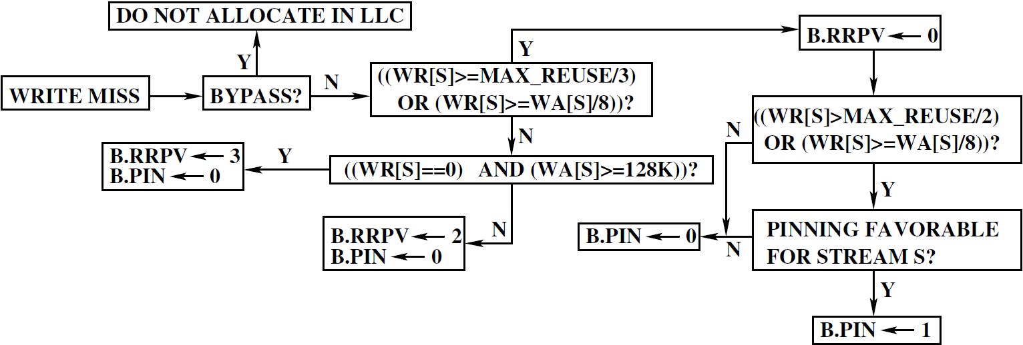
LLC policies
Write miss sub-policy for stream S
Borrowed from baseline
Employs dueling between two set samples (with and without pinning)

Slide 28
LLC policies
Write hit sub-policy
Two goals
Protect the streams with good WR reuse (can use pinning)
Streams experiencing write hits can be pinned to save DRAM write bandwidth
A dynamic selection between congestion-oblivious and congestion-aware write hit policies
Congestion-oblivious policy uses aggressive pinning
Suffers when set congestion is high
Congestion-aware policy is very conservative
Never uses pinning
Not easy to predict set congestion dynamically
Employs set-sample-based dueling to pick the best among these two policies

Slide 29
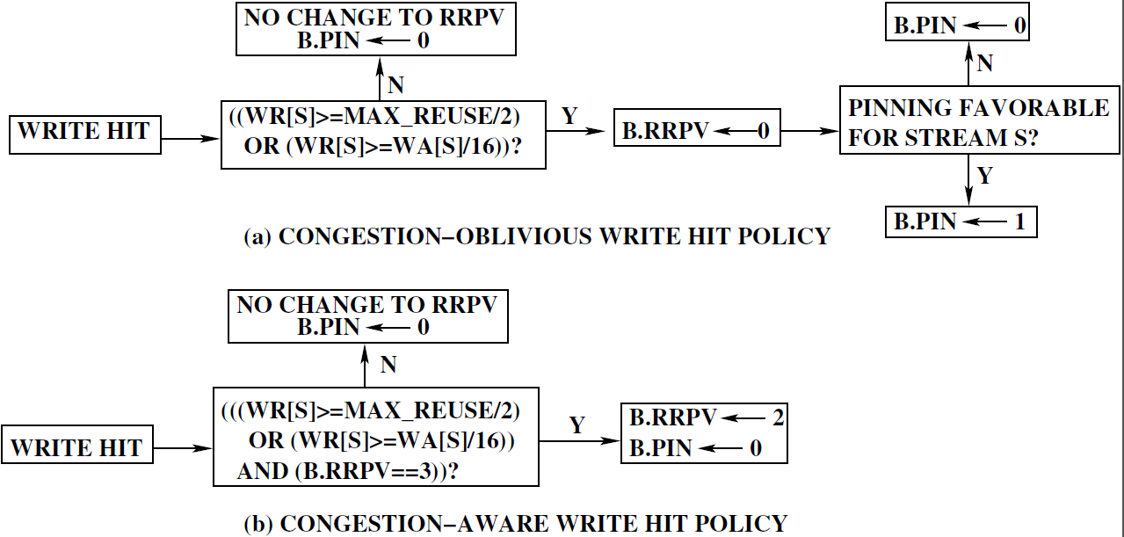
LLC policies
Write hit sub-policy

Slide 30
LLC policies
Read hit sub-policy
Goal is to detect last hit and demote
Highly effective for dynamic texture blocks
Divide the read reuse probability of dynamic texture blocks into three segments: [0, 1/64), [1/64, 1/2), [1/2, 1] and treat these segments differently
Needs one extra bit per sampled block in the WSS cache to distinguish between zero-reuse and positive-reuse dynamic texture blocks
Needs two extra state bits per LLC block for detecting dynamic texture blocks and for distinguishing between zero-reuse and positive-reuse dynamic texture blocks
These states will be referred to as (S1, S2)
A block written to by color/depth/blitter stream becomes a dynamic texture block if and when read by texture sampler

Slide 31
LLC policies
Read hit sub-policy
This logic detects dynamic texture blocks

Slide 32
LLC policies
Storage cost
WSS cache: 2K entries (128 sets, 16 ways)
86 bits per entry: 29 bits of page tag, 8 blocks x 7 bits per block
22 KB (independent of LLC capacity)
Per LLC block: pin bit, two state bits S1, S2
(S1, S2) = (0, 0): default
(S1, S2) = (0, 1): written to by color/blit/depth
(S1, S2) = (1, 0): dynamic texture zero read reuse
(S1, S2) = (1, 1): dynamic texture nonzero read reuse
96 KB for 16 MB LLC
SHiP-PC table: 16K entries x 3 bits/entry
6 KB
Total cost: 124 KB (less than 1% of 16 MB LLC)

Slide 33
LLC policies
State transition of the new LLC state bits
Pin bit transitions are already discussed
Set to one by write miss/hit sub-policy
Reset to zero on read hit or after RRPV reaches 3
RRPV is reset to zero
A block with pin bit set is not considered for replacement
Bits (S1, S2): needed by the read hit sub-policy
0, 0
Written to by color/depth/blitter stream
0, 1
LLC Fill
1, 1
1, 0
Read by
texture sampler
Reads/Writes
Read by
texture sampler

Slide 34
Sketch
Talk in one slide
Result highlights
Simulation infra-structure
Motivation
Our proposal
Reuse probability estimation using sampling
LLC management policies
Simulation results
Summary

Slide 35
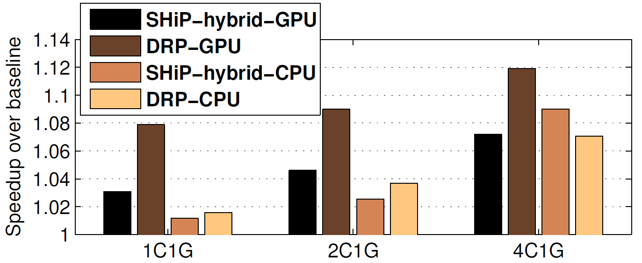
Speedup
8%, 9%, 12% gain over baseline for GPU

Slide 36
Speedup
2%, 4%, 7% gain over baseline for CPU

Slide 37
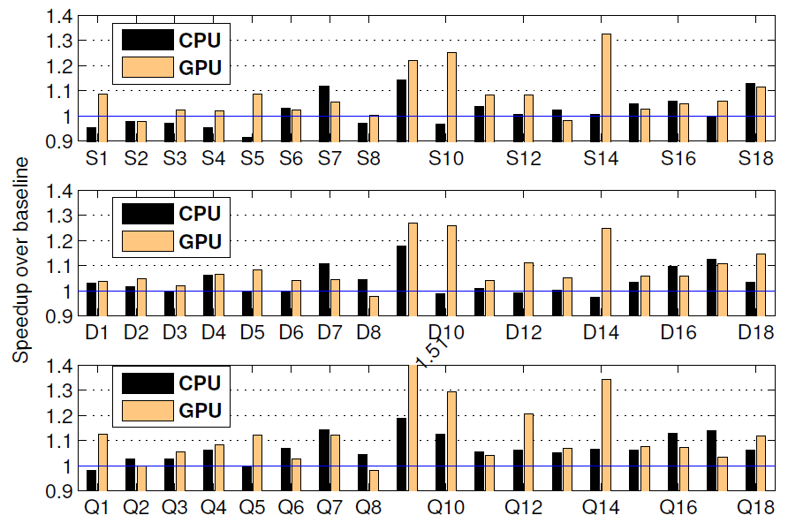
Speedup details
CPU gains in 1C1G and 2C1G are mostly due to reduced
queuing in DRAM schedulers

Slide 38
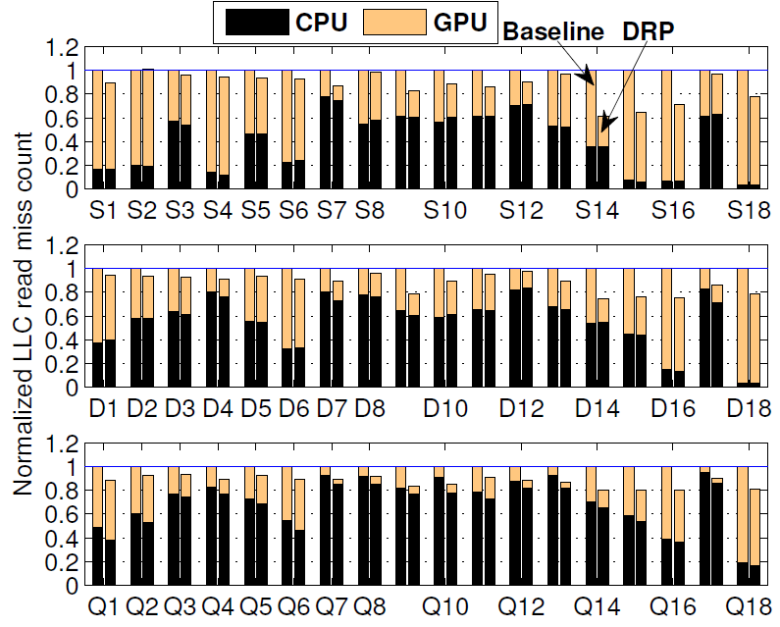
LLC read miss count
Large savings in GPU misses across the board
Savings in CPU misses are visible in some 4C1G mixes

Slide 39
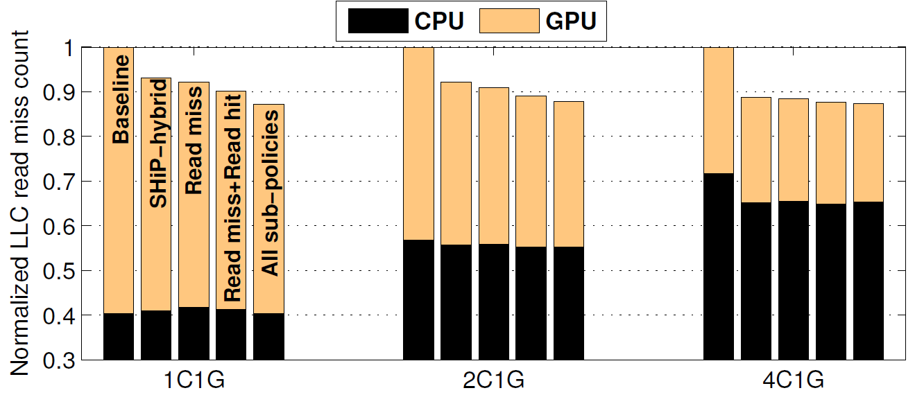
Contribution of sub-policies
All sub-policies offer important contributions
13%, 12%, 13% LLC misses saved in 1C1G, 2C1G, 4C1G
7% less GPU misses in 4C1G compared to SHiP-hybrid

Slide 40
Study of prior art
Two existing proposals for managing shared LLCs in heterogeneous CMPs
Both consider only GPGPU focusing on a small portion (shader island) of the rendering pipeline
TLP-aware policies (TAP) [HPCA 2012]
Samples two cores, inserts all misses from one core at LRU position and from the other at MRU position, observes the performance difference between the two cores to decide if the application is LLC-sensitive
HeLM [PACT 2013]
Bypasses a fraction of GPU misses if the CPU workload is LLC-sensitive and the GPU workload can tolerate LLC misses; decided through the ready context count

Slide 41
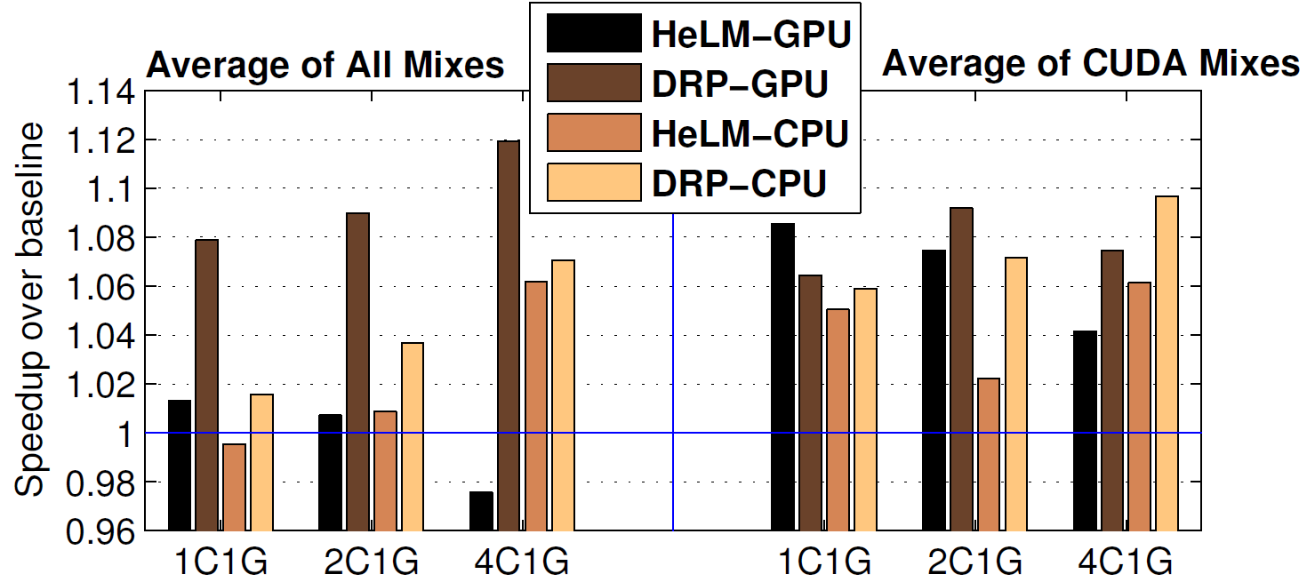
Comparison with HeLM
HeLM’s shader-centric mechanism is ineffective for gfx
Even for GPGPU, HeLM runs into bandwidth shortage

Slide 42
Sketch
Talk in one slide
Result highlights
Simulation infra-structure
Motivation
Our proposal
Reuse probability estimation using sampling
LLC management policies
Simulation results
Summary

Slide 43
Summary
A generic and practically feasible technique for estimating reuse probabilities
Application to the most general CMP architecture for managing shared LLC
For a 4C1G configuration, 13% LLC misses saved, 12% GPU performance improved, 7% CPU performance improved
Other possible applications of the proposed WSS cache to memory system optimizations that rely on reuses

Slide 44
Thank you

