Slide 1
Bandwidth-aware LLC
Efficiently Coordinating Off-chip Read/Write Bandwidth
Mainak Chaudhuri
Indian Institute of Technology Kanpur
Jayesh Gaur, Sreenivas Subramoney
Processor Architecture Research Lab, Intel

Slide 2
Sketch
Talk in one slide
Result highlights
Introduction
Bottleneck analysis
Bandwidth-aware LLC
Prior studies
Simulation infrastructure
Simulation results
Summary

Slide 3
Sketch
Talk in one slide
Result highlights
Introduction
Bottleneck analysis
Bandwidth-aware LLC
Prior studies
Simulation infrastructure
Simulation results
Summary

Slide 4
Talk in One Slide
DRAM bandwidth is shared between reads and writes; writes are drained periodically
DRAM writes are generated by the LLC policy; periodic interruption to read servicing
Our BA-LLC proposal maximizes DRAM read stretches to accelerate critical paths and controls exactly when and for how long writes can interrupt DRAM read stream
BA-LLC relies on run-time analysis of read/write characteristics and bounds policy-related losses with sound analytical models

Slide 5
Result highlights
12% performance improvement in an 8-core system averaged over 50 multi-programmed workloads
Average DRAM read latency decreases by 17% due to better bandwidth scheduling
Comfortably outperforms eager write scheduling and writeback-aware LLC policies
Bridges 75% of performance gap between baseline and a system deploying unbounded write buffers (i.e., no interruption to reads)
RTL synthesis confirms low area overhead and timing closure

Slide 6
Sketch
Talk in one slide
Result highlights
Introduction
Bottleneck analysis
Bandwidth-aware LLC
Prior studies
Simulation infrastructure
Simulation results
Summary

Slide 7
Introduction
BW
BASELINE
READ
time
BW
GOAL
WRITE
time
Detailed analysis shows that there are big holes in read BW demand in several workloads
Challenge: they are very far apart needing larger than even 8K-entry write buffers

Slide 8
Introduction
BW
BASELINE
A DRAM bandwidth scheduling problem managed by the LLC
READ
time
maximize
control when
and how long
BW
GOAL
WRITE
time
Maximize read stretch length; leads to less waiting time and improved read latency
Precisely control write-induced interruption

Slide 9
Sketch
Talk in one slide
Result highlights
Introduction
Bottleneck analysis
Bandwidth-aware LLC
Prior studies
Simulation infrastructure
Simulation results
Summary

Slide 10
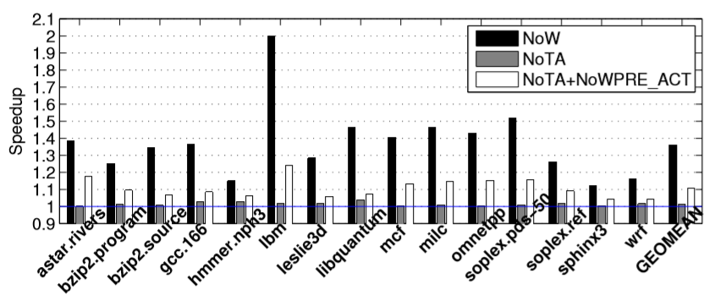
Bottleneck analysis
DRAM writes introduce three inefficiencies that hamper/delay read servicing
  Channel turnaround, poor write locality, bandwidth consumption of writes
  No write BW: 36% speedup, no TA: 1.4% speedup, no TA and no ACT/PRE: 11% speedup
Need BW coordination to improve beyond traditional TA and ACT/PRE overhead reducing techniques

Slide 11
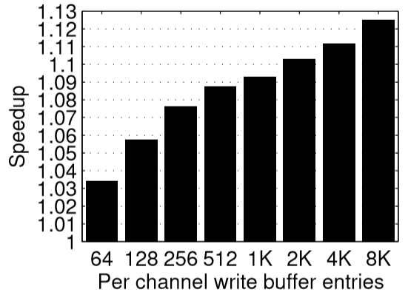
Bottleneck analysis
Big write buffers: naïve way of reducing write disturbance
  Reality: small write buffers due to address CAM
  Why big write buffers are good?

Slide 12
Bottleneck analysis
Three advantages of big write buffers
  Less turnaround, improved write locality from increased bunching options, BW coordination
Observations (data-driven analysis in paper)
  Most gains with medium-sized (e.g., 256) write buffers come from less TA and improved locality
    Techniques that can reduce TA and improve locality would match the performance of medium-sized write buffers
  A good fraction of gains with large-sized (e.g., 8K) write buffers come from BW coordination
    Just TA reduction and locality improvement are not enough for matching the performance of big WBs
Insight: need (or need to emulate) large write buffers to improve beyond traditional TA reducing and locality improving techniques

Slide 13
Sketch
Talk in one slide
Result highlights
Introduction
Bottleneck analysis
Bandwidth-aware LLC
Prior studies
Simulation infrastructure
Simulation results
Summary

Slide 14
BA-LLC: Design overview
Need large write buffers
  Use LLC space; treat the lowest portion of LRU stack as a write buffer (how many ways?)
  How? Use clean LRU replacement policy to buffer dirty blocks in LLC (a la ARI [TACO 2013], NVMs)
Contribution#1: Dynamically maximize in-LLC write buffer capacity so that clean LRU stretches (and hence, DRAM read stretches) get maximized in length
  Sound analytical model to bound the sacrificed LLC hit fraction while computing maximum write buffer width during a phase of the execution
Contribution#2: Scrub LLC dirty blocks when read BW demand is low (controls write BW)

Slide 15
BA-LLC: In-LLC write buffer
LLC sets
WB
MRU
LLC ways
LRU
Dirty blocks accumulate at LRU end as clean LRU keeps victimizing clean blocks
  Prematurely evicted clean blocks sacrifice hits
  Volume of sacrificed hits usually monotonically increases with in-LLC write buffer (WB) width

Slide 16
BA-LLC: In-LLC write buffer width
A read hit histogram (RHH) per LLC bank to compute hit distribution across LRU stack
  Sacrificed hit fraction for WB of width w in LLC bank B =
  Compute max w such that
i=A-1
i=k
i=0
++
MRU
LRU
w
Read hit in LRU position i=k

Slide 17
BA-LLC: In-LLC write buffer width
Write buffer width (number of LLC ways at LRU tail) computed periodically using RHH
  Will be referred to as n_{R}(B) in LLC bank B
Must avoid dirty inclusion victims (DIVs) to exploit maximum effectiveness of clean LRU
  Observation: DIVs increase in volume as write buffer width increases
    Increasing write buffer width pushes clean victims more toward live MRU side of LLC
    Write hits to victim positions are an indication of DIVs
  Use a write hit histogram (WHH) to compute a different write buffer width n_{D}(B) to restrict write hit fraction to the WB ways in LLC bank B

Slide 18
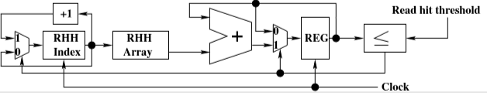
BA-LLC: In-LLC write buffer width
Dynamic write buffer width in LLC bank B = n(B) = max(3, min(n_{R}(B), n_{D}(B)))
  At least three LLC ways given to write buffering
    Empirically decided for a 16-way LLC and our set of workloads
Iterative computation of n_{R}(B)

Slide 19
BA-LLC: Dirty block scrubbing
Honoring the computed maximum WB width n(B) requires cleaning the LRU tail of LLC
  Sub-problem#1: when to scrub
  Sub-problem#2: actual scrubbing protocol
When to scrub
  Could be based on a high water mark on dirty population within WB (= N.n(B))
    Dirty population ≥ N.n(B).τ_{hwm} where N is the number of LLC sets in a bank
    Doesn’t work: different sets fill up with dirty blocks at different rate; need a set-centric criterion also
      Clean LRU can be very bad for sets mostly filled with dirty blocks

Slide 20
BA-LLC: Dirty block scrubbing
When to scrub
  At least one of the following two criteria must be met in an LLC bank B to trigger a scrub
  Criterion#1 [high water mark]
    Dirty population in WB of bank B ≥ N.n(B).τ_{hwm}
  Criterion#2 [overfull sets Ʌ minimum dirty pop.]
    Number of full LLC sets in bank B ≥ N.τ_{f}
      A set is full if all its WB ways are dirty
      Rule to pick Τ_{f} (< 1): larger if LLC hit rate higher
    Dirty population in WB for bank B ≥ N.n(B).τ_{low}
      Required to offer enough scrubbing options
  Additionally, whenever a DRAM channel has no reads, scrubbing starts; but stops on read arrival

Slide 21
BA-LLC: Dirty block scrubbing
Scrubbing protocol
  Once triggered, the scrubber takes two passes over the sets in the triggering LLC bank
    Each pass scrubs at most one block from each set
      Looks up a set during idle LLC cycles
    Minimizes premature scrubs (i.e., write hits to scrubbed blocks) by limiting the number of LRU tail ways to scrub from: uses the write hit distribution in WHH to compute the max number of scrub ways
  Periodically polls the population of pending reads to a DRAM channel and stops scrubbing if read demand crosses a threshold
    Writes can demand DRAM BW only if read BW demand is low

Slide 22
BA-LLC: Dirty block scrubbing
Set traversal order is important for efficient scrubbing
n(B)
Partition
(parallelism)
scrub ways
Consec. sets
(locality)
WB
LLC sets
MRU
LRU
LLC ways

Slide 23
BA-LLC: Design synthesis/Area
FPGA synthesis for rapid testing with a very large set of stimuli
  To gain confidence about RTL correctness
ASIC flow with TSMC 45 nm process for target cycle time of 0.25 ns
  Additional logic area when LLC runs clean LRU policy: 0.01618 mm² per LLC bank
  Additional logic area when LLC runs clean NRU policy: 0.01669 mm² per LLC bank
  Additional logic area when LLC runs clean SRRIP policy: 0.02103 mm² per LLC bank
  Storage overhead: slightly over 1Kbits per LLC bank

Slide 24
Sketch
Talk in one slide
Result highlights
Introduction
Bottleneck analysis
Bandwidth-aware LLC
Prior studies
Simulation infrastructure
Simulation results
Summary

Slide 25
Prior studies
Eager writeback proposals
  Eagerly send writes to idle DRAM channel/rank/bank
    Eager writeback [MICRO 2000]
  Improve write locality by bunching dirty blocks from a few statically predefined LRU ways of the LLC falling on same DRAM row
    Virtual write queue (VWQ) [ISCA 2010]
    DRAM-aware writeback (DAWB) [UT TR 2010]
    Last write prediction-guided (LWPG) writeback [ISCA 2012]
    Dirty block index (DBI) + aggressive writeback (AWB) [ISCA 2014]

Slide 26
Prior studies
Proposals to reduce write volume to DRAM
  Clean LRU with adaptive insertion in LLC to optimize read+write to DRAM: ARI [TACO 2013]
  Retain LLC blocks with write reuse: WADE [TACO 2013]
Our proposal (BA-LLC)
  Goal is to affect BW coordination between DRAM reads and writes; maximizes read stretch length
  Goes beyond eager writebacks that focus mostly on channel turnaround and write locality
  Doesn’t attempt to reduce volume of DRAM writes or reads, but repositions them in time

Slide 27
Sketch
Talk in one slide
Result highlights
Introduction
Bottleneck analysis
Bandwidth-aware LLC
Prior studies
Simulation infrastructure
Simulation results
Summary

Slide 28
Simulation infrastructure
Chip-multiprocessor (CMP) with 8 cores
  Each core: private iL1 cache (32 KB 8-way), dL1 cache (32 KB 8-way), unified L2 cache (256 KB 8-way)
  Shared LLC: 8 MB 16-way / 16 MB 16-way
  Mesh interconnect
  Dual-channel DDR3-1600 and DDR3-2133 DRAM modules
  Fifty multiprogrammed workloads
    35 heterogeneous and 15 rate mixes of SPEC CPU 2006
    500M representative dynamic instructions per thread

Slide 29
Sketch
Talk in one slide
Result highlights
Introduction
Bottleneck analysis
Bandwidth-aware LLC
Prior studies
Simulation infrastructure
Simulation results
Summary

Slide 30
Simulation results: Speedup
Base
LRU
VWQ
DAWB
NRU
LWPG
DBI+AWB
BA-LLC
SRRIP
SRRIP+
SHiP
ARI
0.97
1.00
1.03
1.06
1.09
1.12
1.15

Slide 31
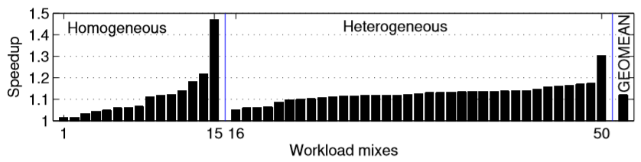
Simulation results: S-curve (LRU)
Average speedup is 12%

Slide 32
Sources of performance in BA-LLC
Average read stretch length increases by 2.4x in BA-LLC
Number of DRAM reads/writes remain almost unchanged on average
Average write buffer capacity
  About five LLC ways: ~2.5 MB (~40K-entry WB)
DRAM read latency improves by 17% on average
DRAM write throughput improves by 50%
DRAM write row hit rate improves from 35% to 40%

Slide 33
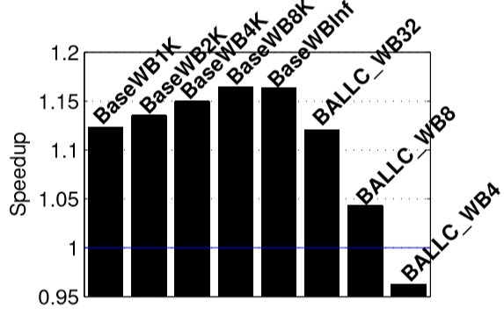
Approaching unbounded WB
BA-LLC with 32-entry WB delivers performance of baseline 1K-entry WB and bridges 75% performance gap between baseline and infinite WB
BA-LLC with 8-entry WB delivers better performance than 32-entry baseline
  Less complex WB with better performance

Slide 34
Sketch
Talk in one slide
Result highlights
Introduction
Bottleneck analysis
Bandwidth-aware LLC
Prior studies
Simulation infrastructure
Simulation results
Summary

Slide 35
Summary
Bandwidth-aware LLC policy proposal to intelligently schedule DRAM read and write bandwidth demands from LLC side
Proposal offers long stretches of exclusive DRAM bandwidth to reads
  Enabled by dynamically computed in-LLC write buffer width to maximize read stretch lengths
  Accompanied by a smart dirty block scrubber
12% speedup averaged over fifty eight-way multiprogrammed workloads
Bridges 75% performance gap with unbounded write buffer

Slide 36
Bandwidth-aware LLC
Efficiently Coordinating Off-chip Read/Write Bandwidth
Thank you

