Slide 1
Pool Directory: Dynamic Directory Allocation in
Many-core Systems
Sudhanshu Shukla, Mainak Chaudhuri
Indian Institute of Technology Kanpur

Slide 2
Sketch
Talk in one slide
Result highlights
Introduction and motivation
Existing proposals and shortcomings
Our proposal: Pool Directory
Simulation infra-structure
Comparison group
Simulation results
Summary

Slide 3
Sketch
Talk in one slide
Result highlights
Introduction and motivation
Existing proposals and shortcomings
Our proposal: Pool Directory
Simulation infra-structure
Comparison group
Simulation results
Summary

Slide 4
Talk in One Slide
Sparse directory is a critical structure for supporting high-performance coherence tracking in many-core chip-multiprocessors
  Average number of bits per sparse directory entry is an important determinant of the overall directory area, particularly at large core count
Our proposal:
  Each sparse directory entry is provisioned with a short pointer for tracking the owner of a private block; handles the common case because private blocks are more in number than shared blocks
  Tracking entries for shared blocks are dynamically allocated as needed from a separate direct-mapped pool of short vector entries

Slide 5
Result highlights
128-core chip-multiprocessor running scientific computing, general-purpose, and commercial multi-threaded workloads
  Our pool directory proposal performs within 2.4% of a full-map bitvector organization at (1/16)x number of entries while investing only one-third space needed by the full-map directory
  Our proposal performs 5% better than the state-of-the-art SCD organization having equal space
  Our proposal saves 20% interconnect traffic and 19% private cache misses compared to SCD due to less number of premature directory evictions
  Our proposal saves 85% dynamic energy in the sparse directory compared to SCD

Slide 6
Sketch
Talk in one slide
Result highlights
Introduction and motivation
Existing proposals and shortcomings
Our proposal: Pool Directory
Simulation infra-structure
Comparison group
Simulation results
Summary

Slide 7
Introduction and motivation
Sparse directory is a set-associative tagged structure attached to each last-level cache (LLC) bank
  Each sparse directory entry tracks the location(s) of an LLC block in the private cache hierarchy attached to each core
  Sparse directory implementation needs to be space-efficient as the number of cores in the chip-multiprocessor increases
  For a given number of sparse directory entries, the average number of bits required for tracking a block plays an important role in the total space investment for coherence tracking

Slide 8
Introduction and motivation
We present a novel sparse directory organization for optimizing the average number of bits devoted to track a block
  The width of a sparse directory entry depends on the degree of sharing experienced by a block
  Typically three types of directory entries are needed
    Single pointer for tracking a private block
    Short vector for tracking a few sharers in pointer or bitvector format
    Large full-map bitvectors for tracking widely shared blocks
  A single-width full-map bitvector directory entry remains heavily under-utilized on average

Slide 9
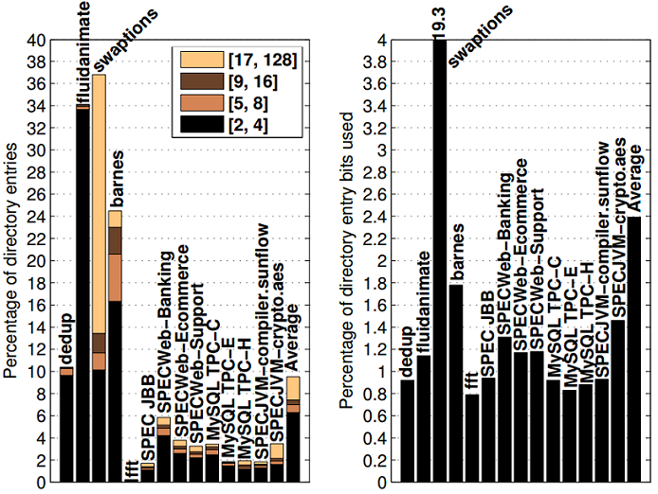
Introduction and motivation
A full-map bitvector entry is heavily under-utilized on average due to large volume of blocks with low degree of sharing
Only 10% of the allocated directory entries observe any sharing for a 2x sparse directory
On average only 2.4% bits of a full-map directory entry ever get set

Slide 10
Sketch
Talk in one slide
Result highlights
Introduction and motivation
Existing proposals and shortcomings
Our proposal: Pool Directory
Simulation infra-structure
Comparison group
Simulation results
Summary

Slide 11
Existing proposals and shortcomings
Several proposals have recognized the under-utilization of full-map bitvector entries
An easy solution is to statically limit the width of the directory entry and sacrifice in terms of the coherence tracking precision e.g., coarse-vector representation
  Not particularly attractive for low sharing degree
Another easy solution is to statically limit the directory entry width, but maintain precision of tracking with limited-pointer representation (good for low sharing degree)
  Requires costly solutions when tracking information overflows the entry width

Slide 12
Existing proposals and shortcomings
Proposals that do not sacrifice tracking precision and do not resort to costly overflow solutions take one of the three forms
Static mix of pointer and full-map bitvector entries [Fang et al. PACT 2013]
  Will be referred to as Hybrid Directory
  Pointer entries track private blocks and the full-map bitvector entries track shared blocks
  Static mix of entries (e.g., six pointer ways and two bitvector ways in an eight-way set) makes it difficult to react optimally to different and dynamic mix of sharing degrees of blocks within and across applications

Slide 13
Existing proposals and shortcomings
Scalable Coherence Directory (SCD) treats a system having pq cores as a hierarchy of p clusters with each cluster having q cores (q ≥ p) [HPCA 2012]
  Each directory entry has q tracking bits
  A block with low number of sharers is tracked using a single directory entry in limited-pointer format (up to q/log₂(pq) sharers)
  A block with larger number of sharers is tracked hierarchically using at most p+1 directory entries
    The root directory entry tracks the clusters
    Each of the p leaf entries tracks the sharers in a cluster
  Directory entry width is square root of full-map

Slide 14
Existing proposals and shortcomings
Shortcomings of SCD
  Multiple directory entries are needed to track a block with medium to high degree of sharing
    Puts pressure on the directory height with increasing sharing degree and number of shared blocks
    Best case requires two directory entries when all sharers are confined to a single cluster
  Each directory entry has a tag and therefore, for tracking a block with multiple directory entries, a significant number of bits are devoted to tags
    In a 1024-core system, with 24-bit tags, a block with 1024 sharers requires at least 33x(32+24) tracking bits, a significant portion of which is invested to tags
  A private block still wastes a good number of tracking bits in a directory entry

Slide 15
Existing proposals and shortcomings
Select Directory attaches just a pointer with each directory entry for tracking the private blocks and dynamically allocates full-map bitvectors from an array of such bitvectors for tracking shared blocks [DATE 2015]
  When tracking a shared block, the pointer attached to the corresponding directory entry points to the full-map bitvector
  Advantage: optimized for tracking private blocks and only one tag per block (unlike SCD)
  Shortcoming: large average wastage when tracking shared blocks
    Each shared block uses a full-map tracking vector

Slide 16
Sketch
Talk in one slide
Result highlights
Introduction and motivation
Existing proposals and shortcomings
Our proposal: Pool Directory
Simulation infra-structure
Comparison group
Simulation results
Summary

Slide 17
Our proposal: Pool Directory
Overview
  Each sparse directory entry maintains a pointer for tracking private blocks
  Shared blocks are tracked by dynamically allocating short vector entries from a separate direct-mapped pool of short vectors
    Each pool entry can use two possible formats for tracking sharers: limited-pointer for tracking a few sharers and segment vector for tracking the sharers if they all fall within a pre-defined cluster of cores
    Multiple contiguous pool entries can be dynamically allocated to a block for tracking a large number of sharers; each pool entry in such a group can independently use one of the two possible formats
    The pointer in the sparse directory entry points to the head pool entry of a group (possibly singleton)

Slide 18
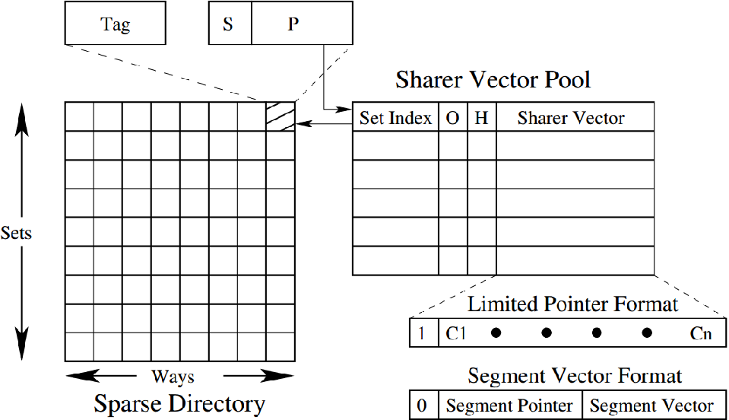
Our proposal: Pool Directory
Single sharer?
Owner pointer/Pool head pointer
Occupied bit
Head bit

Slide 19
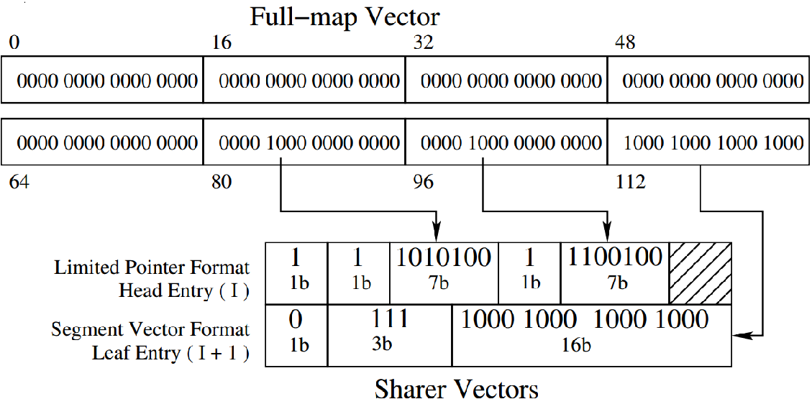
Our proposal: Pool Directory
An example in a 128-core system
  Two 20-bit pool entries encode the six sharers of a shared block (full-map encoding is also shown)
Format bit
Valid bit
Segment/Cluster id

Slide 20
Our proposal: Pool Directory
Advantages over SCD-style hierarchical representation
  Private blocks never contend for pool entries
  Exactly one tag is allocated for tracking a block
    The pool entries do not have tags
    The parent sparse directory entry points to the head pool entry
  There is no need to maintain a root entry within a group of pool entries tracking a shared block
    At most p entries are needed for tracking p clusters (as opposed to p+1 in SCD)
  Each pool entry in a group for tracking a shared block can independently use limited-pointer or segment vector format enhancing compactness

Slide 21
Pool Directory: Adding a sharer
The sparse directory lookup leads to three possibilities
  Miss in directory
  Hit in directory and single sharer bit is set
  Hit in directory and single sharer bit is reset
Miss in directory
  Allocate sparse directory entry, set owner in pointer field, set single sharer bit
Hit in directory and single sharer bit is set
  Allocate a pool entry, set head bit of pool entry, set pointer field of directory entry to point to the pool entry, encode two sharers in the pool entry using limited-pointer format, reset single sharer bit in directory entry

Slide 22
Pool Directory: Adding a sharer
Hit in directory and single sharer bit is reset
  Let the new sharer belong to cluster n
  If the block already has a pool entry encoding sharers in cluster n, that pool entry is used
  Else if the block has a pool entry using the limited-pointer format that has a free limited-pointer field, that pool entry is used
  Else the pool entries allocated to the block are examined to see if the new sharer can be accommodated by changing the format of some of the entries
    For example, if the limited-pointers of a pool entry are encoding sharers belonging to the same cluster, it is better to switch that entry to segment vector format
  Else a new pool entry needs to be allocated

Slide 23
Pool Directory: Adding a sharer
Protocol for adding a new pool entry to a block’s set of pool entries
  Invariant: all pool entries allocated to a block must be contiguous
    Simplifies design, suffices to have a single head pointer to the set of pool entries for a block
  The existing set Q of pool entries allocated to a block is grown by one pool entry forward or backward
    If one of the pool entries before or after Q is free, that entry is allocated
      Will refer to these two entries as Q_ and Q₊
    Else one of Q_ and Q₊ is evicted to make room for the new allocation

Slide 24
Pool Directory: Adding a sharer
Protocol for adding a new pool entry
  To decide between Q_ and Q₊ as the eviction candidate, the following protocol is followed
    Let each pool entry have enough bits to track all sharers in a cluster of K cores
    Assuming a total of C cores, a block will need at most C/K pool entries i.e., |Q| ≤ C/K
    The pool is divided into chunks of size C/K entries
    If Q_, Q, Q₊ belong to the same chunk, one of Q_ and Q₊ is randomly victimized
    Else let Q_ belong to chunk C₁ and Q₊ belong to chunk C₁+1; let the number of entries of Q in C₁ be N1 and in C₁+1 be N2; if N1 ≥ N2, Q_ is victimized and otherwise Q₊ is victimized
      Rationale: let Q grow in the chunk where it already has a bigger share so that interference in adjacent chunks is low

Slide 25
Pool Directory: Adding a sharer
If the access hits in directory and the single sharer bit is reset, the O and H bits of C/K consecutive pool entries are examined starting from the head entry
  Reveals the actual number of pool entries allocated to the accessed block
The pool is provisioned with two read ports
  Latency is bounded by C/2K read cycles
  The worst case latency can be hidden under the LLC access latency at 22 nm process
    Latency can be improved further via pool banking
    With C=128 and K=32, 98.6% of directory allocations need at most two pool entries, 99% allocations need at most three pool entries (average latency overhead of reading out a block’s pool entry is already low)

Slide 26
Pool Directory: Adding a sharer
Protocol for evicting a pool entry
  A valid pool entry eviction is triggered when addition of a new sharer requires a pool entry
    Already discussed how the victim pool entry is chosen
    Selected victim’s sparse directory entry is located
      Each pool entry stores the set index of its sparse directory entry
      The entire sparse directory set is read out and the pointer fields of all the ways are compared against the head entry index of the collection containing the victim pool entry to locate the correct sparse directory entry
    If the selected victim is the only pool entry that the sparse directory entry has, all but one sharer tracked by the pool entry are back-invalidated; the spared sharer is tracked in the sparse directory entry
    Else all sharers tracked by the victim pool entry are back-invalidated

Slide 27
Pool Directory: Adding a sharer
Allocation of the first pool entry for a block
  This is triggered when the number of active sharers of a block reaches two
  This is handled differently from growing the set of pool entries already allocated to a block
    Since the set of pool entries allocated to a block must grow contiguously, position of the first pool entry is important to ensure conflict-free growth in future
  The pool is divided into chunks of size C/K entries and the chunk with a free pool entry is identified by examining the occupied bits
    Round-robin policy for selecting the chunk with a free pool entry; the load across the chunks is kept uniform
  If no free pool entry exists, a tail entry is randomly selected from the round-robin chunk

Slide 28
Pool Directory: Removing a sharer
A sharer/owner needs to be removed on an eviction hint or writeback from private cache
  Our protocol generates an eviction hint to the directory whenever a block is evicted from a core’s private cache hierarchy
  The block is located in the sparse directory
  Removal of the sharer may release a pool entry
  If the number of sharers drops to one, all pool entries are freed and the sharer is tracked using the pointer field in the sparse directory entry
    The single sharer bit is set at this point

Slide 29
Sketch
Talk in one slide
Result highlights
Introduction and motivation
Existing proposals and shortcomings
Our proposal: Pool Directory
Simulation infra-structure
Comparison group
Simulation results
Summary

Slide 30
Simulation infra-structure
CPU cores
  Modeled using Multi2Sim
  128 out-of-order issue dynamically scheduled x86 cores clocked at 2 GHz
  iL1 cache: 32 KB, 8-way, 64B blocks, LRU
  dL1 cache: 32 KB, 8-way, 64B blocks, LRU
  L2 cache: 128 KB, 8-way, 64B blocks, LRU
  L2 cache is non-inclusive/non-exclusive with respect to iL1 and dL1 caches
    Fill on miss; no back-invalidation on eviction
L3 cache
  Shared across all cores, 128 banks (set interleaved), 256 KB 16-way per bank, 64B blocks, LRU

Slide 31
Simulation infra-structure
Sparse directory
  Each L3 cache bank has an eight-way sparse directory slice responsible for tracking the blocks of the bank
  The number of sets in the sparse directory is expressed as a fraction of the aggregate number of L2 cache sets across all cores
  Each slice exercises single-bit NRU replacement
On-die interconnect
  2D mesh, dimension-order routing, single-cycle hop
  Each hop switch connects a core and an L3 cache bank along with its sparse directory slice

Slide 32
Simulation infra-structure
Main memory
  Eight single-channel DDR3-2133 controllers evenly distributed over the mesh, FR-FCFS scheduling, each controller connects to a 2 GB DRAM module
  DRAM modules are modeled using DRAMSim2
    One rank/channel, eight banks/rank, x8 devices, BL=8, 1 KB row/bank/device, 12-12-12
Applications
  Drawn from PARSEC, SPLASH-2, SPEC JBB, TPC (running on MySQL server), SPEC Web (running on Apache HTTP server v2.2), SPEC JVM

Slide 33
Sketch
Talk in one slide
Result highlights
Introduction and motivation
Existing proposals and shortcomings
Our proposal: Pool Directory
Simulation infra-structure
Comparison group
Simulation results
Summary

Slide 34
Comparison group
SCD [HPCA 2012]
  (1/16)x sets, 8 ways; each slice has 16 sets and 8 ways; single-bit NRU replacement (skew-associative organization is also evaluated separately)
  Each entry: valid bit, 31-bit tag, 1-bit coherence state (M/E, shared), 1-bit NRU state, two limited-pointer fields and their valid bits (these 16 bits can also track a cluster of 16 cores in hierarchical representation), two bits for type of entry/ representation (limited-pointer, root, leaf), three bits for cluster id in hierarchical representation
  Total size: 110 KB

Slide 35
Comparison group
Hybrid Directory [PACT 2013]
  (1/16)x sets, 8 ways; each slice has 16 sets and 8 ways; single-bit NRU replacement
  Each entry: valid bit, 31-bit tag, 1-bit coherence state (M/E, shared), 1-bit NRU state
  In a set, six ways can track private owners (seven bits each) and two ways can track shared blocks using full-map vectors (128 bits each)
  Total size: 142.5 KB

Slide 36
Comparison group
Select Directory [DATE 2015]
  (1/16)x sets, 8 ways; each slice has 16 sets and 8 ways; single-bit NRU replacement
  Each entry: valid bit, 31-bit tag, 1-bit coherence state (M/E, shared), 1-bit NRU state, 7-bit pointer, 1-bit pointer state (single sharer vs. full-map entry pointer)
  Each slice has a fully-associative 16-entry table of full-map bitvectors for dynamic allocation to shared blocks; exercises FIFO replacement
    Each bitvector entry has a 128-bit sharer vector, one valid bit, and four bits of back-pointer to the sparse directory set containing the bitvector’s directory entry
  Total size: 117.25 KB

Slide 37
Comparison group
Pool Directory [our proposal]
  (1/16)x sets, 8 ways; each slice has 16 sets and 8 ways; single-bit NRU replacement
  Each entry: valid bit, 31-bit tag, 1-bit coherence state (M/E, shared), 1-bit NRU state, 7-bit pointer, 1-bit pointer state (single sharer vs. pool entry pointer)
  Each slice has a direct-mapped 40-entry pool for dynamic allocation to shared blocks
    Each pool entry has four limited-pointer fields (7 bits each) and their valid bits (these 32 bits can track the sharers in a 32-core cluster in the segment vector format), occupied (O) and head (H) bits, 1-bit format (limited-pointer/segment vector), 2-bit cluster id, and four bits of back-pointer to the sparse directory set
  Total size: 109.625 KB

Slide 38
Comparison group
Full-map Directory
  (1/16)x sets, 8 ways; each slice has 16 sets and 8 ways; single-bit NRU replacement
  Each entry: valid bit, 31-bit tag, 1-bit coherence state (M/E, shared), 1-bit NRU state, 128-bit vector
  Total size: 324 KB
SCD, Select Directory, and Pool Directory are sized to have similar space investment
  110 KB, 117.25 KB, 109.625 KB
The Pool Directory configuration consumes about one-third space of the full-map directory

Slide 39
Sketch
Talk in one slide
Result highlights
Introduction and motivation
Existing proposals and shortcomings
Our proposal: Pool Directory
Simulation infra-structure
Comparison group
Simulation results
Summary

Slide 40
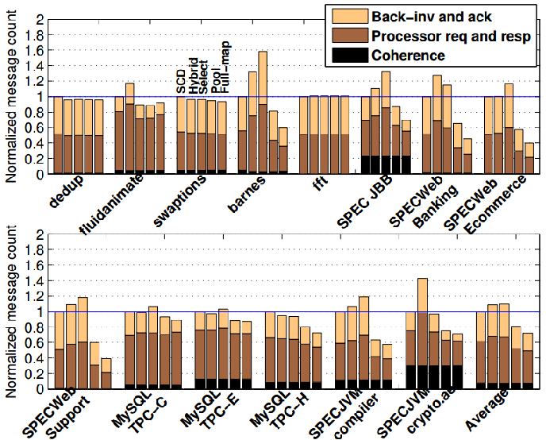
Message count
Pool Directory improves directory space utilization leading to less number of premature eviction of directory entries
Compared to SCD, our Pool Directory proposal saves 19% messages
Hybrid and Select directories increase message count by 9% and 10%

Slide 41
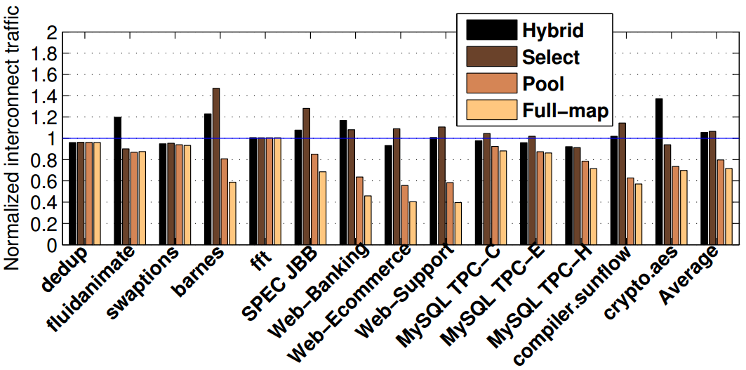
Message traffic (bytes)
Compared to SCD, our Pool Directory proposal saves 20% traffic
Hybrid and Select directories increase traffic by 6% and 7%

Slide 42
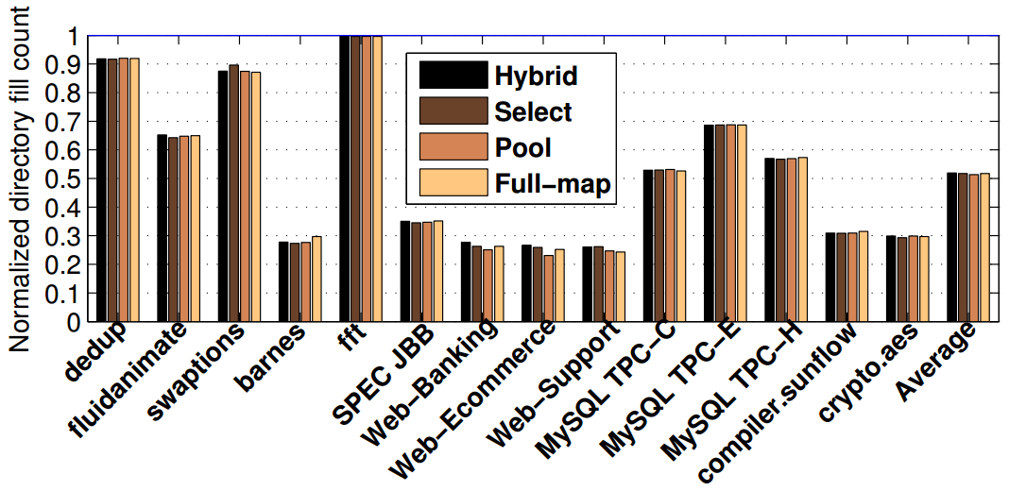
Sparse directory allocations
SCD reduces the directory entry width, but increases the pressure on the directory height significantly
Compared to SCD, large savings in sparse directory allocations
SCD needs at least two directory entries to track more than two sharers

Slide 43
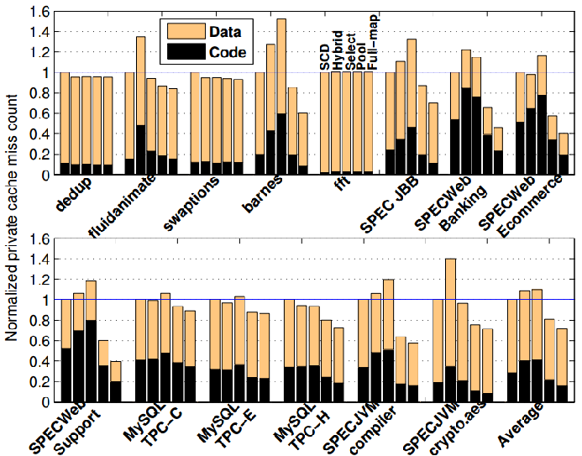
Private cache misses
Pool Directory reduces the number of premature directory entry evictions leading to less number of harmful back-invalidations and private cache misses
Hybrid and Select directories are unable to properly track the widely shared code blocks with their resources and suffer from additional code misses
Compared to SCD, our Pool Directory proposal saves 19% misses
Hybrid and Select directories suffer from 9% and 10% additional misses

Slide 44
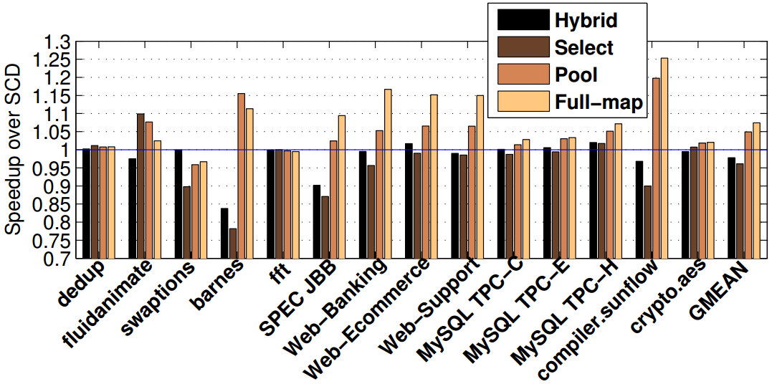
Performance comparison
Pool Directory performs within 2.4% of full-map on average while investing only one-third space
Pool Directory performs 5% better than SCD on average
Hybrid and Select directories perform 2% and 4% worse than SCD

Slide 45
Energy and skew-associativity
Energy comparison with SCD
  Pool Directory saves 85% dynamic energy in coherence tracking compared to SCD at 22 nm process (averaged over all applications)
Skew-associative organization
  We model the sparse directory using a four-way skew-associative Z-cache organization employing H3 hashing and three-level timestamp-based LRU replacement (52 replacement candidates)
  Pool Directory and SCD employ this organization in the sparse directory
    Pool Directory continues to use a direct-mapped pool
  Pool Directory performs 4% better than SCD, saves 82% dynamic energy in coherence tracking, and reduces message traffic by 16%

Slide 46
Sketch
Talk in one slide
Result highlights
Introduction and motivation
Existing proposals and shortcomings
Our proposal: Pool Directory
Simulation infra-structure
Comparison group
Simulation results
Summary

Slide 47
Summary
A novel sparse directory organization optimizing the average number of bits per tracked block
  A direct-mapped pool of short vectors is at the heart of the design
  Each pool entry can track shared blocks in two possible formats: limited-pointer and segment vectors for low to medium sharing degree
  Multiple contiguous pool entries can collectively track widely shared blocks
Pool Directory saves 20% interconnect traffic and performs 5% better than SCD
  Performs within 2.4% of a full-map organization while requiring only one-third space

Slide 48
Thank you

