Slide 1
Tiny Directory
Ultra-low-overhead Coherence Tracking in Many-core Systems
Sudhanshu Shukla, Mainak Chaudhuri
Indian Institute of Technology Kanpur

Slide 2
Sketch
Talk in one slide
Result highlights
Introduction
Tiny Directory
  In-LLC coherence tracking
  Tiny Directory design
  Spilling into LLC space
Simulation infra-structure
Simulation results
Summary and future directions

Slide 3
Sketch
Talk in one slide
Result highlights
Introduction
Tiny Directory
  In-LLC coherence tracking
  Tiny Directory design
  Spilling into LLC space
Simulation infra-structure
Simulation results
Summary and future directions

Slide 4
Talk in One Slide
Sparse directory is a critical structure for supporting high-performance coherence tracking in many-core chip-multiprocessors
  Number of sparse directory entries is an important determinant of performance and the on-chip area invested to the directory
We show how to design very small sparse directories while delivering high performance
  A privately owned block (M/E in MESI) is tracked by borrowing bits from the block’s LLC data way
  Shared blocks with frequent and large-scale read sharing are tracked in a tiny sparse directory
  Entries from the Tiny Directory can be spilled into the LLC space at a controlled rate as needed

Slide 5
Result highlights
128-core chip-multiprocessor running scientific computing, general-purpose, and commercial multi-threaded workloads
  Our Tiny Directory proposal using sparse directories with (1/32)x to (1/256)x entries performs within 1% of a 2x sparse directory
    Tiny Directory capacity ranges from 187KB to 23.75KB
  Our Tiny Directory proposal exercising (1/256)x entries saves 16% energy in the LLC and the sparse directory compared to the 2x baseline
  Our proposal outperforms the state-of-the-art multi-grain directory by large margins
  A significant leap forward in saving on-die SRAM investment for coherence tracking

Slide 6
Sketch
Talk in one slide
Result highlights
Introduction
Tiny Directory
  In-LLC coherence tracking
  Tiny Directory design
  Spilling into LLC space
Simulation infra-structure
Simulation results
Summary and future directions

Slide 7
Introduction
Sparse directory is a set-associative tagged structure attached to each last-level cache (LLC) bank
  Each sparse directory entry tracks the location(s) of an LLC block in the private cache hierarchy attached to each core
  Sparse directory implementation needs to be space-efficient as the number of cores in the chip-multiprocessor increases
  The number of sparse directory entries imposes an upper bound on the number of distinct blocks tracked at any point in time
    This parameter plays an important role in determining the overall performance and the total space investment for coherence tracking

Slide 8
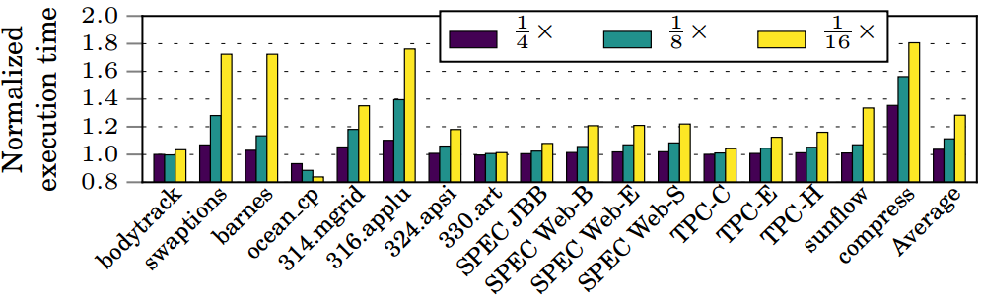
Sparse directory height
Sparse directory height is an important determinant of performance
  Number of sparse directory entries is mentioned as a fraction of the number of blocks in the last-level private cache (L2 cache in our case)
With decreasing directory height, premature directory evictions cause back-invalidation of live blocks from private cache hierarchy
Compared to a 2x sparse directory, execution time increases by 3%,
11%, and 28% for (1/4)x, (1/8)x, and (1/16)x directory heights

Slide 9
Private vs. shared blocks
Recent proposals have recognized the presence of a large volume of private blocks in the on-chip cache hierarchy
  79% of all allocated LLC blocks in our case
  Techniques have been proposed to reduce the overhead of tracking private blocks
  Multi-grain directory devotes one directory entry to track a 1 KB private region [MICRO’13]
    Requires support for dual-grain coherence
  Stash directory does not back-invalidate a private block on evicting its directory entry [HPCA’14]
    Requires broadcast-based recovery if such a block gets shared in future
  OS-identified private pages not tracked [ISCA’11]
    Requires custom OS support

Slide 10
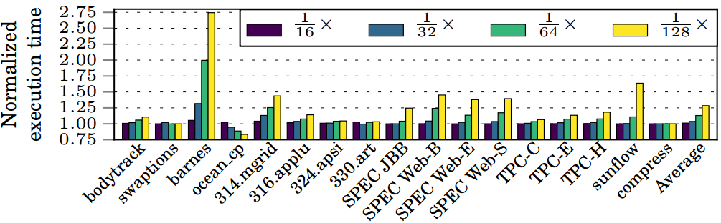
Tracking shared blocks: Limit study
How small the sparse directory can be if private blocks are not tracked in the directory
  A block is tracked in the directory only when it has at least two sharers; tracked until it becomes unowned/non-shared or evicted from directory
Not possible to maintain good performance below (1/16)x even when all overhead of tracking private blocks is eliminated
Compared to a 2x sparse directory, execution time increases by 1%,
4%, 13%, and 28% for (1/16)x, (1/32)x, (1/64)x, (1/128)x directories

Slide 11
Sketch
Talk in one slide
Result highlights
Introduction
Tiny Directory
  In-LLC coherence tracking
  Tiny Directory design
  Spilling into LLC space
Simulation infra-structure
Simulation results
Summary and future directions

Slide 12
Tiny Directory: An overview
Attributes of Tiny Directory
  Directory heights range from (1/32)x to (1/256)x while maintaining performance close to 2x height
    A significant drop in coherence tracking overhead compared to the contemporary designs
  The underlying coherence layer exercises a traditional broadcast-free OS-independent block-grain protocol with a few small extensions
  Focuses on optimizing the directory height alone while assuming a full-map bitvector entry
    Optimizations for directory entry width can be seamlessly integrated

Slide 13
Tiny Directory: An overview
Achieving Tiny Directory height
  Start with a naïve design that doesn’t have a sparse directory
    A block is tracked by borrowing bits from the block’s LLC data way (in-LLC coherence tracking)
      Assumes a traditional non-inclusive/non-exclusive LLC where blocks are filled in LLC on miss and no back-invalidation sent on LLC eviction
    Works well for private blocks except that log C bits need to be sent to the LLC when the block is evicted from the private cache hierarchy (C is core count)
      Needed for reconstructing the LLC block; this extra traffic shows up only for clean evictions
    All read requests to a shared block must be forwarded to a sharer
      LLC cannot supply the block since part of the block is corrupted for tracking coherence

Slide 14
Tiny Directory: An overview
Achieving Tiny Directory height
  Improve the naïve in-LLC coherence tracking mechanism by incorporating a tiny sparse directory that can track the critical read-shared working set
    Helps avoid the three-hop transactions for read-sharing because now the LLC can supply these blocks
  Impossible to size the Tiny Directory to match the critical read-shared working set
    This working set size is not known at design time
  Make the design robust by allowing Tiny Directory entries to spill into the LLC space at a controlled rate while guaranteeing an upper bound on LLC miss rate increase
    Helps phases where read-shared working set is large

Slide 15
Sketch
Talk in one slide
Result highlights
Introduction
Tiny Directory
  In-LLC coherence tracking
  Tiny Directory design
  Spilling into LLC space
Simulation infra-structure
Simulation results
Summary and future directions

Slide 16
In-LLC coherence tracking
Salient features
  Uses no extra storage for coherence tracking
  Borrows bits from the LLC data way of a block for tracking its location(s)
  Extends the traditional baseline MESI protocol
Coherence state encoding
  Two state bits per LLC block as in the baseline
    V=0, D=0: invalid LLC block
    V=1, D=0: valid LLC block, not modified, unowned, not shared
    V=1, D=1: valid LLC block, modified, unowned, not shared
    V=0, D=1: valid LLC block, either owned by a core or shared, bits of data way used for extended encoding

Slide 17
In-LLC coherence tracking
Extended state encoding when V=0, D=1
  Data bit#0: dirty
  Data bit#1: pending/busy
  Data bit#2: owned if 1 and shared if 0
  Data bit#3: owner/sharer encoding format
    If set to 1, next log C bits encode a sharer/owner (C is the number of cores)
    If set to 0, next C bits encode a sharer bitvector
  Either 4+C or 4+log C data bits can be corrupted

Slide 18
In-LLC coherence tracking
V
Tag
B
O/S
Full-Map Sharer Set
Sparse Directory Entry
C-bits
V
D
Tag
Data Block
LLC Entry
Baseline
V
D
Tag
D
B
O/S
En
Sharers
Partial Data
LLC Entry
Corrupted Data
In-LLC coherence tracking

Slide 19
In-LLC coherence tracking
State transitions: LLC fill and read from core
  On an LLC fill, the block transitions from (V=0, D=0) to (V=0, D=1) and 4+log C data bits are used to record the extended state and the owner
  A read request to a block in corrupted exclusive state changes the state to corrupted shared and the block is supplied by the owner
    Critical path same as baseline
  A read request to a block in corrupted shared state adds the new sharer to the bitvector and one of the sharers is elected to supply the block
    Critical path extended to three hops from baseline two hops

Slide 20
In-LLC coherence tracking
R
Respond with data
S
Elect a sharer
and forward
Busy
clear
Read
Tag hit
V=0, D=1
000 (shared)
Home bank
LLC Tag
Home bank
LLC Data
In baseline, home LLC bank would have responded to R directly

Slide 21
In-LLC coherence tracking
State transitions: read-exclusive and upgrade
  A read-exclusive request to a block in the corrupted exclusive state is handled by forwarding the request to the owner
  A read-exclusive request to a block in the corrupted shared state sends out invalidations to all sharers; one of these invalidations is a special one asking the sharer to also supply the block to the requester along with the invalidation ack
  Upgrades are handled similarly except that a data response is not needed
  Critical path remains same as baseline in all these cases

Slide 22
In-LLC coherence tracking
State transitions: private cache evictions
  Eviction of an M state block carries the entire block to the LLC (the traditional writeback)
  Eviction notice of a E state block carries the first 4+log C bits of the block to the LLC
  In both these cases, the LLC block transitions from the corrupted exclusive state to unowned
  Eviction notice of an S state block carries no data to the LLC
    On receiving the eviction notice from the last sharer of a block, the LLC sends a request to this sharer asking for the corrupted portion of the data block
    The sharer supplies the block from the per-core eviction buffer and clears the block from the buffer

Slide 23
In-LLC coherence tracking
Eviction of a modified LLC block in a corrupted state
  The block is reconstructed/updated with the help of the owner or one of the sharers before sending to memory controller
  All sharers are back-invalidated as usual
Latency/Bandwidth considerations at LLC
  Additional latency of LLC data lookup in the critical path of coherence action initiation
    Two cycles extra for our 256 KB LLC data bank
    Negligible fraction of the large round-trip latency between core cache and LLC bank in a 128-core chip
  Additional LLC data writes for coherence info
    Ample spare LLC write bandwidth; off the critical path

Slide 24
In-LLC coherence tracking
Two performance issues to watch out for
  Extra interconnect traffic due to block reconstruction bits (4+C or 4+log C) being carried by the clean block (E and a fraction of S) eviction notices to the LLC from cores
  Reads to shared blocks suffer from lengthened critical path

Slide 25
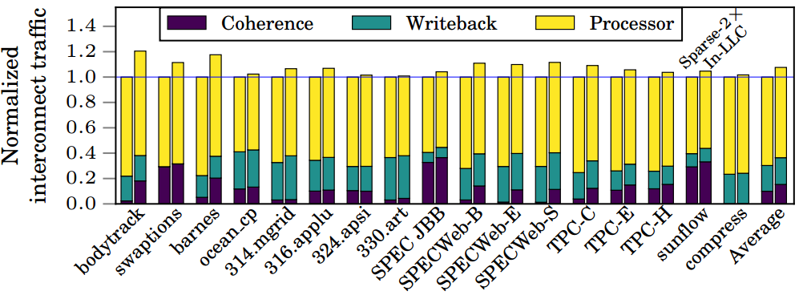
In-LLC coherence tracking
Interconnect traffic (bytes of header and payload) comparison between in-LLC coherence tracking and sparse 2x directory
Additional three-hop read requests to shared blocks lead to an increase in coherence traffic
Compared to a 2x sparse directory, processor request and eviction traffic increases by a percentage each; coherence traffic increases by >5%

Slide 26
In-LLC coherence tracking
Performance comparison with 2x sparse directory
  On average, in-LLC coherence tracking performs 11% worse than a 2x sparse directory
  Several applications lose at least 10% performance: swaptions, barnes, ocean_cp, 316.applu, 324.apsi, SPECWeb
  Primary reason for this loss in performance is the lengthened critical path of reads to shared blocks

Slide 27
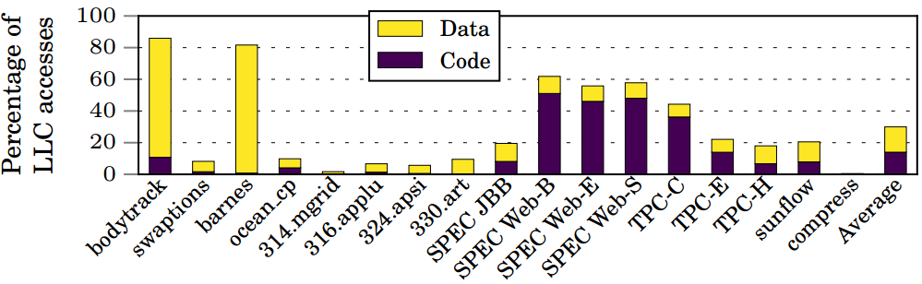
In-LLC coherence tracking
Fraction of LLC accesses that experience lengthened critical path
On average, 30% LLC accesses suffer from this problem
For commercial applications, code accesses suffer more than data

Slide 28
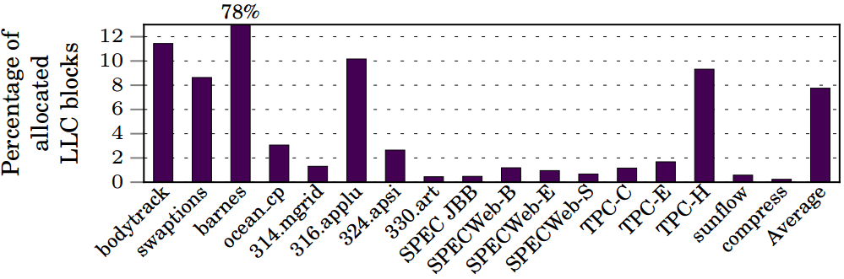
In-LLC coherence tracking
Fraction of allocated LLC blocks that experience accesses with lengthened critical path
On average, only 8% LLC blocks experience this problem
Can we design a small sparse directory to track these offending blocks?

Slide 29
In-LLC coherence tracking
Among the small fraction of offending LLC blocks, is there a subset that covers majority of the lengthened accesses?
  Define Shared Three-hop Read Access (STRA) ratio of a block = fraction of LLC read accesses to the block that need forwarding to a sharer because the block is in shared corrupted state
    All offending LLC blocks have non-zero STRA ratio
    Rest of the LLC blocks have zero STRA ratio
  Divide all LLC blocks into eight categories (C₀ to C₇) based on their STRA ratio: 0, (0, 1/2], (1/2, 3/4], (3/4, 7/8], …, (31/32, 63/64], (63/64, 1]
    A block may change its STRA category during its residence in the LLC

Slide 30
In-LLC coherence tracking
Among the small fraction of offending LLC blocks, is there a subset that covers majority of the lengthened accesses?
  Key observation: LLC blocks in STRA categories C₆ and C₇ with STRA ratio in (31/32, 1] have only 12% of the offending blocks, but cover 54% of the accesses with lengthened critical path
    Large skew among STRA categories
    Higher STRA categories have less offending blocks, but cover more lengthened accesses
    Blocks in these higher STRA categories could be the target of a small sparse directory to avoid the problem of lengthened accesses
  Sets the stage for Tiny Directory

Slide 31
Sketch
Talk in one slide
Result highlights
Introduction
Tiny Directory
  In-LLC coherence tracking
  Tiny Directory design
  Spilling into LLC space
Simulation infra-structure
Simulation results
Summary and future directions

Slide 32
Tiny Directory design
Tiny Directory is a traditional sparse directory
  Augments in-LLC coherence tracking and specializes in tracking a subset of the critical read-shared blocks (with high STRA ratio)
    These blocks remain uncorrupted in the LLC and tracked in the Tiny Directory so that reads to these blocks can be responded by the LLC w/o forwarding
  Very small in size and therefore, must carefully select what to track
  A block is considered to be tracked in the Tiny Directory on an LLC read to the block if
    State of the block is corrupted shared or
    Code block in invalid/unowned/non-shared state
  Tracking such a block in Tiny Directory allows future reads to the block to conclude in two hops

Slide 33
Tiny Directory design
Tiny Directory allocation/eviction policies
  A block being considered for tracking in the Tiny Directory invokes an allocation policy
    If the outcome of the policy is not to track in the Tiny Directory, the in-LLC tracking mechanism is used
    If the policy agrees to track the block in the Tiny Directory, the LLC block, if corrupted, is reconstructed by contacting the owner or one of the sharers and the tracking information is passed on to the Tiny Directory
  An evicted entry from the Tiny Directory transfers the tracking information to the LLC and the block switches to in-LLC tracking mechanism
    If the block is already evicted from the LLC (possible in a non-inclusive LLC), sharers are back-invalidated

Slide 34
Tiny Directory design
Tiny Directory allocation/eviction policies make use of the dynamic STRA (DSTRA) ratio of the LLC blocks
  Two 6-bit counters maintain STRA count (STRAC) and other access count (OAC) for each block
  DSTRA ratio of a block is STRAC/(STRAC+OAC)
  STRAC of a block is incremented on a read access to the block if state of the block is shared
    Such an access would have required three hops in the in-LLC coherence tracking mechanism
  OAC is incremented for other accesses (not WB)
  Maintained by borrowing 12 more bits from LLC data way when the block is tracked in LLC; otherwise maintained in Tiny Directory entry

Slide 35
Tiny Directory design
Allocation/Eviction policy#1: DSTRA policy
  Recall the STRA categories C₀ to C₇ based on STRA ratio: 0, (0, 1/2], (1/2, 3/4], …, (63/64, 1]
  Let the STRA category of the block B being considered for tracking in Tiny Directory be C_{k}
  If there is an invalid way in the Tiny Directory set which block B maps to, that is used to track B
  Else the way with the least STRA category (say, C_{i}) is located in the target set of the Tiny Directory and B is tracked in the directory if i < k
  Tracks a subset of blocks with highest STRA ratio

Slide 36
Tiny Directory policy: DSTRA
R
Respond with data
S
Elect a sharer
and forward
Read
Tag hit
V=0, D=1
Reconst.
bits
000 (shared)
Home bank
LLC Tag
Home bank
LLC Data
Min. STRA cat. C_{i}
STRA cat. C_{k}
Tag miss
i < k
Tiny Dir.
Track in Tiny Directory

Slide 37
Tiny Directory design
Allocation/Eviction policy#2: DSTRA+gNRU
  Major shortcoming of DSTRA: tracking entries for C₇ blocks may stay for too long in the Tiny Directory even if they are not useful any more
  Augment DSTRA with a generational NRU policy
    If an entry does not receive any access for a full generation, it is considered for eviction
    The length of a generation is defined to be the average interval between two consecutive reads to a shared block
    Generation length is determined dynamically

Slide 38
Tiny Directory design
Allocation/Eviction policy#2: DSTRA+gNRU
  Each Tiny Directory entry is provisioned with two state bits: eviction priority (EP) and reuse (R)
  R bit is set and EP bit is reset on an access or fill to an entry
  At the end of each generation, if an entry’s R bit is reset, its EP bit is turned on
    This is a potential eviction candidate in the next generation
  At the beginning of each generation, R bits of all entries are gang-cleared

Slide 39
Tiny Directory design
Allocation/Eviction policy#2: DSTRA+gNRU
  Let the STRA category of the block B being considered for tracking in Tiny Directory be C_{k}
  If there is an invalid way in the Tiny Directory set which block B maps to, that is used to track B
  Else the way with the least STRA category (say, C_{i}) is located in the target set of the Tiny Directory and B is tracked in the directory if one of the following two conditions holds
    i < k (this is DSTRA policy)
    i == k AND the way with STRA category C_{i} has EP bit set
  The second condition is needed to replace the useless entries of a certain STRA category

Slide 40
Sketch
Talk in one slide
Result highlights
Introduction
Tiny Directory
  In-LLC coherence tracking
  Tiny Directory design
  Spilling into LLC space
Simulation infra-structure
Simulation results
Summary and future directions

Slide 41
Spilling into LLC space
Tiny Directory needs to be sized to accommodate the critical read-shared working set
  Such a requirement is impractical because the size of the critical read-shared working set is unknown at design time
    Can vary across applications and across phases of an application
  To make the proposal robust and practical, we incorporate the provision of spilling tracking entries into the LLC
  Two possible spill situations: eviction from the Tiny Directory and denial of allocation in the Tiny Directory by the allocation policy

Slide 42
Spilling into LLC space
A spilled tracking entry occupies an LLC tag and uses the corresponding LLC data way for maintaining the coherence information
  If the tracking entry E_{B} of block B is spilled into the LLC, E_{B} is allocated in the same LLC set as B
    E_{B} and B have the same tag
    For E_{B}, the special state V=0, D=1 is used so that it can be distinguished from B which is guaranteed to be in a non-corrupted shared state with V=1
    An LLC lookup can return at most two tag matches
    E_{B} is always victimized before B from the LLC (easy to enforce in LRU, since E_{B} and B are accessed together)
    When E_{B} is victimized, the coherence information is transferred to B and B switches to a corrupted state
  Spilling must not increase LLC miss rate much

Slide 43
Spilling into LLC space
LLC
Tiny Directory
E_{B}: Coherence Information, B: Block, T: Tag
T
B
T
E_{B}
LLC
Eviction of E_{B} from
Tiny Directory
Spill E_{B}
in LLC
T
E_{B}
Spill
in
LLC ?
Set A
Yes
T
B
Allocation of E_{B} in
Tiny Directory denied
Set B
No
Use In-LLC Coherence Tracking
Eviction of E_{B} from LLC
Tag Array,
Data Array
T
E_{B}
Partial B
LLC

Slide 44
Spilling into LLC space
Sequentially reading out E_{B} and B from the LLC may lengthen the critical path
  Fortunately, both accesses are never on the critical path
  For a read, B is first read out and sent to the requester; update to E_{B} proceeds in background
    Only shared blocks can have spilled tracking entries
  For read-exclusive and upgrade, E_{B} is first read out, invalidations are sent with one of the sharers asked to also supply the data to the requester along with the invalidation ack
    B is read out next, it is switched to the corrupted exclusive state, and E_{B} is invalidated

Slide 45
Spilling into LLC space
Controlling spill rate to constrain LLC miss rate increase
  Goal is to allow as much spill as possible from high STRA categories while keeping the LLC miss rate in check
  Each LLC bank dynamically computes the smallest STRA category C_{i} such that all categories C_{k} with k ≥ i are allowed to spill provided the miss rate of that bank increases by no more than δ
  For a given δ, how to determine C_{i} for a bank?

Slide 46
Spilling into LLC space
Controlling spill rate to avoid large increase in LLC miss rate
  Each LLC bank estimates the miss rate without spilling (MR_{no-spill}) by setting aside a few sets that do not admit any spilled entries
  The rest of the sets admit spilled entries for STRA categories bigger than or equal to C_{i}; from these sets MR_{spill} is estimated
  At the end of each window of 8K accesses to the bank, if MR_{spill} – MR_{no-spill} ≤ δ, i is decremented by one
    In the next window, more spills will be allowed
  Else i is incremented by one

Slide 47
Spilling into LLC space
LLC bank (256 sets)
240 spill sets
Miss rate = MR_{spill}
16 no-spill sets
Miss rate = MR_{no-spill}
Current lower bound category index i
End of 8K-access window
Increase spilling
Decrease spilling
i←i-1
Yes
No
i←i+1
MR_{spill} – MR_{no-spill} ≤ δ

Slide 48
Spilling into LLC space
Selection of δ (LLC miss rate tolerance limit)
  At the end of each 8K-access window, each LLC bank independently classifies the running application into one of four possible classes
    Class A: LLC bank miss rate is at least 10% and DSTRA ratio is at least 0.4 (relatively high tolerance)
    Class B: LLC bank miss rate is at least 10% and DSTRA ratio is less than 0.4 (not much gain from spill)
    Class C: LLC bank miss rate is less than 10% and DSTRA ratio is at least 0.4 (medium tolerance)
    Class D: LLC bank miss rate is less than 10% and DSTRA ratio is less than 0.4 (relatively low tolerance)
  δ for the next window is selected by each bank independently based on the classification
  δ_{A}=1/4, δ_{B}=1/32, δ_{C}=1/16, δ_{D}=1/32

Slide 49
Spilling into LLC space
Not much gain from spill
Large potential gain from spill,
Relatively high tolerance
100%
Miss Rate
Class B
δ_{B}=1/32
Class A
δ_{A}=1/4
10%
Class D
  δ_{D}=1/32
Class C
δ_{C}=1/16
0%
0.0
0.4
1.0
STRA Ratio
Low tolerance
Latency sensitive,
Medium tolerance

Slide 50
Putting it all together
Hit
Tiny Dir.
Usual coherence flow
Miss
Usual flow
Core
request
V=1
Single tag match
Extra latency
Corrupted
LLC
V=0,D=1
Allocate in Tiny Dir./Spill?
Tiny Dir. eviction
Dual tag match
Spilled entry flow
Move to corrupted state or spill?
Move to corrupted state?
No tag match
LLC fill flow
Move to corrupted state?
Allocate in Tiny Dir./Spill (for code)?
Read to corrupted shared: extra one cyc. for state decoding
Read to corrupted exclusive: extra two cyc. (data read)+one cyc.

Slide 51
Sketch
Talk in one slide
Result highlights
Introduction
Tiny Directory
  In-LLC coherence tracking
  Tiny Directory design
  Spilling into LLC space
Simulation infra-structure
Simulation results
Summary and future directions

Slide 52
Simulation infra-structure
CPU cores
  Modeled using Multi2Sim
  128 out-of-order issue dynamically scheduled x86 cores clocked at 2 GHz
  iL1 cache: 32 KB, 8-way, 64B blocks, LRU
  dL1 cache: 32 KB, 8-way, 64B blocks, LRU
  L2 cache: 128 KB, 8-way, 64B blocks, LRU
  L2 cache is non-inclusive/non-exclusive with respect to iL1 and dL1 caches
    Fill on miss; no back-invalidation on eviction
L3 cache
  Shared across all cores, 128 banks (set interleaved), 256 KB 16-way per bank, 64B blocks, LRU, 4 cycles tag+2 cycles data per bank

Slide 53
Simulation infra-structure
Sparse directory
  Each L3 cache bank has an eight-way sparse directory slice responsible for tracking the blocks of the bank
    (1/128)x and (1/256)x slices are fully-associative
  Each slice exercises single-bit NRU replacement in the baseline
On-die interconnect
  2D mesh, dimension-order routing, four-stage pipelined switch (2ns latency), 1ns link latency
  Each hop switch connects a core and an L3 cache bank along with its sparse directory slice

Slide 54
Simulation infra-structure
Main memory
  Eight single-channel DDR3-2133 controllers evenly distributed over the mesh, FR-FCFS scheduling, each controller connects to a 2 GB DRAM module
  DRAM modules are modeled using DRAMSim2
    One rank/channel, eight banks/rank, x8 devices, BL=8, 1 KB row/bank/device, 12-12-12
Applications
  Drawn from PARSEC, SPLASH-2, SPEC OMP, SPEC JBB, TPC (running on MySQL server), SPEC Web (running on Apache HTTP server v2.2), SPEC JVM

Slide 55
Simulation infra-structure
Sparse directory overhead
  Baseline 2x: 8 MB data (8-way set-associative)
  Tiny (1/32)x: 187 KB (8-way set-associative)
  Tiny (1/64)x: 94 KB (8-way set-associative)
  Tiny (1/128)x: 47.5 KB (fully associative 16/slice)
  Tiny (1/256)x: 23.75 KB (fully associative 8/slice)

Slide 56
Sketch
Talk in one slide
Result highlights
Introduction
Tiny Directory
  In-LLC coherence tracking
  Tiny Directory design
  Spilling into LLC space
Simulation infra-structure
Simulation results
Summary and future directions

Slide 57
Simulation results
Execution cycles normalized to baseline 2x
Lower is better
DSTRA
In-LLC coherence tracking performs 11% worse than baseline 2x
Tiny (1/32)x
DSTRA+gNRU
DSTRA+gNRU+Spill
Tiny (1/64)x
DSTRA and DSTRA+gNRU always perform better than in-LLC coherence tracking
Tiny (1/128)x
DSTRA+gNRU+Spill almost bridges the gap with baseline 2x and performs within 1%
Tiny (1/256)x
1.00
1.01
1.02
1.03
1.04
1.05
1.06
1.07
1.08

Slide 58
Simulation results
In the in-LLC coherence tracking mechanism, 30% LLC accesses suffered an increased critical path (reason for performance loss)
How is this percentage in our proposal?
  With (1/32)x directory, 3% for DSTRA, 2% for DSTRA+gNRU, <1% for DSTRA+gNRU+Spill
  With (1/256)x directory, 23% for DSTRA, 20% for DSTRA+gNRU, 4% for DSTRA+gNRU+Spill
  The DSTRA+gNRU+Spill design is able to eliminate the majority of such cases
    Two helping hands: Tiny Directory’s specialized allocation policy and controlled spilling of tracking entries into the LLC space

Slide 59
Simulation results
Analysis of Tiny Directory allocation policies
  DSTRA+gNRU policy enjoys 3%, 12%, 23%, 39% more directory hits than DSTRA policy for (1/32)x, (1/64)x, (1/128)x, (1/256)x sizes
    gNRU gains in importance with decreasing directory size
  DSTRA+gNRU policy experiences 2x, 7x, 50x, 74x more directory fills compared to DSTRA policy for (1/32)x, (1/64)x, (1/128)x, (1/256)x sizes
    gNRU improves the Tiny Directory coverage significantly by eliminating useless entries quickly
  Average number of hits per allocation with DSTRA+gNRU: 59.5, 46.1, 16.6, 17.5
    Each allocated directory entry enjoys high utility

Slide 60
Simulation results
Analysis of controlled spill policy
  Percentage of LLC accesses that find the coherence tracking entry spilled in the LLC when exercising DSTRA+gNRU+Spill: 2%, 5%, 11%, 16% for (1/32)x, (1/64)x, (1/128)x, (1/256)x Tiny Directory sizes
    Without spilling these accesses would have to be forwarded to a sharer for retrieving the data block
  Percent increase in LLC miss rate due to spilling: at most 2.1% and on average less than 0.5% for all Tiny Directory sizes
    Increase in LLC miss rate is bounded by the smallest LLC miss rate tolerance limit (minimum δ is 1/32)

Slide 61
Simulation results
Energy comparison
  Execution cycles and LLC+Dir. total energy (dynamic+leakage) at 22 nm relative to Tiny (1/256)x exercising DSTRA+gNRU+Spill
  Cycles Energy
  Tiny (1/128)x 0.998 0.995
  Base 2x 0.988 1.198
  Base 1x 0.995 1.095
  Base (1/2)x 1.003 1.044
  Base (1/4)x 1.025 1.039
  Base (1/8)x 1.100 1.104
  Base (1/16)x 1.268 1.269
1 MB data array
Comapred to baseline 2x, our proposal with a (1/256)x directory saves 16% energy and performs within a percentage
Lowest energy base

Slide 62
Simulation results
Comparison to related proposals
  Multi-grain directory (MgD) devotes one directory entry to track a 1 KB private region [MICRO’13]
    Requires support for dual-grain coherence
  Stash directory does not back-invalidate a private block on evicting its directory entry [HPCA’14]
    Requires broadcast-based recovery if such a block gets shared in future
  Exec. cycles relative to base 2x (lower is better)
  MgD (1/8)x: 1.001 (baseline (1/8)x: 1.11)
  MgD (1/16)x: 1.08 (baseline (1/16)x: 1.28)
  MgD (1/32)x: 1.29 (baseline (1/32)x: 1.71)
  Stash (1/32)x: 1.41
  Tiny (1/32)x to (1/256)x: 1.005 to 1.01

Slide 63
Sketch
Talk in one slide
Result highlights
Introduction
Tiny Directory
  In-LLC coherence tracking
  Tiny Directory design
  Spilling into LLC space
Simulation infra-structure
Simulation results
Summary and future directions

Slide 64
Summary
A novel coherence tracking mechanism exercising very small sparse directories in the range (1/32)x to (1/256)x
Smart allocation policies for the sparse directory entries backed by controlled spilling of entries into the LLC space
Performs within a percentage of a traditional 2x sparse directory
A significant leap forward in saving on-die SRAM investment for coherence tracking

Slide 65
Future directions
Explore application to more exclusive LLCs
  Magny-Cours LLC: blocks not allocated in LLC when filled into hierarchy; on getting shared, a block is allocated in LLC anticipating more sharing in future; private blocks are allocated in LLC on eviction from core cache
  Possible application of Tiny Directory algorithms
    Assign a region directory entry to a block newly brought into the on-die hierarchy (MgD style)
    When the block is shared, its tracking information is transferred to the LLC data way by corrupting the block and its STRA ratio is monitored; this block’s tracking information can be moved to the directory or spilled in the LLC according to Tiny Directory proposal
Explore application to inter-socket coherence tracking in a multi-socket system

Slide 66
Thank you

