Slide 1
Hierarchy-aware Replacement and Bypass Algorithms for Last-level Caches
Mainak Chaudhuri
Indian Institute of Technology, Kanpur
&
Jayesh Gaur¹, Nithiyanandan Bashyam¹, Sreenivas Subramoney¹, Joseph Nuzman²
¹Intel India ²Intel Israel

Slide 2
Sketch
Talk in one slide
Result highlights
Overview of CHAR
Motivating study: Oracle analysis
Design of CHAR algorithms
Exploiting inner-level reuse patterns
Selective dead hints
Incorporating program counters
Applying to exclusive LLC design
Simulation results
Summary

Slide 3
Sketch
Talk in one slide
Result highlights
Overview of CHAR
Motivating study: Oracle analysis
Design of CHAR algorithms
Exploiting inner-level reuse patterns
Selective dead hints
Incorporating program counters
Applying to exclusive LLC design
Simulation results
Summary

Slide 4
Talk in One Slide
Last-level cache (LLC) does not see the inner-level reuses: all policies are local
Fails to exploit reuse patterns that can only be learned by observing accesses to the inner levels
Our proposal (CHAR)
Learns such patterns by observing L2 cache accesses in a three-level hierarchy
Uses this learning to decide if a block should be made a victim candidate in shared LLC when it is evicted from the private L2 cache of a core
Communicates such decisions to LLC via selective replacement hints
Applies to inclusive LLC to improve replacement
Applies to exclusive LLC to select bypass blocks

Slide 5
Result highlights
Inclusive LLC
6.8% less LLC misses and 3.9% improved throughput on average for 100 4-way multi-programmed workloads compared to SRRIP [ISCA 2010] with hardware prefetcher disabled
5.3% improvement with hardware prefetcher
Reasonable improvements for single-threaded and shared memory parallel applications
Exclusive LLC
3.2% improved throughput compared to TC-AGE [ISCA 2011] and 66.6% less data traffic from L2
8.2% improved throughput compared to inclusive SRRIP and only 17% more data write traffic from L2

Slide 6
Sketch
Talk in one slide
Result highlights
Overview of CHAR
Motivating study: Oracle analysis
Design of CHAR algorithms
Exploiting inner-level reuse patterns
Selective dead hints
Incorporating program counters
Applying to exclusive LLC design
Simulation results
Summary

Slide 7
Overview of CHAR: Inclusive LLC
Single-thread
core
Observe accesses
Improves LLC replacement policy
by evicting early the blocks that are
less likely to be reused
On eviction, classify based on reuse pattern and pass on to dead hint generator
iL1
dL1
Learn reuse probability of each reuse pattern class
L2
Dead hint gen.
Infer liveness of the evicted L2 cache block based on reuse probability of its class
L3
If inferred dead,
generate dead hint to LLC
If dead hint received, increase victimization priority (i.e., update age or RRPV)

Slide 8
Overview of CHAR: Exclusive LLC
Observe accesses
Single-thread
core
Improves capacity allocation in LLC
Reduces data write traffic originating from the L2 cache by bypassing dead clean blocks
On eviction, classify based on reuse pattern and pass on to dead hint generator
iL1
dL1
Learn reuse probability of each reuse pattern class
L2
Dead hint gen.
Infer liveness of the evicted L2 cache block based on reuse probability of its class
L3
If inferred dead, send to memory controller if dirty, else bypass
If inferred live, allocate in L3 cache

Slide 9
Sketch
Talk in one slide
Result highlights
Overview of CHAR
Motivating study: Oracle analysis
Design of CHAR algorithms
Exploiting inner-level reuse patterns
Selective dead hints
Incorporating program counters
Applying to exclusive LLC design
Simulation results
Summary

Slide 10
Motivating study: Oracle analysis
What is the best we can do
If we know the next-use distances of the blocks when they are evicted from the L2 cache?
If this distance is bigger than that of the LLC victim in the target LLC set, we would make this block a victim candidate in the LLC
Average LLC miss count for a dozen SPEC 2000 and 2006 applications on a 2MB 16-way LLC
SRRIP
SRRIP-Oracle
0.83
Belady’s OPT
0.72
0.5
0.6
0.7
0.8
0.9
1.0

Slide 11
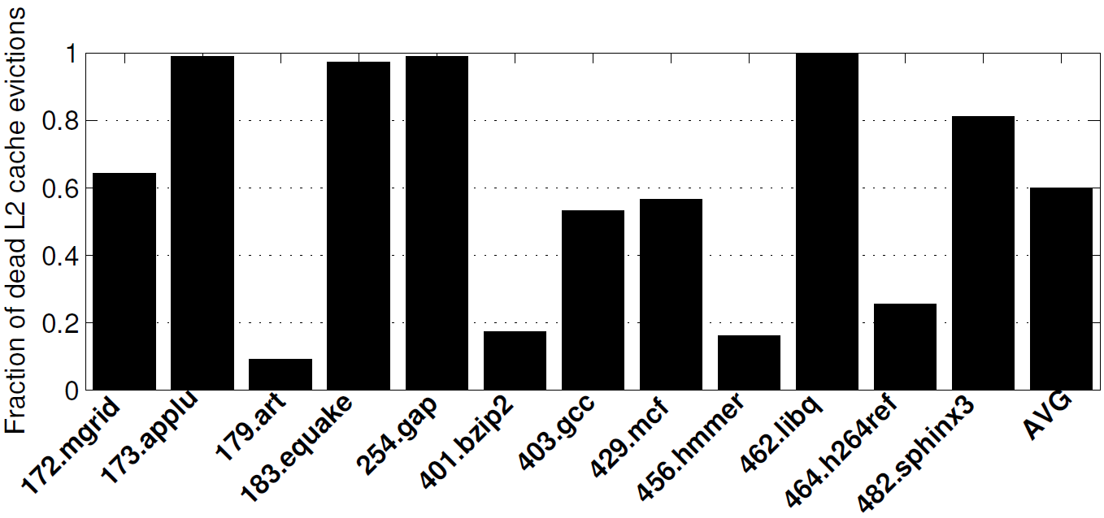
Motivating study: Dead population
Fraction of L2 cache evictions that are not recalled from the LLC
A large fraction of L2 cache evictions is dead
Separating live evictions from dead ones can bridge two-third of the gap between OPT and SRRIP
How to identify the dead L2 cache evictions?
60%

Slide 12
Sketch
Talk in one slide
Result highlights
Overview of CHAR
Motivating study: Oracle analysis
Design of CHAR algorithms
Exploiting inner-level reuse patterns
Selective dead hints
Incorporating program counters
Applying to exclusive LLC design
Simulation results
Summary

Slide 13
Design of CHAR algorithms
Learning from L2 cache access patterns
Goal is to estimate the next-use distance of a block when it is evicted from the L2 cache
Blocks that enjoy hits in LLC are likely to have reuse distances within LLC reach
Class C₄ blocks, predominantly live
How to identify such a block when it is evicted from the L2 cache for the first time?
Assign separate classes to first time L2 cache evictions with different reuse patterns
Hope is that some of these classes would become the primary source of C₄ blocks while the rest won’t
Dynamically one must detect these source classes and generate dead hints for blocks of other classes

Slide 14
Design of CHAR algorithms
Learning from L2 cache access patterns
Class C₃: At least one demand hit during L2 cache residency
Class C₂: No demand hit in L2 cache, evicted in dirty state
Class C₁: No demand hit in L2 cache, evicted in clean state
Class C₀: No demand hit in L2 cache to a prefetched block; wrong or premature prefetches
The blocks from which of these classes will get promoted to C₄ may vary dynamically
Once a block moves to C₄ (through its first LLC hit), it remains in C₄
Requires two extra bits per L2 cache block

Slide 15
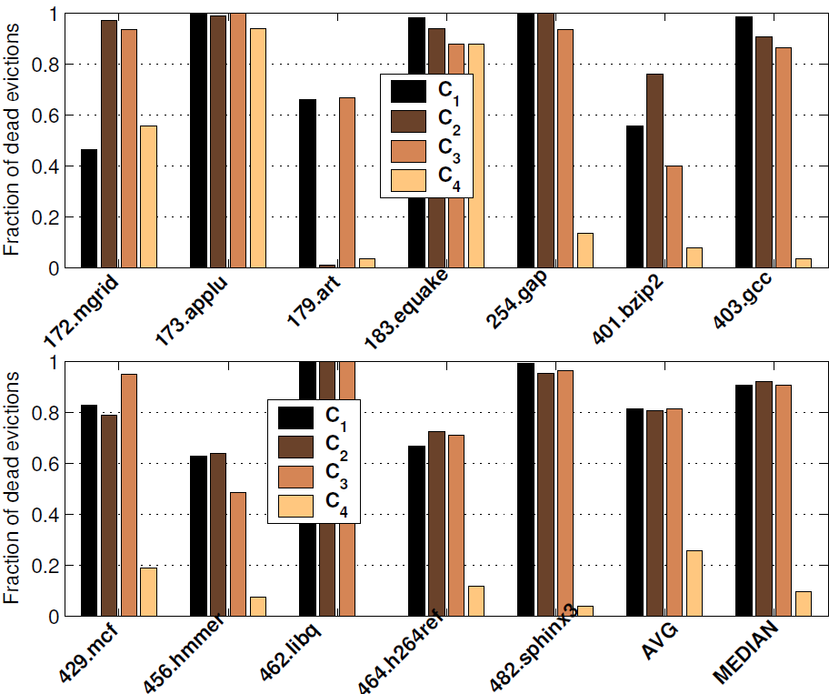
Design of CHAR algorithms
Learning from L2 cache access patterns
Distribution of dead fractions across the classes
C₄ blocks are predominantly live
Dead fractions in other classes vary across applications
Only 10%
dead in C₄

Slide 16
Sketch
Talk in one slide
Result highlights
Overview of CHAR
Motivating study: Oracle analysis
Design of CHAR algorithms
Exploiting inner-level reuse patterns
Selective dead hints
Incorporating program counters
Applying to exclusive LLC design
Simulation results
Summary

Slide 17
Design of CHAR algorithms
Generating selective dead hints
How to identify the good classes i.e., those that primarily source C₄ blocks?
Approximate the probability of reuse of a class by estimating the average LLC hit rate of blocks belonging to that class
When a block belonging to class C_{k} is filled into the L2 cache originating from an LLC hit, the live counter L_{k} of that class is incremented
When a block belonging to class C_{k} is evicted from the L2 cache, the eviction counter E_{k} is incremented
L_{k}/E_{k} is an estimate of reuse probability of class C_{k}

Slide 18
Design of CHAR algorithms
Generating selective dead hints
Learn L_{k} and E_{k} only from a few LLC sample sets
16 per 1024 LLC sets
Increment L_{k} only if the block being filled into the L2 cache maps to one of the LLC sample sets
Increment E_{k} only if the block being evicted from the L2 cache maps to one of the LLC sample sets
The LLC sample sets always execute baseline SRRIP replacement algorithm
Halve L_{k} and E_{k} in regular intervals to estimate an exponential average of these counts
The L_{k} and E_{k} counters reside in the L2 cache controller of each core

Slide 19
Design of CHAR algorithms
Generating selective dead hints
When an L2 cache block mapping to an LLC sample set is evicted, its class id is sent to the LLC for future use (e.g., on a future LLC hit, the class id will be used to increment L_{k})
When an L2 cache block not mapping to an LLC sample set is evicted, its class id k is used to estimate its reuse probability L_{k}/E_{k}
If the reuse probability is below a threshold t, the block is deemed dead and a dead hint is sent to the LLC
The LLC on receiving the dead hint, makes the block a victim candidate

Slide 20
Design of CHAR algorithms
Generating selective dead hints
On L2 cache eviction of a C₄ block, a dead hint is never generated
C₄ blocks are assumed to be live
No need to maintain L₄ counter
What is a good reuse probability threshold t?
Static: easy to implement, a small conservative value (e.g., 1/8 or 1/16) usually works well
Dynamic: we propose to use the hit rate of LLC sample sets as a dynamically adapting threshold
Classes with hit rate below baseline are deemed dead
Tuning suggestions discussed in paper
Implementation of dynamic threshold
E₄ over the number of L2 cache evictions mapping to LLC sample sets is a good estimate of sample hit rate

Slide 21
Design of CHAR algorithms
Implementation details (more in paper)
Counter halving interval: 128 L2 cache evictions mapping to LLC sample sets
Counter size: 8 bits
Two bits per L2 cache block for class encoding
Three bits per block mapping to LLC sample sets to store class id
Overall storage overhead less than 0.3% of bits devoted to cache capacity
Approximate dynamic threshold to make it a power of two
Avoids costly multiplications and divisions
Monitor dead hint rate based on volume of CHAR hits in comparison with baseline LLC sample hits

Slide 22
Sketch
Talk in one slide
Result highlights
Overview of CHAR
Motivating study: Oracle analysis
Design of CHAR algorithms
Exploiting inner-level reuse patterns
Selective dead hints
Incorporating program counters
Applying to exclusive LLC design
Simulation results
Summary

Slide 23
Design of CHAR algorithms
Incorporating program counters
Program counters of load/store instructions have been found to be strongly correlated with the death of cache blocks they touch
We show that our cache block classification captures code space signature quite accurately
The load/store program counters that fill blocks of a class C_{k} into the L2 cache have very small intersection with those of another class C_{k’}
The fill program counters of C₂ and C₃ usually have higher intersection meaning that program counter alone cannot separate these classes
Our reuse-based classification goes beyond program counters to separate single-use dirty blocks (C₂) from multi-use blocks (C₃)

Slide 24
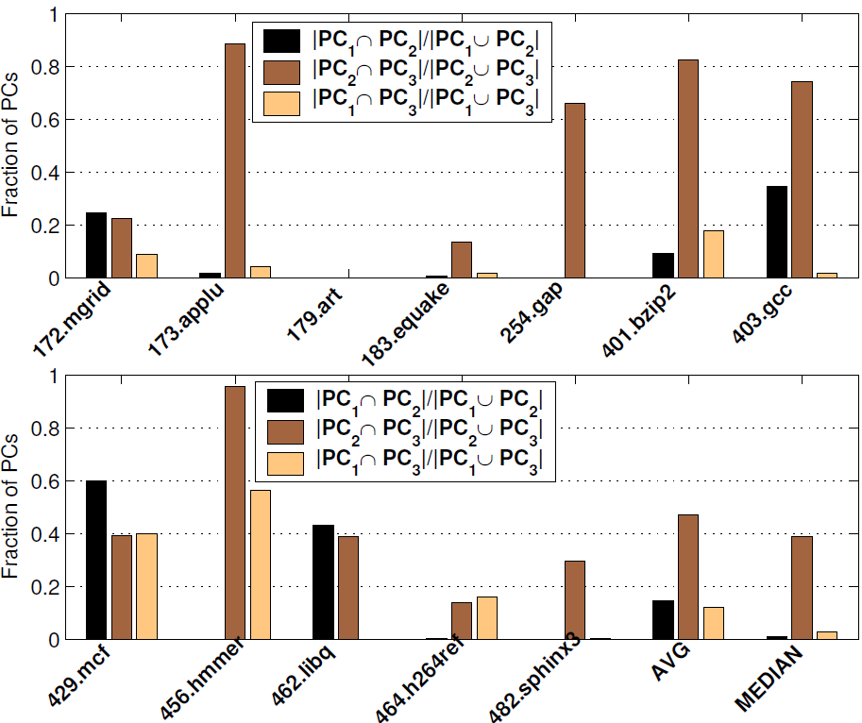
Design of CHAR algorithms
Incorporating program counters
Code space
signature fails
to separate
C₂ and C₃
(C₁, C₂) and
(C₁, C₃) have
small code space
intersection

Slide 25
Design of CHAR algorithms
Incorporating program counters
CHAR summarizes the cache behavior of a class of blocks by a single reuse probability
It is possible to further subclassify the blocks in a class by their fill program counter
A SHiP-PC predictor [MICRO 2011] within each class
We will refer to this policy as CHAR-PC
Maintains an 8-entry fill PC table for each class
Each entry stores a PC and a 3-bit saturating counter
Estimates the reuse count of the blocks filled into the L2 cache by each PC
Infers death of a block if the PC that brought the block has its saturating counter value zero

Slide 26
Sketch
Talk in one slide
Result highlights
Overview of CHAR
Motivating study: Oracle analysis
Design of CHAR algorithms
Exploiting inner-level reuse patterns
Selective dead hints
Incorporating program counters
Applying to exclusive LLC design
Simulation results
Summary

Slide 27
Design of CHAR algorithms
Primer on exclusive LLC
A block is filled into an exclusive LLC when it is evicted from the L2 cache
Referred to as a data write transaction from the L2 cache
Every L2 cache eviction results in one data write transaction in the L2-LLC interconnect
On an LLC hit, the block is de-allocated from the LLC
On an LLC miss, the requested block is filled into the L2 cache from memory
Observation: not all L2 cache evictions need to be filled into LLC
Only the live evictions should be allocated in LLC

Slide 28
Design of CHAR algorithms
Application of CHAR to exclusive LLC
All live blocks evicted from the L2 cache are filled into LLC
A dead block evicted from the L2 cache is filled into LLC if there is space in the target LLC set
Sends dirty dead blocks that are not allocated in the LLC to memory controller
Bypasses the remaining dead blocks
Reduces data write traffic originating from the L2 cache
The bypassed blocks never make it to the interconnect and are dropped by the L2 cache controller
Improves effective capacity allocation in LLC

Slide 29
Design of CHAR algorithms
Application of CHAR to exclusive LLC
Since C₄ blocks are live, such blocks can make a large number of trips between LLC and L2 cache
Allocate in LLC on L2 cache eviction, de-allocate on hit, allocate again on L2 cache eviction, …
Save interconnect traffic further by caching the C₄ blocks in non-inclusive/non-exclusive mode
Fine-grain flexible exclusion
Do not de-allocate a block from LLC on hit because these are the C₄ blocks; since they are live, they will have to be allocated again in future
This policy will be referred to as CHAR-C4
Among the live L2 cache evictions, only sends non-C₄ live evictions and C₄ dirty evictions to LLC
More variants of CHAR-C4 are discussed in the paper

Slide 30
Sketch
Talk in one slide
Result highlights
Overview of CHAR
Motivating study: Oracle analysis
Design of CHAR algorithms
Exploiting inner-level reuse patterns
Selective dead hints
Incorporating program counters
Applying to exclusive LLC design
Simulation results
Summary

Slide 31
Simulation environment
MIPS ISA-based execution-driven simulator
A dozen single-threaded applications chosen from SPEC 2000 and SPEC 2006
One billion dynamic instruction samples
iL1, dL1 = 32 KB 8-way, L2 = 256 KB 8-way, LLC = 2 MB 16-way (SRRIP BL)
Hundred 4-way multi-programmed workloads
Private iL1, dL1 = 32 KB 8-way, private L2 = 256 KB 8-way, shared LLC = 8 MB 16-way (SRRIP BL)
Six 8-way shared memory parallel apps
Private iL1, dL1 = 32 KB 8-way, private L2 = 128 KB 8-way, shared LLC = 8 MB 16-way (SRRIP BL)

Slide 32
Algorithm evaluation
Application of CHAR to LLC victim selection
Evaluated for inclusive LLC (SRRIP baseline)
Compared against DRRIP (2010), SDBP (2010), SHiP-PC (2011), ECI (2010), QBS (2010), PACMan (2011)
Application of CHAR to LLC bypass
Evaluated for exclusive LLC
Bypass not allowed in inclusive LLC
Exclusive LLC already offers a competitive baseline with fill-path bypass enabled
CHAR enables bypass on L2 cache eviction path
We compare CHAR and CHAR-C4 against inclusive SRRIP, non-inclusive SRRIP, and exclusive TC-AGE (2011)

Slide 33
Single-thread IPC results
Needs PC information
DRRIP [2010]
2.7%
SDBP [2010]
3.5%
SHiP-PC [2011]
3.8%
CHAR
3.8%
CHAR-PC
4.4%
1.0%
1.5%
2.0%
2.5%
3.0%
3.5%
4.0%
4.5%
Improvement relative to SRRIP (inclusive LLC)
CHAR and CHAR-PC save 10.9% and 12.4% baseline LLC misses

Slide 34
Single-thread L2-LLC traffic
39% of all L2 cache evictions
69% of all L2 cache evictions
SRRIP
CHAR
10% saving
0.3
0.4
0.5
0.6
0.7
0.8
0.9
1.0
Volume of L2-LLC interconnect transactions
L2 cache misses and fills
L2 cache evictions
Back invalidations and acknowledgments
If E state evictions are sent to LLC always, no gain/loss in traffic

Slide 35
Multi-programmed non-prefetched
TADRRIP
3.1%
ECI
0.5%
QBS
0.2%
SDBP
3.8%
SHiP-PC
3.8%
CHAR
3.9%
0%
0.5%
1.0%
1.5%
2.0%
2.5%
3.0%
3.5%
4.0%
Average throughput improvement over SRRIP (inclusive LLC)
CHAR saves 6.8% baseline LLC misses
CHAR obviates the need to convey PC information down to LLC

Slide 36
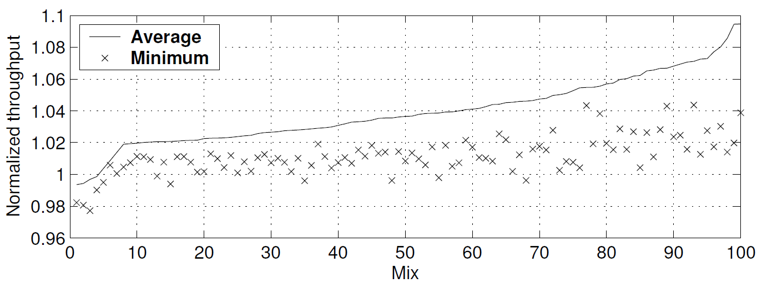
Multi-programmed non-prefetched
Throughput profile of CHAR relative to SRRIP
varies from a loss of 1.0% to a gain of 9.5%

Slide 37
Multi-programmed prefetched
CHAR improves throughput by 5.3% compared to prefetched SRRIP
CHAR saves 15% demand misses from LLC
CHAR injects 8.8% less DRAM requests
PACMan-DYN-Global is a prefetch-aware age management policy proposed in MICRO 2011
Shown to outperform TADRRIP and SDBP in presence of prefetching
PACMan-DYN-Global improves throughput by 2.8%, saves 11.5% LLC demand misses, induces 4.8% more DRAM requests
Additional memory congestion hurts performance

Slide 38
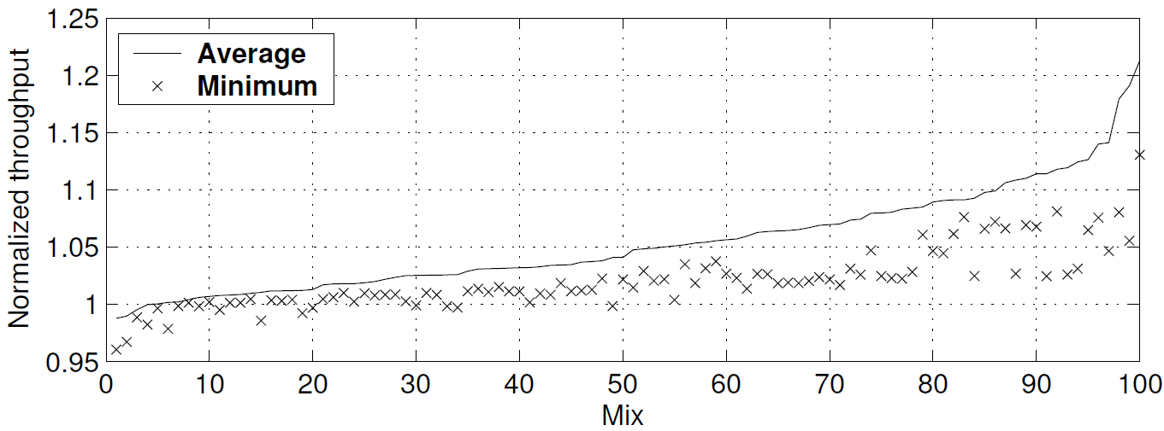
Multi-programmed prefetched
Throughput profile of CHAR relative to SRRIP
varies from a loss of 1.2% to a gain of 21.3%

Slide 39
Static vs. dynamic threshold
Recall that a class of blocks is deemed dead if the reuse probability of the class falls below a threshold
Throughput comparison of static thresholds with our dynamic threshold policy for the multi-programmed workloads with prefetcher enabled
Dynamic
Within a percent
of static best
Static t=1/2
Static t=1/4
Static t=1/8
Static t=1/16
Static t=1/32
4.9%
5.1%
5.3%
5.5%
5.7%
5.9%
6.1%
6.3%

Slide 40
Parallel apps non-prefetched
DRRIP
1.8%
SDBP
0.4%
SHiP-PC
2.1%
CHAR
4.2%
0%
1%
2%
3%
4%
5%
Reduction in execution cycles relative to SRRIP (inclusive LLC)
CHAR saves 11.1% baseline LLC misses

Slide 41
Parallel apps prefetched
CHAR saves 2.2% parallel execution time relative to prefetched SRRIP
PACMan-DYN saves 1.1% parallel execution time relative to prefetched SRRIP
The parallel kernel and apps used from SPEC OMP, SPLASH, and FFTW are usually easy to prefetch

Slide 42
Exclusive LLC results (prefetched)
Average throughput improvement of hundred multi-programmed workloads
NI SRRIP
1.5%
Ex. TC-AGE
4.9%
Ex. CHAR
7.6%
Ex. CHAR-C4
8.2%
0%
2%
4%
6%
8%
10%
Average throughput improvement relative to inclusive SRRIP
CHAR and CHAR-C4 bypass 14.8% and 66.6% L2 cache evictions

Slide 43
Exclusive LLC results (prefetched)
L2 cache to interconnect traffic relative to inclusive SRRIP
TC-AGE: 3.64x
CHAR: 3.15x
CHAR-C4: 1.17x
Dynamically switching the caching mode of C₄ blocks from strict exclusive to non-inclusive/non-exclusive saves a significant amount of L2-LLC transactions
Opens up opportunities to save interconnect bandwidth and, more importantly, power
Only 17% more L2 to interconnect traffic with 8.2% better performance than inclusive LLC

Slide 44
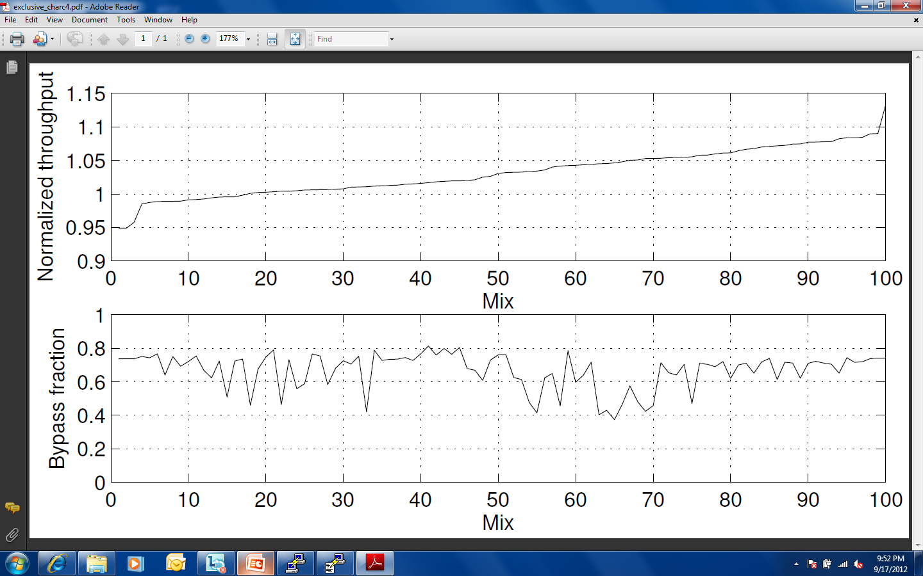
Exclusive LLC results (prefetched)
Average throughput relative to TC-AGE and bypass fraction of individual mixes in CHAR-C4
Throughput relative to TC-AGE
Fraction of L2 cache evictions bypassed
Relative throughput profile varies from a loss of 5.1% to a
gain of 13.3%, while bypass rate ranges from 37% to 81%

Slide 45
Exclusive LLC results: Summary
End-result is a hybrid non-inclusive non-exclusive LLC
Bypasses LLC on fill path from DRAM
Like traditional exclusive LLCs
Generates small amount of extra traffic in the interconnect on L2 cache evictions compared to a fully inclusive hierarchy
Saves large amount of traffic compared to traditional exclusive LLCs
Slightly more traffic than traditional inclusive and non-inclusive LLCs
Improves performance significantly over traditional inclusive, non-inclusive, and exclusive LLCs

Slide 46
Sketch
Talk in one slide
Result highlights
Overview of CHAR
Motivating study: Oracle analysis
Design of CHAR algorithms
Exploiting inner-level reuse patterns
Selective dead hints
Incorporating program counters
Applying to exclusive LLC design
Simulation results
Summary

Slide 47
Summary
Hierarchy-aware replacement and bypass
Categorizes L2 cache blocks into five reuse pattern classes and estimates the reuse probability of each class
If the reuse probability of a class falls below a dynamic threshold, the blocks of that class are prioritized for victimization in inclusive L3 cache and considered for bypass in exclusive L3 cache
Our reuse pattern-based classification accurately captures code space signatures
Obviates the need to communicate PC information to the LLC

Slide 48
Future directions
Where do we stand in comparison to the oracles?
SRRIP
CHAR
0.89
SRRIP-Oracle
0.83
OPT
0.72
0.65
0.70
0.75
0.80
0.85
0.90
0.95
1.00
LLC miss count relative to SRRIP for single-threaded apps
Where do we lose?

Slide 49
Future directions
Compare the hit count experienced by each class of cache blocks
Number of C₄ hits in CHAR is almost equal to that in SRRIP-Oracle
CHAR loses in C₁, C₂, and C₃
Need better characterization of these three classes
Policy | C₁ | C₂ | C₃ | C₄ | Ins | Total
CHAR | 0.11 | 0.08 | 0.04 | 0.76 | 0.01 | 1.00
SRRIP | 0.09 | 0.05 | 0.01 | 0.52 | 0.01 | 0.68
SRRIP-Or | 0.26 | 0.13 | 0.21 | 0.78 | 0.04 | 1.42
OPT | 0.34 | 0.17 | 0.14 | 0.85 | 0.02 | 1.52

Slide 50
Nothing clears up a case so much as stating it to another person.
-Sir Arthur Conan Doyle
[Silver Blaze (1892)]
Thank you

