Slide 1
Pseudo-LIFO:
A New Family of Replacement Policies for Last-level Caches
Mainak Chaudhuri
Indian Institute of Technology, Kanpur

Slide 2
Agenda
Prolog
Configurations and Workloads
Fill Stack Order
Observations
Key Insight and Pseudo-LIFO
Three Pseudo-LIFO Members
  Dead Block Prediction LIFO
  Probabilistic Escape LIFO
  Probabilistic Escape LIFO Lite
Empirical Studies
Concluding Remarks

Slide 3
Prolog: Meeting Belady in the LLC
Caches are usually designed to satisfy near-term uses
  Basis for the popular LRU and its derivatives
  Loosely follows from Belady’s work (1966)
  Unfortunately, as the caches get bigger and highly associative, the deviation from Belady’s world is too high
    Because all the near-term uses are captured well and now a good policy must look far into the future for selecting a replacement candidate if it has any hope of meeting Belady

Slide 4
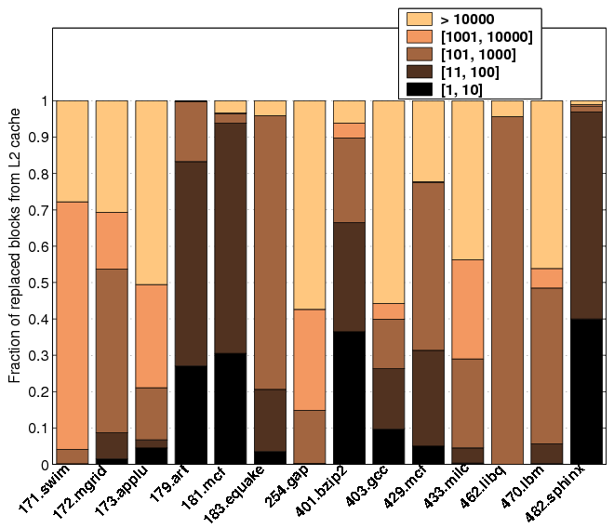
Prolog: Meeting Belady in the LLC

Slide 5
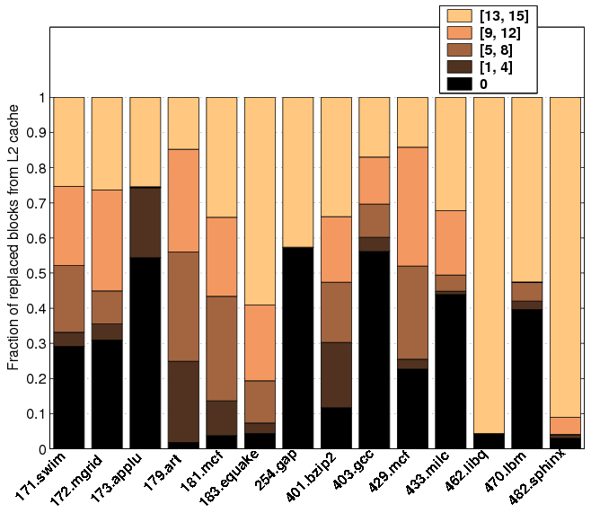
Prolog: Meeting Belady in the LLC

Slide 6
Prolog: Meeting Belady in the LLC
Looking too far into the future is a difficult ballgame, if not impossible
  A feasible strategy would be to dynamically configure a significant portion of the LLC to serve as a “folded victim buffer” so that a subset of the far-flung reuses is satisfied
  In other words, replace a subset of blocks from LLC that have already seen all near-term uses to make room for the new blocks
    Makes you at least as good as LRU
  Don’t touch the other subset; let them sit in the LLC and feed a subset of far-flung uses
    A reasonable heuristic for getting closer to Belady

Slide 7
Agenda
Prolog
Configurations and Workloads
Fill Stack Order
Observations
Key Insight and Pseudo-LIFO
Three Pseudo-LIFO Members
  Dead Block Prediction LIFO
  Probabilistic Escape LIFO
  Probabilistic Escape LIFO Lite
Empirical Studies
Concluding Remarks

Slide 8
Configurations
All configurations use a two-level inclusive cache hierarchy
LLC is composed of 1 MB 16-way set associative banks in all configurations with a (9+4)-cycle tag+data pipe
All configurations use 4 GHz OoO-issue 4-4/2/3-8 cores with two-level branch predictors and 32 KB 4-way L1 caches
All caches exercise true LRU as the baseline replacement policy

Slide 9
Configurations
Single-core configuration
  2 MB LLC (i.e., two banks)
  Useful for deriving insights into isolated performance of benchmark applications
  Not useful for production runs

Slide 10
Configurations
Multi-core configurations
  Two configurations considered to address the disparity in cache demand of multiprogrammed and multi-threaded workloads
  4-core with shared 8 MB LLC (i.e., 8 banks) used to evaluate 4-way multiprogrammed workloads
  8-core with shared 4 MB LLC (i.e., 4 banks) used to evaluate 8-way multi-threaded workloads

Slide 11
Configurations
Multi-core configurations
  LLC banks, the cores, and four memory controllers sit on a bidirectional ring (actually, composition of three bidirectional rings: 9-bit command, 40-bit address, 256-bit data)
  Four virtual queues are multiplexed on each physical ring to avoid coherence deadlocks
    Request, invalidation/intervention, response, completion
  Home LLC bank for an address is decided by the lower few bits of the global set index

Slide 12
Configurations
Multi-core configurations
  Latency vs. B2R BW trade-off: two LLC banks share a ring switch
  Coherence is maintained by keeping a bitvector and states with each LLC tag
    MESI protocol is simulated

Slide 13
Configurations
Little bit about memory controllers
  Each runs at 2 GHz and talks to a single-channel 4-way banked DDR2-800 x4 chips
    16 data chips and 2 ECC chips in a DIMM card (single rank)
  (MC, B#) is computed by XORing the lower four bits of LLC tag with PA[16:13]
    Still not enough for streaming workloads

Slide 14
Configurations
Will discuss three sets of results for each configuration
  Start with a generic cache hierarchy with unequal block sizes at different levels (128B LLC and 32B L1), assume a flat 80 ns DRAM latency plus 20 ns channel transfer
  Consider a DDR2-800 DRAM with 6-6-6 latency; fix the bank computation-related performance problem for streaming workloads
  Specialize the cache hierarchy to have a uniform 64B block size

Slide 15
Workloads
Single-threaded
  Subset of SPEC2000 and SPEC2006 with at least one MPKI in LLC
  Runs a representative one billion dynamic instruction set (cache warmup unnecessary)
Multiprogrammed
  Mixes of SPEC benchmarks
  Workload completes after each member has committed at least one billion instructions
Multi-threaded
  Drawn from SPLASH-2 and SPEC OMP
  Runs to completion

Slide 16
Agenda
Prolog
Configurations and Workloads
Fill Stack Order
Observations
Key Insight and Pseudo-LIFO
Three Pseudo-LIFO Members
  Dead Block Prediction LIFO
  Probabilistic Escape LIFO
  Probabilistic Escape LIFO Lite
Empirical Studies
Concluding Remarks

Slide 17
Fill Stack Order
Replacement policies view the blocks within a set in a certain suitable order
  Access recency stack in LRU
Introduce a new order i.e., the fill order stack of the blocks in a set
  A new priority order based on age of a block in a set (simple, but never considered!)
  The most recently filled block is at position zero and the least recently one is at position A-1
    Independent of replacement policy (contrast with FIFO)

Slide 18
Fill Stack Order
Fill
Fill stack (0 to A-1)
WAYS
Evict and re-adjust
(no tag/data movement)
Re-adjust only on LLC fills (contrast with LRU) ☺

Slide 19
Fill Stack Order
Fill positions of the ways in a set are maintained in a randomly accessible CAM
  Index with way and CAM with fill position
  Each CAM cell implements a less than operator and each CAM row has a short incrementer of log A bits
  Shared incrementer? Latency-area trade-off

Slide 20
Fill Stack Order
Assume each LLC bank to be single-ported
  Only one fill stack adjustment pipe needs to be integrated with the LLC fill flow
  Requires A short incrementers (each log A bits in size) per LLC bank
  The eviction way comes out of the replacement logic along with its fill position
  The fill position is sent to the CAM and all positions less than this position are incremented by one
  Largely off the critical path

Slide 21
Agenda
Prolog
Configurations and Workloads
Fill Stack Order
Observations
Key Insight and Pseudo-LIFO
Three Pseudo-LIFO Members
  Dead block Prediction LIFO
  Probabilistic Escape LIFO
  Probabilistic Escape LIFO Lite
Empirical Studies
Concluding Remarks

Slide 22
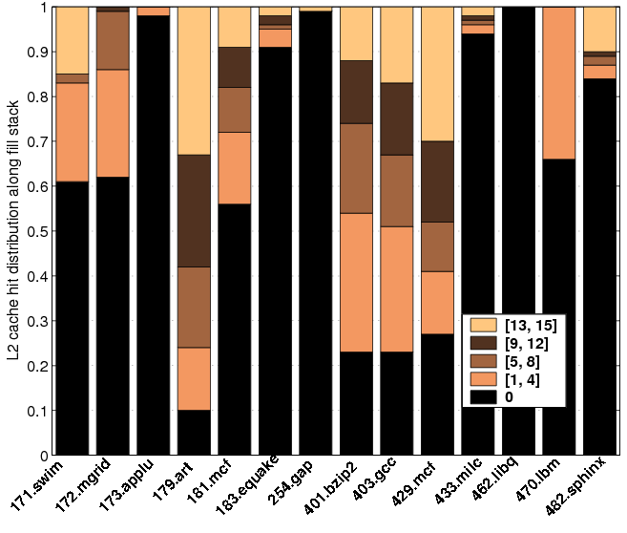
Observations
Fill stack position could serve as a good indicator of near-term death

Slide 23
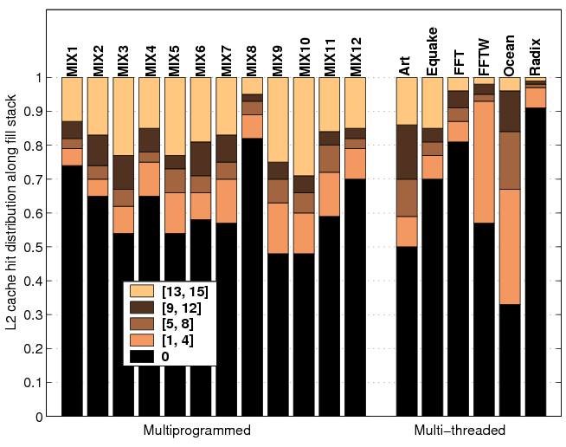
Observations
Fill stack position could serve as a good indicator of near-term death

Slide 24
Observations
Couple of already known facts
  There are cache blocks that appear a large number of times in the LLC miss stream i.e., working sets are revisited
  Repeat interval of these blocks in miss stream is very large e.g., median number of misses between the eviction and the next use of a block is often more than ten thousand
  Traditional victim caching won’t help

Slide 25
Agenda
Prolog
Configurations and Workloads
Fill Stack Order
Observations
Key Insight and Pseudo-LIFO
Three Pseudo-LIFO Members
  Dead Block Prediction LIFO
  Probabilistic Escape LIFO
  Probabilistic Escape LIFO Lite
Empirical Studies
Concluding Remarks

Slide 26
Key Insight and Pseudo-LIFO
Would like to retain a subset of the repeating working sets
Exploit the LLC hit distribution’s bias on fill stack to dynamically partition each set into two logical parts
  Use one part to bring new blocks and satisfy near-term uses; this is the upper part of the fill stack
  Use the other part (lower part) to retain a subset of the blocks that were brought in (more like a “self-adjusting folded” victim buffer)

Slide 27
Key Insight and Pseudo-LIFO
Fill
Fill stack (0 to A-1)
HOT WAYS
COLD WAYS
Replacement zone
Retention zone
Key challenge: dynamically learning such a partition

Slide 28
Key Insight and Pseudo-LIFO
Pseudo-LIFO replacement family
  Attach higher priority to blocks residing closer to top of fill stack in replacement decisions
  Different members of the family can use different types of criteria and algorithms to further refine this ranking so that premature evictions from upper stack are minimized and capacity retention in lower stack is maximized

Slide 29
Why Pseudo-LIFO may Work
Where are the optimal victims located within a cache set?
  Execute LRU replacement and at each replacement find out the position of the Belady’s MIN victim in fill order
  Percentage of optimal victims within top five positions, [0, 4], of fill order (16-way sets): 80% in ST, 54% in MP, 54% in MT
  More recently filled blocks are likely to be the best candidates for victimization
  Chance or can be generalized?

Slide 30
Why Pseudo-LIFO may Work
The presence of a dense population of optimal victims in the upper parts of the fill order is not an accident
  Two types of reuses for each data point: near-term and far-flung
  A cache block dies soon after it is filled and is touched again after a very long time. The trend is prevalent in programs operating on very large data sets in nested loops
  LFD candidate will necessarily be among the last few filled blocks. It will be the youngest block in the set that has already seen all its near-term uses. Hints at a pseudo-LIFO policy.

Slide 31
Why Pseudo-LIFO may Work
Upper few slots of fill order are enough to satisfy all near-term uses
  Percentage of last-level cache hits within the top five, [0, 4], fill order positions: 78% in ST, 71% in MP, 80% in MT
  Majority of the cache blocks are done with near-term uses while walking the top few positions of the fill order

Slide 32
Agenda
Prolog
Configurations and Workloads
Fill Stack Order
Observations
Key Insight and Pseudo-LIFO
Three Pseudo-LIFO Members
  Dead Block Prediction LIFO
  Probabilistic Escape LIFO
  Probabilistic Escape LIFO Lite
Empirical Studies
Concluding Remarks

Slide 33
Dead Block Prediction LIFO
A block is about to leave the replacement zone when its near-term uses complete
  Existing dead block predictors (DBPs) are good at computing this time instant
  One recent flavor of DBP-assisted replacement victimizes the dead block closest to the LRU position [MICRO’08]; this decision disregards the far-flung uses
Dead block prediction LIFO (dbpLIFO) victimizes the dead block closest to the fill stack top

Slide 34
Probabilistic Escape LIFO
DBPs are often good, but …
  Storage-heavy
  Disregards far-flung uses
  As the caches get bigger, they often degenerate to LRU
Primary goal of peLIFO
  Identify just enough dead blocks in a set and use these frames to bring in new blocks
  Preserve the blocks in the remaining frames so that they can enjoy a subset of far-flung uses also

Slide 35
Probabilistic Escape LIFO
Can we “estimate” near-term death without resorting to storage-heavy DBPs?
Conjecture: there exists small k such that a block is not used in the near-term once it crosses fill stack position k
  Different blocks would have different values of k; even different sets would have different values of k
  Is it possible to learn the average or the expected behavior with little book-keeping?

Slide 36
Probabilistic Escape LIFO
Compute the probability that a block experiences hits beyond fill stack position k
  Escape probability P_{e}(k)
  Estimated over an “epoch” for a pair of LLC banks (switch-grain); an epoch is defined in terms of the number fills into the bank-pair (a power of two, say, 2^{N})
  Estimated as the ratio of the number of blocks that experience at least one hit beyond fill stack position k to the number of blocks filled into a bank-pair in an epoch

Slide 37
Probabilistic Escape LIFO
P_{e}(k) = H(k)/2^{N}
  Easy to compute if H(k) is a power of two; if not, over-estimate it by rounding up to the next power of two; denote the over-estimate by P_{e}*(k)
  Generate log₂(1/P_{e}*(k)) and store the values in an array, say, epCounter[0:A-1], one for each LLC bank-pair
  epCounter[k] plotted against k shows prominent knees, signifying major drops in the number of blocks that experience hits

Slide 38
Probabilistic Escape LIFO
N=16
epCounter[k]
(one sample epoch of 429.mcf)
escape points
(potential replacement points)
1/32
5
1/16
4
1/8
3
1/4
2
1/2
1
k
0
2
9
13
15
epCounter clusters

Slide 39
Probabilistic Escape LIFO
Escape points are fill stack positions that are potential replacement points
Three escape points from the top of the fill stack are enough for capturing the dynamics in the replacement zone
Define policy P_{i} tied to the i^{th} escape point ep_{i} as follows (i є {0, 1, 2})
  Victimize the block closest to the top of the fill stack if its current fill stack position is bigger than or equal to ep_{i}, but hasn’t experienced a hit in its current fill stack position

Slide 40
Probabilistic Escape LIFO
Let P₃ be the baseline replacement policy (LRU in this study)
Pick the best among P₀, P₁, P₂, and P₃ via set dueling (details in paper)
What have we achieved?
  A deterministic replacement policy that computes certain probabilities to find out the preferred replacement positions defining the replacement zone dynamically
  If one of P₀, P₁, and P₂ wins the set dueling, we expect a close to LIFO replacement, thereby maximizing retention

Slide 41
Probabilistic Escape LIFO
How to compute H(k) ?
  H(k) is the number of blocks that experience at least one hit beyond fill stack position k
  Suppose a block B experiences a hit at fill stack position s and its last hit was in position p (last hit position is set to zero on fill)
  Increment H[p:s-1] by one

Slide 42
Agenda
Prolog
Configurations and Workloads
Fill Stack Order
Observations
Key Insight and Pseudo-LIFO
Three Pseudo-LIFO Members
  Dead Block Prediction LIFO
  Probabilistic Escape LIFO
  Probabilistic Escape LIFO Lite
Empirical Studies
Concluding Remarks

Slide 43
Probabilistic Escape LIFO Lite
The peLIFO policy requires that each block carry its last hit fill position
  log A bit investment per block
The peLIFOLite policy removes this overhead and moves some computation to epoch boundary
  When a block B hits at position k for the first time, simply H[k] is incremented
  At the end of each epoch, compute H[k] = ∑_{i>k} H[i] and then move on to escape probability curve computation

Slide 44
Probabilistic Escape LIFO Lite
The escape points of peLIFO are inherited by peLIFOLite if a particular condition holds
  Define a two-valued function h_{B}(k) for each block B, such that it is one if B experiences at least one hit at fill stack position k and zero otherwise
  h_{B}(k) is either monotonic or bitonic of one particular type (rises and then falls)
  Good news: for almost all blocks, this condition holds
  peLIFOLite can have additional escape points

Slide 45
Agenda
Prolog
Configurations and Workloads
Fill Stack Order
Observations
Key Insight and Pseudo-LIFO
Three Pseudo-LIFO Members
  Dead Block Prediction LIFO
  Probabilistic Escape LIFO
  Probabilistic Escape LIFO Lite
Empirical Studies
Concluding Remarks

Slide 46
Single-threaded Applications
dbpLIFO
LRU
peLIFO
pcounterLIFO
dbpConv [MICRO’08]
DIP [ISCA’07]
VC [ISCA’90]
0.7
0.8
0.9
1.0
Normalized execution cycles
On a more realistic 6-6-6 DDR2-800 DRAM
model with FR-FCFS scheduling, peLIFO saves
7% execution cycles compared to LRU.

Slide 47
Multiprogrammed Workloads
dbpLIFO
LRU
peLIFO
pcounterLIFO
dbpConv [MICRO’08]
UCP [MICRO’06]
TADIP [PACT’08]
ASP [ASPLOS’08]
PIPP [ISCA’09]
VC [ISCA’90]
0.7
0.8
0.9
1.0
1.1
1.2
Normalized average CPI
On a more realistic DRAM model, peLIFO saves
15% of average CPI compared to LRU.

Slide 48
Multi-threaded Workloads
dbpLIFO
LRU
peLIFO
pcounterLIFO
dbpConv [MICRO’08]
UCP [MICRO’06]
TADIP [PACT’08]
ASP [ASPLOS’08]
PIPP [ISCA’09]
VC [ISCA’90]
0.7
0.8
0.9
1.0
Normalized execution time
On a more realistic DRAM model, peLIFO saves
10% of execution cycles compared to LRU.

Slide 49
Interaction with Prefetcher
All results shown so far do not have any prefetcher enabled
  Simplifies understanding
With 16-stream stride prefetchers integrated with core caches
  ST-peLIFO saves 9% execution cycles
  Mprog-peLIFO saves 15% execution cycles
  MT-peLIFO saves 8% execution cycles
peLIFO is observed to improve the effectiveness of prefetching in certain kinds of workloads

Slide 50
peLIFOLite: ST Workloads
Done on a hierarchy with uniform 64B block sizes
LRU
128B baseline
DIP [ISCA’07]
peLIFO
peLIFOLite
0.5
0.6
0.7
0.8
0.9
1.0
Normalized LLC miss count
On average (geo-mean), 92% blocks have desired h function

Slide 51
peLIFOLite: MProg Workloads
Done on a hierarchy with uniform 64B block sizes
LRU
128B baseline
TADIP [PACT’08]
peLIFO
peLIFOLite
0.5
0.6
0.7
0.8
0.9
1.0
Normalized average LLC miss count
On average (geo-mean), 96% blocks have desired h function

Slide 52
peLIFOLite: MT Workloads
Done on a hierarchy with uniform 64B block sizes
LRU
128B baseline
TADIP [PACT’08]
peLIFO
peLIFOLite
0.5
0.6
0.7
0.8
0.9
1.0
Normalized LLC miss count
On average (geo-mean), 94% blocks have desired h function

Slide 53
Additional Storage Overhead
ST MProg MT
Base cache 2 MB 8 MB 4 MB
dbpConv 37 KB 232 KB 172 KB
dbpLIFO 45 KB 264 KB 198 KB
peLIFO 18 KB 72 KB 36 KB
peLIFOLite 10 KB 40 KB 20 KB
pcounterLIFO 26 KB 104 KB 52 KB
peLIFOLite:5 KB space per megabyte of LLC ☺

Slide 54
Agenda
Prolog
Configurations and Workloads
Fill Stack Order
Observations
Key Insight and Pseudo-LIFO
Three Pseudo-LIFO Members
  Dead Block Prediction LIFO
  Probabilistic Escape LIFO
  Probabilistic Escape LIFO Lite
Empirical Studies
Concluding Remarks

Slide 55
Concluding Remarks
Exploits “spare” ways to set up a self-adjusting capacity retention area folded into the LLC
  Satisfies a subset of far-flung reuses while honoring the near-term uses
Salient contributions
  A storage-lite dead block predictor
  A superclass of DIP and TADIP
Next important question
  How to best utilize the folded retention space?

Slide 56
Reality Check
peLIFOLite
LRU
ST
Offline optimal [Belady, 1966]
peLIFOLite
MProg
Offline optimal
peLIFOLite
MT
Offline optimal
0.5
0.6
0.7
0.8
0.9
1.0
Normalized LLC miss count

Slide 57
Pseudo-LIFO:
A New Family of Replacement Policies for Last-level Caches
Thank you
Mainak Chaudhuri
Indian Institute of Technology, Kanpur

