Slide 1
Oral Presentation
August 14, 2024

Slide 2
“Learning how to give a presentation well is a significant life skill” https://www.oxford-royale.com/articles/outstanding-presentation/

Slide 3
Ways to give Outstanding Presentation (Courtesy: Oxford Royale)
Check the technology
Focus on what the audience needs to know
Choose slides that complement what you’re saying
Use the ‘notes’ section if you have to provide slides
Concentrate on the key message
Use the 10/20/30 rule

Slide 4
Ways to give Outstanding Presentation (Courtesy: Oxford Royale)
Tell stories
Use your voice
Don’t try to answer every possible question
Have a strong opening
Use the space
Give your audience something to take home

Slide 5
Example
This is not an article!
Quantum computing is a rapidly-emerging technology that harnesses the laws of quantum mechanics to solve problems too complex for classical computers.
Today, IBM Quantum makes real quantum hardware — a tool scientists only began to imagine three decades ago — available to hundreds of thousands of developers. Our engineers deliver ever-more-powerful superconducting quantum processors at regular intervals, alongside crucial advances in software and quantum-classical orchestration. This work drives toward the quantum computing speed and capacity necessary to change the world.
These machines are very different from the classical computers that have been around for more than half a century. Here's a primer on this transformative technology.
https://www.ibm.com/topics/quantum-computing

Slide 6
Oral Presentation
DO’s
DONT’s
Title (large font)
Outline (good to have)
Content
  Short sentences
  Simple words
  Bullet points
  Animate
Graphics
Self-explanatory tables/figures
Dense slides
Abbreviations
Typos/grammatical errors
Verbosity
Small fonts
Mismatch in fonts
Distracting background
Confusing flow

Slide 7
Examples – Present your view

Slide 8
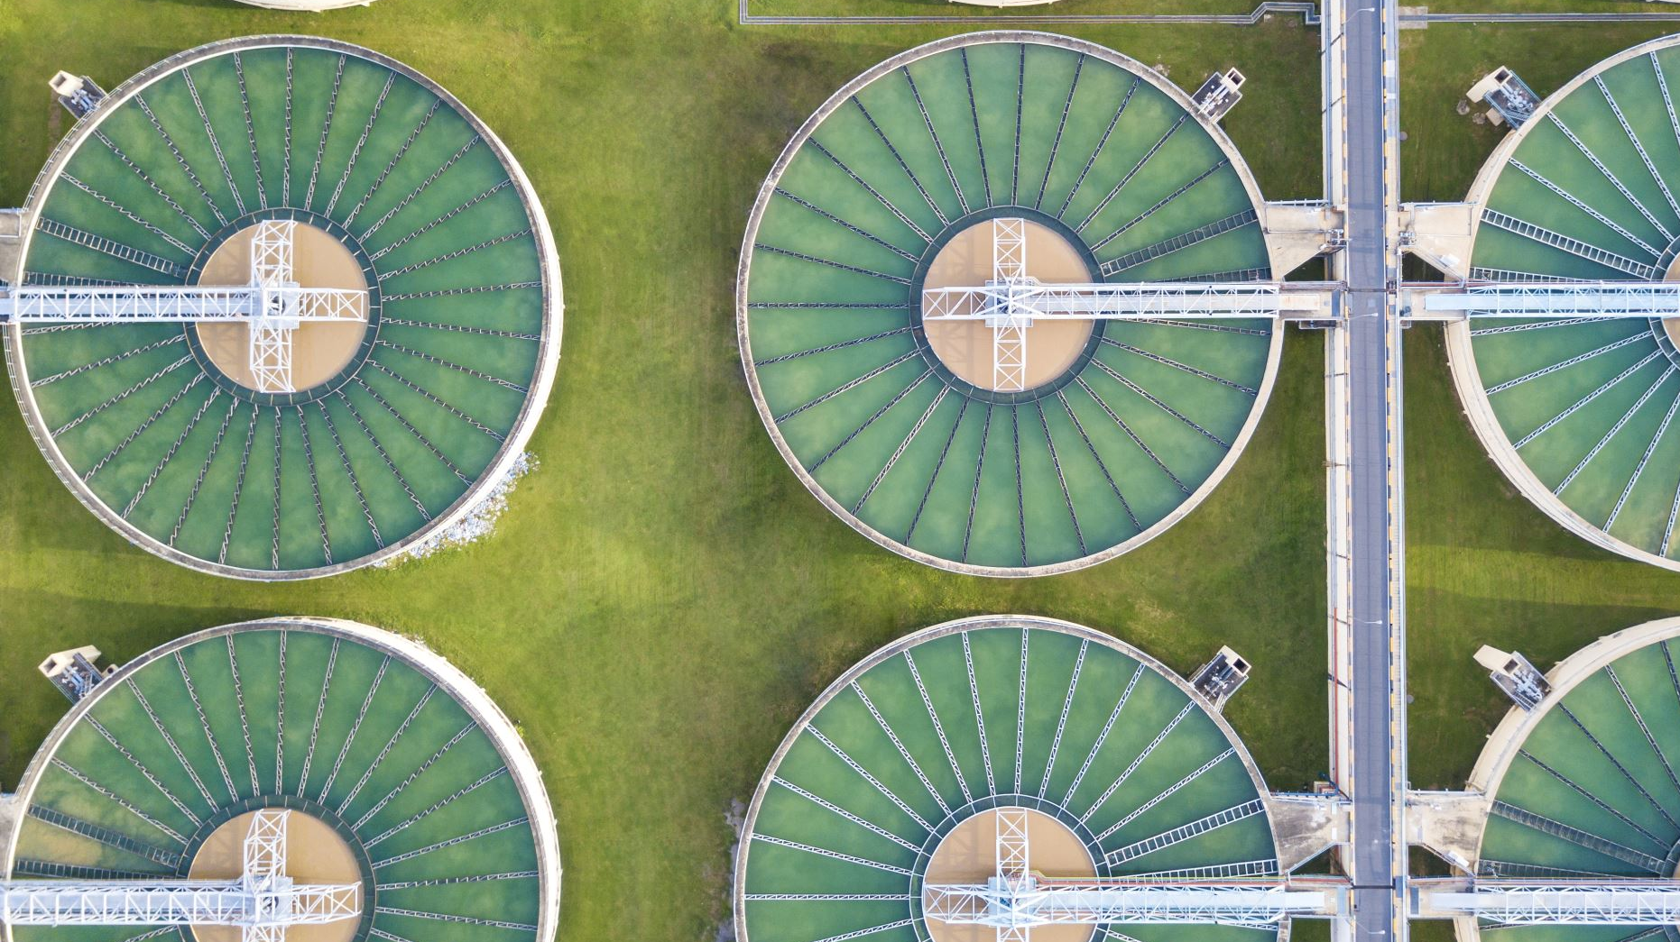
Current Initiatives
Sewage Treatment Plants with a capacity of 1.35 million litres per day
Treated wastewater is used for horticulture and irrigation
Planned Initiatives
Greywater segregation and reuse – segregate greywater and blackwater before treatment to reduce strain on groundwater resources
Expansion of the existing rainwater harvesting infrastructure
Installation of aerators, waterless urinals and other fixtures

Slide 9
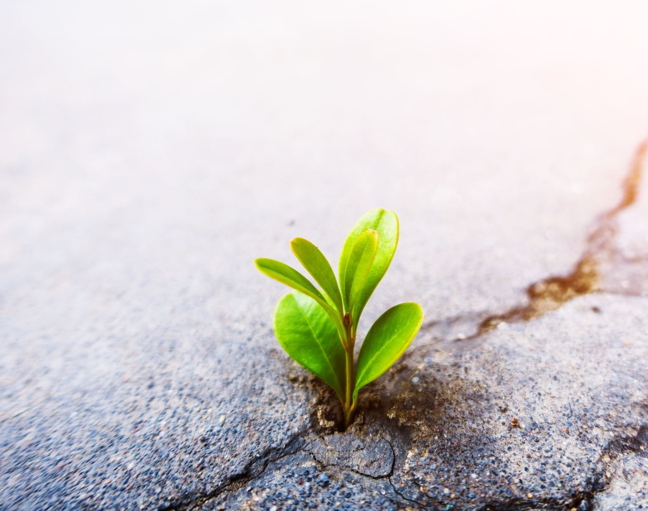
Sustainable development
Sustainable development balances current and future needs, ensuring intergenerational equity.​
It encompasses economic, social, and environmental goals, fostering a harmonious approach.​
Sustainable development promotes inclusive economic growth, enhanced social well-being, and environmental preservation.​
This long-term strategy acknowledges the interdependence of economics, society, and ecology.​
Ultimately, it aims to create a more equitable and sustainable world, vital for our planet's well-being.​
​

Slide 10
DON’Ts
Do not use 50% of the slide for a not-so-relevant picture

Slide 11
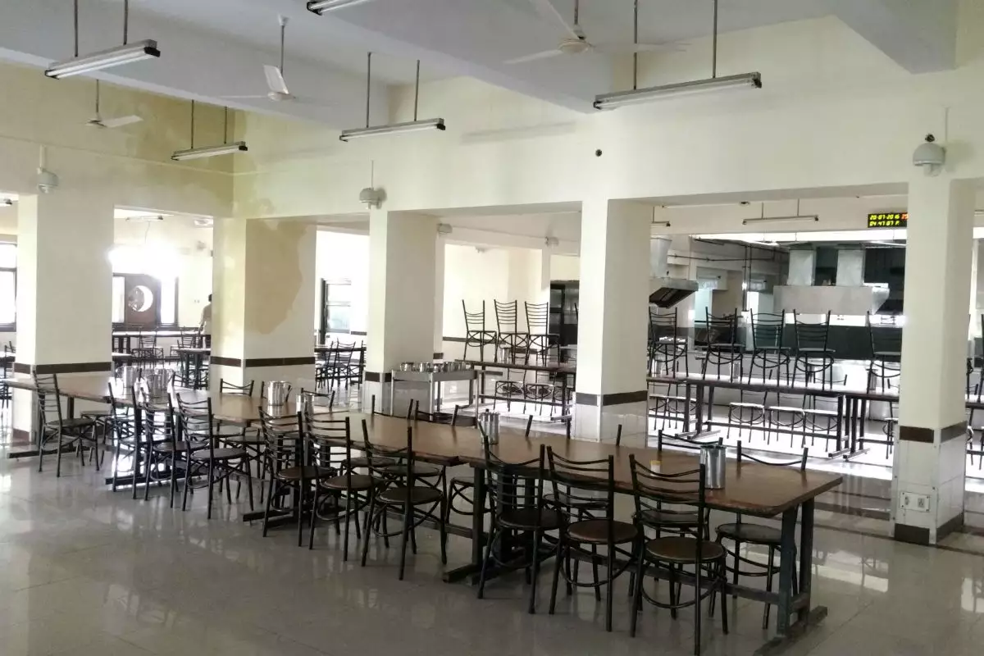
IITK Mess Menu
HEC 23-24
You don’t need a silver fork to eat good food,
you need group 3 as your HEC!

Slide 12
DON’Ts
Do not use 50% of the slide for a not-so-relevant picture
Strong opening

Slide 13
Friday (Rs. 67)
Macaroni/Upma
Egg Curry
Malai Methi Paneer
Chhole Kulche
Special Fruit Custard
Saturday (Rs. 90)
Rice Cakes + Nutella
Chickpeas (gravy)
Fried Rice
Hakka Noodles
Manchurian
Spring Rolls
Chicken Biryani
Malai Kofta

Slide 14
Friday (Rs. 67)
Macaroni/Upma
Egg Curry
Malai Methi Paneer
Chhole Kulche
Special Fruit Custard
Saturday (Rs. 90)
Rice Cakes + Nutella
Chickpeas (gravy)
Fried Rice
Hakka Noodles
Manchurian
Spring Rolls
Chicken Biryani
Malai Kofta

Slide 15
DON’Ts
Do not use 50% of the slide for a not-so-relevant picture
Animate
  Bring up few lines at a time

Slide 16
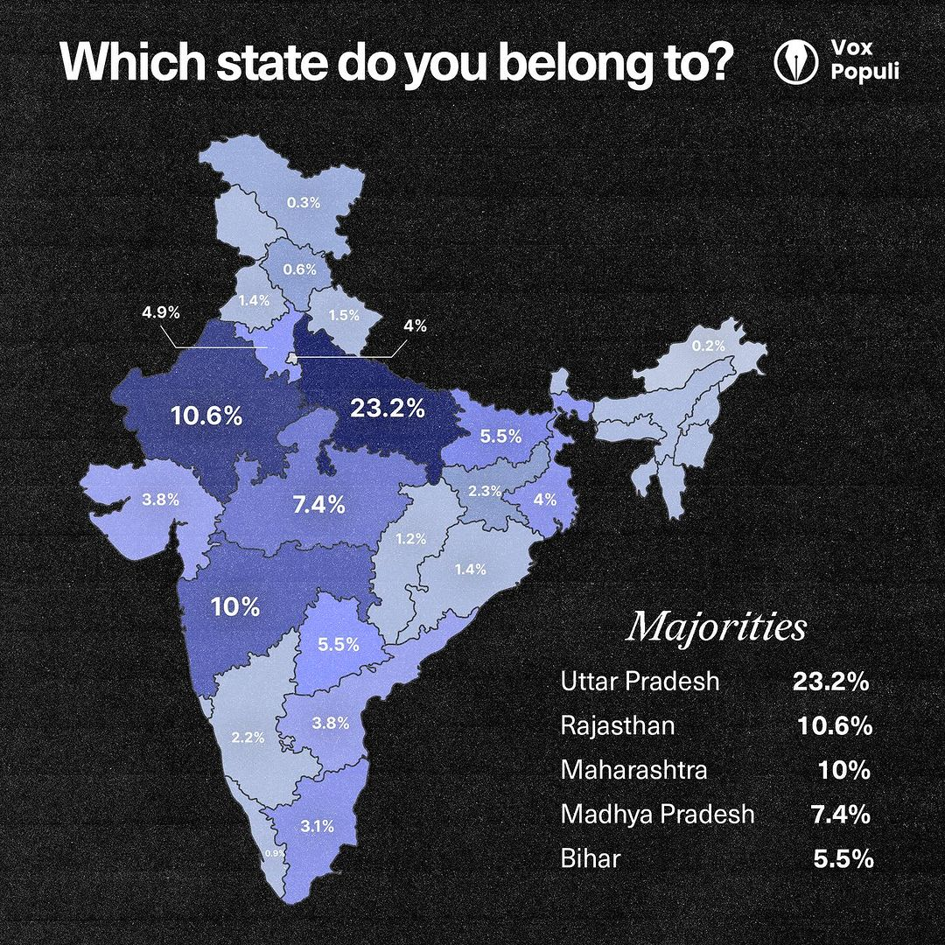
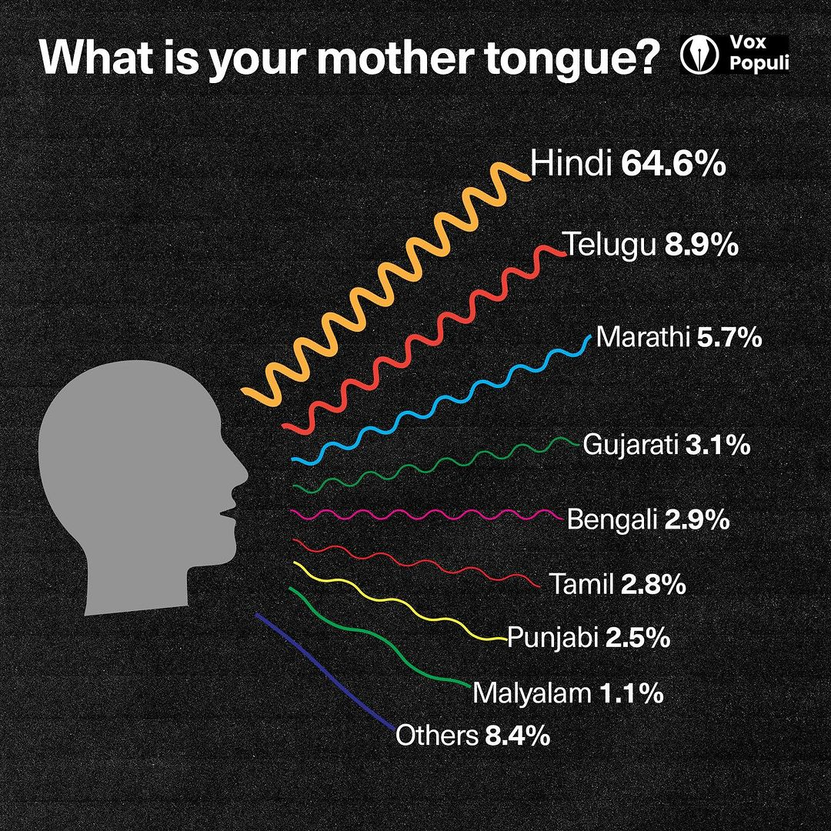
Geographical Diversity
There are students from all over INDIA.
We have more than 8 different languages spoken here.
Images Courtesy: Vox Populi

Slide 17
  Summary
  Do not read from the slide
  Use space efficiently
  Pay attention to font sizes
  Practice before you submit
  Do not refer to notes for a 5-minute presentation
  Use animations properly if you have them
  Use images
  Do not put a laundry list of items
  https://www.wiley.com/en-us/network/publishing/research-publishing/writing-and-conducting-research/6-tips-for-giving-a-fabulous-academic-presentation

Slide 18
Today’s presentation topic
(same as your poster)
  Prepare a presentation about your area of research
    literature survey
    initial research work
    preliminary results (optional)
  Please think about your audience (course participants and instructors/TAs)
  Final submission deadline 11:50 AM (negative marks for late submissions)

