Slide 1
Poster Presentation
August 9, 2024

Slide 2
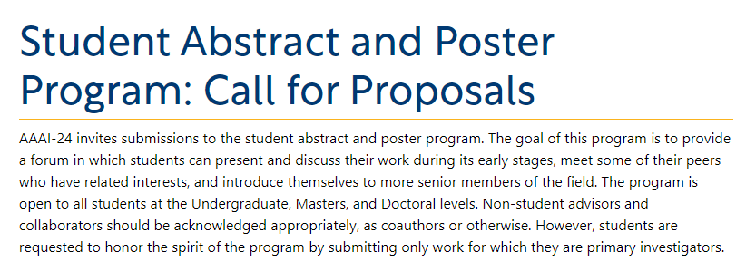
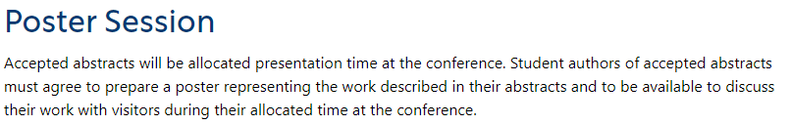
Posters: Present Preliminary Work
AAAI Call for Posters
https://aaai.org/aaai-conference/student-abstract-and-poster-program-call-for-proposals/

Slide 3

Posters: Present Preliminary Work
https://sc23.supercomputing.org/program/posters/research-posters/

Slide 4
Poster Presentation
DO’s
DONT’s
Title (large font)
Layout
  Sections (include titles)
Content
  Short sentences
  Simple words
  Bullet points
  Big font
Graphics
Self-explanatory tables/figures
Abbreviations
Typos/grammatical errors
Verbosity
Small fonts
Mismatch in fonts
Mismatch in background colours
Confusing flow

Slide 5
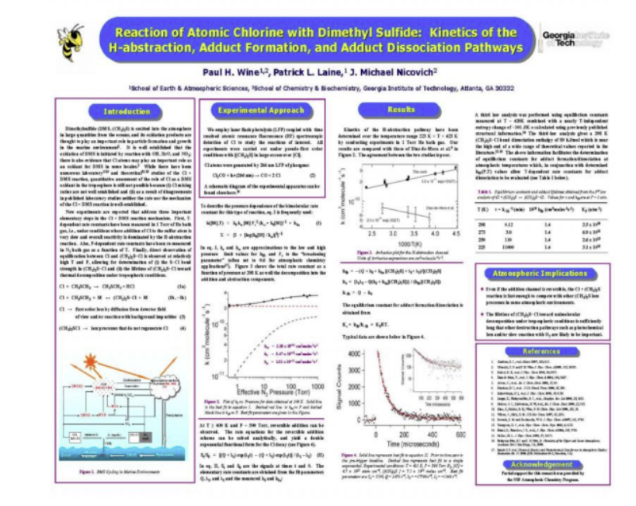
https://cpb-us-e1.wpmucdn.com/sites.psu.edu/dist/a/36309/files/2016/04/Posters-The-Good-and-the-Bad.pdf
Notes:
https://cpb-us-e1.wpmucdn.com/sites.psu.edu/dist/a/36309/files/2016/04/Posters-The-Good-and-the-Bad.pdf

Slide 6
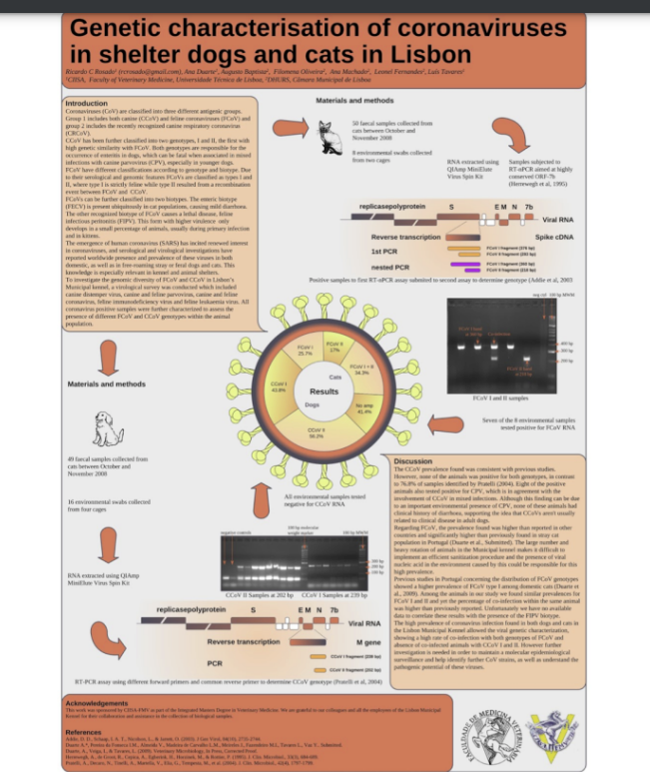

Slide 7
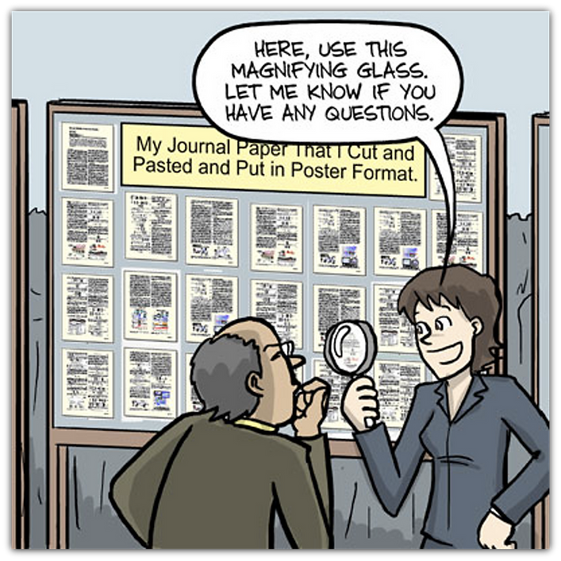

Slide 8
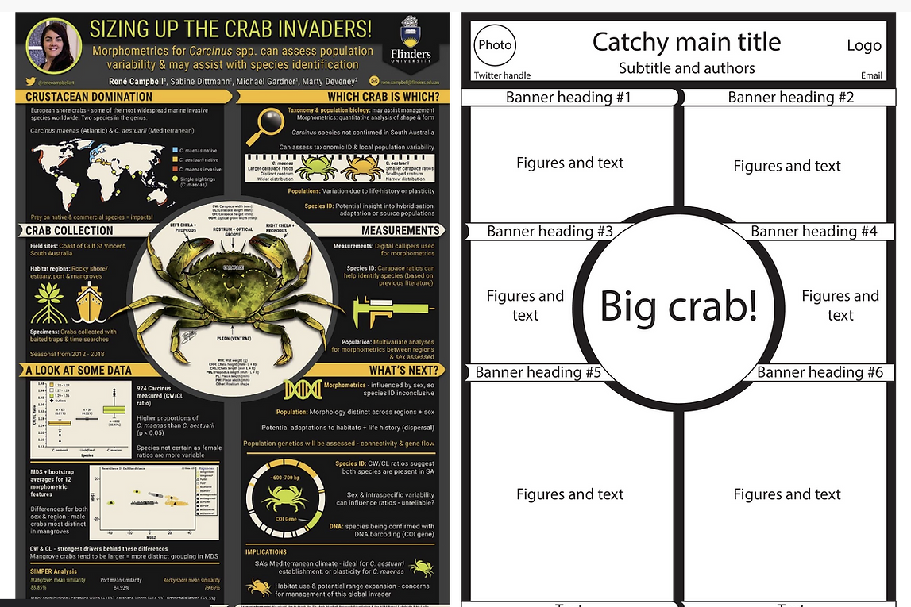
https://www.animateyour.science/post/best-examples-of-scientific-posters

Slide 9
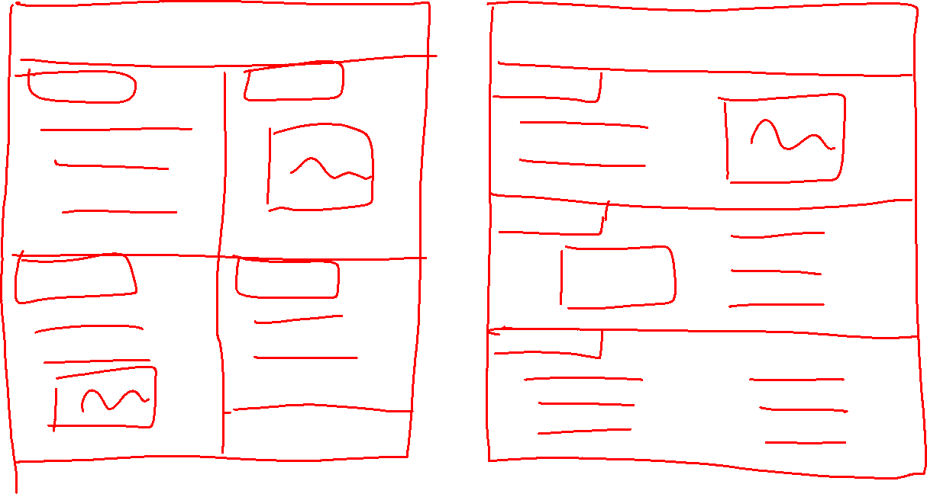

Slide 10
NeurIPS Poster Template
https://docs.google.com/presentation/d/19ZOqm41e1b7Keo5_P-FKlbwhcjl1ha5K/edit#slide=id.p1

Slide 11
Assignment 4: Poster Presentation
  Prepare a poster about your area of research
    literature survey
    initial research work
    preliminary results (optional)
  Please think about your audience (course participants and instructors/TAs)
  Use the provided template preferably
  Short review at 11:15 AM by the instructor
  Final submission deadline 11:50 AM.
No mobile phones
Design yourself (no external resources please)
Think of sequence
Plan layout

