Slide 1
Typesetting
Lecture 3
August 7, 2024

Slide 2
Review of Abstract Writing
Please use Name_RollNumber.pdf as the file name (preferably do not submit .docx)

Slide 3
Examples of what you may want to avoid

Slide 4
Example 1
A well written paper should try to cater to each of these audiences: introduction and abstract should draw reader’s interest focussing on a broader set of readers, methods and results should address mostly reviewers and subject experts, conclusions should target every group. We talk about omitting needless words and how to write concisely. We highlight the importance of using figures and tables, as they can convey the ideas more precisely and effectively. A good writer puts themselves in the reader's shoes, while thinking about the relevance of the ideas to the reader and their motivations. They pace the writing to entice the reader to keep reading and not get bored.

Slide 5
Example 1
A well written paper should try to cater to each of these audiences: introduction and abstract should draw reader’s interest focussing on a broader set of readers, methods and results should address mostly reviewers and subject experts, conclusions should target every group. We talk about omitting needless words and how to write concisely. We highlight the importance of using figures and tables, as they can convey the ideas more precisely and effectively. A good writer puts themselves in the reader's shoes, while thinking about the relevance of the ideas to the reader and their motivations. They pace the writing to entice the reader to keep reading and not get bored.

Slide 6
Example 1
A well written paper should try to cater to each of these audiences: introduction and abstract should draw reader’s interest focussing on a broader set of readers, methods and results should address mostly reviewers and subject experts, conclusions should target every group. We talk about omitting needless words and how to write concisely. We highlight the importance of using figures and tables, as they can convey the ideas more precisely and effectively. A good writer puts themselves in the reader's shoes, while thinking about the relevance of the ideas to the reader and their motivations. They pace the writing to entice the reader to keep reading and not get bored.

Slide 7
Example 1
A well written paper should try to cater to each of these audiences: introduction and abstract should draw reader’s interest focussing on a broader set of readers, methods and results should address mostly reviewers and subject experts, conclusions should target every group. We talk about omitting needless words and how to write concisely. We highlight the importance of using figures and tables, as they can convey the ideas more precisely and effectively. A good writer puts themselves in the reader's shoes, while thinking about the relevance of the ideas to the reader and their motivations. They pace the writing to entice the reader to keep reading and not get bored.

Slide 8
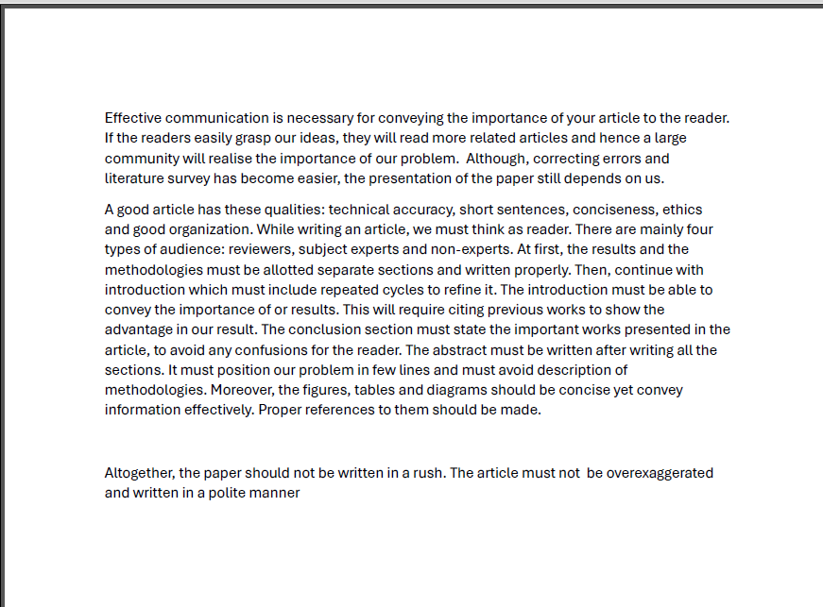
Example 2

Slide 9
Example 2
While writing an article, we must think as reader. There are mainly four types of audience: reviewers, subject experts and non-experts. At first, the results and the methodologies must be allotted separate sections and written properly. Then, continue with introduction which must include repeated cycles to refine it. The introduction must be able to convey the importance of or results. This will require citing previous works to show the advantage in our result.

Slide 10
Example 2
While writing an article, we must think as reader. There are mainly four types of audience: reviewers, subject experts and non-experts. At first, the results and the methodologies must be allotted separate sections and written properly. Then, continue with introduction which must include repeated cycles to refine it. The introduction must be able to convey the importance of or results. This will require citing previous works to show the advantage in our result.

Slide 11
Example 3
This article describes the best way for Effective communication in terms of technical writing and presentation. They provide seven basic principles for all types of good technical writing and those are as follows: Technical Accuracy, Conciseness and Clarity, Good Organization and Structure, Error free English, Usefulness of the results, Ethicalness. Later they also discussed the best way to start writing.

Slide 12
Example 3
This article describes the best way for Effective communication in terms of technical writing and presentation. They provide seven basic principles for all types of good technical writing and those are as follows: Technical Accuracy, Conciseness and Clarity, Good Organization and Structure, Error free English, Usefulness of the results, Ethicalness. Later they also discussed the best way to start writing.

Slide 13
Example 4
A well written article carries the ideas/results of the author to a larger audience. In this article the author explains importance and tips of good technical writing. It starts with the basic principles that make a good article. It gives a sequence of steps that be followed. It underscores the importance of writing with an audience in mind, more specifically what audience to target in each section. It highlights the importance of using the length proportionately. The examples clarify the common errors of redundant/irrelevant information. The summary of do’s and don’ts give a quick starting point for a beginner looking into technical writing to get started with his first piece.

Slide 14
Example 4
A well written article carries the ideas/results of the author to a larger audience. In this article the author explains importance and tips of good technical writing. It starts with the basic principles that make a good article. It gives a sequence of steps that be followed. It underscores the importance of writing with an audience in mind, more specifically what audience to target in each section. It highlights the importance of using the length proportionately. The examples clarify the common errors of redundant/irrelevant information. The summary of do’s and don’ts give a quick starting point for a beginner looking into technical writing to get started with his first piece.

Slide 15
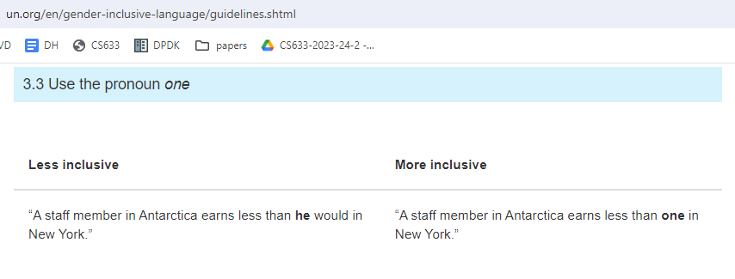
Inclusive Language

Slide 16
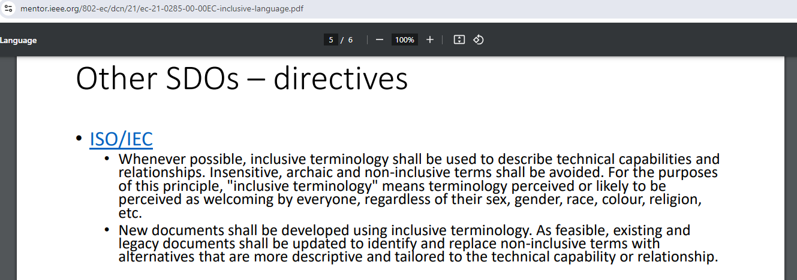
Inclusive Language

Slide 17
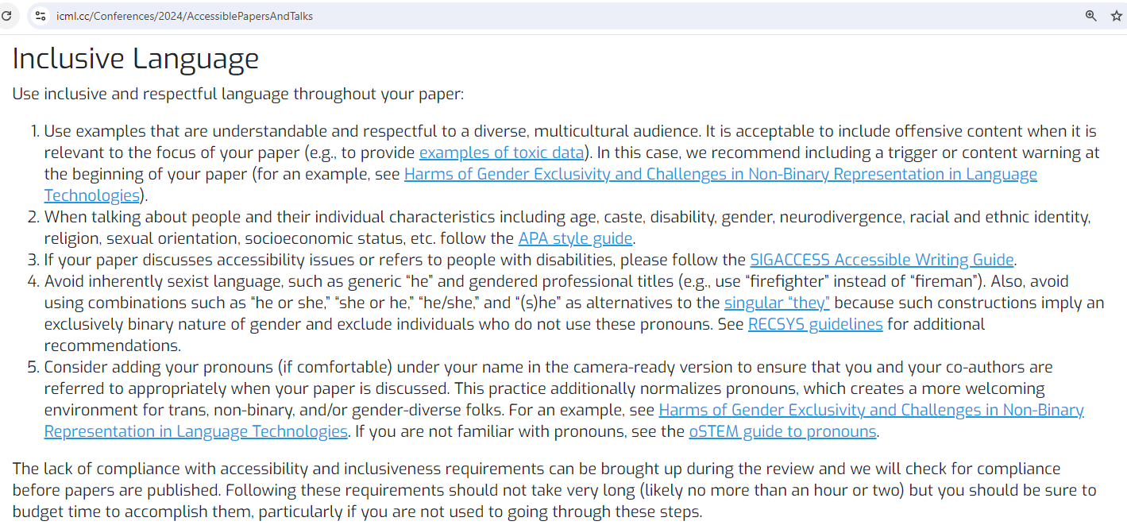
Inclusive Language

Slide 18
Typesetting – LaTeX

Slide 19
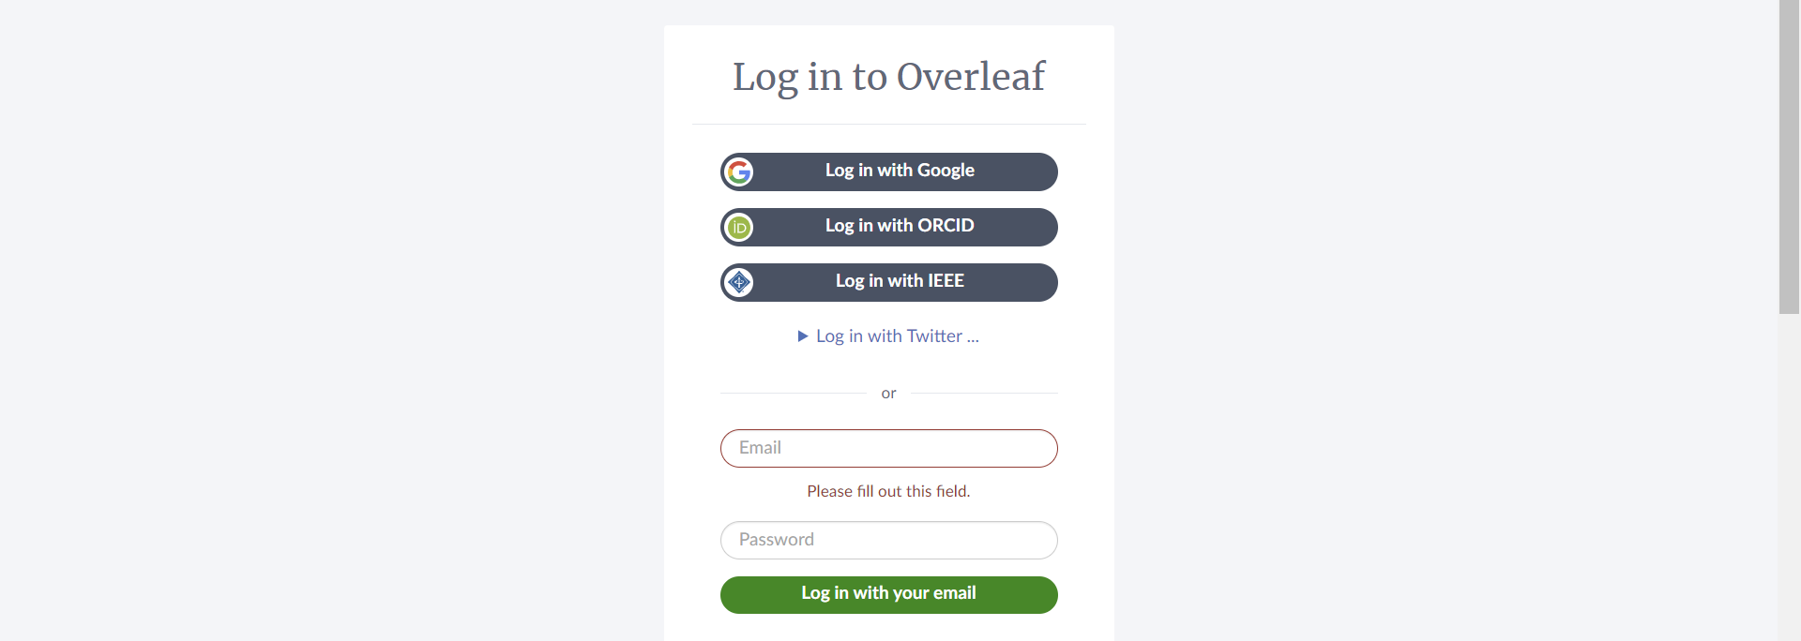
www.overleaf.com

Slide 20
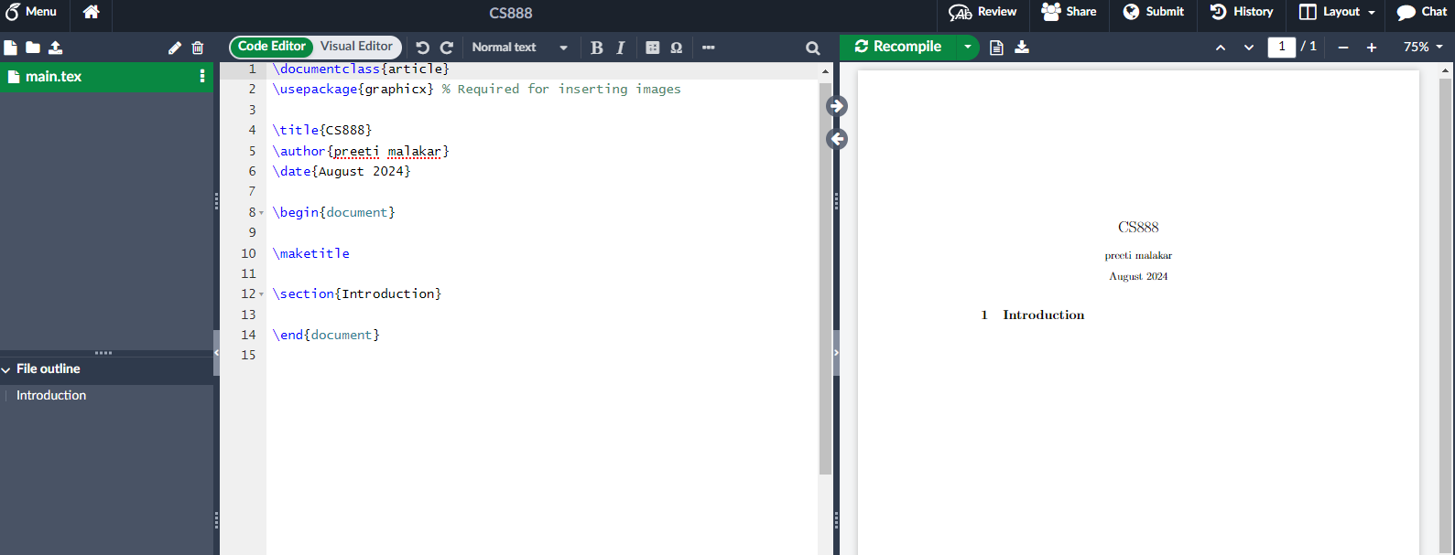
New Project -> Blank Project

Slide 21
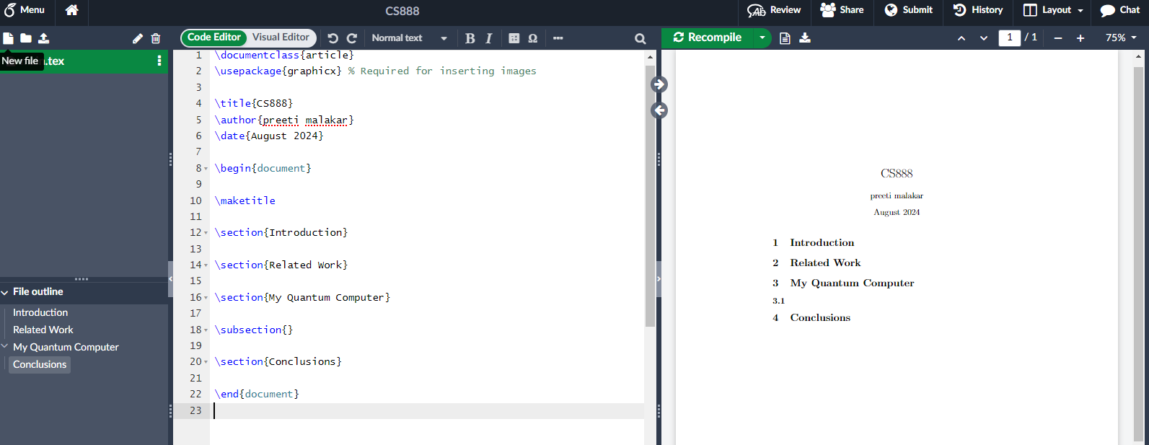
Sections

Slide 22
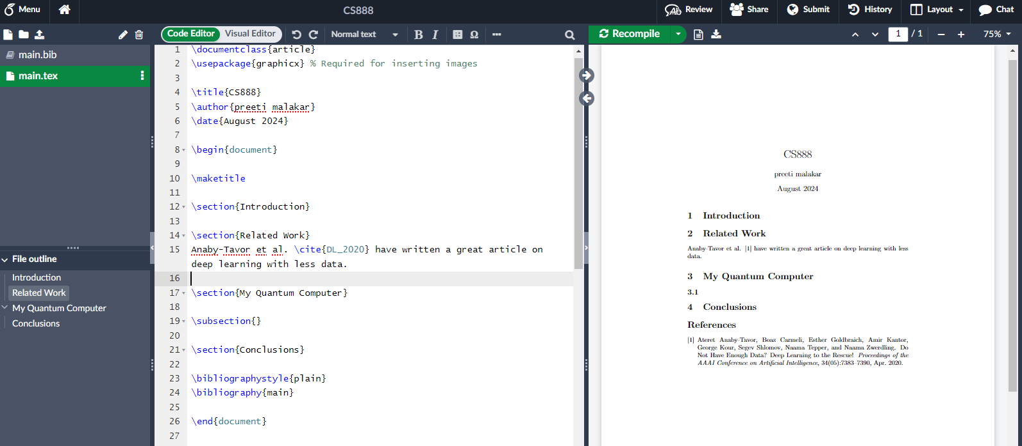
References
@article{DL_2020,
title={{Do Not Have Enough Data? Deep Learning to the Rescue!}},
volume={34},
number={05},
journal={Proceedings of the AAAI Conference on Artificial Intelligence},
author={Anaby-Tavor, Ateret and Carmeli, Boaz and Goldbraich, Esther and Kantor, Amir and Kour, George and Shlomov, Segev and Tepper, Naama and Zwerdling, Naama},
year={2020},
month={Apr.},
pages={7383-7390}
}

Slide 23
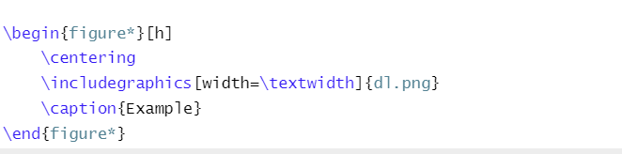
Figures

Slide 24
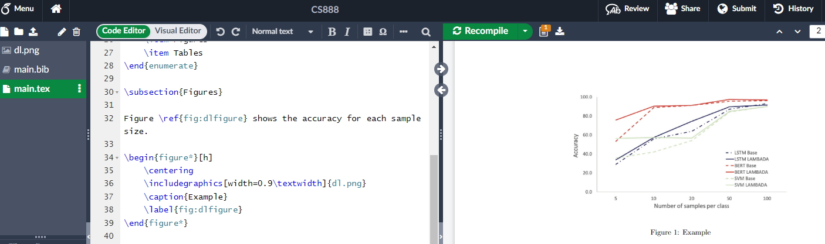
Labels

Slide 25
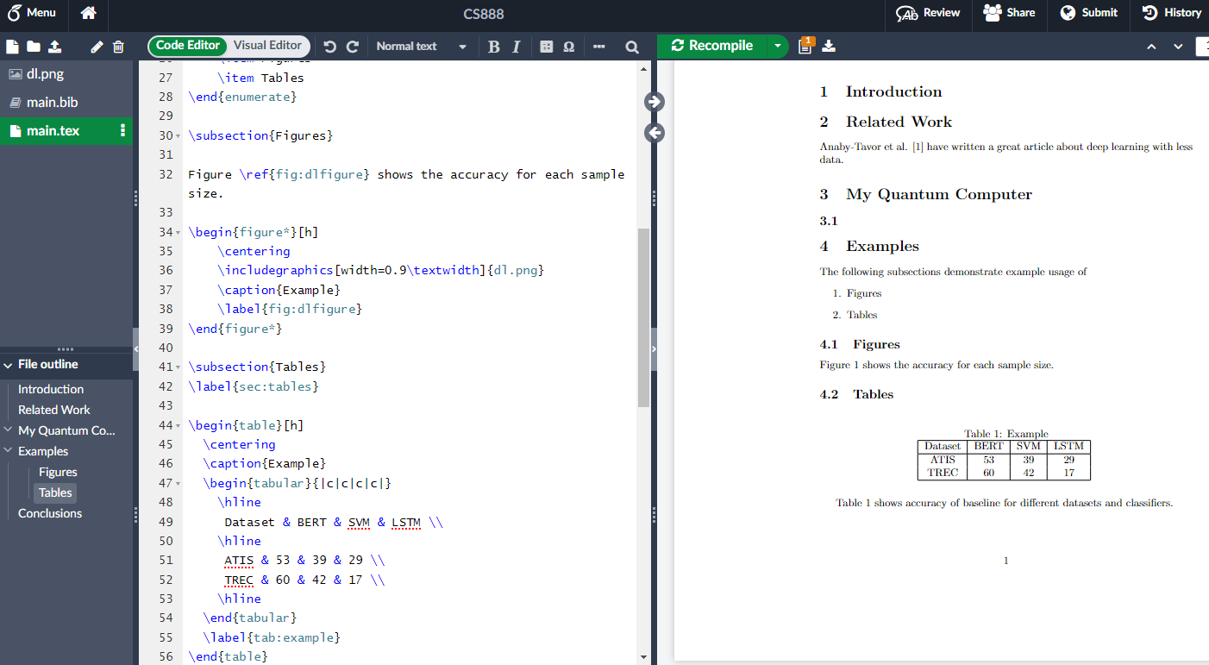
Tables

Slide 26
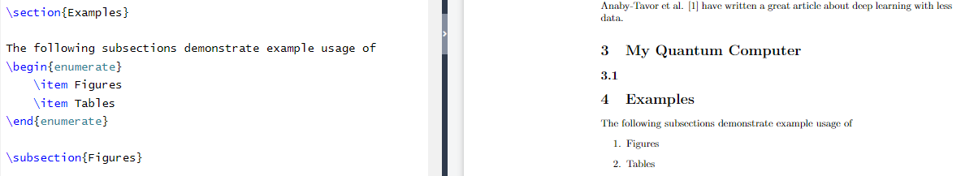
Enumerate

Slide 27
Assignment 3
Write a short article about your any of your courses (300-400 words).
  Organize into sections
  Add at least one figure/table
  Cite
Submit on hello.iitk.ac.in by 11:50 AM.
Please use Name_RollNumber.pdf as the file name (preferably do not submit .docx)

