Slide 1
Written Communication
August 2, 2024

Slide 2
Reminder
Attendance is compulsory
  If you are found to be absent for more than 2 classes, it may lead to an X
Bring a device for in-class assignments
Leave a gap of at least one seat between you and your neighbour

Slide 3
TAs
Vishal
Vraj (new)

Slide 4
Communication Skills
Written
Verbal
https://drexel.edu/graduatecollege/professional-development/blog/2018/July/Five-types-of-communication/

Slide 5
Today
Review
Written forms of communication

Slide 6
Review Test – Find the typos
Titan, previously called Cyclops 2, was a submersible that imploded on 18 June 2023 while transport tourists visit the wreckage of Titanic The submersible was created and operated OceanGate. It was the first privately-owned submersible with a claimed maximum depth of 4,000 m (13,000 ft, and the first completed crewed submersible with hull constructed of titanium and carbon fiber composite materials. After testing with dives to its maximum intended depth in 2018 and 2019 the original composite hull of Titan developed fatigue damage and was replaced by 2021. In that year, OceanGate began transporting paying customers to the wrec of Titanic, completing several dives to the wreck site in 2021 and 2022. during the submersible's first expedition in 2023, all five occupants was killed when the Titan imploded. OceanGate lose contact with Titan and contacted authorities later that day after the submersible was overdue for return. A massive international search and rescueoperation ensued and ended on 22 June, when debris from Titan discovered about 1,600 feet (500 metres) from the bow of Titanic. (Edited from Wikipedia)

Slide 7
Key
Titan, previously called Cyclops 2, was a submersible that imploded on 18 June 2023 while transporting tourists visit to the wreckage of Titanic. The submersible was created and operated by OceanGate. It was the first privately-owned submersible with a claimed maximum depth of 4,000 m (13,000 ft), and the first completed crewed submersible with a hull constructed of titanium and carbon fiber composite materials. After testing with dives to its maximum intended depth in 2018 and 2019, the original composite hull of Titan developed fatigue damage and was replaced by 2021. In that year, OceanGate began transporting paying customers to the wreck of Titanic, completing several dives to the wreck site in 2021 and 2022. During the submersible's first expedition in 2023, all five occupants were killed when the Titan imploded. OceanGate lost contact with Titan and contacted authorities later that day after the submersible was overdue for return. A massive international search and rescue operation ensued and ended on 22 June, when debris from Titan was discovered about 1,600 feet (500 metres) from the bow of Titanic. (Edited from Wikipedia)
Missing prepositions
Missing punctuations
Grammatical errors
Typos

Slide 8
General Guidelines
DO
Space after comma, not before comma
Space after full stop
Start sentence with capital letter
Short sentences
Use punctuation marks
AVOID
Grammatical errors
Typos
Spelling mistakes
Long sentences
Acronyms

Slide 9
Synonyms
Boastful (i) Arrogant (ii) Humble (iii) Pompous (iv) Joyful
Frugal (i) Thrifty (ii) Generous (iii) Evasive (iv) Lavish
Petrified (i) Enlivened (ii) Tired (iii) Terrified (iv) Excited
Ardent (i) Loyal (ii) Keen (iii) Fervent (iv) Passionate

Slide 10
Synonyms
Boastful (i) Arrogant (ii) Humble (iii) Pompous (iv) Joyful
Frugal (i) Thrifty (ii) Generous (iii) Evasive (iv) Lavish
Petrified (i) Enlivened (ii) Tired (iii) Terrified (iv) Excited
Ardent (i) Loyal (ii) Keen (iii) Fervent (iv) Passionate

Slide 11
Today
Review
Written communication skills
  CV
  Email
  Webpage
  Extended abstract
  Poster paper
  Poster
  Full paper
  Presentation

Slide 12
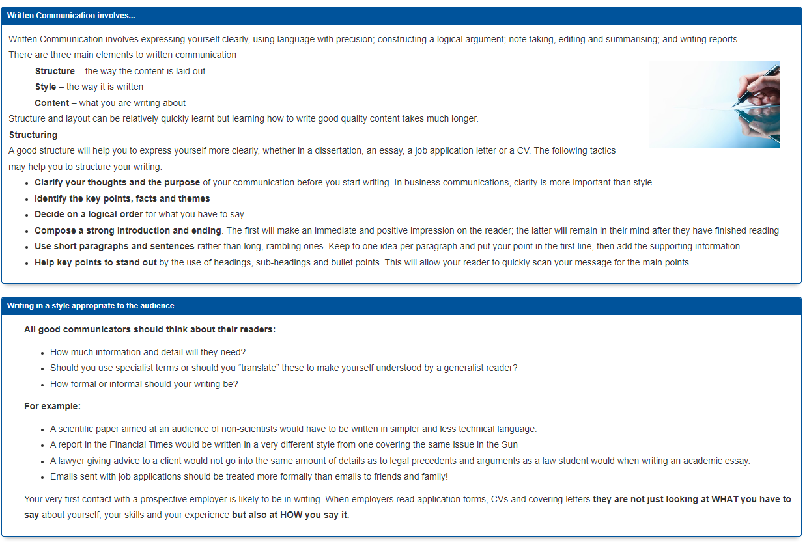
https://libguides.wigan-leigh.ac.uk/c.php?g=667800&p=4736451

Slide 13
Email Example 1 – What not to do
due to some reasons i missed the first class ,as i was not able to give the test happened today so i want to inform you that please let me also involved in any group ,also i ensure you that i will not miss further classes .

Slide 14
Email Etiquettes
due to some reasons i missed the first class ,as i was not able to give the test happened today so i want to inform you that please let me also involved in any group ,also i ensure you that i will not miss further classes .

Slide 15
Email Example 2 – What not to do
*Respected Sir,*
*With humble prayer I am to inform you that I am keenly interested in …….. **under the guidance of your kindness. Presently I am an …… and working for about …………..*
*If you kindly give me a chance as a guidance I shall be ever grateful to you.*
*With kind regards,*
*FN LN*

Slide 16
Email Etiquettes
*Respected Sir,*
*With humble prayer I am to inform you that I am keenly interested in …….. **under the guidance of your kindness. Presently I am an …… and working for about …………..*
*If you kindly give me a chance as a guidance I shall be ever grateful to you.*
*With kind regards,*
*FN LN*

Slide 17
Email Example 3 – What not to do
Dear Professor ………,
My name is ………., a highly motivated …………. student pursuing a …………………..I'm writing to express my strong interest in an unpaid internship opportunity under your guidance this summer (May-July)* to gain experience in the application of machine learning (ML) algorithms to ………….* I've been following your research and find your work on …………….incredibly fascinating. While my current projects have focused on *full-stack applications using technologies* like ………………………………..., my strong foundation in AI/ML concepts (Machine Learning, Neural Networks) makes me eager to explore their application in …………... My experience building applications like "RealTime Chat App" demonstrates my proficiency in coding, and projects like *"RaOne AI" (using Python and OpenAI) *showcase my interest in utilizing AI. My coursework in "*Data Structures and Algorithms*" has equipped me with *strong problem-solving skills*, which I believe would be valuable in the research setting. Being located near ………….allows for a daily commute, eliminating the need for accommodation. I am particularly interested in the following areas of your research:* ……………………………………………………………………………….. …………………………………………………………………………………………………………………………………………………………………………………………………………………………………………………………………………………………………………………………………………………………………. *My primary goal is to learn and contribute meaningfully *to your research group. I do not require any stipend; I solely want to learn the latest ML technologies and their application in ………………………………………………..from you. I*'ve attached my resume *for your review. Thank you for your time and consideration. I look forward to discussing this opportunity further. Sincerely, …………

Slide 18
Email Example 3 – What not to do
Dear Professor ………,
My name is ………., a highly motivated …………. student pursuing a …………………..I'm writing to express my strong interest in an unpaid internship opportunity under your guidance this summer (May-July)* to gain experience in the application of machine learning (ML) algorithms to ………….* I've been following your research and find your work on …………….incredibly fascinating. While my current projects have focused on *full-stack applications using technologies* like …………………………………, my strong foundation in AI/ML concepts (Machine Learning, Neural Networks) makes me eager to explore their application in …………... My experience building applications like "RealTime Chat App" demonstrates my proficiency in coding, and projects like *"RaOne AI" (using Python and OpenAI) *showcase my interest in utilizing AI. My coursework in "*Data Structures and Algorithms*" has equipped me with *strong problem-solving skills*, which I believe would be valuable in the research setting. Being located near ………….allows for a daily commute, eliminating the need for accommodation. I am particularly interested in the following areas of your research:* ……………………………………………………………………………….. …………………………………………………………………………………………………………………………………………………………………………………………………………………………………………………………………………………………………………………………………………………………………. *My primary goal is to learn and contribute meaningfully *to your research group. I do not require any stipend; I solely want to learn the latest ML technologies and their application in ………………………………………………..from you. I*'ve attached my resume *for your review. Thank you for your time and consideration. I look forward to discussing this opportunity further. Sincerely, …………

Slide 19
Email Etiquettes
Be concise
Proof-read your email
  No grammatical errors
  No typos
  Proper sentence construction
Use informative subject line
Use proper salutations
  “Hi”/ “Dear” / “Hello” is fine, not “Hey”
Follow general writing guidelines
Adapted from Prof. Kosslyn’s notes, Harvard University

Slide 20
Tips on Writing Emails
https://www.bu.edu/com/files/2021/11/WC_emails_to_profs_and_TAs.pdf
https://showme.missouri.edu/2015/emailing-your-professor-youre-doing-it-wrong/
https://writingcenter.gmu.edu/writing-resources/different-genres/sending-email-to-faculty-and-administrators
https://www.wpunj.edu/accessibilityresourcecenter/documents/Email%20Etiquette_revised.pdf
https://www.purdue.edu/advisors/students/email.php
What not to do
https://library.fairmontstate.edu/SEE/bad

Slide 21
Assignment 1
Write an email to your course instructor asking for permission to allow for leave during the class on next Monday.

Slide 22
Online Presence
Homework – Design your own webpage
Name
Department
Institute
Email ID
Photograph (optional but preferable)
Educational background
Courses taken
Presentations/talks given anywhere (department, institute, workshops, conferences)
Posters/short papers
Publications
Service (volunteer, external reviewer, …)

Slide 23
Technical Article
Title
Abstract
Introduction
Related Work
Methodology
Experiments and Results
Conclusions
References

Slide 24
Technical Article
Use paragraphs
  Neither too short nor too long
Do not sound repetitive
Do not be verbose
(Report/paper) Use active voice
Use first person plural pronoun
  We (not I)

Slide 25
Technical Writing
Know your audience
Have sufficient time
  To think about organization
  To write
  To draw figures (high-resolution)
  To revise

Slide 26
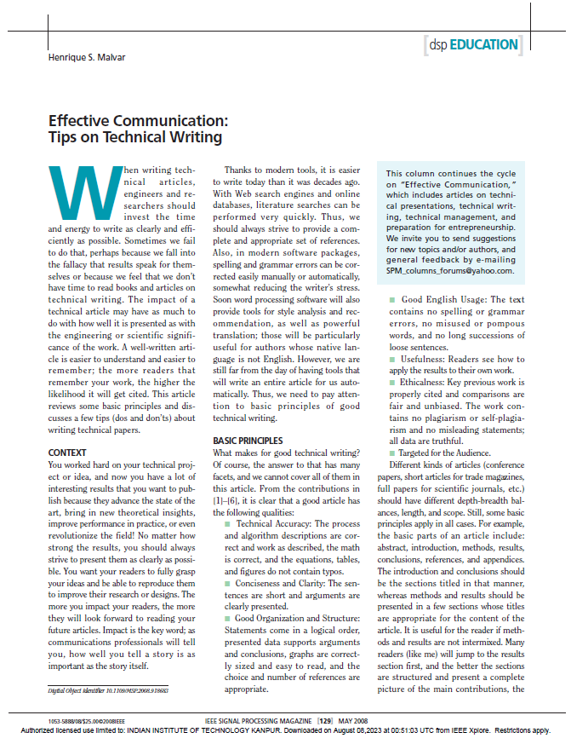
Assignment 2
Write a summary (abstract) of the paper in 250 words

Slide 27
Organization
https://libguides.wigan-leigh.ac.uk/c.php?g=667800&p=4736451

