Slide 1
CS888: Introduction to Profession and Communication Skills
Preeti (pmalakar)
Nitin (nitin)
Debadatta (debam)
Nisheeth (nsrivast)
July 31, 2024

Slide 2
Course Timings and Modules
WF: 10:30 AM – 12 PM @KD103
5 modules
  Part 1
  Part 2
  Part 3
  Part 4
  Part 5

Slide 3
Course Details
Units: 2-0-0-0 (6)
Course objectives:
  Technical writing
  Editing your own work
  Precis writing
  Critiquing others' work
  Preparing and making presentations
  Preparing and presenting posters

Slide 4
Part 1 (PM)
This will cover how to effectively communicate research. There will be discussion on (1) preparing a poster, (2) preparing a presentation, and (3) general guidelines for writing a research paper. The students will be asked to prepare a short poster, presentation and write-up. The lecture may highlight general guidelines of communications – (1) Grammatically correct (2) Precise (3) Effective use of images (4) Organization (5) Proper flow (6) Pace of presentation (7) Importance of legible figures in a paper.

Slide 5
Part 2 (Prof. Nitin)
Research Methodology and Paper writing in Theoretical Computer Science – introduction to proof techniques (deduction, induction, contrapositive, contradiction, diagonalization) with some examples, power of randomization in algorithm design, notions of intractability, and how hardness can be a boon. The difference between Conjecture, Axiom, Hypothesis and Theorem; The difference between an efficient algorithm and an efficient heuristic ? How to survey the literature, do research, and prove something new and publication-worthy? How to structure a theory paper, how to make it readable for non-experts?

Slide 6
Part 3 (Prof. Deba)
Research Methodology and Paper writing in Computer Systems
Overview of different dimensions of system research —
Problem formulation—Building/evolving hypotheses and problem statements, motivating problems and proposed solution ideas.
Empirical analysis — experiment design, analysis, reporting, tools and techniques
Design and implementation—Root cause analysis and development involving existing systems, tools and techniques for navigating large code bases, integration of proposed ideas, checking correctness, bug fixing approaches and tools

Slide 7
Part 4 (Prof. Nisheeth)
Research Methodology and Paper writing in Data Science
This part will additionally introduce students to more specialized aspects relevant for data science research pipelines. In particular, the following will be covered:
Typical research design: problem definition, mathematical solution, algorithmic implementation, evaluation.
Considerations for evaluation: cross-validation, leaderboards, data leakage, hypothesis testing, dataset decay.

Slide 8
Part 5 (PM)
This part will require preparation of an extended abstract (around 4 pages) of a research paper by each student. Please note this must be an original paper (concept paper is fine).

Slide 9
Course Modules
Part 1 | Part 2 | Part 3 | Part 4 | Part 5
Jul 31 | Aug 21 | Sep 11 | Oct 18 | Nov 1
Aug 2 | Aug 23 | Sep 13 | Oct 23 | Nov 6
Aug 7 | Aug 28 | Sep 25 | Oct 25 | Nov 8
Aug 9 | Aug 30 | Sep 27 | Oct 30 | Nov 13
Aug 14 | Sep 4 | Oct 4
Aug 16 | Sep 6 | Oct 16

Slide 10
Grading
Complete at least 75% of all assignments
  In-class assignments
  Bring your laptop to class everyday
  Perform well!
Prepare an extended abstract of a research paper
  Prepare well!
No mid-sem, no end-sem

Slide 11
Course Policies
Attendance is compulsory
  TA will take attendance
  Please be on time
  If you are found to be absent for more than 2 classes, it may lead to an X
  Bring a device for in-class assignments
Please maintain silence when others are speaking
  Keep your mobile phones in silent mode or switch it off (No alarms)
Do NOT CHEAT
  Cite the sources
  Do not use any AI Chat Bot for your assignments

Slide 12
Plagiarism Policy
Plagiarism will NOT be tolerated
https://www.cse.iitk.ac.in/pages/AntiCheatingPolicy.html
You may ask the instructor or TA in case of doubts
  Learn and let others learn
  Try your best

Slide 13
Logistics
https://www.cse.iitk.ac.in/users/cs888/
Announcements/uploads on
  MooKIT
  Course webpage
  Course email alias
Email should always be prefixed with [CS888] in the subject
  cc pmalakar
Office hour: T 5:00 – 5:30 PM (KD221)

Slide 14
Course Staff Email IDs (@cse.iitk.ac.in)
Instructors: pmalakar, nitin, nsrivast, deba
TAs
vdeka

Slide 15
Course Participants
Batch Year | Roll No | Student Name | Email
1 | 231110601 | Anupam Roy | anupamr23@iitk.ac.in
2 | 231110602 | Binong Kiri Bey | binong23@iitk.ac.in
3 | 231110603 | Divyaksh Shukla | divyakshs23@iitk.ac.in
4 | 231110604 | Naman Baranwal | namanb23@iitk.ac.in
5 | 231110605 | Pushkar Bhardwaj | pushkarb23@iitk.ac.in
6 | 231110606 | Sanjeet Singh | sanjeetsi23@iitk.ac.in
7 | 231110607 | Shanu Saklani | sshanu23@iitk.ac.in
8 | 231110608 | Shivam Pal | pshivam23@iitk.ac.in
9 | 231110610 | Bikash Saha | bikashsaha23@iitk.ac.in
10 | 231110611 | Indranil Thakur | indranilt23@iitk.ac.in
11 | 232110601 | Riyansha Singh | riyanshas23@iitk.ac.in
12 | 232110603 | VIKAS KUSHWAHA | vikask23@iitk.ac.in
13 | 232110604 | Foram Paresh Lakhani | foramp23@iitk.ac.in

Slide 16
Assignment 0: Round of Introduction
Feel free to mention whatever you are comfortable to speak about
Time limit: 3 minutes
Briefly introduce yourself
Your educational background
Your research area
Your future goals

Slide 17
Next Lectures
Good communication skills (written and verbal)
  Clearly express yourself while speaking
  To be understood by the audience
  Convey what you actually meant
Good presentation skills
  Use less text in the slide
  Animate
  Infographic
Listen to others speaking
  Mentor
  Critic

Slide 18
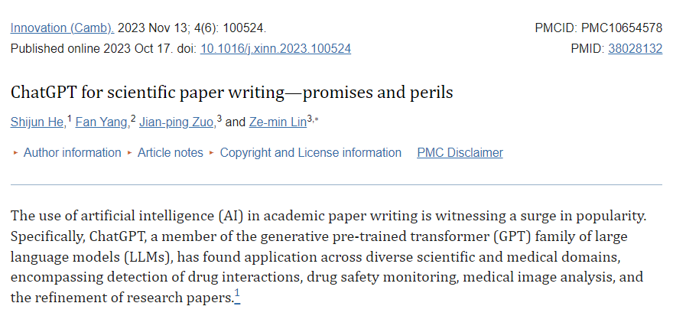
AI-assistance?

Slide 19
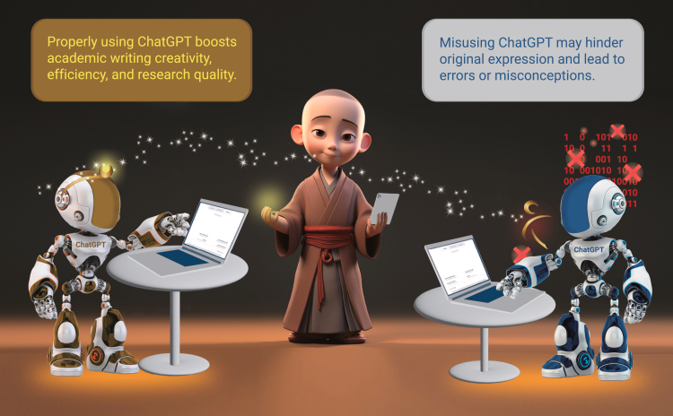
Overreliance – good or bad?
ChatGPT for scientific paper writing – promises and perils, He et al., Innovation 2023
https://www.ncbi.nlm.nih.gov/pmc/articles/PMC10654578/

Slide 20

References

Slide 21
Diagnostic Test

