Slide 1

Query-Driven Visualization of Large Data Sets
Group : 9
Arnika kaithwas, Krishna Kumar Bais, Pradeep Sahu
Department of Computer Science and Engineering
Indian Institute of Technology Kanpur (IITK)
email: {arnikak24, krishnakb24, pradeeps24 }@cse.iitk.ac.in

Slide 2
Abstract
The aim of this paper is to make the analysis and visualization process more efficient and manageable, especially as the size of datasets continues to grow.
This abstract introduces a new approach to analyzing large and complex visual datasets, particularly in scientific research, by focusing on "interesting" subsets of data.
Previous research mainly focused on range queries within scalar fields. And these methods have limitations when dealing with more complex, multidimensional, and multivariate queries.
The authors propose a new tool called "DEX" (short for Dextrous Data Explorer) to address these limitations which uses a technique called “Bitmap Indexing”.
In addition to benchmark performance and analysis, the authors applied DEX to a real-world problem in combustion simulation data analysis.

Slide 3
Introduction
Motivation and Problem Statement: Managing and analyzing large scientific datasets is a major challenge in research, with the sheer volume of data making it difficult to focus on the most relevant subsets for analysis and visualization.
The authors proposes a methodology known as “Query-Driven Visualization” and to implement this they combine the state of arts scientific data management technology with visualization tools.
The existing methods like isosurface acceleration are limited to single-valued search criteria and cannot handle complex, multidimensional queries, restricting their applicability in more intricate data analysis scenarios.
The experimental results show that DEX outperforms the well-known accelerated isosurfacing algorithm by factors ranging from 137% to 392% depending upon the source data.

Slide 4
Related Work
Large and Complex Data Visualization
Scalable Visualization technique: As data resolution increases researchers have developed techniques to increase the capacity of the visualization pipeline through parallelism.
Two examples of scalable applications are VisIt and ParaView.
It increases the processing load on human observer and do not necessarily aid in the understanding of large and complex datasets.
Data Simplification and Reduction: focuses on reducing the amount of data that needs to be processed and visualized.
There are also automatic feature detection and data-mining techniques that are useful to confirm the presence and absence of known phenomena but might miss unexpected features.

Slide 5
Query-Driven Visualization
Highlights the data that a user defines “interesting”.
VisDB System: helps to visualize data by filtering and ranking data based on relevance to a user-defined query.
The result is O(n) memory and processing complexity for each and every query.
Relevance Factor: VisDB uses statistical heuristics to rank and cluster similar data together. And particularly well suited for use with qualitative and fuzzy queries.
Scout Software System: Provides the ability to perform expression based queries using a simple programming language along with visualization on GPU.
For 2D data, it renders a single quadrilateral, and for 3D data, it uses view-aligned slices to perform direct volume rendering.
Both the systems have O(n) complexity.
“Visual Analytics” has been coined to describe a set of activities, it’s goal simplify complex and multidimensional data by showing only information that is relevant to the user’s current inquiry.

Slide 6
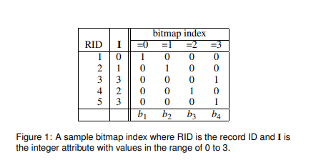
Bitmap Indices
An efficient index data structures for accelerating multi-dimensional range queries for read-only or read-mostly datasets.
Bitwise logical operations are used to handle multidimensional and multivariate queries.
A potential downside of bitmap indices is that they can require a lot of storage but can be compressed and the methods are-
Byte aligned Bitmap Code(BBC)
Word-Aligned Hybrid(WAH)
It has binning strategies to speed up multidimensional queries for high cardinality attributes.

Slide 7
Isosurfaces
The canonical isosurface algorithm consist of two broad processing step:
Find the cells that contain isosurfaces
Generate the geometry for the isosurface:
Marching Cubes algorithm is the earliest methods for isosurface extraction having O(n) complexity in searching.
To improve the search process there are several techniques:
Octree
Span-space Searches
2D Regular lattice
Out-of-Core approach
None of these algorithms would be effective to handle multidimensional, multivariate queries or dynamic data.

Slide 8
Dex Architecture
The implementation consists of four broad phases:
Index Construction
Index searching
Region Growing
Geometry Construction

Slide 9
Index Construction
There are two primary factors of concern with respect to constructing the index structures used to accelerate data queries:
Computational Complexity
In case of Bitmap Indices each data value is examined and a corresponding bitmap code is added to the index. The computational complexity of this operation is O(n).
Tree-based methods, such as B-trees or quad-trees require either a complete sort or sorted insertion.
Storage Requirements
in the worst-case scenario, the size of the bitmap index can reach 2n words.
The size of tree-based structures has an upper bound of O(nlogk n) and tend to require about 4n words of storage.

Slide 10
Index Searching
The primary strengths of bitmap indices for searching is :
Low computational and storage complexity
Efficient for complex, multidimensional queries
The search is done using FastBit software, which executes queries with a worst-case time complexity of O(k).
Conversion of compressed bitmap into a list of blocks in space. For 3D space data, there are three types of block
Line Segments: A series of connected cells along a line.
Groups of Connected Lines: Multiple connected lines of cells.
Groups of Connected Planes: Entire connected planes of cells
The process of converting a consecutive group of 1s to a block takes a constant number of machine instructions.
Converting WAH compressed bitmap to a list of blocks scales linearly with the number of blocks.

Slide 11
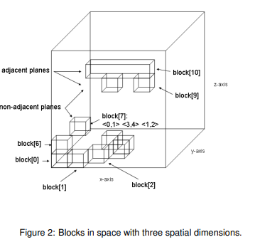
Region Growing
Region Growing is the process of taking the individual blocks and grouping them into larger connected regions.
The goal is to identify which blocks are part of the same spatial region using an algorithm that has an order of complexity that is sublinear with the number of blocks.
Blocks are considered connected if they touch at a face, edge, or corner (26-connected neighbors).
Algorithm well regardless of the resulting concavity or convexity of the resulting grown region.

Slide 12
Geometry Construction
Bounding Boxes: FastBit uses 3D bounding boxes to represent regions matching a query.
Disjoint Issue: These boxes are topologically disjoint, unsuitable for direct visualization.
Mesh Conversion: The boxes are converted into an unstructured mesh representing the selection’s outer hull.
Data Mapping: This mesh allows accurate mapping of data for visualization.
Visualization Use: The mesh enables further visualization techniques like volume rendering on the selected data.

Slide 13
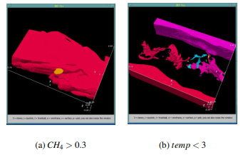
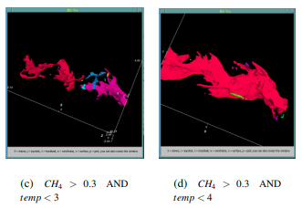


Slide 14
Multiresolution Support
if the query result exceed the available processing resources , FastBit supports returning data at different levels of resolution.
It encodes indices for hierarchy of resolutions, each provide a downsampled version of the data.
Bitmap indices estimate the number of cells a query will return, helping choose an appropriate resolution level.
The current method selects one cell from each 2x2x2 cluster, potentially losing topological detail.
Future Improvement: Plans include multiresolution sampling to preserve topological correctness.

Slide 15
Experimental Results
Two key questions addressed:
what is the cost of constructing bitmap indices?
how does the data search capability of DEX compare to a “standard implementation” of an isosurface algorithm that uses a span-space technique to accelerate data queries?
The benchmark data used is a multivalued combustion simulation dataset with approximately 56 million data points from a 383³ grid resolution, containing 38 variables per grid cell.
The hardware used for the benchmarks is a 2.8Ghz P4 machine with 2GB of RAM, and a SCSI RAID capable of 60MB/s in I/O bandwidth.

Slide 16
Index Construction
For this experiment, the researchers created a custom program that reads all the data for a specific variable into memory, constructs an index for that data, and then saves the index to a file.
It is a one-time process. Once the index is built, it is used during the data query stage, where the actual searching or querying of the data occurs. The results are passed on to other parts of the system for further analysis, visualization, or rendering.
The researchers mention that they couldn't measure the size of the span-space tree used by VTK’s isosurface algorithm. However, tree-based structures, like the span space tree, are known to have O(n log n) storage requirements.

Slide 17
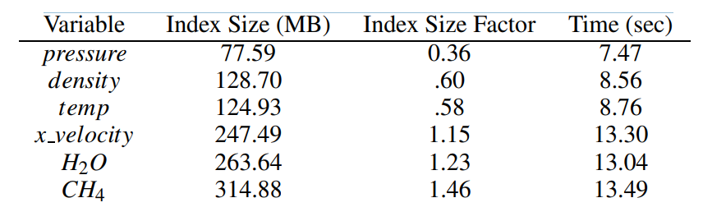
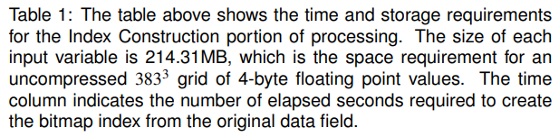

Slide 18
Data Search Performance Analysis
The benchmark comparison between DEX and VTK's Accelerated Marching Cubes for data search and geometry generation: The benchmark measures two phases of performance.
Data Search Phase:
VTK uses a span-space algorithm to find cells that intersect the isosurface (points where a surface passes through the dataset).
DEX uses a bitmap index to find cells based on a <= operation, locating all data points inside the isosurface, not just those on the surface.
Geometry Generation Phase:
VTK generates triangles (about 2.5 per cell) representing the isosurface.
DEX generates 12 triangles per cell (a finite-element hexahedron), which means it generates more geometry overall.
DEX performs better than VTK, producing results faster in both the search and geometry generation phases.

Slide 19
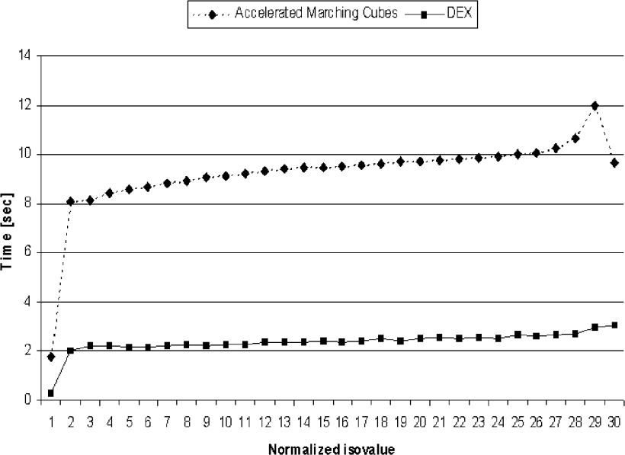

Slide 20
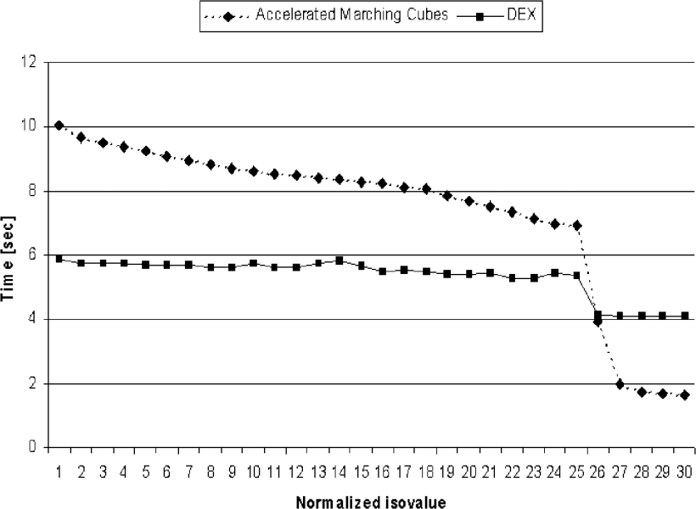

Slide 21
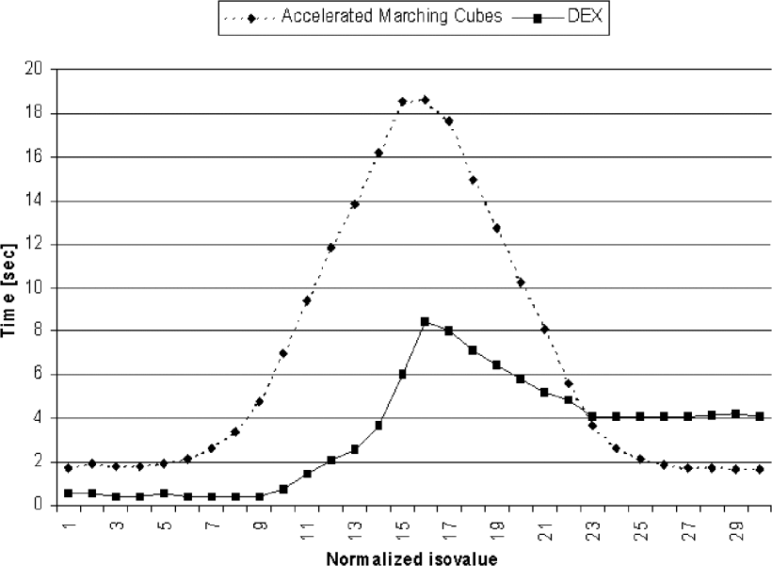

Slide 22
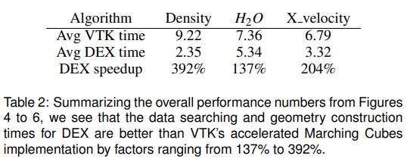
DEX's speedup (improvement over VTK):

Slide 23
Processing Stages in DEX:
Index Searching: Locates the cells that meet the search criteria.
Region Labeling: Labels connected regions within the data that satisfy the criteria.
Geometry Construction: Builds the finite-element geometry for each cell
For attributes like density, all three stages take roughly equal time. For attributes like H2O and x velocity, most time is spent in the geometry construction phase. If the cells that meet the criteria are densely packed, finding and labeling them takes less time.

Slide 24
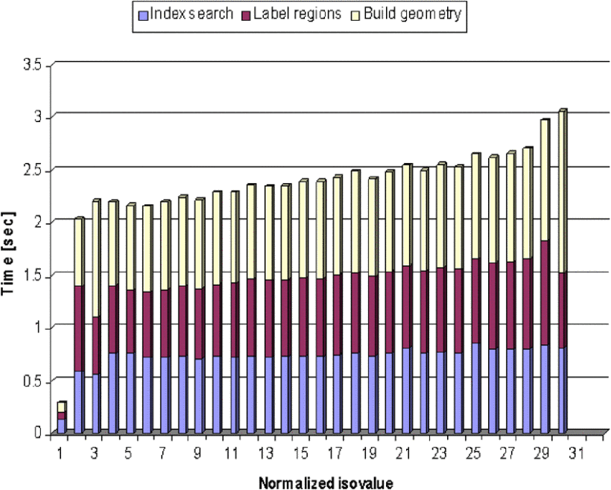

Slide 25
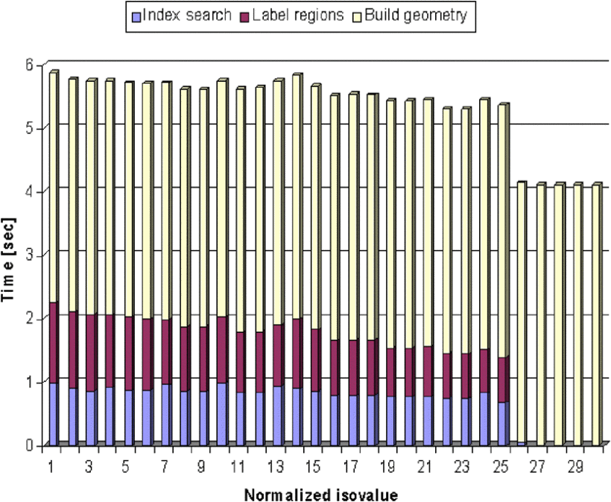

Slide 26
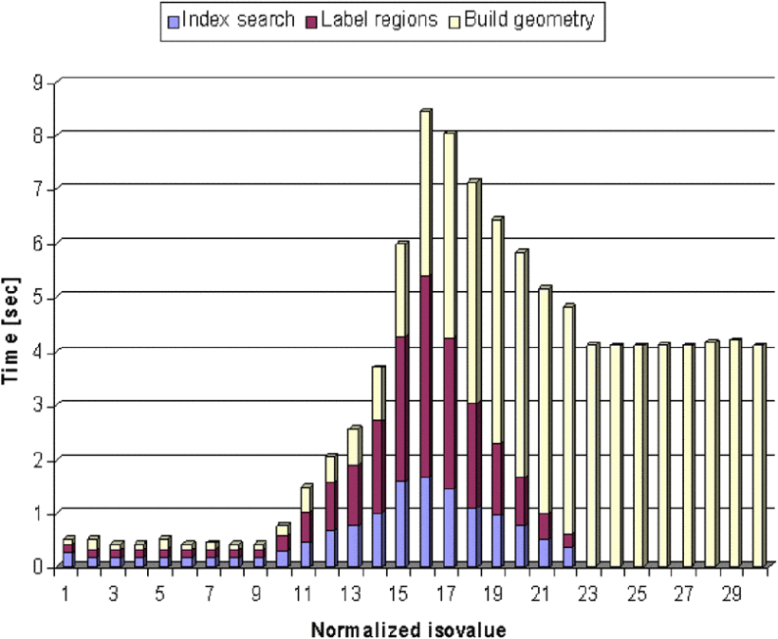

Slide 27
Future Work
Incorporation into main stream and visualization
Current State: The capabilities of bitmap indices (like those used in DEX) are currently part of a research prototype that is experimental and not widely accessible to everyday scientists.
Future Goal: Integrate this technology into popular visualization tools used by scientists, making it widely available for complex data analysis and visualization.
Search Estimation and Multiresolution Queries
Challenge: Poorly designed queries can end up returning too much data.
Solution: Use FastBit’s ability to quickly estimate how many data cells meet a query, allowing for reduced-resolution searches to avoid overwhelming the system.
Topology-Preserving Multiresolution Queries:
Current Approach: Early methods create multiresolution data by simply downsampling the data.
Improved Approach: Enhance methods to ensure that even if a coarser level of data meets the query requirements, the finer details are preserved. This ensures that important features remain visible at all levels of detail.

Slide 28
View Dependent Subsetting:
Current Limitation: Query times can be affected by the complexity of the query.
Improved Approach: Encode the location of each grid point in the indices. This allows queries to focus on regions of interest within the current view, improving efficiency by only processing the visible cells.
These future directions aim to make advanced data indexing and searching technologies more practical and effective in real-world applications.

Slide 29
Conclusion
DEX is a query-driven visualization framework that leverages advanced data indexing and search technology from the scientific data management community, offering improved computational and storage efficiency compared to previous query-driven visualization and isosurface acceleration methods. Its index construction algorithm operates with O(n) complexity and storage, significantly outperforming span-space accelerated isosurfacing techniques that require O(nlogn). During data search, DEX's FastBit algorithm has O(k) complexity, making it 137% to 392% faster than VTK’s Accelerated Marching Cubes. Additionally, DEX supports complex multivariate and multidimensional range queries in O(k) time, surpassing tree-based methods and proving useful for data analysis in fields like High Energy Physics. Its modular architecture enables flexible application across diverse data analysis and visualization challenges.

Slide 30
Thankyou!

