Slide 1

Fast Parallel Surface and Solid Voxelization on GPUs
Michael Schwarz, Hans-Peter Seidel
Presented by
Arindom Bora, Khush Khandelwal, Md Rahbar
Indian Institute of Technology Kanpur (IITK)
email: {arindom21, khushk21, mdrahbar21}@iitk.ac.in

Slide 2
Outline
Introduction
Surface voxelization: Triangle/Box Overlap Test
Types of surface voxelization
Conservative voxelization
6-separating voxelization
Solid voxelization
Sparse solid voxelization
Implementation
Results
Conclusion

Slide 3


What are Pixels?
A pixel is a “single” block of information about “color”
complete image
Dimension: 1920 pixels x 1080 pixels
2073600 pixels
Source: Wallflare.com

Slide 4
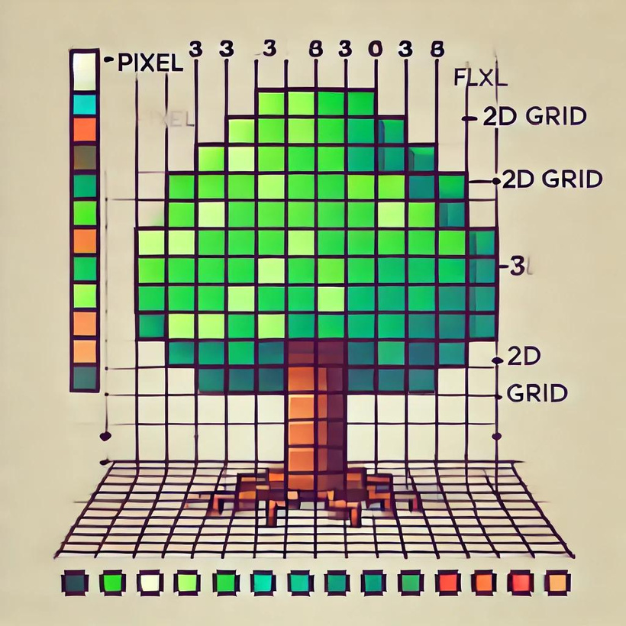
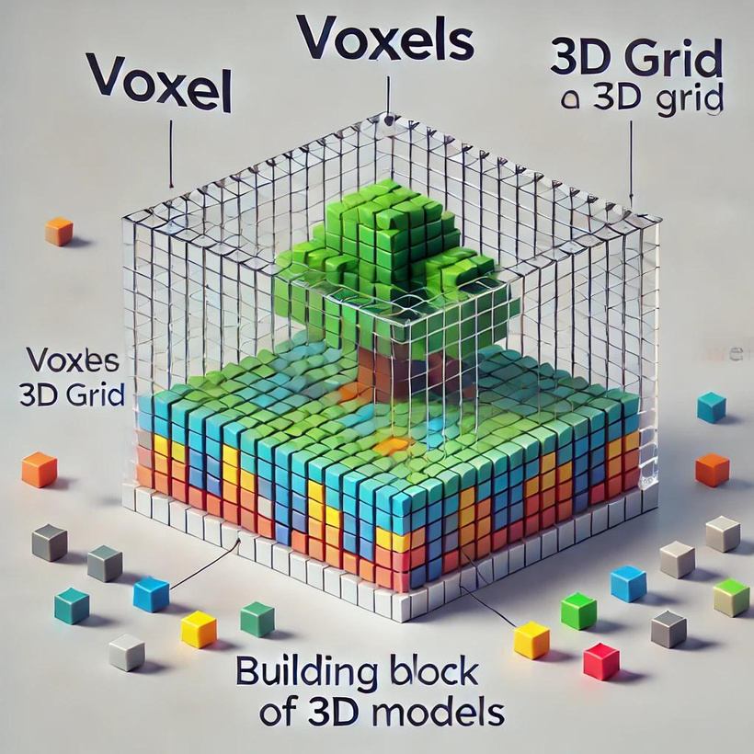
What are Voxels?
Voxels are three-dimensional pixels, short for "volumetric pixels."
Add one more dimension

Slide 5


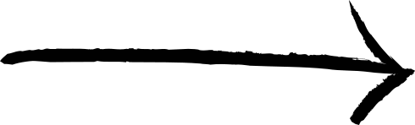
Information in VOXELS
Voxel
Single information about
Color
Height
Width
Single information about
Height , Width and Depth are fixed across all pixels and voxels
Depth
Density
Opacity
Material properties
+
Pixel
roughly 1/96 of an inch, or 0.26 millimeters
Voxels are especially valuable in fields like medical imaging, 3D modeling, and scientific visualization, where depth and volume play integral roles.
While pixels lay the groundwork for understanding digital images on screens, voxels offer a bridge to exploring and interacting with 3D spaces in a digital context. Together, they encapsulate a wide spectrum of visual representation, from the simplest of digital graphics to the most complex of 3D simulations

Slide 6
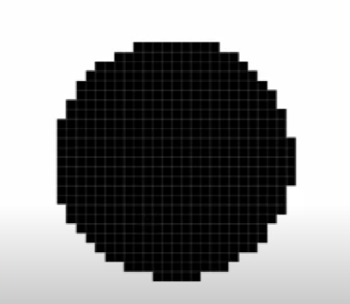
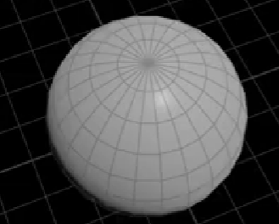
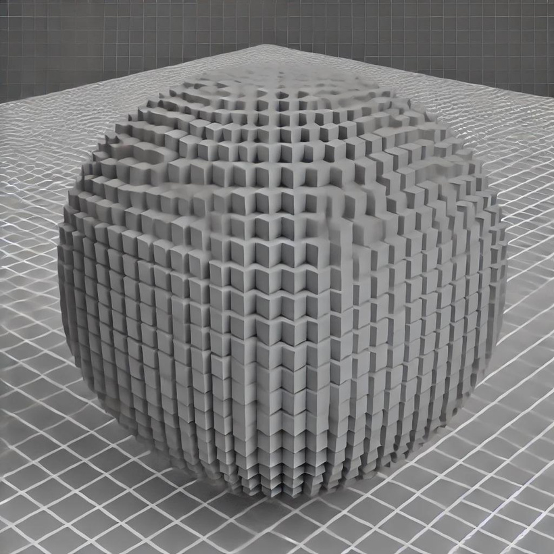
What is the need of Voxel?
3D surface doesn’t represent information outside or inside of the shell
2D: bunch of pixels
Why don’t we fill outside and inside with a bunch of points
This is not going to give us the continuous set of data
Bunch of voxels
Represents continuous information
Source: Nine Between

Slide 7
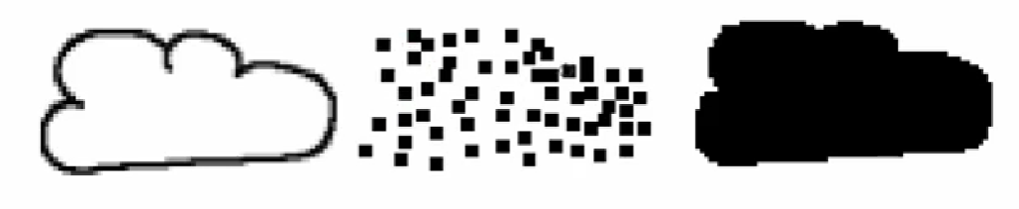
What is the need of Voxel?
Cloud as a surface
Cloud as a set of points
Cloud as a set of voxels
Continuous set of information
No gaps in information
No information inside the cloud
Gap in information
No information outside the cloud
Source: Nine Between

Slide 8
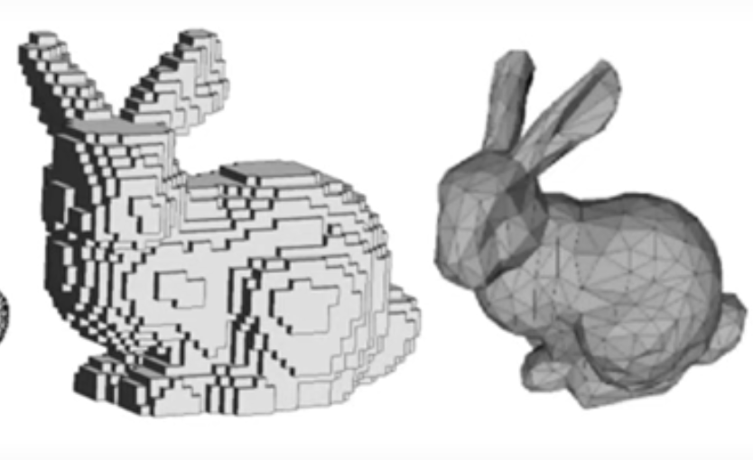
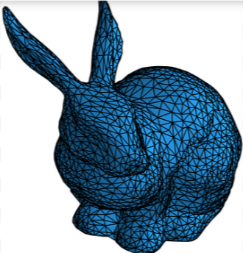
Surface Voxelization
Triangle mesh
Voxel Grid
Surface voxelization involves converting the surface of a 3D object into a discrete set of small cubic volumes called voxels. The goal is to identify which voxels the surface of the object intersects or touches
Source: https://doi.org/10.3390/electronics8101196
Source: CVF.com

Slide 9
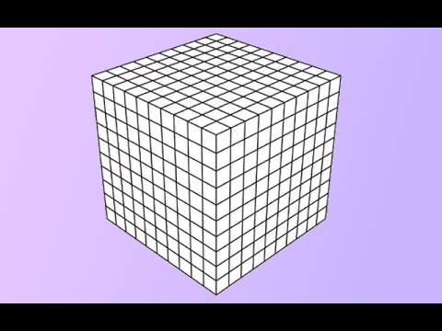
Surface Voxelization - Triangle/Box Overlap Test
Imagine a 3D object like a triangle mesh representing a cube. To voxelize this surface, you would overlay a 3D grid of voxels over the triangular/polygon mesh
The challenge is to determine which of these voxels intersect the triangles of the mesh
The triangle/box overlap test determines whether a triangle (part of the 3D object's surface) overlaps with a voxel (a small cube in the 3D grid). This test is performed for each triangle of the mesh against all voxels within the bounding box of that triangle
+
Source: stuartspence9921

Slide 10
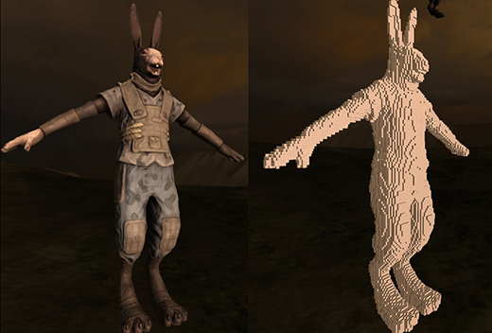
An Intutive Example
http://blog.wolfire.com/2009/11/Triangle-mesh-voxelization

Slide 11

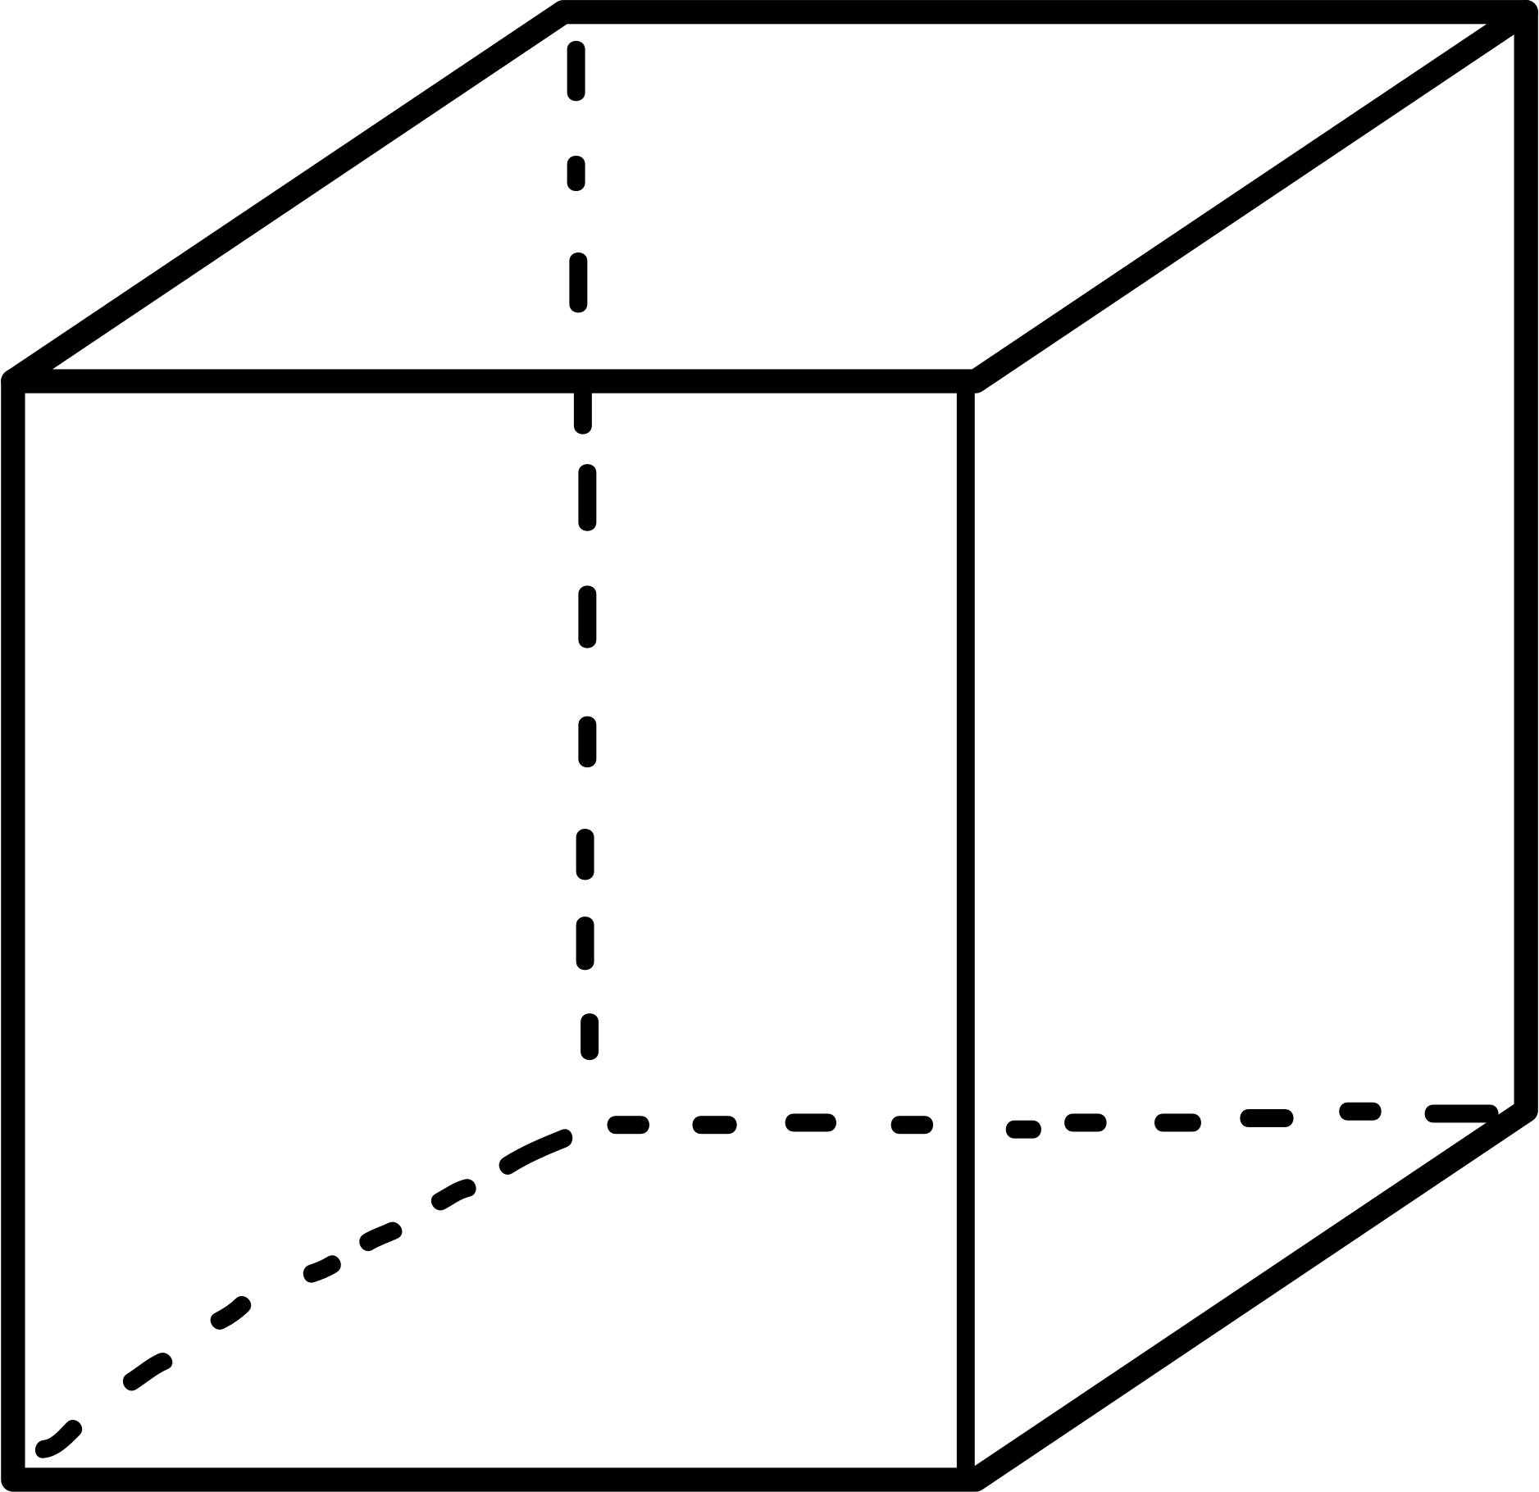
Mathematical Approach
The minimum corner of a voxel is the point with the smallest coordinates (x, y, z) in the voxel's local coordinate system. It is often referred to as the "origin" of the voxel and serves as the reference point for defining the voxel’s position within the 3D space
Given a triangle T with vertices v0, v1, v2 and an axis-aligned box B (voxel) with
minimum corner p and side length ∆p
Step 1:
Plane Overlap Condition:
Define the Triangle’s Plane:
Calculate the normal vector (n) of the triangle using the cross product of two of its edges:
n=(v1​−v0​)×(v2​−v0​)
Critical Points of the Voxel:
Identify critical point c of the voxel that could be on either side of the plane. This is
calculated based on the direction of the normal vector (n). For instance:
y
pᵧ+Δpᵧ
If the x-component of the normal is positive, select the corner at p+Δp for x.
If it’s negative, select the corner at p.
p+Δp
Plane Check:
Check if the two points p + c and the opposite box corner p + (∆p − c) lie on different
sides of the plane or one lies on the plane. Mathematically, this is:
p
pₓ+Δpₓ
x
(<n, p> + d1) × (<n · p> + d2) ≤ 0
d1 = ⟨n, c - v0⟩
d2 = ⟨n, (Δp - c) - v0⟩
pz+Δpz
z

Slide 12
Step 2:
2D Projection Overlap Tests
For each of the three coordinate planes (xy, xz, yz), perform the following steps:
Project the Triangle and Voxel:
Project the triangle and voxel onto the chosen 2D plane, for example, the xy-plane
Edge Functions:
Use edge functions to define the boundaries of the triangle in the 2D plane. An edge function for a line between two vertices v_i and v_{i+1}​ is defined as:
Edge Function = (x − vi.x) · (vi+1.y − vi.y) − (y − vi.y) · (vi+1.x − vi.x)
The sign of this function tells you which side of the edge a point lies on
Test Voxel Corners:
Evaluate the edge functions at specific corners of the voxel’s projection to determine if any corners are inside the triangle. For the voxel in the xy-plane, the corners to test might be
(p.x,p.y) and (p.x+Δp.x,p.y+Δp.y) etc

Slide 13
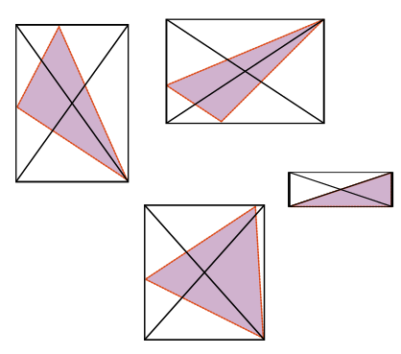

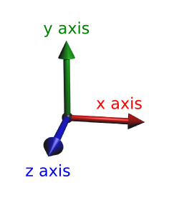
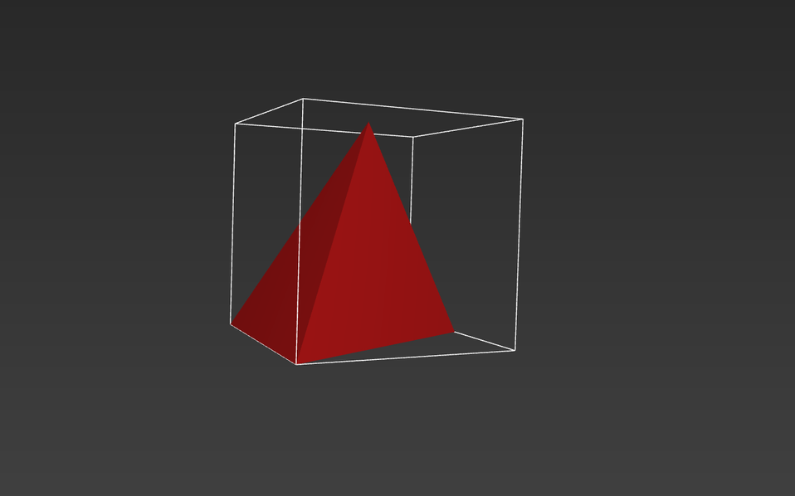

Step 3:
Bounding Box Overlap Check
Bounding Box of the Triangle:
Compute the Axis-Aligned Bounding Box (AABB) of the triangle in 3D space
defined by 2 points:
Minimum Corner
Maximum Corner
Maximum
Corner
Overlap with Voxel’s AABB:
Check if this bounding box overlaps with the voxel's bounding box.
If there's no overlap, the voxel is not intersected by the triangle
Source: @taozi, Mathematics Stack Exchange
Source: @egitma, medium.com

Slide 14
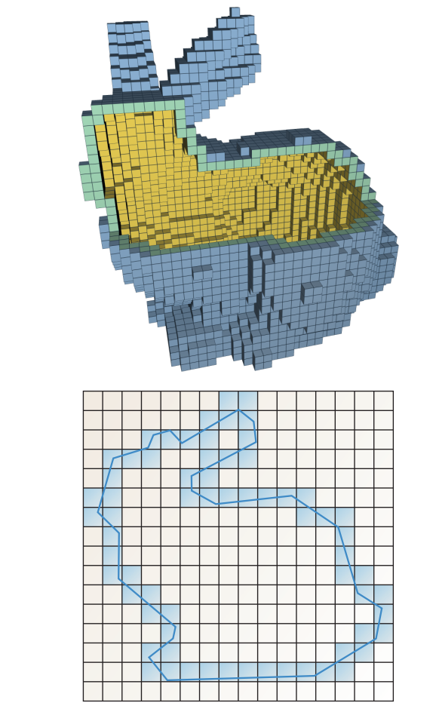
Different types of Surface Voxelization
Conservative
6-Separating Voxelization
Conservative Voxelization: Sets all voxels that overlap or touch any part of the triangle. This results in a denser set of voxels, capturing all possible interactions with the triangle
A method that marks all voxels that a triangle overlaps or touches, including edges and corners without missing any thin or small features

Slide 15
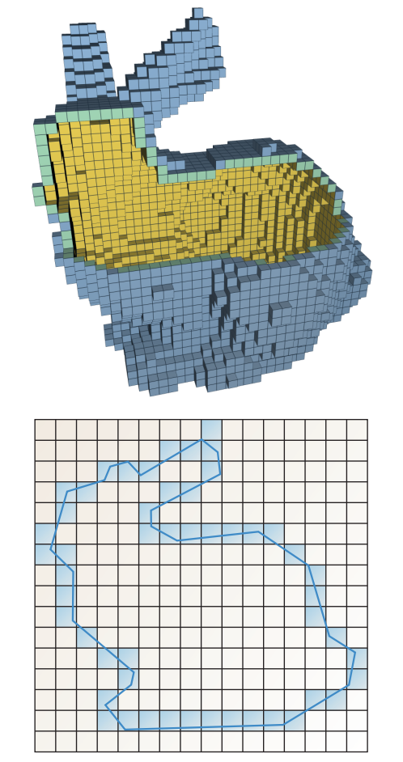
Different types of Surface Voxelization
Conservative
6-Separating Voxelization
6-Separating Voxelization: Aims for a thinner voxelization where only the essential voxels are set to maintain 6-connectivity (voxels sharing faces are connected)

Slide 16
Conservative Surface Voxelization – Implementation
Triangle-Parallel Approach:
To obtain a conservative voxelization, all voxels overlapped by an input mesh’s triangles must be determined. One natural data-parallel approach to this computation is processing all triangles in parallel, launching one thread per triangle
Step 1: Bounding Box Calculation
To narrow down the number of voxels that need to be tested for overlap with each triangle, minimizing the computational load by focusing only on voxels within the triangle’s bounding area
To identify which voxels within the calculated bounding box actually intersect with the triangle surface, ensuring that all surface-relevant voxels are correctly marked
Step 2: Overlap Test Execution
Iterate Over Voxels in the Bounding Box
Execute Triangle/Box Overlap Test
Plane Overlap Test
2D Projection Tests
Bounding Box Check
Mark Voxel if Overlap Exists

Slide 17
Conservative Surface Voxelization – Implementation
Triangle-Parallel Approach:
Step 3: Optimization Techniques
Atomic Operations
Problem: In a parallel GPU environment, each triangle is processed by a separate thread. When multiple triangles overlap the same voxel, the corresponding threads may attempt to update the same bit simultaneously
Solution: Use atomic operations, such as atomic OR, which ensures that updates to the voxel grid are performed safely and consistently. Atomic operations allow multiple threads to update the same memory location without interference, preventing conflicts
Explained ahead from page 21...

Slide 18
Conservative Surface Voxelization – Implementation
Triangle-Parallel Approach:
Step 3: Optimization Techniques
Handling 1D and 2D Bounding Boxes:
Specific cases are considered where the bounding box is only one voxel thick in one or more dimensions. For such 1D or 2D cases, the overlap tests are simplified:
If a bounding box covers just one voxel in at least two directions, no further tests are required—all covered voxels can be directly marked.
Reduced Overlap Checks
In some scenarios, the overlap tests can be simplified based on specific configurations:
For example, if the AABB spans only one voxel in the z-direction (essentially making it 2D), tests in the z-axis can be simplified or skipped, reducing computational load.
Optimization Benefit: Reducing overlap checks speeds up the voxelization process, especially in cases where the AABB is not fully three-dimensional, saving on unnecessary calculations.

Slide 19
Overview of Voxel Updates in Parallel Conservative Voxelization
In GPU-based voxelization, updating voxel states accurately and efficiently is a critical aspect, especially when processing multiple triangles concurrently. Each triangle might affect several voxels, and these updates need to be coordinated carefully to avoid conflicts and ensure that all relevant voxels are marked correctly
1. Encoding Voxel States with Bits:
Each voxel’s state (whether it is part of the surface or not) is represented by a single bit in a 32-bit integer array.
if a voxel is part of the surface, its corresponding bit is set to 1;
otherwise, it remains 0
The voxel grid is stored as a linear array of 32-bit integers.
Each bit within an integer corresponds to a specific voxel in the grid
Voxels are indexed linearly such that consecutive voxels along the x-axis are represented by consecutive bits in a 32-bit integer

Slide 20
Overview of Voxel Updates in Parallel Conservative Voxelization
“In a parallel GPU environment, each triangle is processed by a separate thread. When multiple triangles overlap the same voxel, the corresponding threads may attempt to update the same bit simultaneously”
solution
Atomic OR
Process
1. Looping Over Voxels:
When processing a triangle, the algorithm loops over all voxels within the triangle’s bounding box. The innermost loop progresses along the x-direction because adjacent voxels along the x-axis are represented by consecutive bits in the same 32-bit value.
2. Buffered Writes to Registers:
Instead of performing an atomic operation for each voxel immediately, the updates are first buffered in a register within the GPU thread
A register is a small, fast storage location inside the GPU, used to hold temporary values during computation. As the loop iterates over the voxels, the corresponding bits in a 32-bit register are set for each voxel that should be marked

Slide 21
Overview of Voxel Updates in Parallel Conservative Voxelization
3. Bit Masking:
For each voxel that needs to be marked, a bitmask is created to set the correct bit in the 32-bit register
Example:
Suppose you are processing a set of voxels aligned along the x-axis, and their positions correspond to the 0th, 1st, and 2nd bits within a 32-bit integer
If the first and third voxels need to be set (positions 0 and 2), the bitmask for these would be:
For the 0th voxel: “000...0001” (sets the 0th bit)
For the 2nd voxel: “000...0100” (sets the 2nd bit)
These bitmasks are combined using bitwise OR operations as the loop progresses:
First voxel: 000...0001
Third voxel: OR operation with first, 000...0001 | 000...0100 = 000...0101
The result in the register after processing these voxels would be 000...0101
4. Final Atomic Write:
Once all relevant voxels for this 32-bit value have been processed, the entire register value (with all necessary bits set) is written back to the main memory in a single atomic operation.
This significantly reduces the number of atomic operations because the update for all 32 bits is batched into one operation.

Slide 22
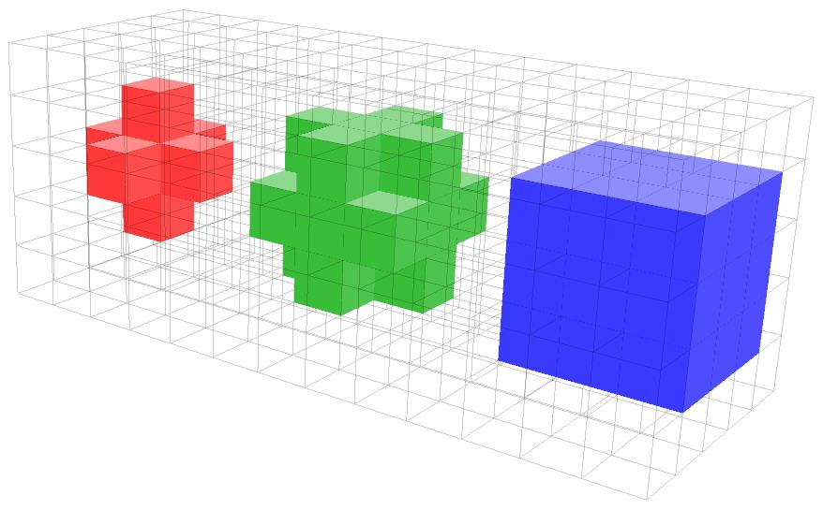
26-Seperatibility (Conservative Voxelization)
A single voxel has 26 neighbouring voxels as depicted here
8 surrounding it in its own plane
9 surrounding it in the front plane
9 surrounding it in the back plane
two voxels are said to be 26-adjacent if they share a common vertex, edge, or face (any of the three)
Similarly, 26-seperatibility ensures that two voxels on the both side of surface are not connected through any path i.e. niether through vertex, nor through edge and nor through face
Source: ScienceDirect.com

Slide 23
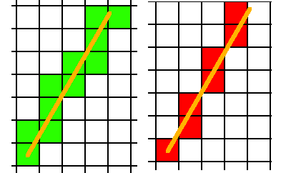
6-Seperatibility
On the right is the typical line rasterization: the algorithm finds the one pixel nearest the line within each row (or column, depending on slope). This produces what we usually think of as a "1-pixel-thick" line. On the left is a conservative (26-Seperatibility) rasterization, which finds every pixel whose rectangle is touched by the line, and it produces a thicker line
6-separating voxelization is like the thin line on the right, and 26-separating is like the thick line on the left, but in 3D. If you imagine the line is actually a triangle viewed on-edge, this is analogous to what the voxelization would look like
26-Seperatibility
6-Seperatibility
Source: @NathanReed, computerGraphicsStackExchange.com

Slide 24
6-Separating Surface Voxelization
A variant of surface voxelization that produces a "thinner" representation of the surface
Objective:
To create a voxelization that is 6-connected (adjacent by faces only), making it a more compact representation
Method Adaptation:
6-separating surface voxelization adapts the basic principles of conservative voxelization but with adjustments to the overlap criteria to maintain 6-connectivity and minimize voxel count
Modifying Overlap Tests
Incorporation of 6-Separating Criteria

Slide 25
Mathematical Approach
Plane Overlap Test Modifications:
Define the Dominant Axis:
Identify the dominant axis of the triangle's normal vector n. The dominant axis is the one with the largest
absolute component of the normal vector, i.e.:
= arg max|n#|
#=x,y,z
⋄
This axis will guide the adjustments to the overlap test because the most significant contributions to the overlap will occur along this axis
Modified Offsets for Plane Test:
d1 = ⟨n, 1/2 ∆p − v0⟩ + 1/2 ∆p⋄|n⋄|
d2 = ⟨n, 1/2 ∆p − v0⟩ − 1/2 ∆p⋄|n⋄|
Δp : voxel's side length
Δp⋄: side length along the dominant axis
These offsets adjust the voxel marking criteria to capture only the voxels necessary for 6-connectivity,

Slide 26
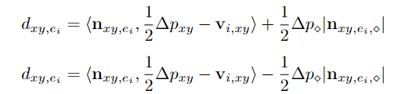


Mathematical Approach
2D Projection Overlap Test Modifications
“For 2D projections (e.g., onto the XY plane), the overlap tests are adapted to maintain 4-separability in 2D, analogous to 6-separability in 3D. This ensures that in the projected plane, pixels (voxels in 3D) are only marked if necessary for edge connectivity”
Offsets for 2D Projection Overlap Test:
: normal vector of the edge in the 2D projection plane
: voxel size in the projection

Slide 27
Advantages of 6-Separating Surface Voxelization
Thinner Representation:
By focusing on 6-connectivity, this method produces a thinner voxel representation of the surface, reducing memory usage and processing overhead
Less Memory-Intensive:
Since fewer voxels are marked compared to more conservative approaches, the overall memory footprint is lower. This is particularly beneficial in large-scale 3D applications where memory efficiency is critical
Maintains Surface Integrity:
Despite the reduced voxel count, the method ensures no gaps in the surface representation, maintaining the essential topological features needed for accurate modeling and analysis
Consistency Across Tessellations:
By strictly adhering to 6-connectivity, the voxelization remains consistent even when the input mesh undergoes different tessellations. This ensures that the representation is robust and reliable across various surface configurations

Slide 28
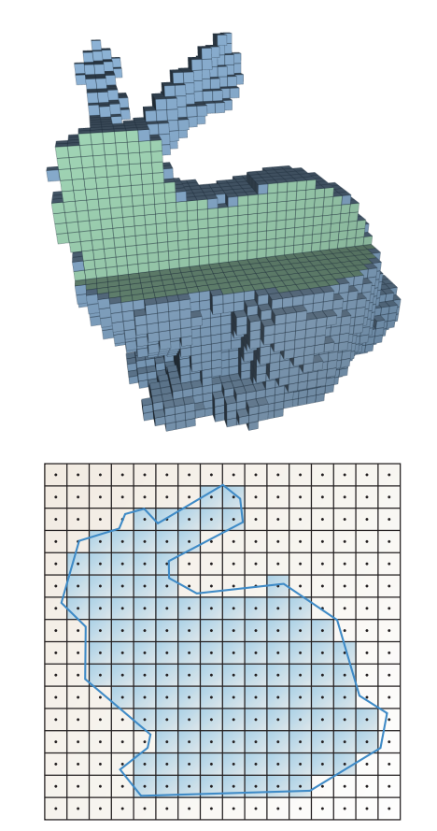
Solid Voxelization
Solid voxelization involves marking all voxels that are inside a 3D object, not just those on the surface

Slide 29
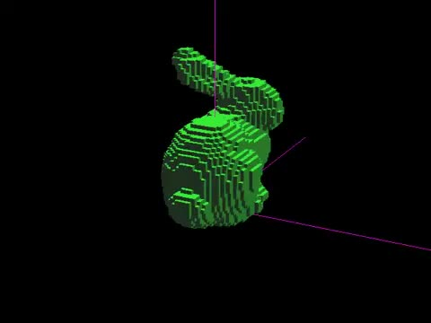
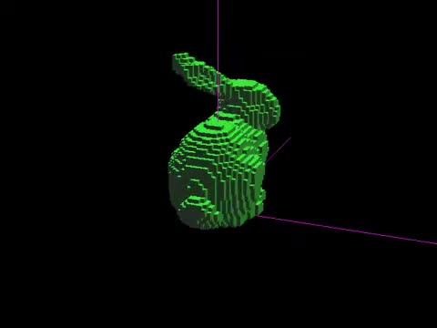
Surface Voxelization
Solid Voxelization
Source: @Yuki Koyama, Youtube

Slide 30
Solid Voxelization
Triangle-Parallel Method
This method processes each triangle of the object’s mesh in parallel using GPU threads, similar to surface voxelization. However, instead of marking only intersecting voxels, it aims to identify and fill the interior voxels
Step 1: Bounding Box Calculation in the yz plane (Same as Surface Voxelization)
Step 2: Overlap Tests (Same as Surface Voxelization)
Step 3: If overlap is detected, the centre of the voxel is projected along the x axis onto the triangle’s plane.
Let the resulting x coordinate in voxel space be q.
Step 4: For x in range ⌊q + 0.5⌋ to n_x − 1 , flip the bits of voxels in the column using the atomc XOR function.
Drawbacks :
The number of relevant voxel columns can vary significantly among the triangles processed by one warp, leading to underutilization.
For larger voxel grids, flipping all voxels in the derived x range poses high memory bandwidth requirements. Moreover, many atomic operations may have to be sequentialized, negatively affecting performance.

Slide 31
Solid Voxelization
Tile-based solid voxelization
The tile-based approach divides the voxel grid into tiles, each containing multiple voxel columns (specifically, 4x4 voxel columns in the yz-plane). Triangles are assigned to these tiles based on their intersection with the tiles’ voxel columns
Tile Assignment
Step 1: For each triangle, determine how many tiles it overlaps by projecting them on the YZ plane.
This is done in parallel across all triangles. Initialize a work queue of this size.
Step 2: Visit all the triangles again in parallel. When a tile is found to be overlapped by a triangle, insert the
corresponding tile/triangle pair into the work queue. Sort the queue according to the tile index.
Tile Processing
Step 1: For each tile, allocate one thread per voxel column. Each thread is responsible for checking its voxel
column against the assigned triangles, using overlap tests to determine which voxels to fill.
Step 2: If the triangle overlaps the voxel column, the thread identifies which voxels in that column are affected by
the triangle. These voxels are flipped from outside to inside (or vice versa) using bitwise xor operation.
Optimization : Instead of writing to memory for each voxel immediately, the results are buffered in local memory (registers). Once the entire column is processed, the changes are flushed (written) to global memory in one go to minimize memory operations.

Slide 32
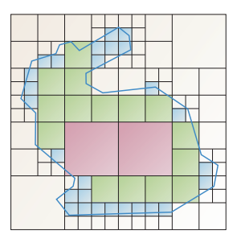
Efficient Voxelization Using Sparse Hierarchical Structures
Solid voxelization drawbacks:
Operates on the entire grid of voxels, explicitly storing each voxel’s state.
Inefficient due to large uniform regions being stored explicitly.
The paper suggests a sparse hierarchical structure, a more space-efficient representation. Thus, a method for solid voxelization that uses an octree as representation is proposed.

Slide 33
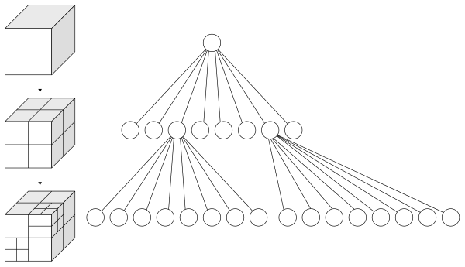
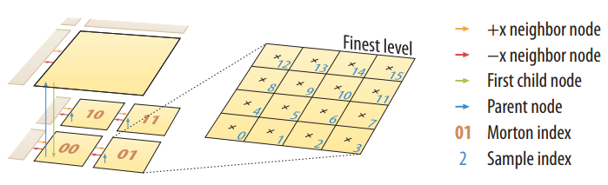
Efficient Voxelization Using Sparse Hierarchical Structures
What is an Octree ?
An octree is a tree data structure in which each internal node has exactly eight children. Octrees are most often used to partition a 3D space by recursively subdividing it into 8 octants.
All nodes of one level are stored contiguously, sorted according to the Morton space-filling curve.
Level 0 nodes : Voxel sub-grid of size 4x4x4 (finest-level)
Level 1 nodes : Voxel sub-grid of size 8x8x8
and so on...
The first child of any node has an index that is a multiple of 8. Each node maintains a pointer to its first child as well as pointers to its parent and its neighbors in x direction.
Overview of the octree structure (2D analog)

Slide 34
Construction of Octree
Determination of Level-1 Active NodesㅤㅤㅤㅤㅤㅤㅤㅤㅤㅤㅤㅤㅤㅤㅤㅤㅤㅤㅤㅤㅤㅤㅤㅤㅤㅤㅤㅤㅤㅤㅤㅤActive nodes at level-1, which are overlapped by the input mesh, are identified through a conservative surface voxelization using level-1 resolution grids. The resulting list of active nodes is sorted in Morton order, referred to as ActNodes1.ㅤㅤㅤㅤㅤㅤㅤㅤㅤㅤㅤㅤㅤㅤㅤㅤㅤㅤㅤㅤㅤㅤㅤㅤㅤㅤㅤㅤㅤㅤ
InitializationㅤㅤㅤㅤㅤㅤㅤㅤㅤㅤㅤㅤㅤㅤㅤㅤㅤㅤㅤㅤㅤㅤㅤㅤㅤㅤㅤㅤㅤㅤㅤㅤㅤㅤㅤㅤㅤㅤㅤㅤㅤㅤㅤㅤAllocate and initialize child nodes for all active level-1 nodes. Set x-neighbor pointers between adjacent child nodes that share the same parent node for fast traversal during voxelization.
Bottom-Up ConstructionㅤㅤㅤㅤㅤㅤㅤㅤㅤㅤㅤㅤㅤㅤㅤㅤㅤㅤㅤㅤㅤㅤㅤㅤㅤㅤㅤㅤㅤㅤㅤㅤㅤㅤㅤㅤㅤㅤㅤㅤFor each active level-1 node, check if the next node in ActNodes1 has a different level-2 parent. ㅤㅤㅤㅤㅤWrite 1 to Flag1 if it does, otherwise write 0. ㅤㅤㅤㅤㅤㅤㅤㅤㅤㅤㅤㅤㅤㅤㅤㅤㅤㅤㅤㅤㅤㅤㅤㅤㅤㅤㅤㅤPerform an exclusive scan on Flag1 to compute ParentIndex1, which gives the indices of level-2 parent nodes in the octree.
Creating Higher-Level NodesㅤㅤㅤㅤㅤㅤㅤㅤㅤㅤㅤㅤㅤㅤㅤㅤㅤㅤㅤㅤㅤㅤㅤㅤㅤㅤㅤㅤㅤㅤㅤㅤㅤㅤㅤㅤㅤㅤUse ParentIndex1 to allocate & initialize level-1 nodes (Nodes1) in octree & establish parent-child relationships. Derive a list of active level-2 nodes (ActNodes2) by stripping the least significant 3 bits from the Morton codes of level-1 nodes. ㅤㅤㅤㅤㅤㅤㅤㅤㅤㅤㅤㅤㅤㅤㅤㅤㅤㅤㅤㅤㅤㅤㅤㅤㅤㅤㅤㅤㅤㅤㅤㅤㅤㅤㅤㅤㅤㅤㅤㅤㅤㅤRepeat the same process for higher-level nodes (level-3, level-4, etc.) until a single root node is reached.

Slide 35
Voxelization into Octree
Step 1: Allocate one thread per triangle and perform Rasterization in the yz Plane to determine the overlapping
voxels.
Step 2: In case of an overlap, project the centre of the overlapping voxel along the x axis onto the triangle’s plane
to get the x index (q) of the first voxel that needs to be flipped.
Step 3: The level-0 node containing that voxel is identified, and all voxels in the corresponding column of its voxel
sub-grid within the local x-index range are flipped via an atomic xor operation.
Hierarchical inside/outside propagation
Step 1: Identify head nodes (no set level-0 −x neighbor)
Step 2: When 8 level-0 nodes with the same level-1 parent have all their voxels in agreement, propagate the flip
information to the level-1 parent node.
Step 3: This propagation to the next coarser level and then within this level is performed analogously for the
remaining levels.

Slide 36
Implementation
The paper implements the described voxelization approaches in CUDA
The methods take an indexed triangle set as input, provided in a vertex and an index buffer.
At first, the vertices are always transformed to voxel space and the voxel grid is initialized with zeroes.
Atomic memory
Except for the tile-based solid voxelization, all introduced approaches make heavy use of atomic memory operations.
Rasterization-based voxelization techniques employ the GPU’s fixed-function ROP units to set or flip bits.
For the used (GT200-based) hardware, atomic memory operations are expensive and can easily dominate the runtime if the same memory location is touched by multiple atomics.
Making a warp access triangles with a certain stride increases the chance that concurrently executed atomics refer to different memory locations.
This is because contiguously stored triangles are typically close in 3D space.

Slide 37
Results
Multiple models and various voxel grid sizes are used for testing the proposed methods.
Intel Core 2 Quad 2.83 GHz with an NVIDIA GeForce GTX 285, using isotropic voxels and making the grid closely encompass the whole model.
The following slides show three tables:
Table 1: Surface voxelization
Table 2: Solid voxelization
Table 3: Sparse solid voxelization
Pipeline-based approach {Zhang et al.] is used as a baseline for benchmarking the results in table 1 & 2.

Slide 38
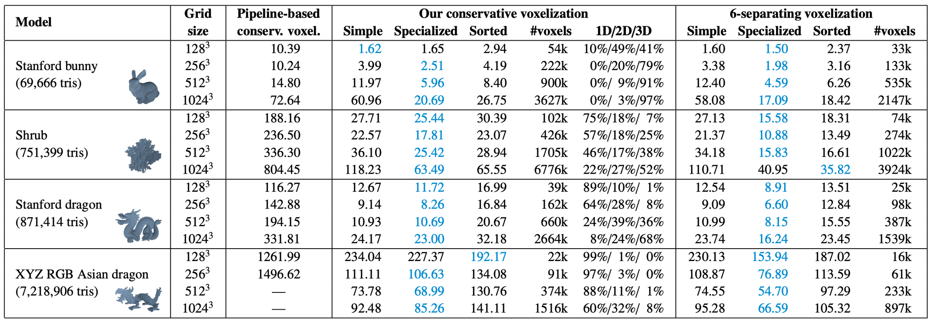
Results
Running time (in ms) for different surface voxelization methods, along with the number of resulting voxels and the encountered percentage of cases with a 1D, 2D and 3D bounding box. For comparison, the pipeline-based approach by Zhang et al. [2007] is included

Slide 39
Results
Inferences from Table 1:
Shrub model has many branches, berries and leaves giving a high surface complexity, resulting in a large number of overlapped voxels.
The specialized version turned out to perform fastest and sorting didn’t pay off.
Compared to pipeline-based conservative voxelization [Zhang et al. 2007], the proposed data-parallel methods and 6-separating voxelization are consistently faster.

Slide 40
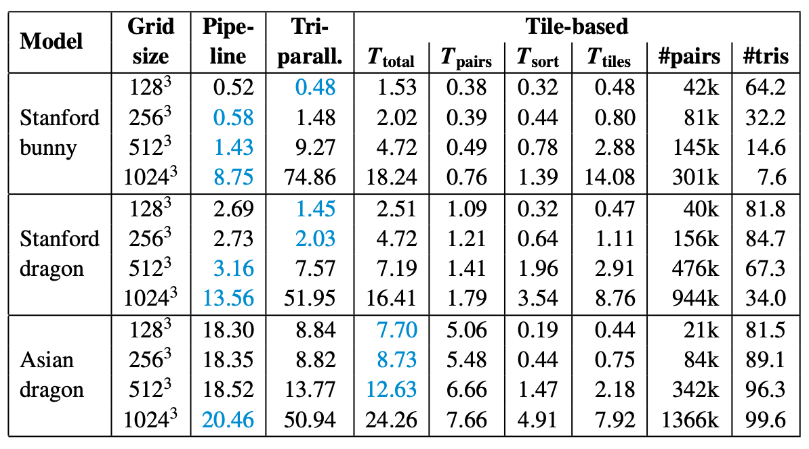
Results
Running time (in ms) for different solid voxelization methods. The break-down for the tile-based approach considers determining the work queue (Tpairs), sorting it (Tsort), and processing the tiles (Ttiles). Moreover, the number of tile/triangle pairs in the queue and the average triangle list length per active tile are provided.

Slide 41
Results
Inferences from Table 2:
The tile-based method becomes faster than the triangle-parallel approach if the grid size is high or the model features many triangles.
For these cases the overhead of assigning triangles to tiles and always testing all voxel columns in a tile for overlap is offset by the saving in memory bandwidth and the avoidance of atomic operations.

Slide 42
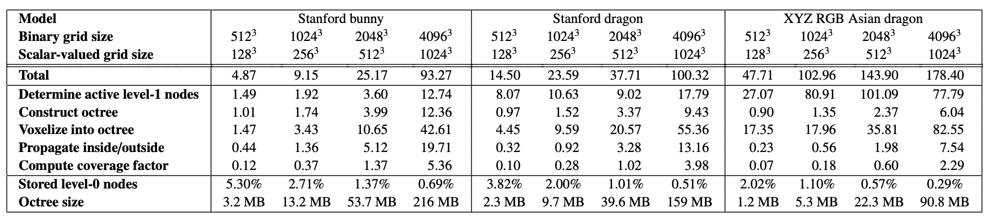
Results
Running time (in ms) for our sparse solid voxelization method, including a break-down. The percentage of explicitly stored level-0 nodes provides a measure of sparseness. The given octree size accounts for both the structure and the data

Slide 43
Results
Inferences from Table 3:
The octree-based solid voxelization is very sparse. In particular, we are able to represent a voxelization covering a grid of size 4096^3 with just 216 MB (bunny model), comprising both the data and the octree structure.
It turns out to be more expensive for models with a higher triangle count.
The timing break-down indicates that the determination of active level-1 nodes is rather costly and can even clearly dominate the overall time which can be traced back to the heavy use of atomic operations.

Slide 44
Conclusion
Data-Parallel Voxelization Algorithms:
Developed algorithms for surface and solid voxelization that enable real-time applications.
Conservative Voxelization:
Achieves up to 10x performance improvement over previous GPU-based methods.
Introduces a new triangle/box overlap test useful in other domains.
Solid Voxelization Strategies:
Provides data-parallel alternatives to hardware rasterizers, especially for tasks requiring multiple data updates per fragment.
Octree-Based Sparse Voxelization:
Enables higher-resolution voxelizations on GPUs with a compact hierarchical structure.
Offers a custom rendering pipeline surpassing previous GPU limitations.

Slide 45
Thank you!

