Slide 2
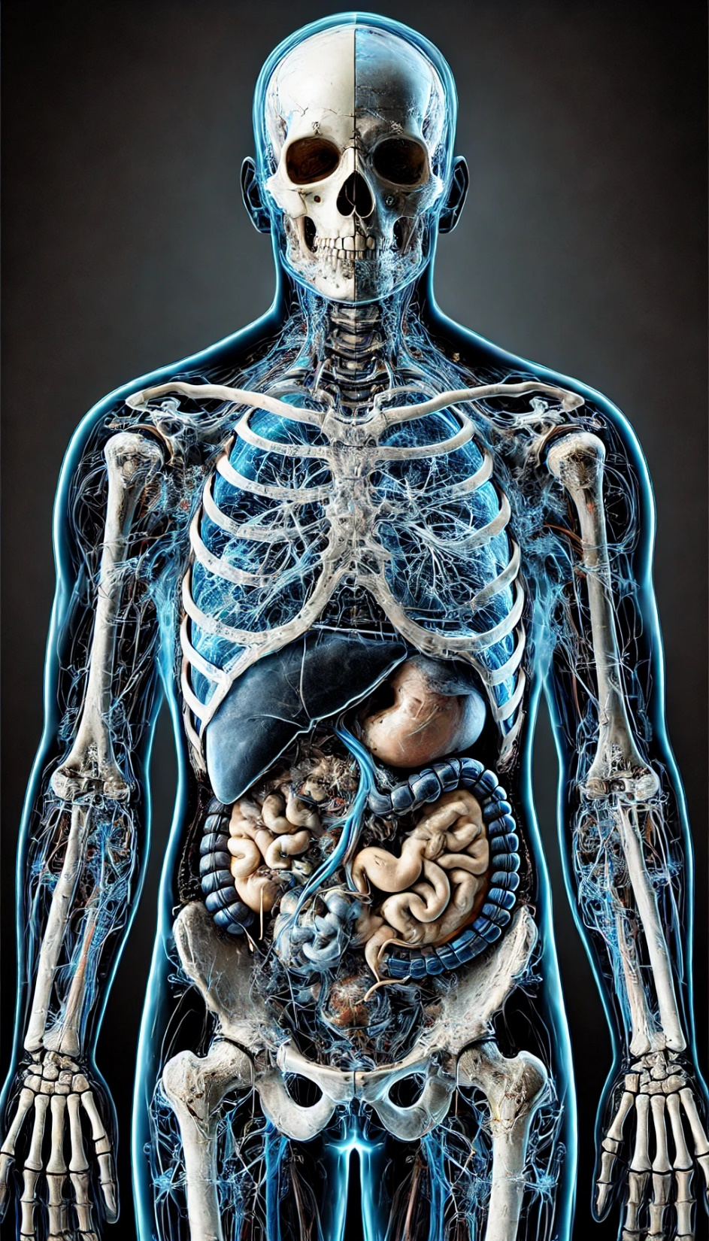
Reduced Dimensions :
X and Y Axis
Variates :MRI ,CT SCAN and X-RAY

Slide 3
CT SCAN
MRI
X-RAY

Slide 4
Select window

Slide 5
CS677
Topics in Large Data Visual Analytics
GAINING UNDERSTANDING OF
MULTIVARIATE AND MULTIDIMENSIONAL DATA
THROUGH VISUALIZATION
Selan dos Santos, Ken Brodlie, 2004
Group 18
G.Rishi | 200364
Rishit | 241110056
Major Rajan | 241110089

Slide 6
KEY ASPECTS
How dimensionality reduction can be achieved.
Presenting uniform approach for filtering multivariate and multidimensional data
Allowing extraction of data subjects as per position in 3d-space or values of variable in table

Slide 7
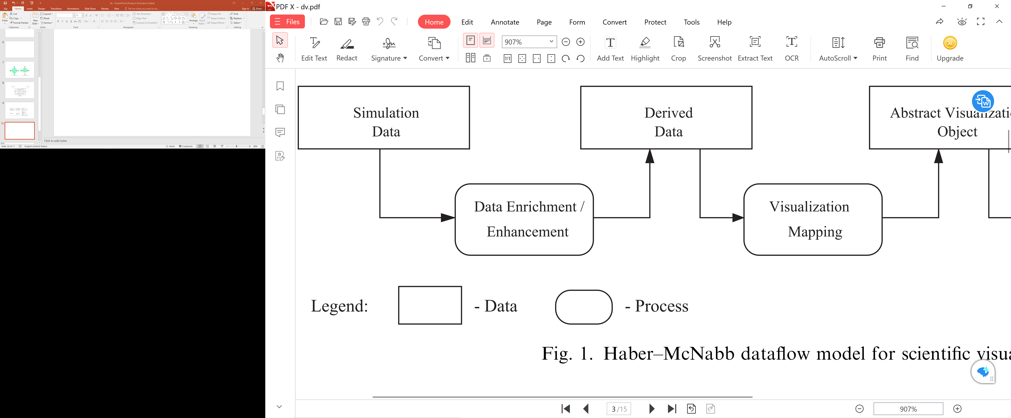
Scientific Visualization Pipeline
Isosurface
Isocontour
Volume Rendering
Scatter plot
Grid data
Desired step size
Model of Physical Activity
Interpolation
Prepare data for visualization
Convert numerical data
To abstract geometrical
representation
Create image from
The geometry
Haber- McNabb Model for Scientific Visualization
Basis of VTK, IRIS Explorer, Open Data Visualization Explorer and many other visualization systems

Slide 8
MULTIDIMENTION & MULTIVARIATE DATA
Consider a function f(x)
F(x) = { f_{1,} f₂, f₃, f₄, f₅,………..……..f_{k}}
components
f(x) | f₁ | f₂ | f₃ | f₄ | f₅ | f_{k}
weather | pressure | Wind speed | temp | precipitation | humidity | ....hailstorm
combustion | turbulance | Emission speed | pressure | Temp | _ | _
Body mapping | MRI | CT Scan | X-ray | Bone scan | Blood saturation | ...Muscle scan
EM propogation | Power radiated | polarisation | velocity | wavelength | ionization | ...magnetic field

Slide 9
MULTIDIMENTION & MULTIVARIATE DATA
Consider a function f(x)
F(x) = { f_{1,} f₂, f₃, f₄, f₅,………..……..f_{k}}
X = { x₁, x₂, x₃, x₄……………………x_{n})
components
X axis
Y axis
Z axis
Time
dimensions
Each data item is as a sample from a k variate function defined over an n-dimensional domain D

Slide 10
MULTIDIMENTION & MULTIVARIATE DATA
Species | SEPAL WIDTH | SEPAL LENGTH | PETAL WIDTH | PETAL LENGTH | FLOWER SIZE | FLOWER COLOUR
COUNTRY | GDP | PER CAPIT | INFLATION RATE | HAPPINESS | AVERAGE IQ | COLOUR
AGE | EDUCATION | WEIGHT | HEIGHT | BMI | DISABILITY | HOURS OF TRG

Slide 11
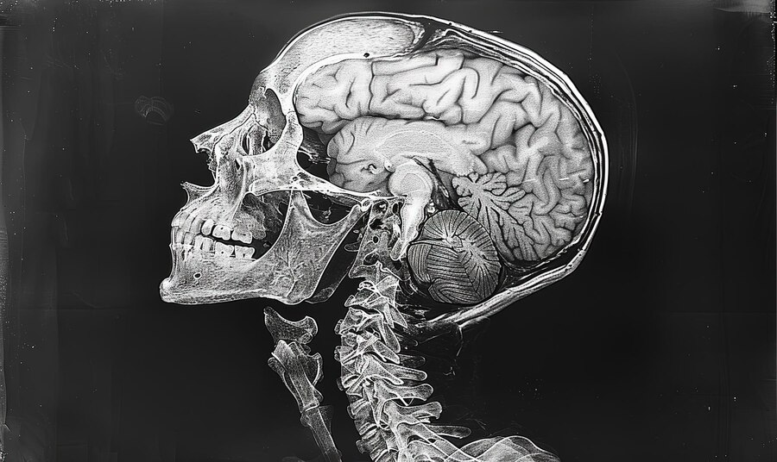
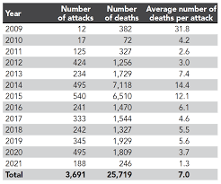
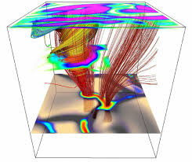
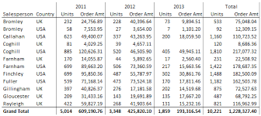
MULTIDIMENSIONAL VISUALIZATION MULTIVARIATE VISUALIZATION
Domain Scientific of visualization
Physical phenomenon
Continuous
Large Data table
Understand relation between variates
Information visualization
Geometrical representation in n-dimentions

Slide 12
Objective Functions : Visualization
Parameter Optimization functions : We visualize value of an objective function F =f₁(x)
We have large number of control parameters X={x₁, x₂, x₃, x_{4,…..}x_{n}}
Need to Understand n-dimensional space around the optimum.
Multicriteria objective function: Apart from control parameters there may be certain constraints.
Example: Design of a Car (Two Objectives)
Decision Variables:
x1​: Engine size
x2​: Car weight
x3​: drag coefficient
x4​: Suspension stiffness
Minimizing fuel consumption : F₁= f(x₁,x₂,x₃)
Maximizing comfort : F₁= f(x₂,x₄)
Constraints:
x1≥1.2 (minimum engine size)
x2≤2000 (maximum weight)
x3≤0.35 (aerodynamics limit)
x4∈[1000,3000] N/mx (stiffness)

Slide 13
WHY DIMENTIONALITY REDUCTION?
How to visualize more than one dimension in simulation data?
How to visualize objective function with large number of variates?
Small Dimensions : Easy to comprehend
2D Visualization : scatter plots, Isocontors
3D Visualization: isosurfacing, volume rendering , 3-d graphs
Medical data: Multivariate and Multidimensional
Combining the two variates in some way within the volume rendering process.
Since the data and display dimensions essentially match ,There is no dimension
Common to all types of ‘high-dimensional’ visualization is a need to reduce the dimensionality.

Slide 14
Dimensionality Reduction: Scientific Visualization
Multidimension data : 2D orthogonal subspaces of X
present a grid of contour maps
Each of these subspaces is a slice of the original data
Hyperslice : 2-D or 3-D orthogonal subspace of original data
Fix (n-2) variables
Obtain a grid of subspaces

Slide 16
Dimensionality Reduction: Information Visualization
Multivariate Data, Tabular Data
Column Represents An Attribute, Row Represents An Observation Of These Attributes.
Set Of K Attributes With n Elements : F(x) = { f₁, f₂, f₃, f_{4………..}f_{k}}
Goal Of Visualization : Searching For Patterns, Structure (Clusters), Trends, Behavior, Or Correlation Among Attributes
Geometrically : N Points In K-dimensional Space.
The Resulting Information Is Then Fed Into The Exploratory Stage Of The Knowledge acquiring Process

Slide 17
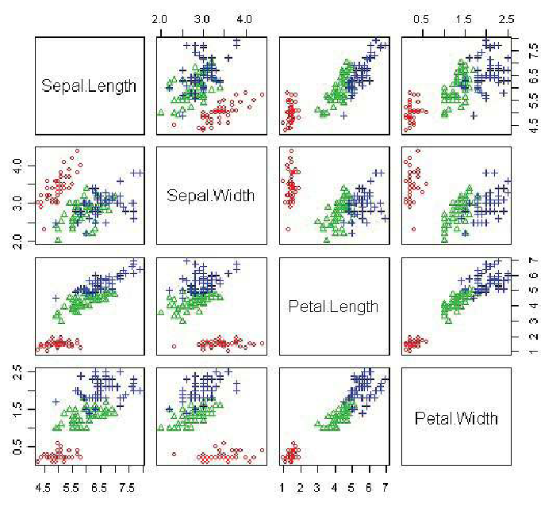
Information Visualization
Visualization :There are two main approaches.
First approach : The data is reduced to 2D or 3D by a grid of scatter plots.
Second approach : Technique in which a large number of variates can be presented in low-dimensional display format.

Slide 18
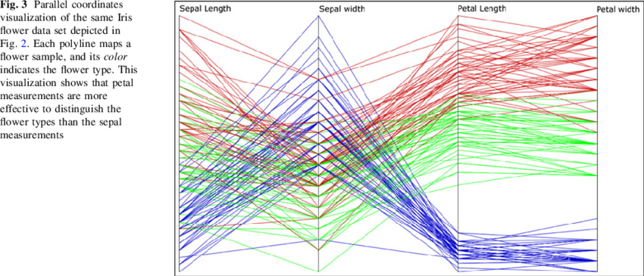
Information visualization
Lay orthogonal axis in parallel
Corresponds data across multiple dimensions
Ability to plot higher dimension data
Each polyline maps one sample
Each colour represents separate species
Parallel Coordinate Plots
Each datapoint mapped into a continuous function
F(x)= x₁/√2+ x₂ sin(t) + x₃ cos(t)+ x₄sin(2t)+ x₄cos(2t)…………
Each curve represent one datapoint
Similar data will have similar curve
Easily detects pattern, clusters, outliers.
Andrews Plot

Slide 19
Information Visualization
Glyphs are small, symbolic shapes /graphical objects that represent data points or elements
encode multiple variables simultaneously within a single symbol
Shape may represent different categories
Size may denote magnitude
Orientation may denote flow direction
Glyphs

Slide 20
Scientific Visualization Pipeline
Isosurface
Isocontour
Volume Rendering
Scatter plot
Grid data
Desired step size
Model of Physical Activity
Interpolation
Prepare data for visualization
Convert numerical data
To abstract geometrical
representation
Create image from
The geometry
Haber- McNabb Model for Scientific Visualization
Basis of VTK, IRIS Explorer, Open Data Visualization Explorer and many other visualization systems

Slide 21
Extension of Haber McNabb Model
Analysis : Use of some technique to produce the data
Computer centered approach centered approach
Use of inbuilt modules in the visualization tool
Filtering : Extraction of the portion of data we wish to visualize
Human centered approach
Use of inbuilt modules in the visualization tool
DATA TYPE | DATA FILTERING | FILTERING
MULTIDIMENTIONAL | INTERPOLATION | Select Dimensions
 |  | Select window on domain of Dimensions
MULTIVARIATE | PCA, MDS, VHDR | Selects variables
 |  | Select window on range of variables

Slide 22
PCA : Principal Component Analysis
It’s a technique that projects the data into a lower-dimensional subspace
Combination of original variables in smart way
which projects the data into a lower-dimensional—i.e., lower number of variates—subspace
These new variables are called principal components
Ranked from most important to least important.
These components capture the most significant variance in the data
first axis is the unit vector which preserves the maximum info as possible
PROBLEMS
Original set of variates are no longer retained.
Visualization Data whose variates are not easily interpreted in terms of the variates of the Problem Data

Slide 23
MDS : Multidimensional Scaling
Multidimensionality reduction technique, works differently from PCA
MDS uses nonlinear optimization
map the data points into a lower-dimensional space
Preserves the distances/similarities between points high-dimensional space.
Makes a map of data points
PROBLEMS
original set of variates are no longer retained.
Visualization Data whose variates are not easily interpreted in terms of the variates of the Problem Data

Slide 24
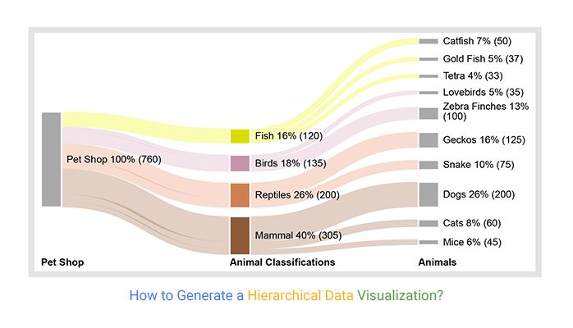
VHDR : VISUAL HIGH DIMENSION REDUCTION
Here the variates are placed into clusters
Representative variate is selected : Centre of the cluster
Or a new variate which is an average of the cluster.
Reduces the complexity of the final display
Meaning of the variates is preserved
CS677: Topics in Large Data Analytics and Visualization 23

Slide 25
Extension of Haber McNabb Model

Slide 26
Extension of Haber McNabb Model
Inclusion of tools for data filtering in existing systems

Slide 27
VISUALIZATION MODEL : IRIS EXPLORER
IRIS Explorer : Structure of the Proposed Reference Model.
DataSrcId module : Reads in the data and associated information such as dimensionality, type (multidimensional or multivariate) and ranges for each dimension
NDWin : Module corresponds to the n-dimensional Window tool
Igraph : Module corresponds to the Interaction Graph tool
Subsetter : Module implements the Subsetter concept
Isosurface module
Renderer module

Slide 28
VISUALIZATION MODEL : IRIS EXPLORER
In IRIS Explorer, modules can handle a grid of data of any dimension
IRIS Explorer’s modules reduce the dimensionality of the data to 1D, 2D, or 3D
IRIS Explorer supports 4D data representations by incorporating a time dimension.
Here, a set of 3D data is animated to represent changes over time, with the fourth parameter acting as a time step.
Hence data can be viewed across complex multidimensional spaces while retaining the intuitive clarity of spatial and temporal mappings

Slide 29
N-DIMENTIONAL WINDOW
N- DIMENTIONAL WINDOW : USER INTERFACE FOR WINDOW DEFINATION TOOL
DIMENTIONS : RECONGNISED FROM THE INPUT DATA, LAID OUT AS VERTICES OF N-SIDED POLYGON
SPOKES : MEANS OF SPECIFYING THE EXTENT OF THE DOMAIN AND THE FOCUS POINT OF THAT DIMENTION
CYAN DOTS : LOWER BOUND OF THE DOMAIN
RED DOT : UPPER BOUND OF THE DOMAIN
YELLOW DOT : FOCUS POINT OF THE DOMAIN
GREEN LINE : CONNECTS A CHOSEN RANGE IN ALL DIMENTIONS
DOTTED LINE : CONNECTS FOCUS DATA IN THE CHOSEN RANGE
CHANGING ALL THESE WILL GENERATE DIFFERENT FOCUS DATA

Slide 30
INTERACTION GRAPH
INTERACTION GRAPH : DIMENTION SPECIFICATION TOOL
DIMENTIONS : RECONGNISED FROM THE INPUT DATA, LAID OUT AS VERTICES OF N-SIDED POLYGON
CHOSEN DIMENTION, SINGLE VERTEX DEFINES 1 D SPACE
SPOKES : 2-D SUB-SPACE
All the possible subspaces are encoded in this representation
Allows the user to create and manipulate as many subspaces as necessary to form a mental model of the complex data.
Unselected dimension / variate remain fixed at their focal point

Slide 31
INTERACTION GRAPH
FOCUS POINT
Function value
INTERACTION GRAPH : DIMENTION SPECIFICATION TOOL
Lines joining selected vertices are thickened, and the vertices are highlighted.
Selection will create 2D data that can be visualized using a contour map or surface view.
CS677: Topics in Large Data Analytics and Visualization 25

Slide 32
INTERACTION GRAPH
FOCUS POINT
Function value
INTERACTION GRAPH : DIMENTION SPECIFICATION TOOL
A third selection will give a 3D data that could be Isosurfaced, or volume rendered, as shown in the above image.
If we have a 3D field, but toggle off one of the parameters, we create a 2D plot with the selected dimensions of the earlier 3D data.

Slide 33
INTERACTION GRAPH
FOCUS POINT
Function value
INTERACTION GRAPH : DIMENTION SPECIFICATION TOOL
Selecting now a fourth parameter, we move into a new 3D space which is slice of 4D space and so on

Slide 34
INTERACTION GRAPH
FOCUS POINT
Function value
INTERACTION GRAPH : DIMENTION SPECIFICATION TOOL
The dimension 4 has been selected, which returns the output to a 3D visualization but now of a different 3D subspace (2-3-4-space).
Selecting now a fourth parameter, we move into a new 3D space which is slice of 4D space and so on

Slide 35
SUBSETTER
Subsetter : The final module, takes the description of the filter given by the n-dimensional Window and Interaction Graph, and extracts the corresponding Focus Data

Slide 36
VISUALIZATION OF MULTIVARIATE DATA : IRIS EXPLORER
Exactly the same interface can be used, the n-Dimensional Window restrict the range of values of the variates.
Interaction Graph selects the variates of interest by clicking on the variate numbers at the vertices of the polygon.
Subsetter operation then extracts the Focus Data for input to the next stage of the pipeline.

Slide 37
APPLICATIONS OF THE FILTER PROCESS
Chained Rosenbrock function:
It is commonly used in optimization to test an algorithm's performance over multidimensional landscapes that present both smooth and challenging surfaces.
Below is a generalization of the original Rosenbrock function, it has a banana-shaped valley.
Shape of the Rosenbrock Function

Slide 38
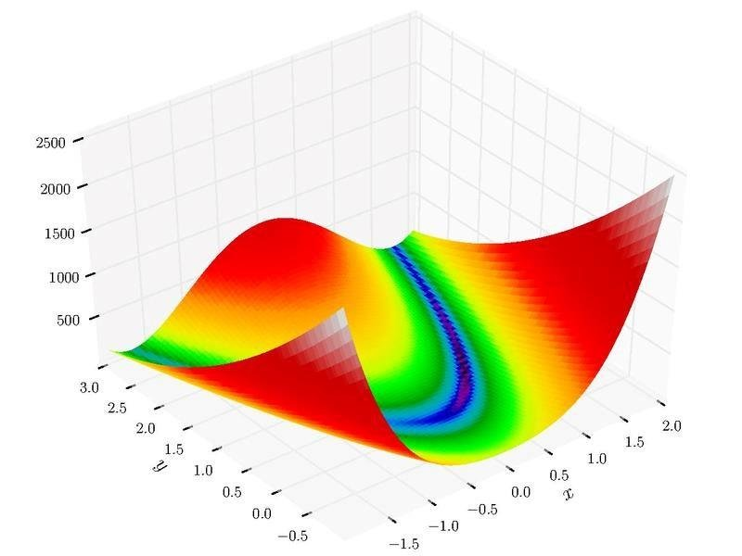
Complete Image of Rosenbrock Function
This image shows the entire Rosenbrock Function of it’s 2D version.
In this paper the part only around blue colour has been shown. But this image shows entirety of the Rosenbrock Function.
CS677: Topics in Large Data Analytics and Visualization 32

Slide 39
APPLICATIONS OF THE FILTER PROCESS
Complexity:
The function has a narrow, curved valley leading to the global minimum, making it difficult for optimization algorithms to reach the minimum efficiently in high dimensions.
Global Minimum:
The global minimum of the Chained Rosenbrock function is at
(1, 1, 1, 1)for each component.
Applicability:
The chained structure and increased dimensionality make
it ideal for benchmarking algorithms that handle complex search spaces in
multidimensional optimization tasks
Four-dimensional example has been chosen for explanation
Shape of the Rosenbrock Function

Slide 40
VISUALIZATION OF ROSENBROCK FUNCTION
The minimum point of the function is at (1,1,1,1).
To check the behavior of Rosenbrock function near the minimum, lets use the three tools
N - dimensional Window :
Used to restrict data to a region near the minimum, and specify the focus point as (1,1,1,1)
Interaction Graph:
Applied to study the behavior of the 4D function near the minimum point (1,1,1,1). Exploration Sequence is generated by selecting different dimensions with the Interaction Graph

Slide 41
VISUALIZATION OF ROSENBROCK FUNCTION
Focus Point
Function value
PARAMETER 1 ALLOWED TO VARY
PARAMETER 1 & 2 ALLOWED TO VARY

Slide 42
VISUALIZATION OF ROSENBROCK FUNCTION
PARAMETER 1 ,2 &3 ALLOWED TO VARY
PARAMETER 1 ,2 &3 ALLOWED TO VARY
Isosurfaced around focal point with value 10.
Minima near (1.0, 1.0,1.0) and (-1.0, 1.0, 1.0)
Combined view of dimensions (1,2,3) with slice planes in dimensions (1,2) and in dimensions (2,3)

Slide 43
VISUALIZATION OF ROSENBROCK FUNCTION
Focus Point
Function value
Function value
Toggle parameter 1 to give a slice through the space at the focus point of parameter 1.
This Confirms the view we had from the previous image
Selecting parameter 4 allows us to enter the 3D space of parameters 2, 3 and 4
Iso-surface of value 10 in the (2,3,4)-space, indicating a tube structure containing the low values of the function

Slide 44
Nelder and Mead Simplex method for Multivariate Optimization

Slide 45
Nelder-Mead Simplex Method
Here in this paper the Nelder-Mead Simplex method is used to find the minima of Rosenbrock function.
It is a direct search method. This means that it calculates the value of the function and compares it to the other values. It does not use derivatives.
The Nelder-Mead method uses Simplex which is a shape consisting of n+1 vertices for n-dimensions
For 2D function, simplex is a triangle
For 3D function, simplex is a tetrahedron
For 4D function, simplex is a pentachoron
For example, we have some function in 2D space f(x, y) and we wish to find local minima.
We begin with 3 arbitrarily selected points to form our simplex.

Slide 46
Nelder-Mead Simplex Method
The steps for the method are as follows
Sort
Reflect
Extend
Contract
Shrink
Check Convergence

Slide 47
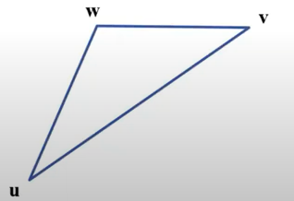
Sort
Evaluate the function f at the three points of the simplex
Sort and label points the three points u, v, and w according to the functions value.
That is:
f(u) < f(v) < f(w)
According to the function, u is the best performing point (gives the smallest value of the three) and w is the worst performing point.

Slide 48
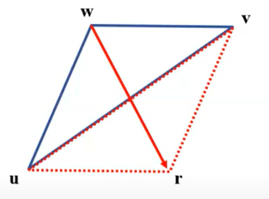
Reflect
Reflect the worst point w through the centroid of the remaining points u and v to obtain a reflected point r.
Evaluate f(r).
If the cost at the reflected point f(r) is better than f(v) but not better than f(u), then replace w with r. With this change, v will become the worst performing point in the simplex. Go to step 6 to check convergence.

Slide 49
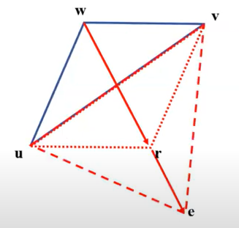
Extend (if f(r) < f(u))
If the cost at the reflected point, f(r) is better than f(u), then extend the reflected point r even further to e. Evaluate f(e). (lf r is better than u, this step attempts to be a tiny bit greedy by trying something even further in that direction.)
If the cost at the extended point f(e) is even better than the cost at the reflected point, f(r), replace the worst point w with the extended point e. Go to step 6 to check convergence.
If the cost at the extended point f(e) is not better than the cost at the reflected point, f(r), replace the worst point w with the reflected point r. Go to step 6 to check convergence.

Slide 50
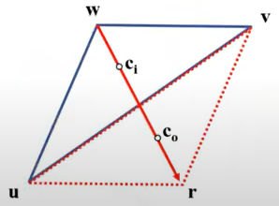
Contract
If the checks in step 2 or step 3 are not satisfied, then the reflected point r is not better than v or u and it would be pointless trying to improve the simplex by using the reflected point r as it would only become the new worst performing point. Instead, contract the worst point w to points ci and co along the line of reflection.
ci is the inside contracted point and is 1/4 of the way between w and r.
co is the outside contracted point and is 3/4 of the way between w and r.
Evaluate the function at both contracted locations. If either of these points perform better than f(v), then replace w with the better performing point. Go to step 6 to check for convergence

Slide 51
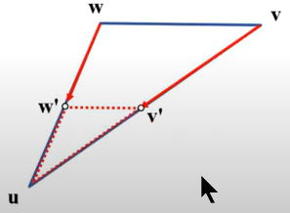
Shrink
If neither of the contracted points perform better than v, then we shrink the simplex towards the best performing point u
Replace v with v’ a point halfway between u and v
Replace w with w’ a point halfway between u and w

Slide 52
Visual aid on Nelder-Mead method

Slide 53
Visual aid on Nelder-Mead method

Slide 54
IRIS Explorer with combination of 2 pipelines
The top one for the multidimensional data (Rosenbrock function in 4D) and the bottom one for the multivariate data (the optimization trajectory)
Both pipelines make use of the same type of modules for filtering the data.
At the end the output of both pipelines are combined into a single visualization

Slide 55
IRIS Explorer with combination of 2 pipelines

Slide 56
Future Work
An extended version of the filtering model to allow multiple filters or concurrent views corresponding to the visited locations in the n-dimensional space.
The filtering process also accommodates multiple Interaction Graph selections of the dimensions (cells) which correspond to the concept of subspaces.
The Workspace Manager maintains a record of all cells that have been created and updates them whenever a change of the focus point or dimensional range has been made via the n-dimensional Window module.
The final output is now an array of Focus Data.

Slide 57
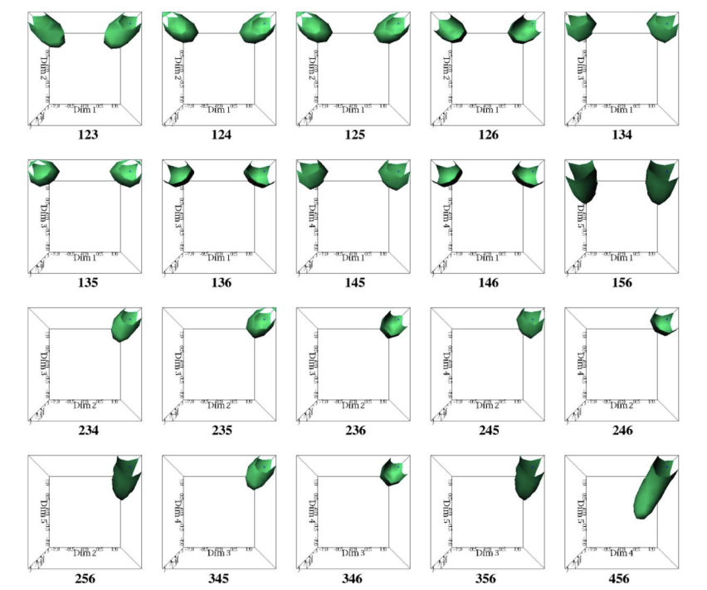
Future Work
The next future work is to work on the Rosenberg Function with higher number of dimensions.
In this paper, a 6D Rosenberg function is visualized through all possible 3D combinations.
An Interaction Graph is constructed with 6 dimensions as vertices and edges as pairs of dimensions.
So, all the possible triangles are selected and visualized as shown in following images

Slide 58
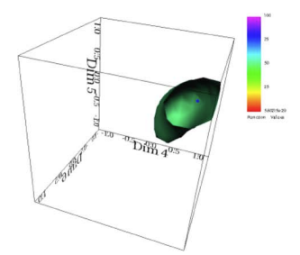
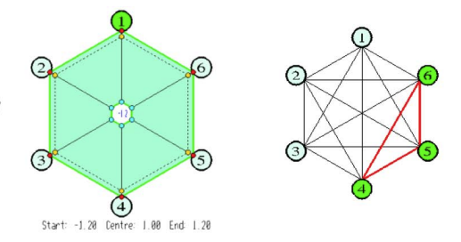
Future Work
Interaction Graph for 6D-Rosenberg Function
The focal point of 6D-Rosenberg Function is (1,1,1,1,1,1), which is kind of similar to (1,1,1,1) which is focal point of 4D-Rosenberg Function used above.
The interesting part is in every selected combination, we can see a part of banana-shaped isosurface, which shows its correctness in every combination.
So, this work is planned on extended to 10- and 20-dimensions version of Rosenberg Function

