Slide 1

NVBit: Nvidia’s Binary Instrumentation Tool
Mainak Chaudhuri
Dept. of Computer Science and Engineering, IIT Kanpur

Slide 2
NVBit
What is instrumentation?
  A technique for inserting extra code into an application to observe/study/change its behavior
  Primary purpose is program analysis and performance profiling
  There are many other use cases such as architectural studies by intercepting function calls, or specific type of instructions, or all instructions
    Warp divergence analysis, cache analysis, etc.
    Any microarchitecture feature can be analyzed once the right set of instructions or API calls is captured

Slide 3
How to do instrumentation
Where to insert code
  For cache study, insert new code for every load and store instruction
  For warp divergence study, insert new code for every branch or memory instruction
What code to insert
  For cache study, new code should model a cache or a cache hierarchy
    Input to this code is the intercepted load/store
  For warp divergence study, new code should capture degree of divergence in a warp
    Input to this code is the intercepted branch/memory instruction

Slide 4
How to do instrumentation
How to insert new code
  Source code instrumentation
    Directly changes the source code
    Drawbacks: need access to source code, cannot instrument external libraries, need recompilation
  Static binary instrumentation
    Directly changes the binary after it is compiled
    Positive: does not need access to source code
    Drawbacks: branch targets need careful manipulation, cannot instrument dynamically loaded libraries and objects
  Dynamic binary instrumentation
    Inject code in binary at run-time (a la JIT comp.)
    Positives: source code not needed, can instrument anything that runs as part of the binary’s AS

Slide 5
NVBit
Does dynamic binary instrumentation
  Takes two inputs: the application binary and an instrumentation program written in C/C++
    The instrumentation program describes where in the binary to insert new code and what code to insert (writing this program is the main task)
    The instrumentation program is known as an nvbit tool and is compiled as a shared object
    As the application runs, the nvbit tool is used to dynamically and incrementally instrument part of the binary that is about to execute
      A function is instrumented only once by maintaining state per instrumented function
    Concepts similar to just-in-time compilation are used to affect dynamic instrumentation
      Instrumented code is just-in-time compiled to generate the instrumented binary

Slide 6
NVBit tool
Entry into nvbit tool can take place at several points of a binary
  Referred to as callbacks
  All callback functions execute on the CPU
    These are traditional C functions
  When the binary starts, nvbit_at_init () gets called
    Use this to initialize any states and structures that the instrumentation procedure would need
  When the binary is about to exit, nvbit_at_term () gets called
    Use this to write out any collected stats or close files or clean up structures

Slide 7
NVBit tool
Entry into nvbit tool can take place at several points of a binary
  When a GPU context is created, nvbit_at_ctx_init (CUcontext) is called
    Use it to collect information about CUcontext at start
  When a GPU context terminates, nvbit_at_ctx_term (CUcontext) is called
    Use it to collect information about CUcontext at end
  Before the first kernel is launched, nvbit_tool_init (CUcontext) is called
    Use it to initialize any CUcontext-dependent state needed for instrumentation

Slide 8
NVBit tool
Entry into nvbit tool can take place at several points of a binary
  At the beginning and at the end of every CUDA driver API call, nvbit_at_cuda_event (CUcontext ctx, int is_exit, nvbit_api_cuda_t cbid, const char* name, void *params, CUresult* status) is invoked
    is_exit is 0 if it is beginning and 1 if it is end of API
    cbid is the unique identifier of driver API
    name is the API name
    params is a pointer to a structure containing API parameters
    *status is the error code (if any) of the API call

Slide 9
NVBit tool
Entry into nvbit tool can take place at several points of a binary
  The instrumentation code is included in the nvbit_at_cuda_event function
    For example, CUDA APIs for launching a kernel can be identified from cbid and the kernel can be instrumented if not already instrumented
    Inserts calls to the to be injected function (may call it analysis function) at appropriate locations and compiles the new binary that will be executed
    Adds two sources of overhead to the overall execution time of a running application: extra time to compile the new binary and extra time to execute the instrumentation procedure and the analysis function

Slide 10
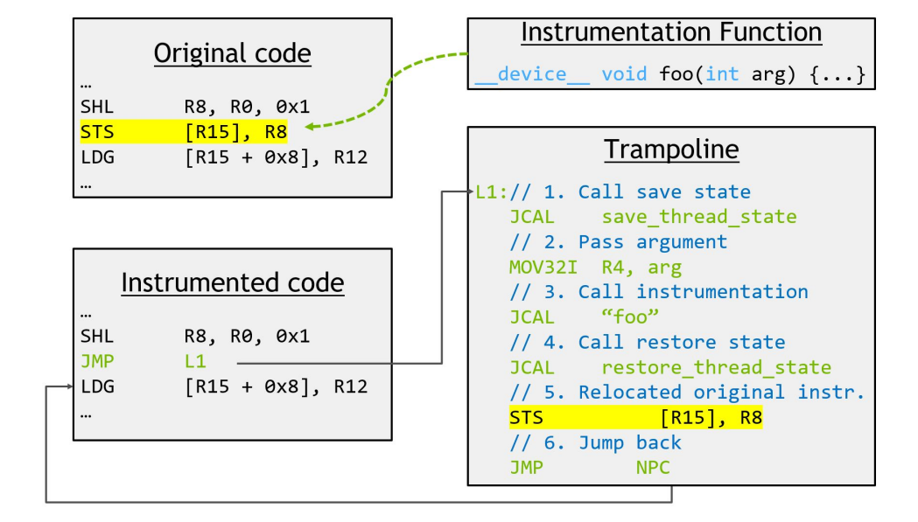
NVBit tool
Instrumentation flow
Analysis Function
// Analysis Function
Dynamic selection between original and instrumented code
Source: Villa et al. MICRO 2019.

Slide 11
Injecting instrumentation code
Instrumentation APIs of NVBit are used to inject calls to analysis function
  The extra code that injects such a call is executed every time nvbit_at_cuda_event function is called
    This overhead is proportional to the number of CUDA API driver calls
  The injected analysis function executes once per instrumentation grain
    For now, we will assume that this is once per dynamic instruction of the instrumented kernel
    This introduces the lion’s share of the total overhead due to execution of extra code

Slide 12
Injecting instrumentation code
Instrumentation APIs of NVBit are used to inject calls to analysis function
  The analysis function to be injected must be a legitimate function that can run on the GPU
  The function nvbit_insert_call (Instr* i, const char* fun_name, ipoint_t point) is used to insert a call to the function with name “fun_name” before or after instruction i
    point is IPOINT_BEFORE or IPOINT_AFTER
  Each argument to the analysis function can be passed using the appropriate flavor of nvbit_add_call_arg_flavor (Instr* i, …)
    Argument order should be maintained

Slide 13
Injecting instrumentation code
Most commonly used flavors of nvbit_add_call_arg_*
  nvbit_add_call_arg_guard_pred_val (Instr*)
    Pass the predicate of the instruction
  nvbit_add_call_arg_const_val32 (Instr*, uint32_t)
    Pass a 32-bit value as argument
  nvbit_add_call_arg_const_val64 (Instr*, uint64_t)
    Pass a 64-bit value as argument
  nvbit_add_call_arg_reg_val (Instr*, int rn)
    Pass the contents of register number rn as argument

Slide 14
Injecting instrumentation code
An instruction i can be removed from the original binary using the nvbit_remove_orig (Instr* i) call
  Typical use case is to replace an instruction by an injected analysis function
To select between instrumented or original kernel at run-time, nvbit_enable_instrumented (CUcontext, CUfunction, flag) call is used
  Must be called at the beginning of the kernel launch API to decide whether the original kernel or the instrumented kernel will run

Slide 15
Injecting instrumentation code
Injected analysis function can examine and update register values
  int32_t nvbit_read_reg (uint64_t rn)
    Returns the value in register rn
  void nvbit_write_reg (uint64_t rn, int32_t v)
    Writes v into register rn
  int32_t nvbit_read_pred_reg ()
    Returns the calling warp’s predicate register value
  void nvbit_write_pred_reg (int32_t v)
    Writes v into the calling warp’s predicate register

Slide 16
Inspection APIs
Instrumentation code usually needs to inspect the binary of the kernel for inserting calls to the analysis function
  To get a vector of all functions called by the kernel
    nvbit_get_related_functions (CUcontext ctx, CUfunction f) where f is the target kernel
  To get a vector of all instructions in program order for a function f
    nvbit_get_instrs (CUcontext ctx, CUfunction f)
  To get the static CFG of function f
    nvbit_get_CFG (CUcontext ctx, CUfunction f)
    A CFG has a vector of basic blocks (member bbs)

Slide 17
Instrumentation granularity
Instrumentation can be done at different grains
  For each instruction
  For each basic block
    A basic block is a sequence of instructions terminating at a control flow changing instruction
    A basic block has a unique single entry point and a unique single exit point

Slide 18
Instrumentation granularity
Instrumenting at a coarser grain can speed up the instrumented code
  Less instrumentation overhead
  For example, the instructions can be counted per basic block and then added to the total instruction count on each visit to a basic block

Slide 19
Code reference
Read the header files to know the available NVBit APIs
  core/nvbit.h lists all NVBit APIs and structure definitions
  core/cuda.h and core/generated_cuda_meta.h list all CUDA structure definitions and constants
  core/tools_cuda_api_meta.h lists CUDA API to callback id mapping
  core/instr_types.h lists all instruction-related structures and constants

