Slide 1
GPU Microarchitecture

Slide 2
Agenda
Introduction
Architecture overview
CUDA thread hierarchy
Control divergence
Warp scheduling
Memory hierarchy
Synchronization
Structure of a GPU program
Compute capability

Slide 3
Introduction
Graphics processing units (GPUs) are historically designed for photorealistic scene rendering
  Takes the scene geometry as input and produces color for each pixel in the scene frame
  Lot of parallelism as individual pixel can be operated on in parallel with very little synchronization
  To take advantage of this inherent massive parallelism, GPUs have evolved to have a large array of simple processing units
  Exploiting this massive parallel architecture for accelerating general-purpose computing is referred to as general-purpose computing on GPU or GPGPU for short

Slide 4
Introduction
General-purpose computing on GPUs
  Early attempts at GPGPU required mapping input data to an equivalent input geometry and mapping output data to pixel colors in the frame buffer
    Required good knowledge of graphics APIs such as OpenGL or DirectX and a good understanding of the scene rendering pipeline in the GPU
  Recognizing the large potential for performance improvement, more programmer-friendly APIs were developed for programming a GPU
    Initial APIs were specific to GPUs
    More portable universal APIs came into being later
  Today GPGPU is almost like writing C/C++ programs with a few API calls to assign parallel tasks and data to the GPUs

Slide 5
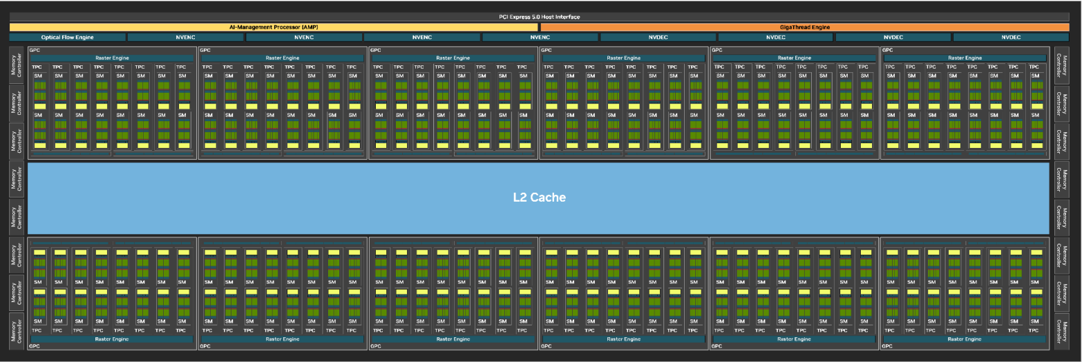
Architecture overview
GB202 architecture (taken from Blackwell architecture whitepaper)

Slide 6
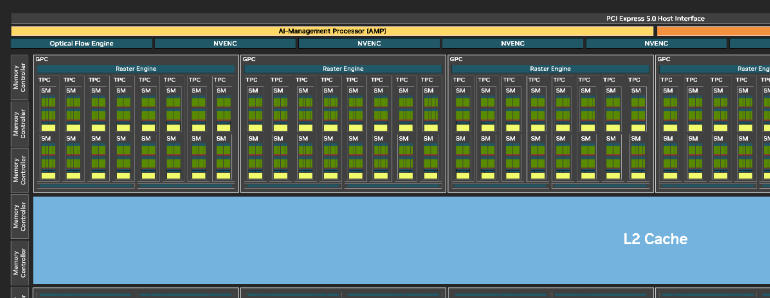
Architecture overview
GB202 architecture (taken from Blackwell architecture whitepaper)

Slide 7
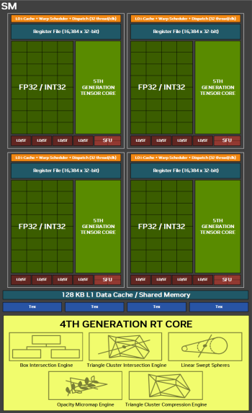
Architecture overview
GB202 architecture (taken from Blackwell architecture whitepaper)

Slide 8
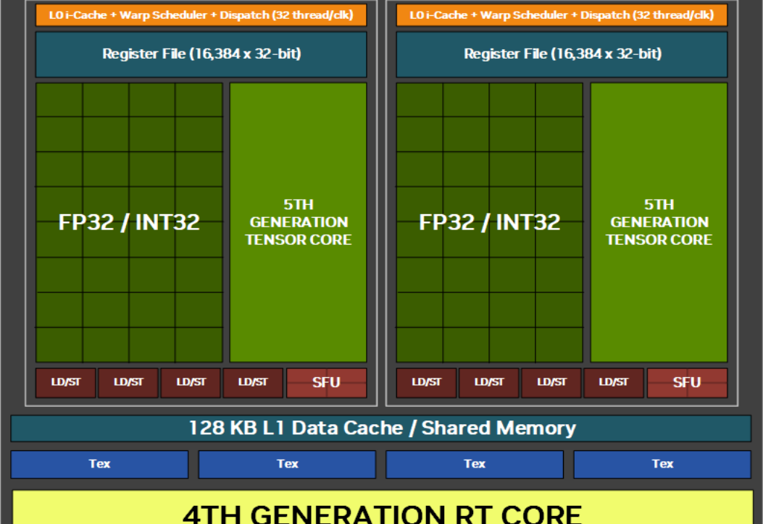
Architecture overview
GB202 architecture (taken from Blackwell architecture whitepaper)

Slide 9
Architecture overview
The complete GB202 microarchitecture has
  12 graphics processing clusters (GPCs) clocked at 2.4 GHz
  8 texture processing clusters (TPCs) per GPC
  2 streaming multiprocessors (SMs) per TPC
  16 single-channel memory controllers each having a 32-wide GDDR7 DRAM channel
    Each wire can transfer effectively 8 bits every half cycle using a 3-level pulse amplitude modulation encoding scheme
    The channels operating at 1.75 GHz clock frequency have aggregate bandwidth of 1.75 Gcycle/s x 16 bits/cycle/wire x 32 wires/channel x 16 channels or 1.792 TB/s
    Compare this to the bandwidth of a 16-way banked L3 cache operating at 2 GHz and pumping out a 64-byte block from each bank every cycle: 2 Gcycle/s x 64 B/cycle/bank x 16 banks or 2 TB/s
  128 MB L2 cache shared by all GPCs

Slide 10
Architecture overview
Each streaming multiprocessor of GB202 has
  128 CUDA cores partitioned into four clusters
  Each cluster has
    One L0 instruction cache producing one instruction per cycle
    One warp scheduler and dispatcher that dispatches one warp instruction per cycle
    16384 32-bit registers
    One tensor core
    One special function unit for computing transcendental functions
    Four load/store address generators
  128 KB L1 data cache + shared memory with configurable partitions (shared memory is software managed)
  Four texture units
  One ray tracing core

Slide 11
Architecture overview
A GPU device interfaces with the host CPU through the PCIe interface and other GPUs through NVLink interface
GPU
GDDRx DRAM
SM
SM
GPU
GDDRx DRAM
SM
SM
L2 cache
L2 cache
NVLink
PCIe
GPU
GDDRx DRAM
SM
SM
DDRx DRAM
PCIe
CPU
L2 cache

Slide 12
CUDA thread hierarchy
The CUDA threads are arranged hierarchically
  Purely logical view with no physical correspondence
  Threads are partitioned into blocks of threads
  The collection of thread blocks is referred to as a grid
  A grid is a three-dimensional collection of thread blocks
  Each thread block is a three-dimensional collection of threads
  The three-dimensional arrangement of thread blocks and threads in a block has no relationship with how threads are mapped on CUDA cores
  All threads in a thread block are scheduled on the same SM
  There is no context switch of thread blocks
    If all SMs are exhausted, a new thread block can be scheduled only after some thread block completes
    Grid-wide global barriers may deadlock

Slide 13
CUDA thread hierarchy
The CUDA threads are arranged hierarchically
  Threads in a block are further grouped into physical entities called warps each containing 32 threads matching the number of CUDA cores in one of the four partitions of an SM
  A warp is a scheduling unit i.e., a ready warp from a thread block is picked up by the scheduler (each SM partition has a scheduler) and issues it to the CUDA cores of the partition
  The threads in a warp execute in lock-step i.e., all threads execute the same instruction but operate on different data points
    Creates problem with branches because the “if block” and the “else block” may get executed by different subsets of threads
    Referred to as intra-warp control divergence

Slide 14
Control divergence
Intra-warp control divergence
  if (x[i] >= 0) x[i]++;
  else x[i]--;
  Suppose x[i] is operated on by thread i
  Lock-step execution is no longer possible
  The threads for which x[i] is non-negative will execute first while the remaining threads in the warp will sit idle
  Next the other subset of threads will execute while the first subset will sit idle
  The diverging branches are essentially serialized within a warp
    Leads to loss in speedup
  First subset must wait for the second subset to reconverge before resuming lock-step execution: recipe for deadlock

Slide 15
Control divergence
Example of intra-warp control divergence (assume four threads in a warp)
  A;
  if (thread_id < 2) { B; C; }
  else { D; E; }
  F;
A
B
C
D
E
F
T0
T1
T2
T3
time

Slide 16
Control divergence
Example of intra-warp control diveregence
  Lock using atomicCAS (int *addr, expectedVal, newVal)
  Atomic compare and set: atomically compares the value at addr with expectedVal and if the comparison passes, sets the value at addr to newVal; returns oldVal at addr
  while (atomicCAS (&lock, 0, 1));
  x++; // Critical section code
  lock = 0;
  Requirement to reconverge after the while loop before proceeding to critical section makes this implementation deadlock

Slide 17
Control divergence
Following is a deadlock-free implementation
  int done = 0;
  while (!done) { // Threads already done diverge and skip
  if (!atomicCAS(&lock, 0, 1)) { // Lock holder diverges
  x++; // Critical section code
  lock = 0;
  done = 1;
  }
  // All threads reconverge and proceed to next iteration
  }

Slide 18
Control divergence
Per warp active mask, program counter (PC), reconvergence PC
On encountering a branch, the active masks and start PCs of the two paths and the reconvergence PC are pushed onto a “SIMT divergence stack”
Implementation up to Pascal architecture
B, 0011, 0, F
A
B
C
D
E
F
T0
D, 1100, 0, F
T1
F, 1111, 1, 0
T2
T3

Slide 19
Control divergence
From Volta architecture onward, per thread program counter and stack are maintained
  32x state
  Any group of threads with the same PC can be scheduled together in a cycle
  Independent thread scheduling
  Lock-step execution of threads in a warp is no longer guaranteed
  Intra-warp synchronization instruction must be used to force reconvergence of threads within a warp
  Paths from SIMT divergence stack independently participate in scheduling
    These sub-warps become independent scheduling entities

Slide 20
Control divergence
Example of independent thread scheduling
  A;
  if (thread_id < 2) { B; C; }
  else { D; E; }
  F; __syncwarp(); G;
A
B
D
C
E
F
G
T0
T1
T2
T3
time

Slide 21
Control divergence
Example of independent thread scheduling
  Lock using atomicCAS (int *addr, expectedVal, newVal)
  Atomic compare and set: atomically compares the value at addr with expectedVal and if the comparison passes, sets the value at addr to newVal; returns oldVal at addr
  while (atomicCAS (&lock, 0, 1));
  x++; // Critical section code
  lock = 0;
  Lock holder can execute the critical section and release the lock, while the remaining threads in a warp loop on atomicCAS
  Independent thread scheduling makes it deadlock-free

Slide 22
Warp scheduling
Warp scheduling
  The threads in a warp may suffer from long delays due to memory access or some long-latency floating-point operation
  Delay due to memory access is particularly large
  If the threads in a warp access contiguous addresses all falling on a cache block, these accesses are coalesced and a single L2 cache access is made in the case of an L1 cache miss
    The L1 cache block size is usually 128 bytes matching this good case
  If the threads in a warp have irregular accesses, coalescing may not work at its peak efficiency generating 32 L2 cache accesses in the worst case
    These accesses may take different amounts of time

Slide 23
Warp scheduling
Warp scheduling
  If any thread in a warp is waiting for a memory operation to complete, the warp is de-scheduled and a new ready warp is scheduled in its place
    There is no register saving or restoring during context switch; hence scheduling overhead is low
  If different threads in a warp take different amounts of time to complete their memory accesses, it leads to what is referred to as memory divergence
    The longest delay dictates when the warp will be ready for scheduling
  An SM can schedule warps from multiple different thread blocks simultaneously to maximize utilization of the CUDA cores
    Full warp scheduling can be preferred over sub-warps (unfair)

Slide 24
Warp scheduling
Which warps should be scheduled in a given cycle?
  Decided by a warp scheduling algorithm
  Only active (or ready) warps (or sub-warps) are eligible to be scheduled
    Definition of ready: not stalled due to branch, memory access, computation, or structural hazard
Loose round-robin (LRR) scheduling [Rogers et al., 2012]
  Schedule the next eligible round-robin warp in this cycle
  All eligible warps make equal progress
  Warps enjoy spatial locality if that is how the program data is partitioned
  All warps may stall on long-latency operations together exhibiting periodic high-utilization and no-utilization phases

Slide 25
Warp scheduling
Loose round-robin scheduling
  Consider an array A that is double the size of the L1 data cache (aggregate across all SMs)
  The following code snippet shows the advantages and disadvantages of round-robin scheduling
  for (i=0; i<N; i++) A[i] = f(i); // Initialize
  for (i=N-1; i>=0; i--) A[i] = g(A[i]); // Compute
  If g is just one instruction, all intra-warp locality is exploited
  If g has more instructions, there is a danger of L1 cache thrashing if the number of ready warps is very large

Slide 26
Warp scheduling
Two-level round-robin scheduling [Narasiman et al., 2011]
  Form warp groups consisting of consecutive warps preserving inter-warp DRAM locality
  Keep scheduling the warps from a warp group in round-robin fashion until all warps in the group stall at which point the next round-robin warp group is scheduled
  Attempts to stagger the stalls across the warp groups minimizing the no-utilization time spans

Slide 27
Warp scheduling
Greedy then oldest (GTO) [Rogers et al., 2012]
  Keep the oldest warp scheduled until it stalls at which point the oldest warp among the ready ones is scheduled
  Age of a warp is measured from its creation time
    Oldest warp is the one with the smallest creation time
    Ties are broken in favor of the smallest warp id
  GTO improves intra-warp L1 cache locality by not bringing in too much of data simultaneously
  A case for scheduler-controlled cache thrashing
Two-level GTO [Rogers et al., 2012]
  GTO within a warp group and across warp groups
  The oldest warp group is the one that has the oldest warp

Slide 28
Warp scheduling
Cache-conscious warp scheduling (CCWS) [Rogers et al., 2012]
  What is the optimal number of warps to be considered for scheduling during a time window in a streaming multiprocessor?
  Idea is to keep scheduling the warps that could have enjoyed L1 cache hits if other interfering warps were not scheduled
  Each warp is assigned a base score x at the beginning, the score is incremented by y whenever the hardware detects a lost L1 cache hit, and the score is decremented by 1 each cycle otherwise as long as the score is more than x
  Warps are sorted in descending order of score and the maximum number of warps are selected from top such that the sum of their scores does not exceed a threshold T

Slide 29
Warp scheduling
Cache-conscious warp scheduling (CCWS) [Rogers et al., 2012]
  A warp that is not selected for scheduling is descheduled at its next load instruction
  How does a warp detect a lost L1 cache hit due to inter-warp interference?
  When a block is inserted by a warp into the L1 cache, the warp id is recorded in the extended tag of the block
  When a block is evicted from the L1 cache, its tag is copied into the filling warp’s victim tag array
    A per-warp extra storage
  When a warp suffers an L1 cache miss, it looks up its victim tag array and if the tag is found there, one lost hit is detected and the tag is invalidated from the victim tag array

Slide 30
Warp scheduling
Divergence-aware warp scheduling (DAWS) [Rogers et al., 2013]
  A warp with threads accessing different cache blocks in the same instruction is often referred to as a warp having memory divergence
    A memory divergent warp has a very high L1 cache footprint per instruction, but may have a lot of reuse across instructions
  A warp with control divergence gets its total footprint divided over time
    A scheduler that is aware of this would allow other warps to be scheduled along with a sub-warp of a control divergent warp

Slide 31
Warp scheduling
Divergence-aware warp scheduling (DAWS) [Rogers et al., 2013]
  CCWS favors warps that have suffered from L1 cache interference
    Does not act until interference is detected
  CCWS assigns the same base score to all warps
    Effectively assumes that all warps have equal volume of reuses
  DAWS estimates footprint and divergence of a warp by either profiling or estimating dynamically through L1 cache and victim tag array hit counts
    Target loops are marked by compiler
    Uses one sample warp to do this estimation in the target loops
  DAWS schedules only those warps whose aggregate footprint can be accommodated in the L1 data cache

Slide 32
Warp scheduling
Take-away regarding warp scheduler design
  Large number of proposals based on L1 data cache locality
  Few others combine L1 data cache locality with warp criticality
  Some proposals bring out synergy between L1 data cache replacement policies and warp scheduling
In the context of Blackwell
  Each SM has four independent warp schedulers
  All scheduled warps share 128 KB L1 data cache
  Without coordination among the four schedulers, it is easy to thrash the L1 data cache
  Problem of optimal warp scheduler design that jointly maximizes the utilization of CUDA cores and L1 data cache space is still wide open

Slide 33
Memory hierarchy
Threads within a thread block can share data through the L1 data cache and/or the software-managed shared memory
  128 KB can be partitioned into L1 data cache and shared memory
  Whatever is not used as shared memory can be used as L1 data cache
Sharing data across thread blocks can happen through “global memory” only
  “Global memory” variables are allocated in L2 cache
  Such sharing is slow
  Implies that synchronization across thread blocks is also slow (implemented using atomic instructions)
  Best performance when thread blocks don’t share any data

Slide 34
Accessing CPU data
Primarily two ways
  Explicit copy from CPU memory to GPU memory
    Allocate space in GPU memory and then invoke DMA to copy the data
  No explicit copy
    Method-1: keep data pinned on CPU and access from GPU
      Slow due to thread stalls arising from data fetch
    Method-2: use unified virtual addressing (UVA) to enable transparent migration of pages between CPU and GPU
      First-touch allocation followed by migration depending on access pattern
      For pre-Pascal GPUs, the migration happens at the time of kernel launch
      From Pascal onward, GPU execution can generate page faults and at the time of page fault, page is migrated
      Migration cost can be partially hidden by hardware prefetching

Slide 35
Synchronization
A large array of atomic instructions to synthesize lock-free as well as lock-based mutual exclusion
  atomicAnd, atomicOr, atomicXor, atomicAdd, atomicSub, atomicExch, atomicMin, atomicMax, atomicInc, atomicDec, atomicCAS
  Each atomic instruction comes with a scope flavor
    Visibility within thread block, within entire GPU, within entire system
Capability to mark load/store instructions (including atomics) as acquire or release
Warp-wide and thread block-wide hardwired barrier instructions (no grid-wide barrier)
Scope-flavored order enforcing fence instructions

Slide 36
A typical GPU program
The GPU threads are launched by the CPU (referred to as the host)
  The task executed by the GPU is referred to as a kernel
  CPU specifies the thread grid structure when launching the kernel
  Two ways for the kernel to access input data and return results to CPU
    Explicit copy between CPU memory and GPU memory
    Use of shared virtual memory between CPU and GPU
      Referred to as unified virtual addressing (UVA) in CUDA
  The kernel specifies the work of a thread in a manner very similar to how POSIX thread functions are written
    Need a way to identify individual threads in a grid of threads

Slide 37
Compute capability
The features supported by a GPU depends on its compute capability
  Compute capability of a GPU is represented as X.Y where X is a major revision number and Y is a minor revision number
  The major revision number is also known as the SM version
  Tesla GPU: major revision 1
  Fermi GPU: major revision 2
  Kepler GPU: major revision 3
  Maxwell GPU: major revision 5
  Pascal GPU: major revision 6
  Volta GPU: major revision 7
  Turing GPU: compute capability 7.5
  Ampere GPU: major revision 8

Slide 38
Compute capability
The features supported by a GPU depends on its compute capability
  Compute capability can be found from the output of deviceQuery
  Certain features are available for all compute capabilities while some others are selectively available
  Thread hierarchy features available to all compute capabilities
    Maximum grid dimensions: x=2³¹-1, y=65535, z=65535
    Maximum thread block dimensions: x=1024, y=1024, z=64
    Maximum number of threads per block in one dimension: 1024
    Warp size: 32 threads

Slide 39
Compute capability
The features supported by a GPU depends on its compute capability
  Thread hierarchy features that vary across compute capabilities
    Maximum number of simultaneous thread blocks per SM
      16 for compute capabilities 3.5, 3.7 (up to Kepler)
      32 from 5.0 to 7.2 (Maxwell, Pascal, Volta)
      16 for 7.5 (Turing)
      32 for 8.0 (early Ampere)
      16 for 8.6, 8.7 (more recent Ampere)
    Maximum number of resident warps per SM at any time
      64 for compute capabilities up to 7.2
      32 for 7.5
      64 for 8.0
      48 for 8.6, 8.7
      Can compute the maximum number of threads per SM

