Slide 1

Multi-core: The Ultimate Dose of Moore’s Law
Mainak Chaudhuri
Dept. of Computer Science and Engineering, IIT Kanpur
[A tale of 50+ years of glory and success]

Slide 2
Trends in Chip Industry
Long history since 1971
  Introduction of Intel 4004
  http://www.intel4004.com/
Today we talk about billions of transistors on a die
  Intel’s 24-core Core i9 processors (Core Ultra family) have 20+ billion transistors
  AMD’s Ryzen 9 family of processors have close to 20 billion transistors
  IBM’s POWER11 processor has 30 billion transistors
    Last month IBM announced the first sub-1 nm (0.7 nm) chip that can pack 100 billion transistors

Slide 3
Trends in Chip Industry
Today we talk about billions of transistors on a die
  Nvidia’s GeForce RTX 5090 (Blackwell architecture) has 90+ billion transistors
  AMD’s Radeon RX 9070 (RDNA 4 architecture) has 50+ billion transistors
  Minimum feature size has shrunk from 10 micron in 1971 to 0.0007 micron today

Slide 4
Agenda
Unpipelined microprocessors
Pipelining: simplest form of ILP
Out-of-order execution: more ILP
Multiple issue: drink more ILP
Scaling issues and Moore’s Law
Why multi-core
  TLP and de-centralized design
Tiled CMP and shared cache
Connection with GPUs
Implications on software

Slide 5
Unpipelined Microprocessors
Typically an instruction enjoys five phases in its life
  Instruction fetch from memory
  Instruction decode and operand register read
  Execute
  Data memory access
  Register write
Unpipelined execution would take a long single cycle or multiple short cycles
  Only one instruction inside processor at any point in time

Slide 6
Pipelining
One simple observation
  Exactly one piece of hardware is active at any point in time
Why not fetch a new instruction every cycle?
  Five instructions in five different phases
  Throughput increases five times (ideally)
Bottom-line is
  If consecutive instructions are independent, they can be processed in parallel
  The first form of instruction-level parallelism (ILP)

Slide 7
Pipelining Hazards
Instruction dependence limits achievable parallelism
  Control and data dependence (aka hazards)
Finite amount of hardware limits achievable parallelism
  Structural hazards
Control dependence
  On average, every fifth instruction is a branch (coming from if-else, for, do-while,…)
  Branches execute in the third phase
    Introduces bubbles unless you are smart

Slide 8
Control Dependence
Branch IF ID EX MEM WB
Instr. X IF ID EX MEM WB
Instr. Y IF ID EX …
Target IF ID …
What do you fetch in X and y slots?
Options: nothing, fall-through, learn past history and predict (today best predictors achieve very high accuracy, often more than 95%)
if (cond) { … }
else { … }

Slide 9
Data Dependence
Hardware bypass
add r1, r2, r3 IF ID EX MEM WB
xor r5, r1, r2 IF ID EX MEM WB
Reads wrong value
Take three bubbles?
Back-to-back dependence is too frequent
Solution: hardware bypass paths
Allow the ALU to bypass the produced value in time: not always possible

Slide 10
Data dependence
load r1, addr IF ID EX MEM WB
add r3, r2, r1 IF ID EX MEM WB
Value available Value needed
Need a live bypass! (requires some negative time travel: not yet feasible in real world)
No option but to take one bubble
Bigger problems: load latency is often high; you may not find the data in cache

Slide 11
Structural Hazard
Instr. 1 IF ID EX MEM WB
Instr. 2 IF ID EX MEM WB
Instr. 3 IF ID EX MEM …
Instr. 4 IF ID EX
…
Usual solution is to put more resources

Slide 12
Out-of-order Execution
Cache miss
load r2, addr
add r3, r2, r1
xor r10, r5, r3
sub r9, r10, r1
addi r29, r29, 0xffff
sll r29, r29, 2
mul r20, r20
Results must become visible in-order

Slide 13
Multiple Issue
Cache hit
load r2, addr
add r3, r2, r1
xor r10, r5, r3
sub r9, r10, r1
addi r29, r29, 0xffff
sll r29, r29, 2
mul r20, r20
Results must become visible in-order

Slide 14
Out-of-order Multiple Issue
Some hardware nightmares
  Complex issue logic to discover independent instructions
  Increased pressure on cache
    Impact of a cache miss is much bigger now in terms of lost opportunity
    Various speculative techniques are in place to “ignore” the slow and stupid memory
  Increased impact of control dependence
    Must feed the processor with multiple correct instructions every cycle
    One cycle of bubble means lost opportunity of multiple instructions
  Complex logic to verify

Slide 15
Moore’s Law
Number of transistors on-chip doubles every 12 months (1965); revised in 1975 to every 24 months
  Phenomenal 58% performance growth every year till late-nineties made possible by the increasing number of on-chip transistors
Doesn’t power consumption increase with increasing number of transistors?
  Dynamic power consumption is proportional to the number of switching transistors
  For a transistor, dynamic power is CV²f
    C=capacitance, V=voltage, f=frequency

Slide 16
Dennard scaling
How power density scales with technology generation (due to Robert Dennard, 1974)
  In each generation, transistor length shrinks by 30% i.e., new size is 0.7x of old size
    180 nm → 130 nm → 90 nm → 65 nm → 45 nm → 32 nm → 22 nm → 14 nm → 10 nm → 7 nm → 5 nm
  New area per transistor is 0.5x of old area
    Allows doubling of transistor count in same area
  New capacitance per transistor is 0.7x of old
    C is proportional to area/length
  To maintain same electric field, voltage must be 0.7x because V = E.d

Slide 17
Dennard scaling
How power density scales with technology generation (due to Robert Dennard, 1974)
  RC delay through transistor becomes 0.7x as it is proportional to capacitance
    Clock cycle time can be reduced to 0.7x
    Frequency can be increased to (1/0.7)x i.e., 1.4x
  Power consumption per transistor becomes (0.7*0.7*0.7*1.4)x or roughly 0.5x
  Since area per transistor becomes 0.5x, power per unit area i.e., power density remains unchanged (known as Dennard scaling)

Slide 18
Dennard scaling
Since 2x transistors can be packed in the same area Moore’s law does not pose any problem with power consumption
  But Dennard scaling ignores static power consumption
    Power consumed even when a transistor is not switching i.e., off
    Arises because a transistor does not switch off completely even if a low voltage is applied
    Static power increases exponentially with decreasing transistor size
    Today with very small transistors, Dennard scaling does not hold any more
    Moore’s law meets the power wall

Slide 19
Scaling Issues
Wires connect transistors
Wire delay does not scale like transistors
Hardware for extracting ILP has reached the point of diminishing return
  Need a large number of in-flight instructions
  Supporting such a large population inside the chip requires power-hungry delay-sensitive logic and storage
  Verification complexity is large
How to exploit so many transistors?
  Must be a de-centralized design which avoids long wires

Slide 20
Multi-core
Put a few reasonably complex processors or many simple processors on the chip
  Each processor has its own primary cache and pipeline
  Often a processor is called a core
  Often called a chip-multiprocessor (CMP)
  What about power consumption?
    Trade-off between clock frequency, core count, core complexity
Did we use the transistors properly?
  Depends on if you can keep the cores busy
    Introduces the concept of thread-level parallelism (TLP)

Slide 21
Floor of today’s chips
Pipe+L1+L2
L3 bank
L3 bank
Pipe+L1+L2
Switch
MC
Interconnection network
MC
Pipe+L1+L2
Pipe+L1+L2
L3 bank
NI
L3 bank
DIMMs
DDRx DRAM channels
DIMMs
Simple interconnection networks:
Linear bus, ring, 2D mesh (usually bidirectional)

Slide 22
Thread-level Parallelism
Look for concurrency at a granularity coarser than instructions
  Put a chunk of consecutive instructions together and call it a thread (largely wrong!)
  Each thread can be seen as a “dynamic” subgraph of the sequential control-flow graph with data dependence edges added: take a loop and unroll its graph
  for (i=0;i<10;i++) { a[0]++; a[0]++;
  a[i]++; a[1]++; …
  } a[2]++; a[4]++;
  … a[5]++;
  a[9]++; …
  a[9]++;

Slide 23
Thread-level Parallelism
One more example
  for (i=10;i<20;i++) { a[10] = a[8] + 1;
  a[i] = a[i-2] + 1; a[11] = a[9] + 1;
  } a[12] = a[10] + 1;
  …
  a[10] = a[8] + 1; a[19] = a[17] + 1;
  …
  a[14] = a[12] + 1;
  a[15] = a[13] + 1;
  …
  a[19] = a[17] + 1;
Data dependence edge

Slide 24
Thread-level Parallelism
One more example
  for (i=10;i<20;i++) { a[10] = a[8] + 1;
  a[i] = a[i-2] + 1; a[11] = a[9] + 1;
  } a[12] = a[10] + 1;
  …
  a[10] = a[8] + 1; a[19] = a[17] + 1;
  a[12] = a[10] + 1;
  …
  a[18] = a[16] + 1;
  a[11] = a[9] + 1;
  a[13] = a[11] + 1;
  …
  a[19] = a[17] + 1;

Slide 25
Thread-level Parallelism
Look for concurrency at a granularity coarser than instructions
  Put a chunk of consecutive instructions together and call it a thread (largely wrong!)
  Each thread can be seen as a “dynamic” subgraph of the sequential control-flow graph with data dependence edges added: take a loop and unroll its graph
  The edges spanning the subgraphs represent data/control dependence across threads
    The goal of parallelization is to minimize such edges
    Threads should mostly compute independently on different cores; but need to talk once in a while to get things done!

Slide 26
Thread-level Parallelism
Parallelizing sequential programs is fun, but often tedious for non-experts
  So look for parallelism at even coarser grain
  Run multiple independent programs simultaneously
    Known as multi-programming
    Can play games while running heavy-weight simulations and downloading movies
    Can browse internet while listening to music and running an anti-virus

Slide 27
Tiled CMP (Hypothetical Floor-plan)
Pipeline
Mem.
Coh.
Cntr.
Pipeline
IL1
DL1
IL1
DL1
L2 slice
L2 slice
Crossbar
L2 slice
Mem.
Coh.
Cntr.
L2 slice
IL1
DL1
IL1
DL1
Pipeline
Pipeline

Slide 28
Shared Cache CMP
Pipeline
Mem.
Coh.
Cntr.
Pipeline
IL1
DL1
IL1
DL1
Non-uniform access L2
(NUCA)
IL1
DL1
Mem.
Coh.
Cntr.
IL1
DL1
Pipeline
Pipeline

Slide 29
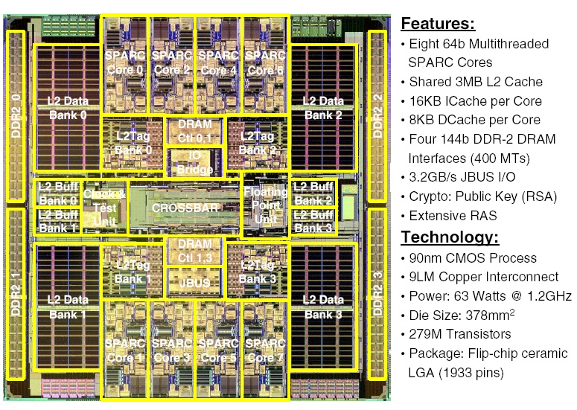
Niagara Floor-plan

Slide 30
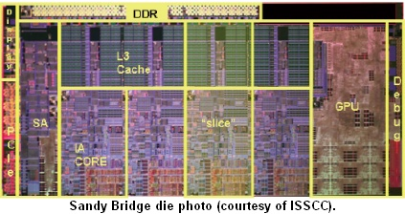
Quad-core Sandy Bridge

Slide 31
Communication in Multi-core
Ideal for shared address space
  Fast on-chip hardwired communication through cache (no OS intervention)
  Two types of architectures
    Tiled CMP: each core has its private cache hierarchy (no cache sharing); Intel Pentium D, Dual Core Opteron, Intel Montecito, Sun UltraSPARC IV, IBM Cell (more specialized)
    Shared cache CMP: Outermost level of cache hierarchy is shared among cores; Intel Nehalem (4 and 8 cores), Intel Dunnington (6 cores), Intel Woodcrest (server-grade Core duo), Intel Conroe (Core2 duo for desktop), Sun Niagara, IBM Power4, IBM Power5
31

Slide 32
Shared vs. Private in CMPs
Shared caches are often very large in the CMPs
  They are banked to avoid worst-case wire delay
  The banks are usually distributed across the floor of the chip on an interconnect
B
B
P
B
B
P
P
B
B
P
B
B

Slide 33
Shared vs. Private in CMPs
In shared caches, getting a block from a remote bank takes time proportional to the physical distance between the requester and the bank
  Non-uniform cache access (NUCA)
This is same for private caches, if the data resides in a remote cache
Shared cache may have higher average hit latency than the private cache
  Hopefully most hits in the latter will be local
Shared caches are most likely to have less misses than private caches
  Replication of data and partitioning of space

Slide 34
Connection with GPUs
GPUs are massive multi-core processors
  Often referred to as many-core processors
Let us look at GeForce RTX 5090 GPU
  Architecture family: Blackwell, GB202
  170 cores (called streaming multiprocessors)
  Each streaming multiprocessor has
    128 32-bit integer/floating point units (called CUDA cores); can work on four 32-entry vectors
    Four tensor cores, one ray-tracing core
    Four texture mapping cores
    Four L0 instruction caches, one 128 KB L1 cache
    Four hardwired thread schedulers
    65536 registers (4 banks x 16384 per bank)
  96 MB shared L2 cache (banked, NUCA)

Slide 35
Floor of a GPU (schematic)
Pipes+L1
L2 bank
L2 bank
Pipes+L1
SM
SM
Switch
MC
Interconnection network
MC
SM
SM
Pipes+L1
NVLink/
PCIe
Pipes+L1
L2 bank
L2 bank
DIMMs
GDDRx DRAM channels
DIMMs

Slide 36
Connection with GPUs
Each streaming multiprocessor works on four 32-entry vectors
  In a vector, each element is operated on by a common instruction
    Single instruction operating on multiple data points in parallel: single instruction multiple data (SIMD) paradigm of vector processing
  How does an instruction operate on multiple data elements in parallel?
    Assign a thread to operate on a data element
    32 threads per vector each executing the same instruction in parallel: single instruction assigned to multiple threads
    Single instruction multiple thread (SIMT) paradigm of vector processing

Slide 37
Connection with GPUs
Each streaming multiprocessor works on four 32-entry vectors
  32 threads operating in lock-step form a scheduling entity called warp
    Think of scheduling a group of 32 threads together
    Warp scheduler is hardwired (in fact, there is no OS running on the GPU)
    A warp waiting for a long-latency memory operation must be descheduled and a ready warp can be scheduled in its place
    A large number of warps would be active at a time inside a GPU of today: context switch is costly
    GPUs do not switch contexts of warps
      A large number of registers and a bank of program counters needed to support many in-flight warps

Slide 38
Connection with GPUs
Each CUDA core has a simple design
  To keep power consumption in check
  In-order single-fetch single-issue pipeline
    Each L0 instruction cache produces the next instruction of a warp
      The instruction is broadcast or issued to 32 CUDA cores after decoding
    Four warp instructions are fetched in a streaming multiprocessor from four L0 instruction caches
      Four pipelines per streaming multiproc. (superscalar)
    Each pipeline supports all data forwarding paths
    No branch predictors
      Predication is used to convert control dependence into data dependence for short-range control dependence
      Warp scheduling to hide other branch resolution stalls
    No out-of-order or multi-issue execution: memory stalls are hidden through warp scheduling

Slide 39
Implications on Software
A tall memory hierarchy
  Within a streaming multiprocessor, threads communicate through private L1 cache (fastest)
  Across streaming multiprocessors communication happens through shared L2 cache
  Multiple GPUs can be connected over a scalable network
    They can communicate between their memories
    Adds one more level of memory hierarchy
A very non-uniform access latency stack

