Slide 1
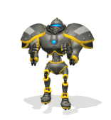
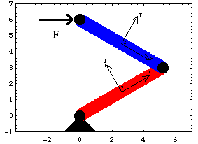
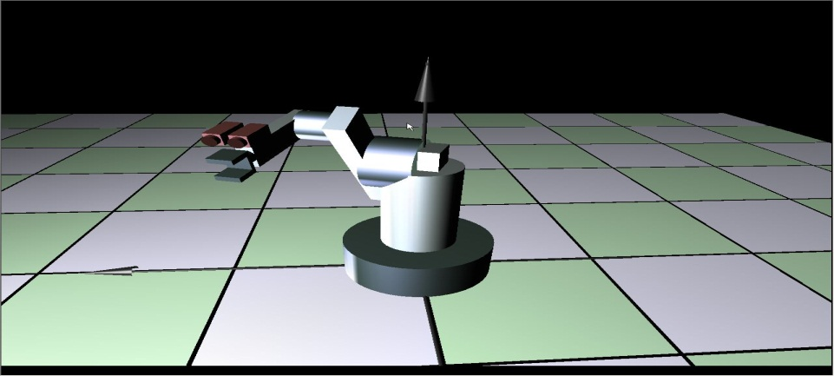
Construction of Ego- model
CS365 : ARTIFICIAL INTELLIGENCE PROJECT
Prepared by:
Swati
Guided by:
Dr. Amitabha Mukerjee

Slide 2
Aim
Given two dimensional planar robot arm with camera at it’s tip and sensors on it’s skin ( using synthetic data) we have to
Vision :Generate the images seen by the camera
Sensor : To display that part of robot which touches the obstacle
Manifold path planning
Assume the world to be a two dimensional planar.
Fig2. 2d image of box containing robot arm with all walls with different colors and corner in black colors
Fig1: Robotic arm with camera at tip

Slide 3
Vision
Algorithm is straight forward
Vision of the camera is 180 degrees
Algorithm
Throw the rays from the camera towards the walls and display the image seen by it. Each points on the walls are assigned with colors which are stored in an array.
Corner of the box
Fig.4 Array[0,…,90] displaying images seen by robot
Fig.3
Bunch of vertical images of blue color
Bunch of vertical images of green color

Slide 4
Sensor
Using sensors on the skin we can show whether obstacle touches the robot or not and glow that part which touches the obstacle.
Algorithm
Overlap the robot arm images with the obstacle call it “A”.
Apply following to get :
if (robot arm image = = (A - obstacle image)
print “Obstacle doesn’t hit the robot”
else
display the part hit by obstacle
Fig .6
Fig .5

Slide 5
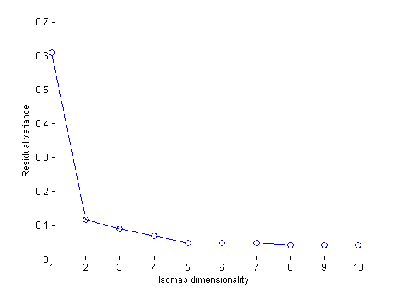
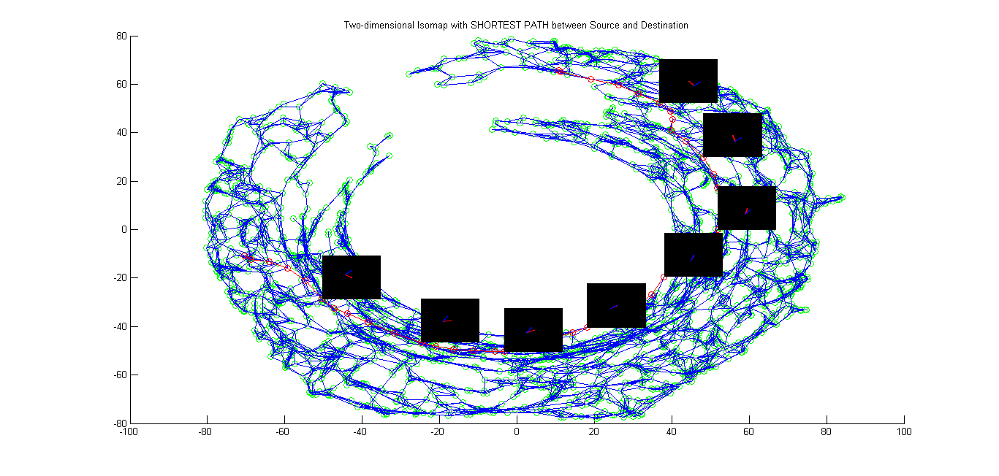
Manifold Motion Planning
Scree plot for the given robot arm images will look Fig.7:
Fig.7
Fig.8
Path planning also possible by removing all the nodes from the graph hitting the obstacle. The plot will look like Fig.8

Slide 6
References
“Obstacle Avoidance Control of Humanoid Robot Arm through Tactile Interaction” by Dzmitry Tsetserukou, Naoki Kawakami, Susumu Tachi
“The advantages of mounting a camera on robot arm” by Radu Horaud, Roger Mohr, Fadi Dornaika, and Boubakeur Boufama
In 2006 IEEE Intl. Conference on Robotics and Automation (ICRA 2006), Orlando, FL, May 2006 “Robot Navigation Using 1D Panoramic Images” by Amy Briggs_,Yunpeng Li, Daniel Scharstein & Matt Wilder
Robotic Arm Camera (RAC) built by the University of Arizona and Max Planck Institute, Germany
http://phoenix.lpl.arizona.edu/science_rac.php
http://www.universetoday.com/99622/curiositys-robotic-arm-camera-snaps-1st-night-images/

