Slide 1
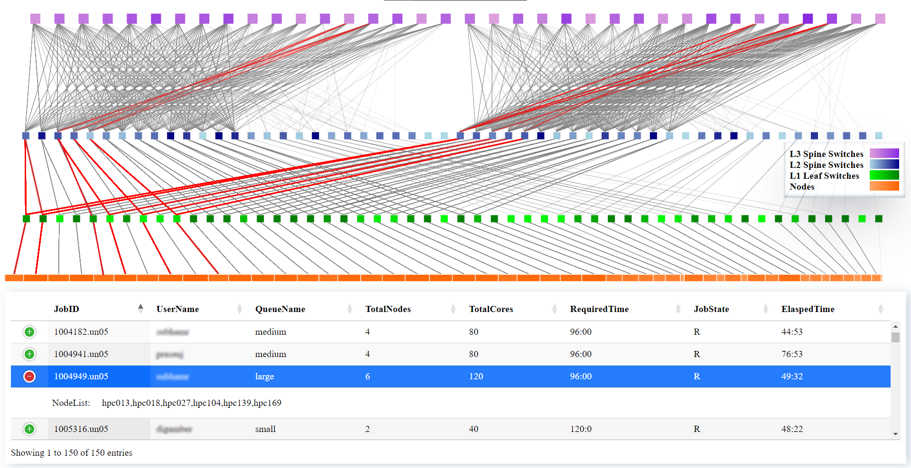
Visual Analysis of Congestion and Interference in Supercomputers
Akshay Sharma, Depanshu Sahu, Preeti Malakar
{akshays, depanshus, pmalakar}@cse.iitk.ac.in Department of Computer Science and Engineering Indian Institute of Technology Kanpur, India
Motivation
Key Contributions
Parallel applications generate communication traffic over shared interconnect of the supercomputer
Network contention and subsequent performance degradation of all applications in execution
Analysis of performance degradation due to interference in the shared links is useful to both users and system administrators
Real-time visualization of congestion in network links and switches may help identify potential bottlenecks
Detailed communication path (hops) generation of MPI applications in execution
Scalable web-based visualization of real-time network traffic generated from applications in execution in supercomputers
Comprehensive visualization and analysis portal of possible network congestion in Infiniband-based supercomputers for every job in execution
Real-time Visualization of Communication Paths of Jobs-in-execution
Job-related information of current jobs in execution (JobId, UserName, Queue Name, NodesRequired, CpuRequired, ElapsedTime, and NodeList) collected from the job scheduler.
IPMPI [2] provides all communication endpoints in an MPI application, which is used to obtain real-time communication paths for every job.
Number of packets transmitted and received through each device used along all communication paths provides complete network flows in the supercomputer.
D3-based visualization of network flows on all links and devices (hosts, switches) for all jobs in execution. Overlapping links between multiple jobs may highlight possible interference.
Data collection
Job communication paths
Active device data
Real-time visualization
Three levels of fat-tree network of PARAM Sanganak are shown in purple, blue and green.
Compute nodes are shown in orange.
The shade of the color shows the congestion in the device. Darker shades imply more network packets through that device.
All jobs in execution are displayed, selection of a running job displays the network traffic generated due to that job.
Real-time visualization of communications in a job in execution on PARAM Sanganak supercomputer at IIT Kanpur.
Conclusions and Future Work
References
We have developed a comprehensive real-time network device and job monitoring system for Infiniband-based supercomputers/clusters.
In future, we plan to enhance our GUI to incorporate historical job analysis and further analysis of performance degradation.
[1] S. A. Smith, C. E. Cromey, D. K. Lowenthal, J. Domke, N. Jain, J. J. Thiagarajan, and A. Bhatele, “Mitigating Inter-Job Interference Using Adaptive Flow-Aware Routing,” in SC18: International Conference for High Performance Computing, Networking, Storage and Analysis, 2018, pp. 346–360.
[2] T. Agrawal and P. Malakar, “IPMPI: Improved MPI Communication Logger,” IEEE/ACM Supercomputing Conference Workshop on Exascale MPI (ExaMPI), 2022.
[3] Kousha, P., SD, K. R., Subramoni, H., Panda, D. K., Na, H., Dockendorf, T., and Tomko, K. (2020). Accelerated real-time network monitoring and profiling at scale using OSU INAM. In Practice and Experience in Advanced Research Computing (pp. 215-223).
We acknowledge the Computer Center, Indian Institute of Technology Kanpur for providing us 24X7 access to the HPC facilities of IIT Kanpur.
https://www.cse.iitk.ac.in/users/akshays/resources.html
Poster Number: 113 HiPC’23 Student Research Symposium

