Slide 1
Efficient Data Race Detection of Async-Finish Programs Using Vector Clocks
Shivam Kumar
IIT Kanpur
Anupam Agrawal
IIT Kanpur
Swarnendu Biswas
IIT Kanpur
Programming Models and Applications for Multicores and Manycores (PMAM 2022)

Slide 2
A Racy Java Program
Object x = null;
Boolean done = false;
Thread T1
Thread T2
x = new Object();
done = true;
while(!done) {}
x.compute();

Slide 3
Data Race
Object x = null;
Boolean done = false;
Thread T1
Thread T2
read
write
x = new Object();
done = true;
while(!done) {}
x.compute();
Data race
Conflicting accesses – two threads access the same shared variable where at least one access is a write
Concurrent accesses – accesses are not ordered by synchronization operations

Slide 4
Data Races Are Bad!!!
Object x = null;
Boolean done = false;
Thread T1
Thread T2
done = true;
x = new Object();
while(!done) {}
x.compute();
NPE

Slide 5
Impact of Data Races

Slide 6
Vector Clock Based Race Detection
Thread T1
Thread T2
T1 | T2
5 | 2
T1 | T2
3 | 4
Thread T1’s logical clock
Last logical clock received from Thread T1
Thread T2’s logical clock
Last logical clock received from Thread T2

Slide 7
Detecting Data Races Using FastTrack
NULL
Var x
Thread T1
Thread T2
T1 | T2
5 | 2
T1 | T2
3 | 4
C. Flanagan and S. Freund. FastTrack: Efficient and Precise Dynamic Data Race Detection. PLDI, 2009.

Slide 8
Detecting Data Races Using FastTrack
5@T1
Var x
Thread T1
Thread T2
T1 | T2
5 | 2
T1 | T2
3 | 4
write(x)

Slide 9
Detecting Data Races Using FastTrack
5@T1
Var x
Thread T1
Thread T2
T1 | T2
5 | 2
T1 | T2
3 | 4
write(x)
Data Race
write(x)
5@T1 > VC_{T2} [T1](=3)

Slide 10
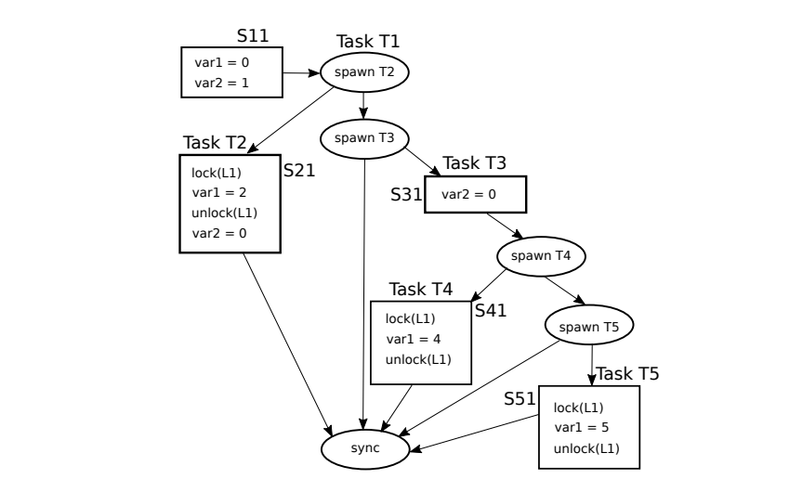
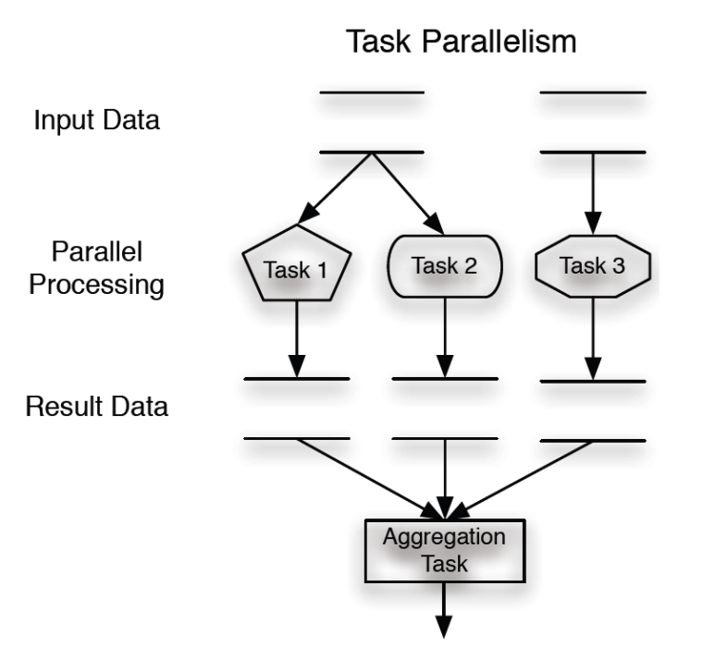
Task Parallel Programs
Task-Parallel Programs
Async-Finish Programs

Slide 11
FastTrack on Task Parallel Programs
Memory Limit Exceeded
Task-Parallel Programs
Vector Clocks not suitable for task parallel programs
~50X overhead
FastTrack

Slide 12
Data Race Detection
Multi-threaded Programs
Task-Parallel Programs
Vector clock analyses are generic, inherently parallel, and have better data locality than tree-based data structures.
Vector Clock
Tree Based
Adarsh Yoga, Santosh Nagarakatte, and Aarti Gupta. Parallel Data Race Detection for Task Parallel Programs with Locks. FSE, 2016.

Slide 13
FastRacer: An Efficient Dynamic Data Race Detector
Per Task Optimizations
FastTrack
FastRacer
Multi-threaded Programs
Task-Parallel Programs
Per Variable Optimizations

Slide 14
FastRacer on Task Parallel Programs
Vector clocks viable for efficient analysis of task-based programs
Task-Parallel Programs
Outperforms SOTA algorithms e.g. PTRacer, C-Racer
FastRacer

Slide 15
FastTrack: Task Spawn
4 | 8 | 3 | 2
Maintaining per-task copies of clock values is mostly redundant
Task T
4 | 8 | 3 | 2 | 1
4 | 8 | 3 | 2 | 2
4 | 8 | 3 | 2 | 3
Task T1
Task T2
Task T3

Slide 16
FastRacer: Task spawn
4 | 8 | 3 | 2
REF
Avoiding needless copies helps improve space and time overhead
Task T
REF | 1
REF | 2
REF | 3
Task T1
Task T2
Task T3

Slide 17
FastTrack: Task Join
1
Task T
Spawn
1 | 2
Task T1

Slide 18
FastTrack: Task Join
1
Task T
Spawn
Join
1 | 2 | 5 | 8 | 6
Task T1

Slide 19
FastTrack: Task Join
No need to store clock values of child tasks after join operation!!!
1 | 2 | 5 | 8 | 6
Task T
Spawn
Spawn
Join
1 | 2 | 5 | 8 | 6
1 | 2 | 5 | 8 | 6 | 3
Task T1
Task T2

Slide 20
FastRacer: Task Join
1
{}
Task T
JoinSet
Spawn
1 | 2
{}
Task T1

Slide 21
FastRacer: Task Join
1
{}
Task T
JoinSet
Spawn
1 | 2
{T3,T4,T5,T6}
Task T1

Slide 22
FastRacer: Task Join
Global data structures are used for efficient set operations
1
{T1,T3,T4,T5,T6}
Task T
JoinSet
Spawn
1 | 3
{T1,T3,T4,T5,T6}
1 | 2
{T3,T4,T5,T6}
Task T2
Task T1

Slide 23
FastTrack: Variable Access
NULL
T1
Var x
T2
T3
T4

Slide 24
FastTrack: Variable Access
C2@T2
T1
Var x
Read(x)
T2
T3
T4

Slide 25
FastTrack: Variable Access
C2@T2, C3@T3
T1
Var x
Read(x)
T2
T3
T4
Read(x)

Slide 26
FastTrack: Variable Access
C2@T2, C3@T3, C4@T4
T1
Variable metadata directly proportional to number of parallel accesses
Var x
Read(x)
T2
T3
T4
Read(x)
Read(x)

Slide 27
FastRacer: Variable Access
NULL
T1
Var x
T2
T3
T4

Slide 28
FastRacer: Variable Access
C2@T2
T1
Var x
Read(x)
T2
T3
T4

Slide 29
FastRacer: Variable Access
C2@T2, C3@T3
T1
Var x
Read(x)
T2
T3
T4
Read(x)

Slide 30
FastRacer: Variable Access
Constant variable metadata for a given lockset
C2@T2, C3@T3
T1
Var x
Read(x)
T2
T3
T4
Read(x)
Read(x)
TIP: Select the two accesses with highest LCA in inheritance tree

Slide 31
FastRacer: An Efficient Dynamic Data Race Detector
Per Task Optimizations
FastTrack
FastRacer
Multi-threaded Programs
Task-Parallel Programs
Per Variable Optimizations

Slide 32
Performance Results

Slide 33
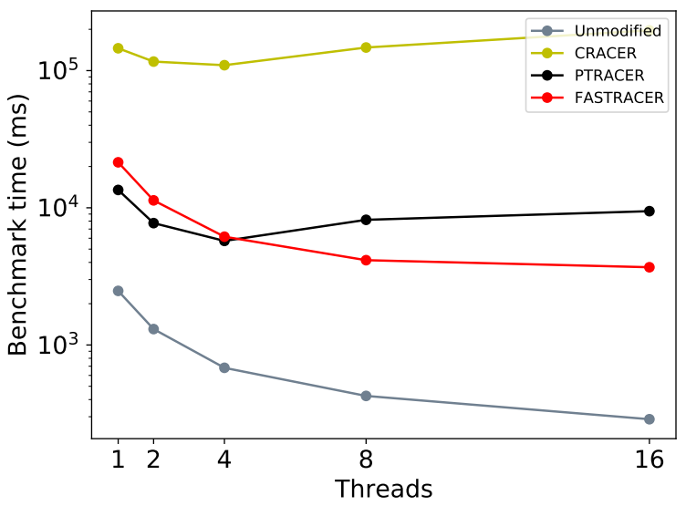
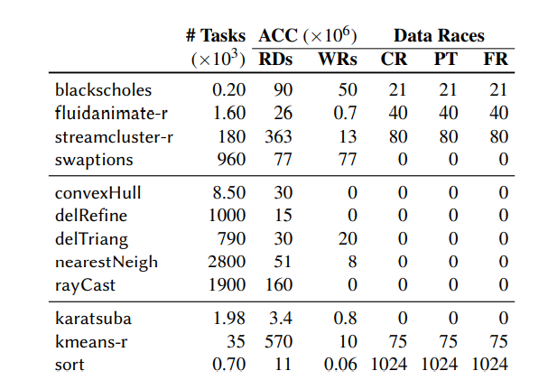
Scalability Plots and Race Reports
Scalability Plots
Race Reports

Slide 34
Contributions
First to show viability of using vector clocks for efficient dynamic analysis of task-based programs
Optimizations discussed are generic enough for several popular frameworks e.g. OpenMP
Publicly available implementations of FastRacer* and related techniques
* https://github.com/prosper/fastracer-pmam-2022

Slide 35
Efficient Data Race Detection of Async-Finish Programs Using Vector Clocks
Shivam Kumar
IIT Kanpur
Anupam Agrawal
IIT Kanpur
Swarnendu Biswas
IIT Kanpur
Programming Models and Applications for Multicores and Manycores (PMAM 2022)

