Slide 1
HTML (HyperText Markup Language)
Siddharth Srivastava

Slide 2
Introduction to HTML
HTML stands for Hypertext Markup Language
It is used to develop web pages and web applications.
HTML is composed of HTML Tags.
These Tags are interpreted by web-browser, in such a way that elements (like text, image, etc.) associated with tags are rendered on browser in desired way.
Now Lets start with practical of HTML

Slide 3
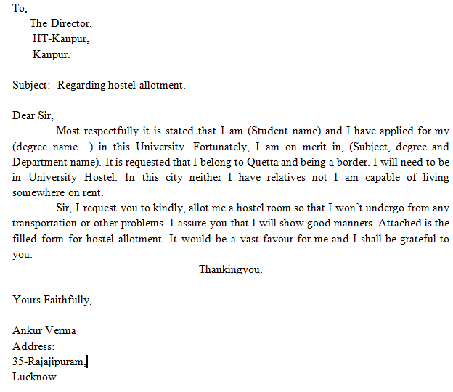
Understanding Structure and Tags
To Tag
Subject Tag
Body Tag
Sender Tag

Slide 4
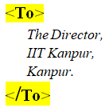
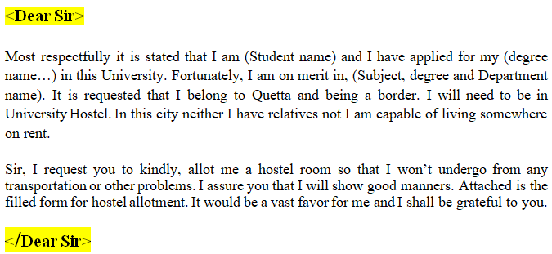
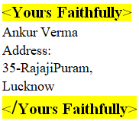
Understanding Structure and Tags
To Tag
Subject Tag
Body Tag
Sender Tag

Slide 5
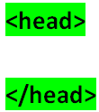
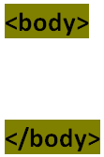
Understanding Basic
HTML Structure & HTML Tags
DEMO of
1)How to write HTML file.
2) How to store HTML File.
3) <Title> </Title> tag in HTML.
4) How to use <BR> using first.html
Notes:
Use first.html file to demonstrate use of <br> tag

Slide 6
Task 1
Go to URL https://www.cse.iitk.ac.in/users/sidsri/SummerSchool/
Download Task 1.
Your aim is to use <br> tag as told just now.
You can verify your result by opening answer1.html file. Your result must match output of this file.
Now Lets start with practical of <br> tag.

Slide 7
Understanding Paragraph Tag
<p> </p> denotes paragraph tag.
Any thing written between <p> </p> is considered as paragraph and browser automatically adds some space before <p> and after </p> tag.
Check It out using “Second.html” and “The Jungle Book Summary.doc” file.
Align attribute can only be placed with <p> tag not with </p> tag. If we don’t use align attribute then by default paragraph is left align.
<p> tag can have align attribute which can change alignment of text. As shown in class
<p align=“Left”>I am Left Align</p> | I am Left Align
<p align=“Right”>I am Right Align</p> | I am Right Align
<p align=“Center”>I am Center Align</p> | I am Center Align
<p align=“Justify”>I am Justify</p> | I am Justify

Slide 8
Task 2
Go to URL https://www.cse.iitk.ac.in/users/sidsri/SummerSchool/
Download Task 2.
Your aim is to use <br>, <p> </p> tag and align attribute as told just now.
You can verify your result by opening answer2.html file. Your result must match output of this file.
Now Lets start with practical of <br>, <p> </p> tag and align attribute. ☺ ☺

Slide 9
Understanding Heading Tag
There are six type of heading tags present in HTML as shown below
<h1>Heading 1</h1>
<h2>Heading 2</h2>
<h3>Heading 3</h3>
<h4>Heading 4</h4>
<h5>Heading 5</h5>
<h6>Heading 6</h6>

Slide 10
Understanding Horizontal Rules Tag
<hr> denotes horizontal rule tag.
Like <br> tag it is also ending tag i.e. it don’t have any closing tag associated with it.
When we use <hr> then a line is displayed on webpage.
This line is horizontal and often known as horizontal rule or horizontal line.
It is used to break the content of webpage using horizontal rule or horizontal line.

Slide 11
Task 3
Go to URL https://www.cse.iitk.ac.in/users/sidsri/SummerSchool/
Download Task 3.
Your aim is to use heading tags to give proper size to headings.
You can verify your result by opening answer3.html file. Your result must match output of this file.
Now Lets start with practical of heading tags. ☺ ☺

Slide 12
Handling Images in HTML
Images are handled in html using <img> tag.
<img> tag is also ending tag as <br> (i.e. it do not have an ending tag associated with it).
Since images are stored in files so they are accessed using “src” attribute.
[Syntax <img src=“filename.jpg”>]
Image size is set using “width” and “height” attributes.
[Syntax <img src=“filename.png” width=“200px” height=“150px”> where px=pixel]

Slide 13
Handling Images in HTML
(Alt attribute)
Syntax:
<img src=“url” alt=“Image not found”>

Slide 14
Task 4
Go to URL https://www.cse.iitk.ac.in/users/sidsri/SummerSchool/
Download Task 4.
Your aim is to use image tag and its attributes.
You can verify your result by opening a.html,b.html,c.html and d.html files.
Now Lets start with practical of this tag. ☺ ☺

Slide 15
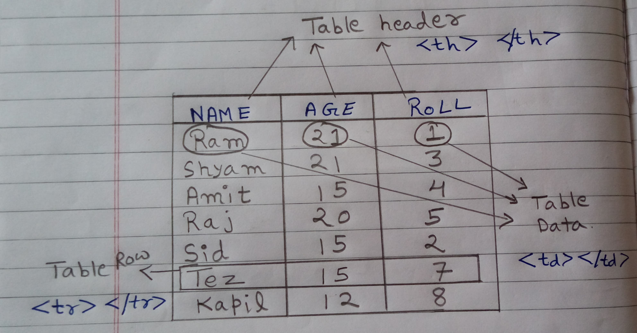
Concept of Table in HTML

Slide 16
Table Tag in HTML
Syntax:
<table>
<tr>
<th>Name</th>
<th>Age</th>
<th>Roll No.</th>
</tr>
<tr>
<td>Ajay</td>
<td>21</td>
<td>1</td>
</tr>
<tr>
<td>Vijay</td> <td>19</td> <td>3</td>
</tr>
<tr>
<td>Ram</td> <td>22</td> <td>2</td>
</tr>
</table>

Slide 17
Table Tag in HTML
(border attribute)
Syntax:
<table border=‘2’ cellspacing=‘5’ cellpadding=‘10’>
<tr>
<th>Name</th> <th>Age</th> <th>Roll No.</th>
</tr>
<tr>
<td>Ajay</td> <td>21</td> <td>1</td>
</tr>
<tr>
<td>Vijay</td> <td>19</td> <td>3</td>
</tr>
<tr>
<td>Ram</td> <td>22</td> <td>2</td>
</tr>
</table>

Slide 18
Task 5
Go to URL https://www.cse.iitk.ac.in/users/sidsri/SummerSchool/
Download Task 5.
Your aim is to use table tag and its attributes.
You can verify your result by opening a.html.
Now Lets start with practical of this tag. ☺ ☺

Slide 19
Task 6
Homework or Classwork

Slide 20
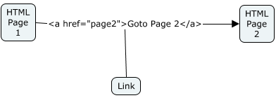
Understanding <a> tag
DEMO of Hyperlinking
Using 7.html

Slide 21
Task 7
Go to URL https://www.cse.iitk.ac.in/users/sidsri/SummerSchool/
Download Task 7.
Your aim is to use hyperlink tag and its attributes.
You can verify your result by opening a.html.
Now Lets start with practical of this tag. ☺ ☺

Slide 22
Some Easy and Quick tags
While processing text using word processor software like ms-word, libera office, etc. you frequently use following options.
Underline the text.
Make some portion of text BOLD
Make some portion of text Italics.
Create Lists (having numbers like this one, or having bullets) which may be ordered or unordered.
In HTML using following tags you can do all these things.

Slide 23
Some Easy and Quick tags
Feature | Tag | Output
Underline | <u> I am Underlined</u> | I am Underlined
Bold | <b> HI I am Bold </b> | HI I am Bold
Italics | <i> Am I italics </i> | Am I Italics
Unordered List [where ul=unordered list li=list item ] | <ul> <li>I am List Item 1</li> <li>I am List Item 2</li> </ul> | I am List Item 1 I am List Item 2
Ordered List [where ol=ordered list li=list item ] | <ol> <li> List Item 1</li> <li>List Item 2</li> </ol> | 1. List Item 1 2. List Item 2
Note* Red colour statements in “feature” column are used to represent meaning of tag elements.

Slide 24
Some Easy and Quick tags
Feature | Tag | Output
Ordered List [starting at Index 5] {“start” attribute alter the starting index of ordered list} | <ol start=“5”> <li> List Item 1 at index 5</li> <li>List Item 2 at index 6</li> </ol> | 5. List Item 1 at index 5 6. List Item 2 at index 6
Description List [where dl=description list dt=description term dd=description data ] | <dl> <dt>Eyes</dt> <dd>Part of Body use to see.</dd> <dt>Cycle</dt> <dd>A vehicle use for locomotion</dd> </dl> | Eyes Part of Body use to see. Cycle A vehicle use for locomotion

Slide 25
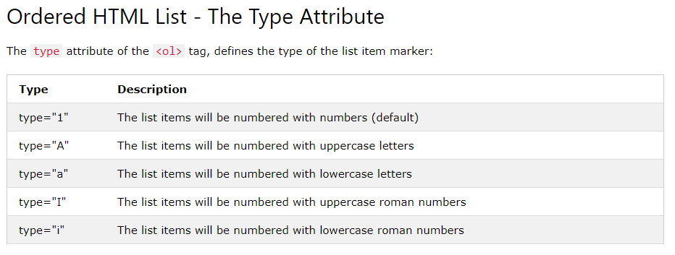
Some Easy and Quick tags

Slide 26
Task 8
Go to URL https://www.cse.iitk.ac.in/users/sidsri/SummerSchool/
Download Task 8.
Your aim is to use bold, italic, underline, list tags and their attributes.
You can verify your result by opening answer8.html.
Now Lets start with practical of these tag. ☺ ☺

Slide 27
Now
Starts
Fun

Slide 28
Introducing Form Elements
Blackboard Work Starts Now….

Slide 29
Task 9
Understanding Basic Form elements
Form
Text Fields (both for Text and Password)
Buttons
Concept of Client Server Architecture
<form>
<input type=“text>
<input type=“password”>
<input type=“button”>
</form>

Slide 30
Task 10
Login Form
<form name="f1" id="fid1">
User Name:<br>
<input type="text" name="tf1" id="tf1" required><br>
Password:<br>
<input type=“password" name="tf2" id="tf2" required><br><br>
<input type="button" name="b1" id="b1" value="Reset">
<input type="submit" name="b2" id="b2">
</form>

Slide 31
Task 11 & 12
Understanding Basic Form elements
Check boxes
Radio Buttons
<form>
<input type="checkbox" name=“food" value=“DOSA">DOSA<br>
<input type="checkbox" name=“fo" value=“PIZZA">PIZZA
</form>
<form>
<input type="radio" name="gender" value="male" checked> Male<br>
<input type="radio" name="gender" value="female"> Female<br>
<input type="radio" name="gender" value="other"> Other
</form>

Slide 32
Task 13
Understanding Basic Form elements
option
<form>
<select>
<option>one</option>
<option>one</option>
</select>
</form>

Slide 33
Task 14
Understanding Basic Form elements
Range
<form>
<input type=“range” min=‘0’ max=‘100’ value=‘50’>
</form>

