Slide 1
Randomized Algorithms
CS648
Lecture 18
Approximate Distance Oracles
Algorithm for Min-cut : part 1

Slide 2
Approximate Distance oracles

Slide 3
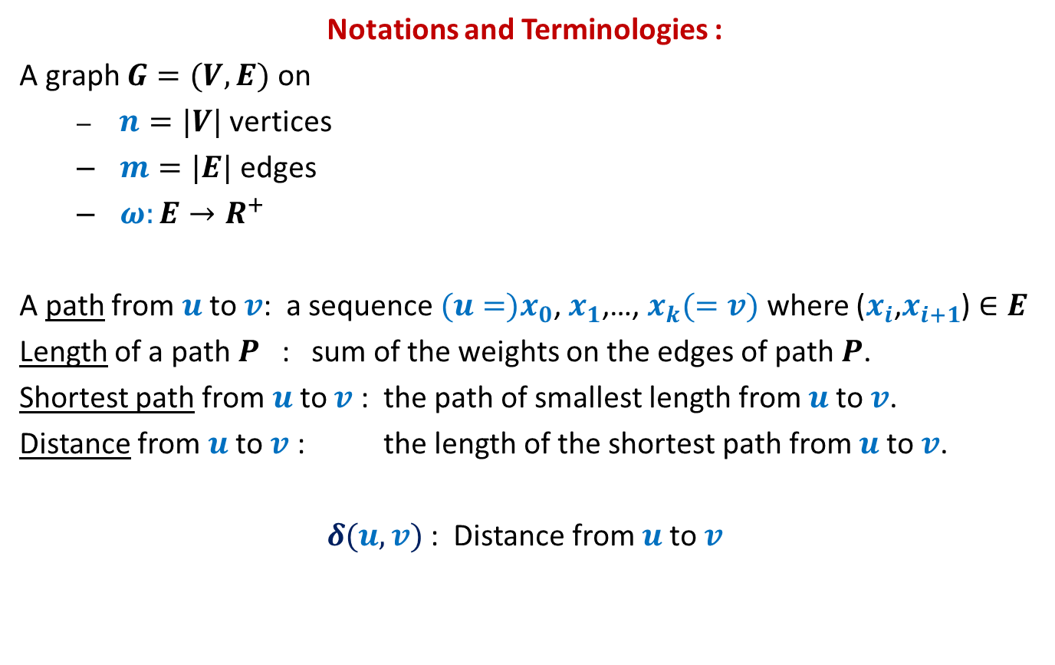
All-Pairs Shortest Paths
Notations and Terminologies :
A graph $G=(V,E)$ on
  $n=|V|$ vertices
  $m=|E|$ edges
  $ω:E→R^{+}$
A path from $u$to $v$: a sequence ${(u=)x}_{0}$, $x_{1}$,…, $x_{k}(=v)$ where ($x_{i}$,$x_{i+1}$) $∈E$
Length of a path $P$ : sum of the weights on the edges of path $P$.
Shortest path from $u$to $v$ : the path of smallest length from $u$to $v$.
Distance from $u$to $v$ : the length of the shortest path from $u$to $v$.
$δ(u,v)$ : Distance from $u$to $v$

Slide 4
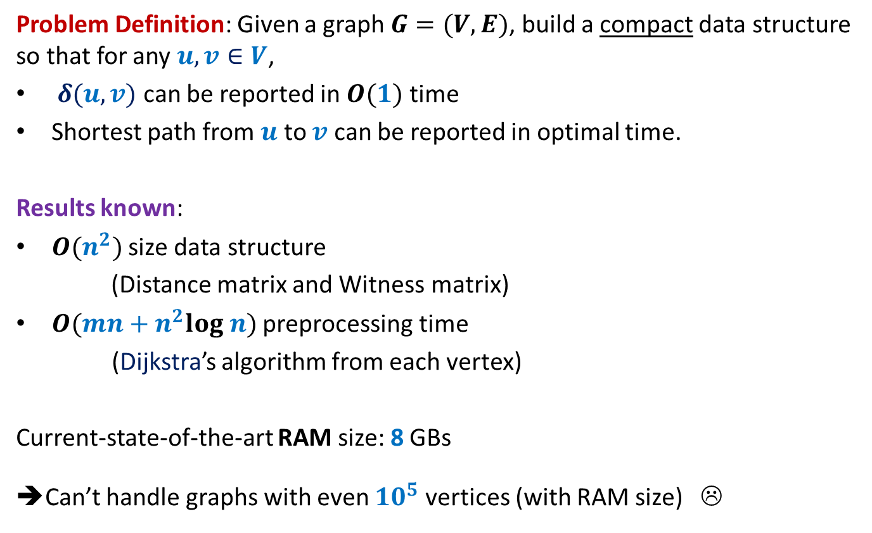
All-Pairs Shortest Paths
Problem Definition: Given a graph $G=(V,E)$, build a compact data structure so that for any $u,v∈V$,
$δ(u,v)$ can be reported in $O(1)$ time
Shortest path from $u$ to $v$ can be reported in optimal time.
Results known:
$O(n^{2})$ size data structure
(Distance matrix and Witness matrix)
$O(mn+n^{2}log n)$ preprocessing time
(Dijkstra’s algorithm from each vertex)
Current-state-of-the-art RAM size: 8 GBs
➔Can’t handle graphs with even ${10}^{5}$ vertices (with RAM size) ☹

Slide 5
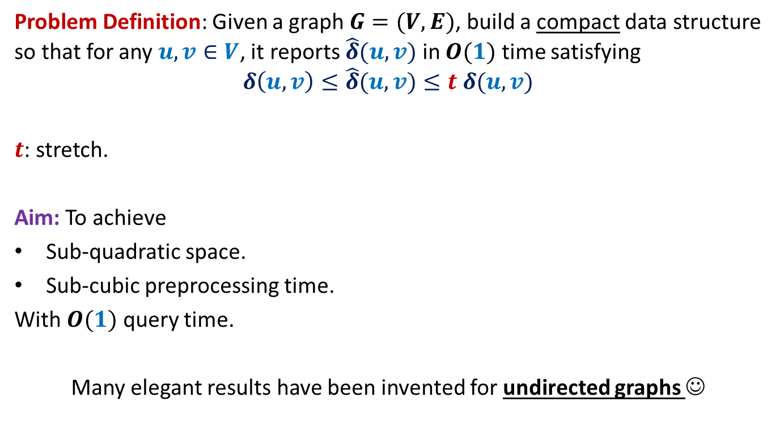
All-Pairs Approximate Shortest Paths
Problem Definition: Given a graph $G=(V,E)$, build a compact data structure so that for any $u,v∈V$, it reports $\hat{δ}(u,v)$ in $O(1)$ time satisfying
$$δ\left(u,v\right)≤\hat{δ}(u,v)≤t δ(u,v)$$
$t$: stretch.
Aim: To achieve
Sub-quadratic space.
Sub-cubic preprocessing time.
With $O(1)$ query time.
Many elegant results have been invented for undirected graphs ☺

Slide 6





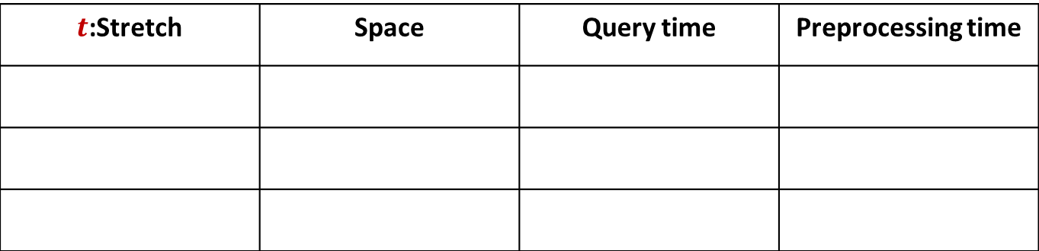







A truly magical result
Approximate Distance Oracles
$t$:Stretch | Space | Query time | Preprocessing time
$$3$$
$$O(n^{1+\frac{1}{2}})$$
$$O(1)$$
$$O({mn}^{\frac{1}{2}})$$
$$5$$
$$O(n^{1+\frac{1}{3}})$$
$$O(1)$$
$$O({mn}^{\frac{1}{3}})$$
$$2k−1$$
$$O(n^{1+\frac{1}{k}})$$
$$O(k)$$
$$O({k mn}^{\frac{1}{k}})$$
Mikkel Thorup and Uri Zwick:
Approximate Distance Oracles for graphs,
Journal of ACM (4), 2005

Slide 7
Inspiration from our daily life

Slide 8




Air/Road Network
$$Lucknow$$
$$Delhi$$
$$Kanpur$$
$$Bangalore$$

Slide 9
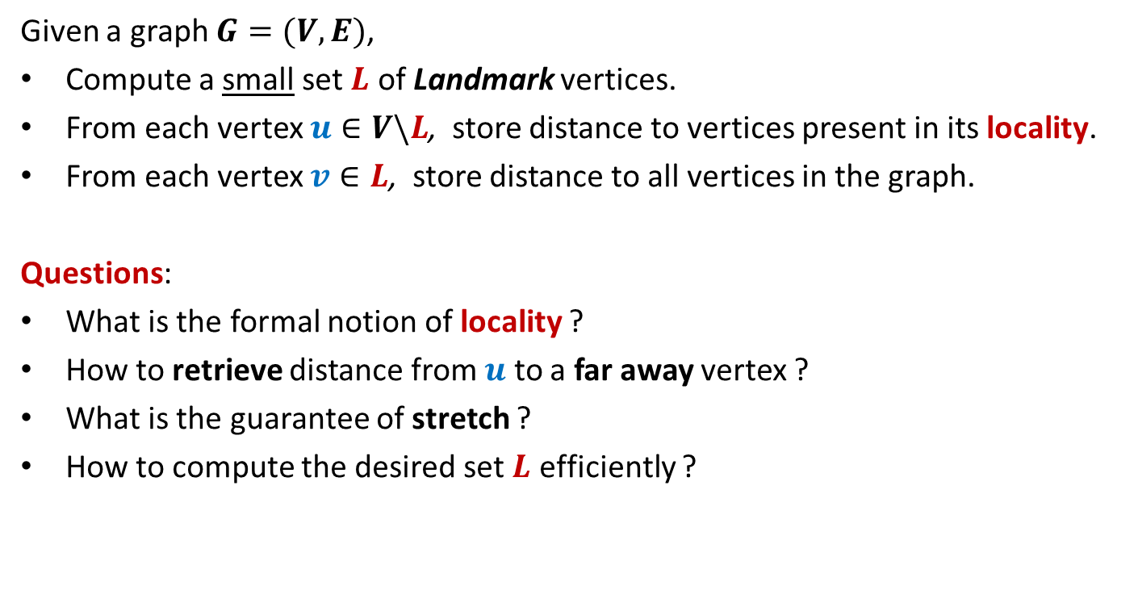
The Idea
Given a graph $G=(V,E)$,
Compute a small set $L$ of Landmark vertices.
From each vertex $u∈V\backslash L$, store distance to vertices present in its locality.
From each vertex $v∈L$, store distance to all vertices in the graph.
Questions:
What is the formal notion of locality ?
How to retrieve distance from $u$ to a far away vertex ?
What is the guarantee of stretch ?
How to compute the desired set $L$ efficiently ?

Slide 10

Formal notion of locality
$$u$$

Slide 11



Formal notion of locality
$Ball(u,V,L)$= {$x∈V| δ\left(u,x\right)<δ\left(u,L(u)\right)$}
$$L(u)$$
$$u$$
$$Ball(u,V,L)$$

Slide 12





Reporting distance from $u$
Report $δ\left(u,L(u)\right)+δ\left(L(u),v\right)$
$$δ\left(u,L(u)\right)≤δ\left(u,v\right)$$
$$v$$
$$v$$
$$L(u)$$
$$u$$
$$Ball(u,V,L)$$

Slide 13



What is the stretch ?
stretch $≤3$
$$δ\left(u,L(u)\right)≤δ\left(u,v\right)$$
??
$$≤δ\left(u,v\right)+δ\left(u,L(u)\right)$$
$≤2δ\left(u,v\right)$
$$v$$
$$L(u)$$
$$u$$
$$Ball(u,V,L)$$

Slide 14
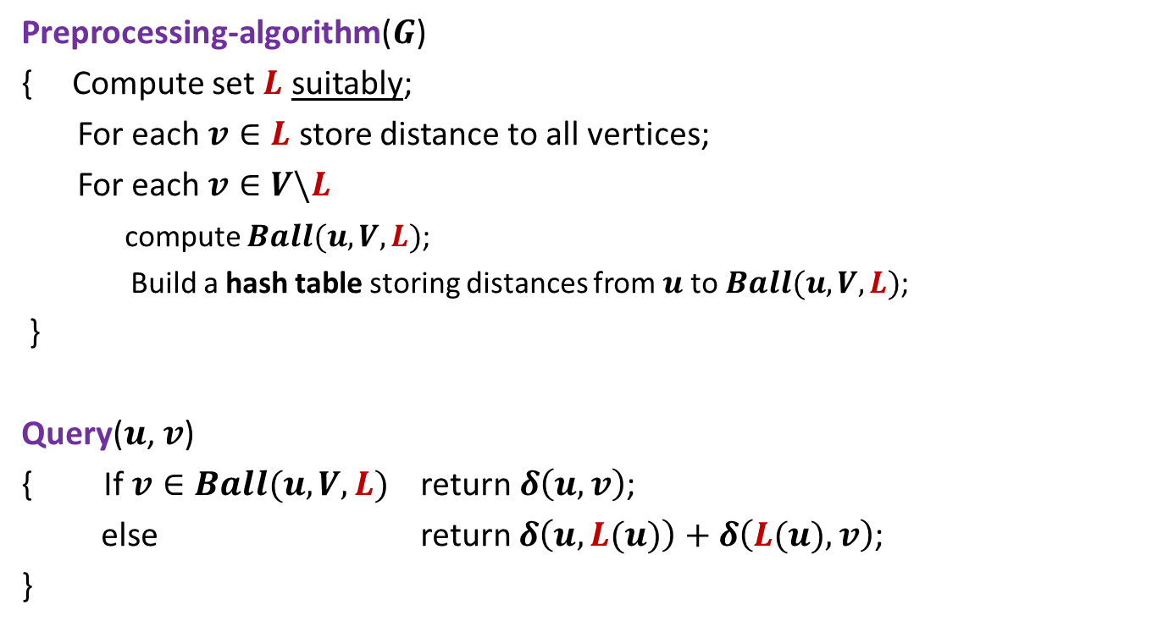
3-approximate distance oracle
Preprocessing-algorithm($G$)
{ Compute set $L$ suitably;
For each $v∈L$ store distance to all vertices;
For each $v∈V\backslash L$
compute $Ball(u,V,L)$;
Build a hash table storing distances from $u$to $Ball(u,V,L)$;
}
Query($u$, $v$)
{ If $v∈Ball(u,V,L)$ return $δ\left(u,v\right)$;
else return $δ\left(u,L(u)\right)+δ\left(L(u),v\right)$;
}
Global distance info.
Local distance info.

Slide 15
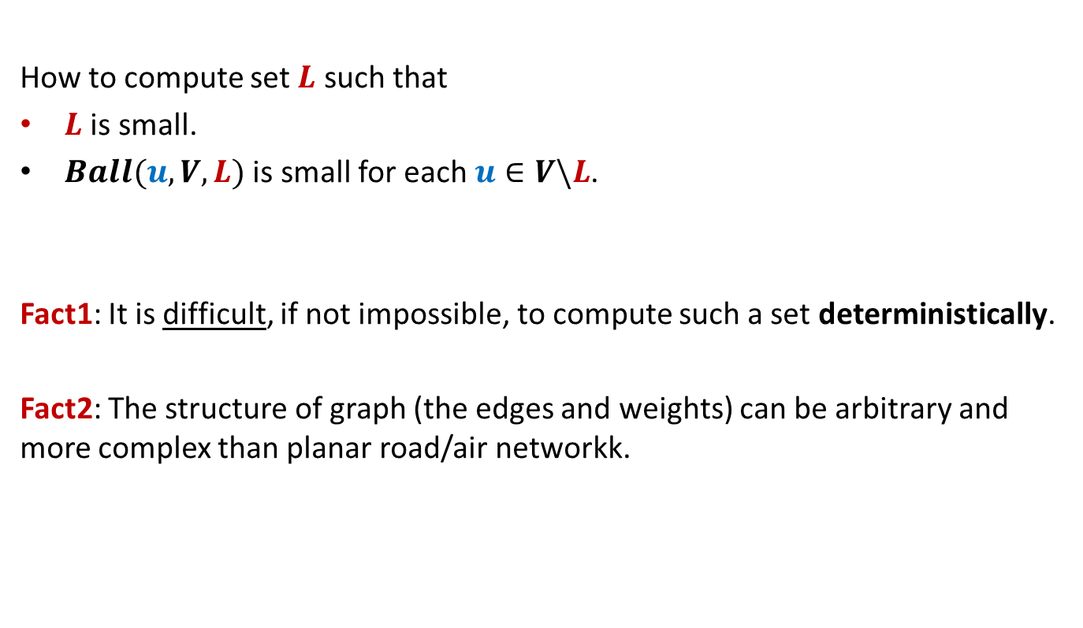
The real challenge left
How to compute set $L$ such that
$L$ is small.
$Ball(u,V,L)$ is small for each $u∈V\backslash L$.
Fact1: It is difficult, if not impossible, to compute such a set deterministically.
Fact2: The structure of graph (the edges and weights) can be arbitrary and more complex than planar road/air networkk.

Slide 16
The real challenge left
$$L(u)$$
$$u$$
$$Ball(u,V,L)$$

Slide 17
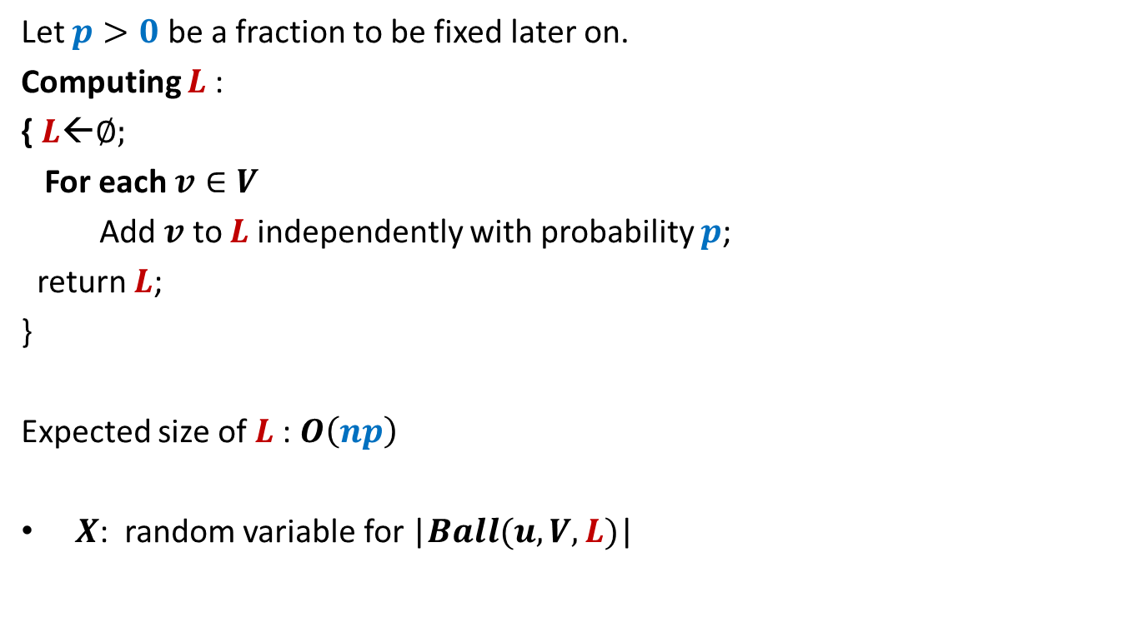
Conquering the challenge
Let $p>0$ be a fraction to be fixed later on.
Computing $L$:
{ $L$←∅;
For each $v∈V$
Add $v$ to $L$independently with probability $p$;
return $L$;
}
Expected size of $L$: $O\left(np\right)$
$X$: random variable for |$Ball(u,V,L)$|

Slide 18

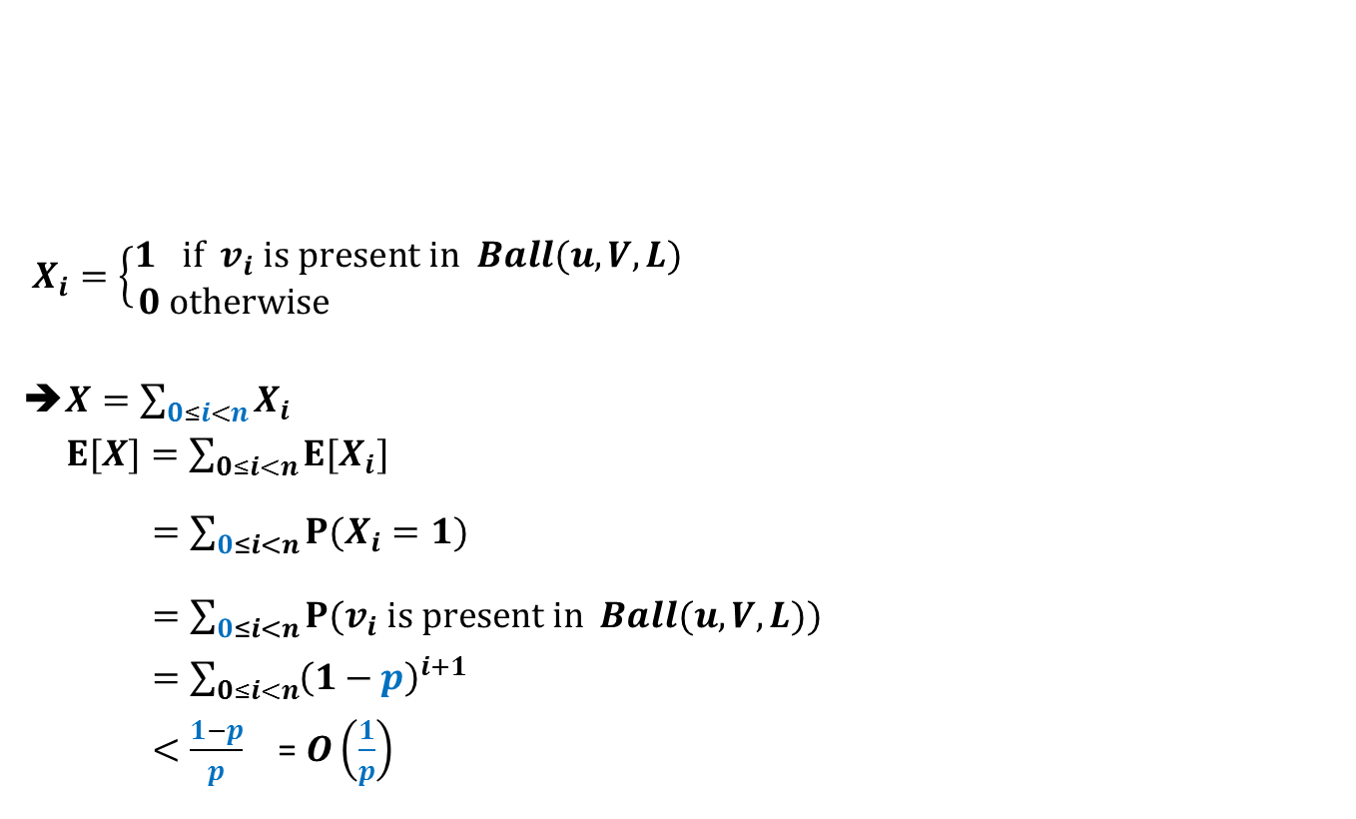
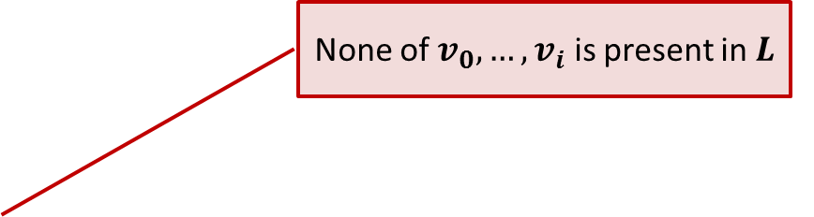



Expected size of $Ball(u,V,L)$
$$Ball(u,V,L)$$
$X_{i}=\left\{\begin{aligned}1 if v_{i} is present in Ball(u,V,L) \\ 0 otherwise \end{aligned}\right.$
➔$X=\sum_{0≤i<n}{X_{i}}$
$E[X]=\sum_{0≤i<n}{E[X_{i}]}$
$=\sum_{0≤i<n}{P(X_{i}=1)}$
$=\sum_{0≤i<n}{P(v_{i} is present in Ball(u,V,L))}$
$=\sum_{0≤i<n}{{\left(1−p\right)}^{i+1}}$
$<\frac{1−p}{p}$ = $O\left(\frac{1}{p}\right)$
$$u$$
$v_{1} v_{2}$ … $v_{i}$ … $v_{n−1}$
Increasing order of distance from $u$
None of $v_{0}, …,v_{i}$ is present in $L$

Slide 19

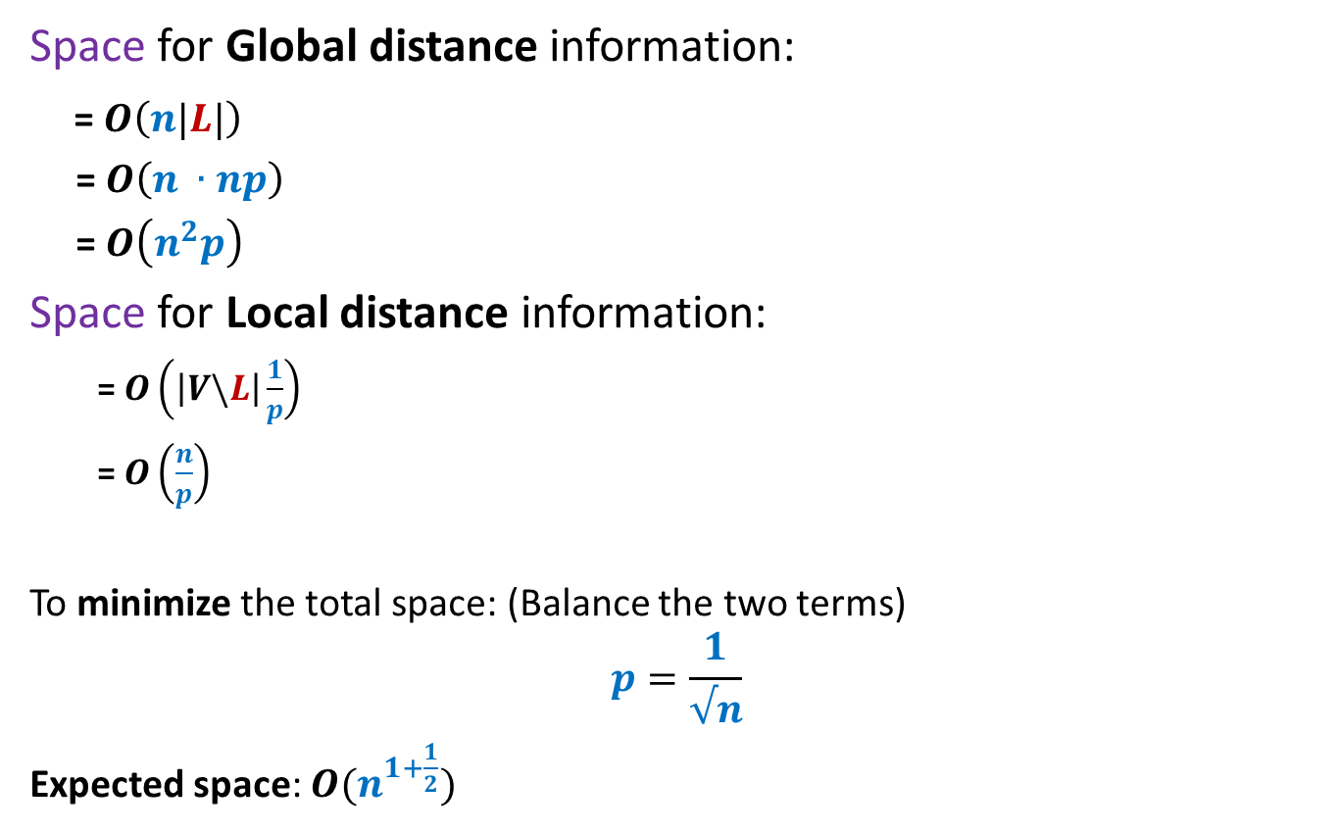
Expected space of
3-approximate distance oracle
Space for Global distance information:
= $O\left(n|L|\right)$
= $O\left(n ∙np\right)$
= $O\left(n^{2}p\right)$
Space for Local distance information:
= $O\left(\left|V\backslash L\right|\frac{1}{p}\right)$
= $O\left(\frac{n}{p}\right)$
To minimize the total space: (Balance the two terms)
$$p=\frac{1}{√n}$$
Expected space: $O(n^{1+\frac{1}{2}})$
Each vertex in $V\backslash L$ keeps a Ball)

Slide 20
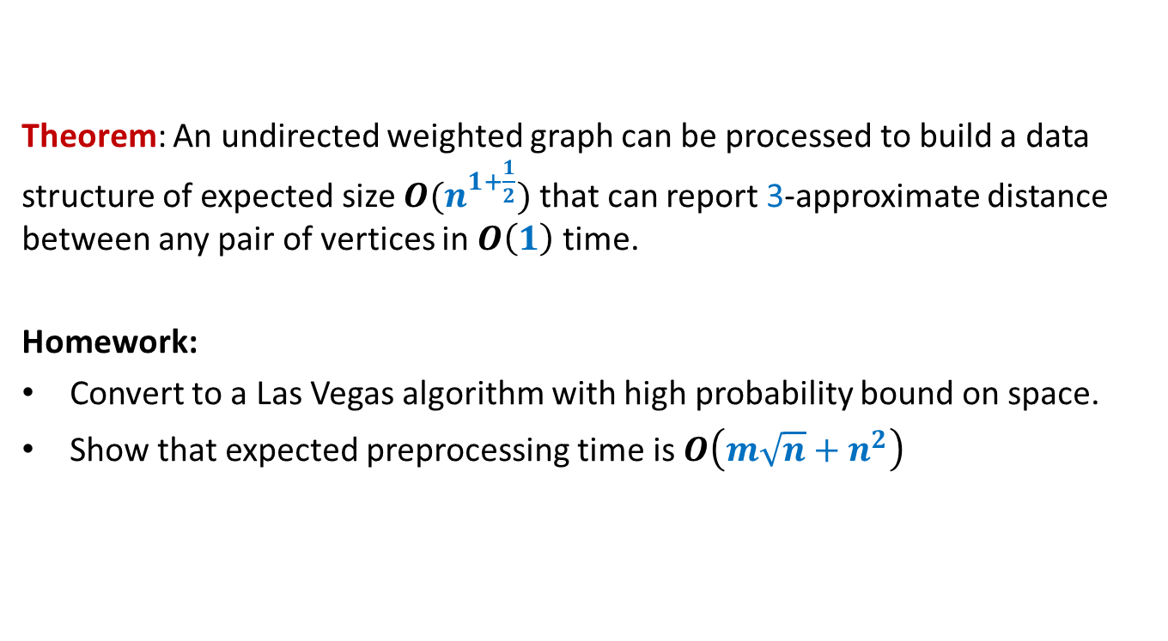
Theorem: An undirected weighted graph can be processed to build a data structure of expected size $O(n^{1+\frac{1}{2}})$ that can report 3-approximate distance between any pair of vertices in $O\left(1\right)$ time.
Homework:
Convert to a Las Vegas algorithm with high probability bound on space.
Show that expected preprocessing time is $O\left(m\sqrt{n}+n^{2}\right)$

Slide 21
5-approximate distance oracle
Meant for only those (hopefully nonzero no. of) students whose aim is more than just a good grade in this course.

Slide 22


3-approximate distance oracle
$$L$$
$$V$$

Slide 23


5-approximate distance oracle
$$L_{2}$$
$$L_{1}$$
$$V$$

Slide 24




5-approximate distance oracle
$$L_{2}(u)$$
$$L_{1}(u)$$
$$u$$
$$Ball(u,V,L_{1})$$
$$Ball(u,L_{1}, L_{2})$$

Slide 25
problem 2
Min-cut

Slide 26

Min-Cut
$G=(V,E)$: undirected connected graph
Definition (cut):
A subset $C⊆E$whose removal disconnects the graph.
Definition (min-cut): A cut of smallest size.
Problem Definition: Design algorithm to compute min-cut of a given graph.

Slide 27
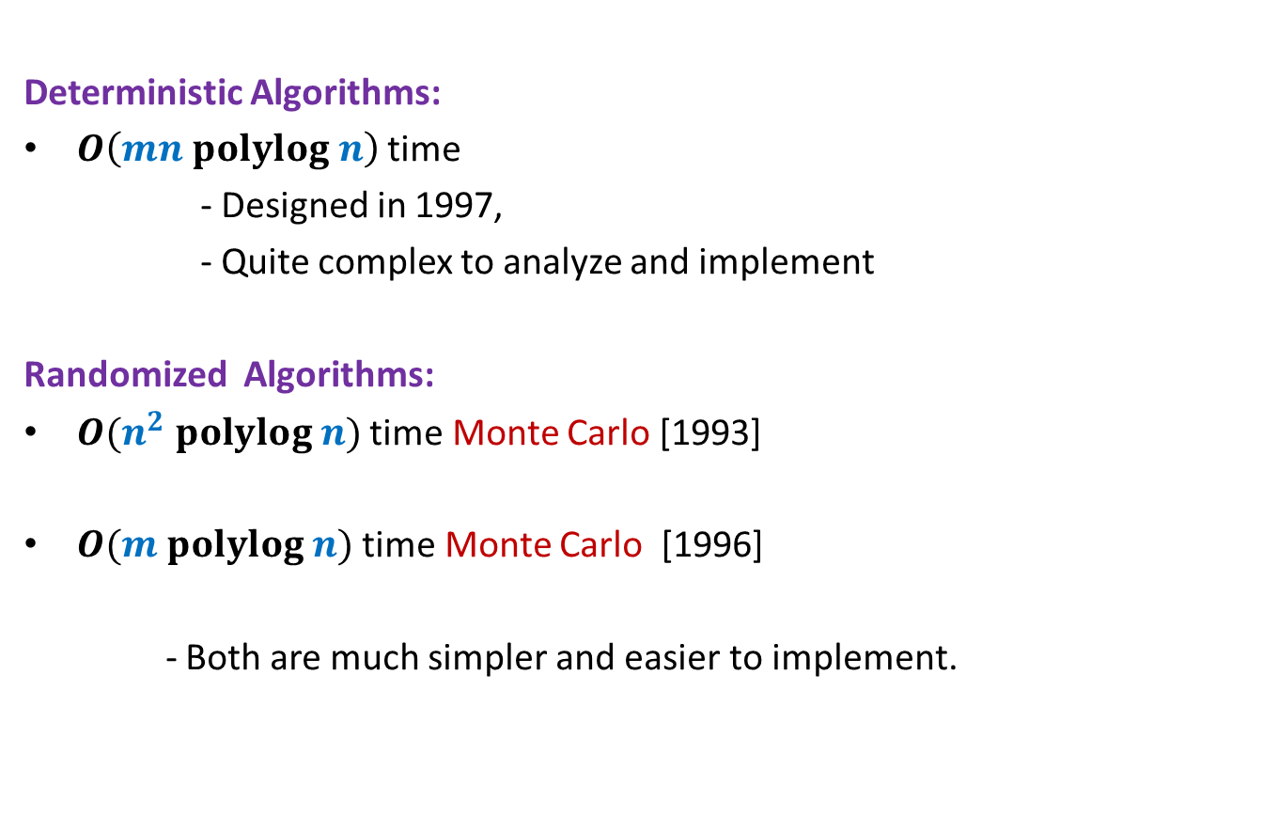
Min-Cut
Deterministic Algorithms:
$O\left(mn polylog n\right)$ time
- Designed in 1997,
- Quite complex to analyze and implement
Randomized Algorithms:
$O(n^{2} polylog n)$ time Monte Carlo [1993]
$O(m polylog n)$ time Monte Carlo [1996]
- Both are much simpler and easier to implement.

Slide 28
some basic facts

Slide 29
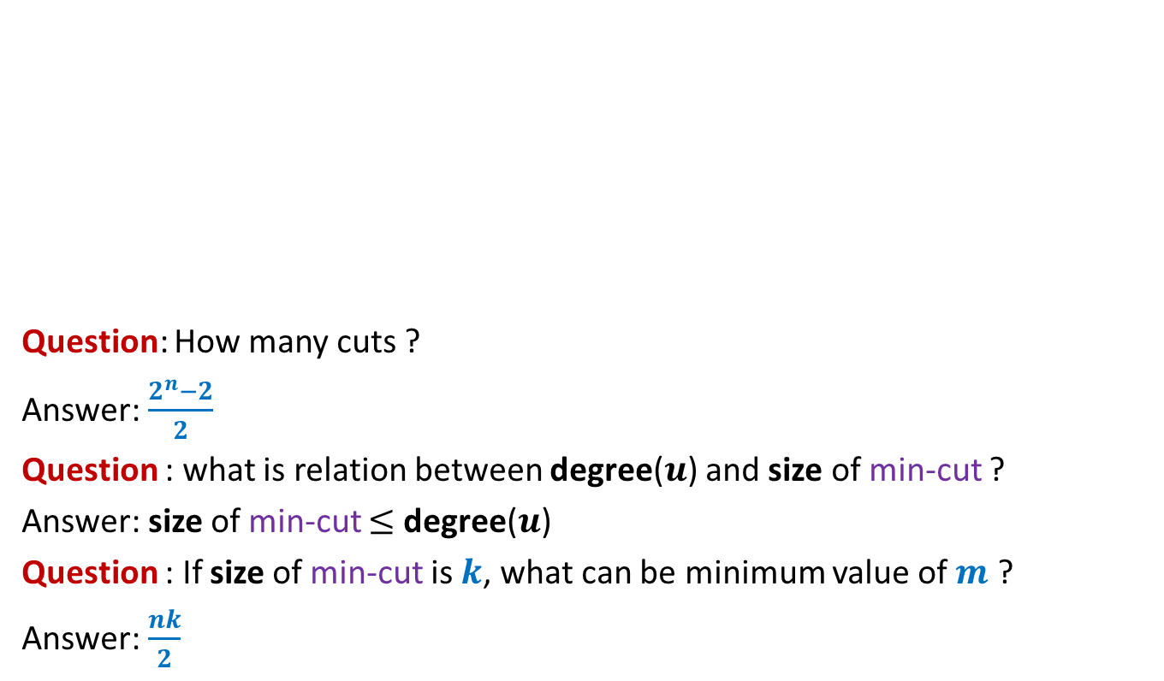
Min-Cut
Question: How many cuts ?
Answer: $\frac{2^{n}−2}{2}$
Question : what is relation between degree($u$) and size of min-cut ?
Answer: size of min-cut $≤$ degree($u$)
Question : If size of min-cut is $k$, what can be minimum value of $m$ ?
Answer: $\frac{nk}{2}$

Slide 30



















Contract($G,e$)
$$u$$
$$x$$
$$a$$
$$l$$
$$v$$
$$y$$
$$b$$
$$h$$
$$w$$
Contract($G,(x,y))$
$$u$$
$$a$$
$$l$$
$$v$$
$$xy$$
$$b$$
$$h$$
$$w$$

Slide 31
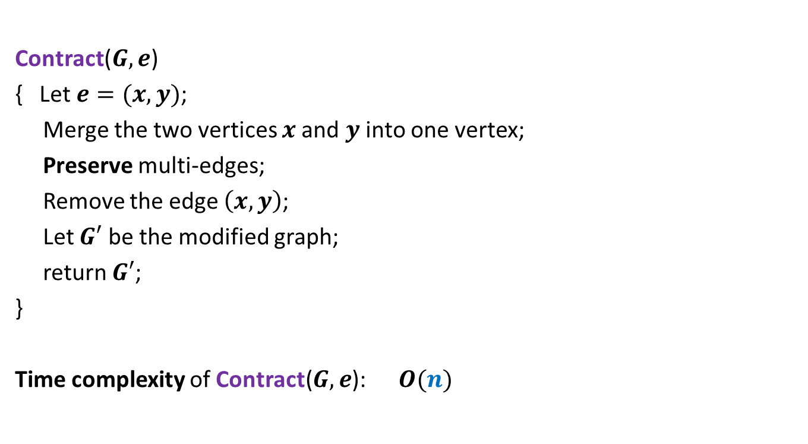

Contract($G,e$)
Contract($G,e$)
{ Let $e=(x,y)$;
Merge the two vertices $x$and $y$ into one vertex;
Preserve multi-edges;
Remove the edge $\left(x,y\right)$;
Let $G′$ be the modified graph;
return $G′$;
}
Time complexity of Contract($G,e$): $O(n)$

Slide 32
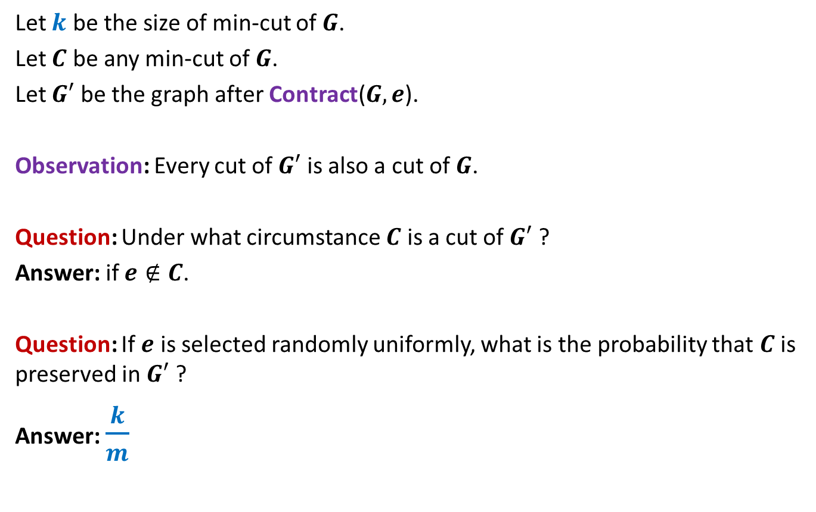
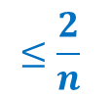
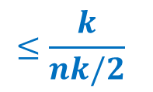
Contract($G,e$)
Let $k$ be the size of min-cut of $G$.
Let $C$ be any min-cut of $G$.
Let $G′$ be the graph after Contract($G,e$).
Observation: Every cut of $G′$ is also a cut of $G$.
Question: Under what circumstance $C$ is a cut of $G′$ ?
Answer: if $e∉C$.
Question: If $e$ is selected randomly uniformly, what is the probability that $C$ is preserved in $G′$ ?
Answer: $\frac{k}{m}$
$$≤\frac{k}{nk/2}$$
$$≤\frac{2}{n}$$

Slide 33
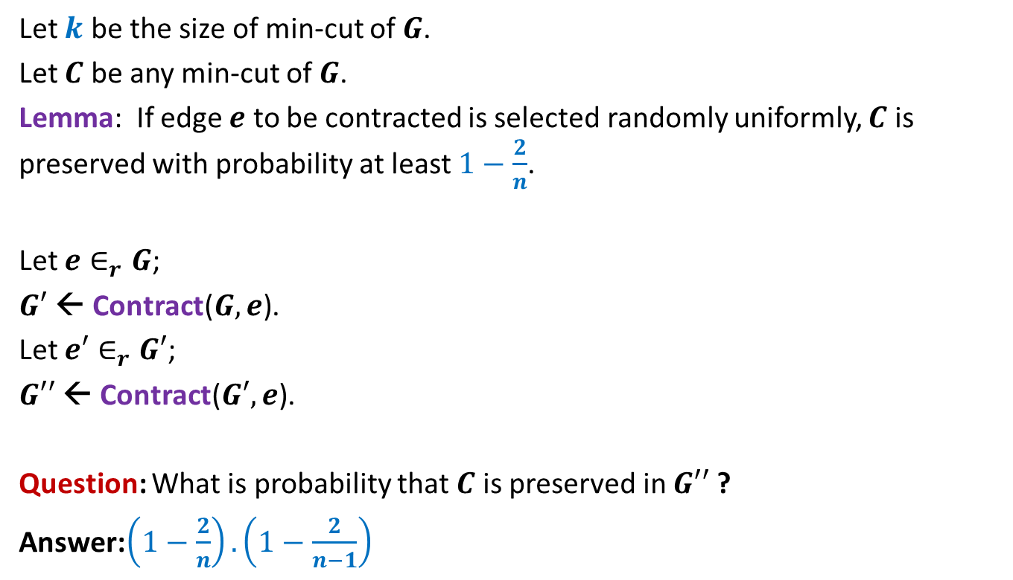
Contract($G,e$)
Let $k$ be the size of min-cut of $G$.
Let $C$ be any min-cut of $G$.
Lemma: If edge $e$ to be contracted is selected randomly uniformly, $C$ is preserved with probability at least $1−\frac{2}{n}$.
Let $e∈_{r}G$;
$G′$ ← Contract($G,e$).
Let $e′∈_{r}G′$;
$G′′$ ← Contract($G′,e$).
Question: What is probability that $C$ is preserved in $G′′$ ?
Answer:$\left(1−\frac{2}{n}\right).\left(1−\frac{2}{n−1}\right)$

Slide 34


Algorithm for min-cut
Min-cut($G$):
{ Repeat ?? times
{
Let $e∈_{r}G$;
$G$ ← Contract($G,e$).
}
return the edges of multi-graph $G$;
}
Running time: $O(n^{2})$
$$n−2$$

Slide 35

Algorithm for min-cut
Question: What is probability that $C$ is preserved during the algorithm ?
Answer: $\left(1−\frac{2}{n}\right).\left(1−\frac{2}{n−1}\right).\left(1−\frac{2}{n−2}\right)…\frac{3}{5}.\frac{2}{4}.\frac{1}{3}$
= $\left(\frac{n−2}{n}\right).\left(\frac{n−3}{n−1}\right).\left(\frac{n−4}{n−2}\right)…\frac{3}{5}.\frac{2}{4}.\frac{1}{3}$
= $\frac{2}{n}.\frac{1}{n−1}$
>$\frac{1}{n^{2}}$

Slide 36
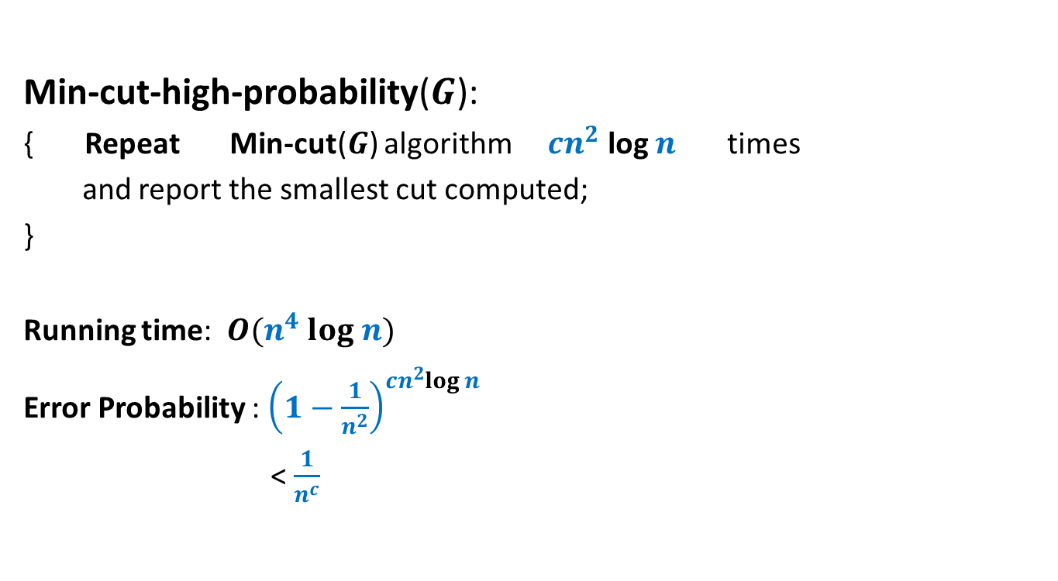
Algorithm for min-cut
Min-cut-high-probability($G$):
{ Repeat Min-cut($G$) algorithm $cn^{2}$ log $n$ times
and report the smallest cut computed;
}
Running time: $O(n^{4} log n)$
Error Probability : ${\left(1−\frac{1}{n^{2}}\right)}^{cn^{2}log n}$
< $\frac{1}{n^{c}}$

