Slide 1
Will It Rain Tomorrow?
An Introduction to Concentration Inequalities and Statistical Learning Theory
Notes:
Will get to that question later Very basic stuff from literally ground up – question

Slide 2
Agenda for this talk
Performance of learning algorithms on unseen data
Topics
Statistical Estimation, Uniform Convergence, Capacity Measures
Learning Algorithm
Train Data
Hypothesis
Test Data
This discussion

Slide 3
A Big Thank You to the Organizers
Program Committee
Aditya Gopalan
Prateek Jain
Sundarajan Sellamanickam
Manik Varma
MSR Outreach Team
Vidya Natampally
Chris Gould-Sandhu
Satish Sangameswaran
Technical Team
Vyshak Jain

Slide 4
Will It Rain Tomorrow?
http://www.clker.com/clipart-25248.html
Notes:
Started workshop – hope weather cordial

Slide 5
Lack of Precise Modelling
http://www.clipartpanda.com/clipart_images/welcome-to-our-website-20977848
Notes:
Confident Predictions require deep understanding
Current monsoon – predicted -15%, actual +45%

Slide 6
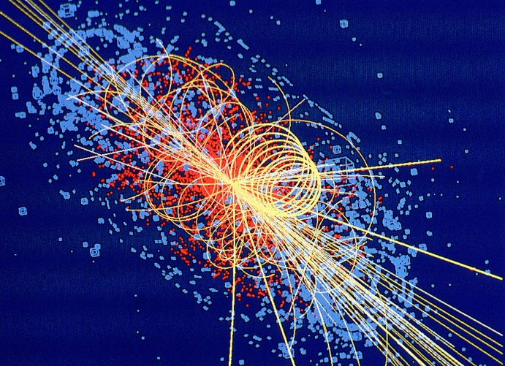
Other Applications
Medical Diagnosis
Stock Price Prediction
Event Detection
Spam Filtering
Anomaly Detection
Online Advertising
www.123rf.com
home.web.cern.ch
Notes:
Ranging from medicine to trying to sell people stuff online
Disease models, User profiles
Cant model exactly but try our best

Slide 7
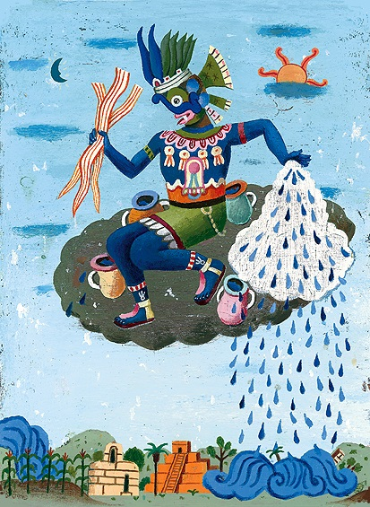
Modelling Rain with the Flip of a Coin
Estimate the bias of this divine coin?
http://cliparts.co/gold-coin-picture
http://www.johnparraart.com/TlalocRainGod.htm
Notes:
Since a hard task, simple model
Gain useful statistics
Not that bad a model – different coins
Basically a coin lands heads p – find it

Slide 8
Probability Theory 101

Slide 9
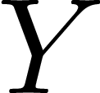
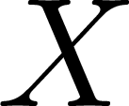
Primer on Random Variables
Expectation of a R.V.
Linearity of Expectation
Exercise!!
Notes:
Think of random variables as an assistant who calls our values – die, coins

Slide 10
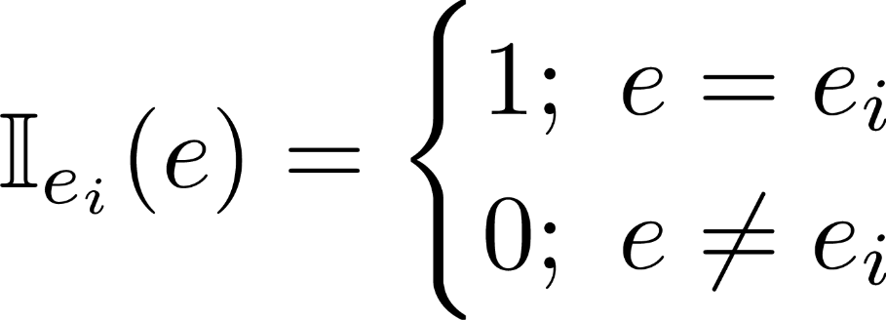
Primer on Random Variables
Variance of a R.V.
Example: Indicator R.V.s
Exercise!!
Notes:
Like an alarm that goes off when something interesting happens

Slide 11
Concentration Inequalities
Tail inequalities, Tail bounds, Large deviation bounds
Dizzying variety of forms, strengths, specificities
Underlying message
Well-behaved r.v. take values about their expectation or Behavior is a true test of character
Useful in estimation, inference, and prediction tasks
Past Behavior ↔ Intrinsic Property ↔ Future Behavior
Notes:
If someone does not get the euphoria behind Game of Thrones, it would eventually be clear in conversation with friends

Slide 12
Concentration Inequalities

Slide 13
Concentration Inequalities
Sequence of Independent and Identically Distributed (i.i.d.) Random Variables
Empirical Average
Exercise!!
Variance Reduction!
Notes:
Note: Empirical average is itself a random variable

Slide 14
Markov’s Inequality
For any positive-valued r.v. ( ),
Proof
Notes:
Note: Markov’s is actually very powerful

Slide 15
Markov’s Inequality
Proof
Notes:
Note: Markov’s is actually very powerful

Slide 16
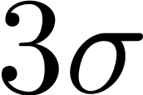
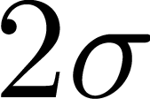
Chebyshev’s Inequality
Variance of a random variable
For any finite variance r.v. ( )
Proof
Exercise!!

Slide 17
Chernoff-Hoeffding’s Inequality
Simpler form for Bernoulli r.v.
Empirical average
If r.v. are i.i.d. then
Notes:
Coin flip example

Slide 18
Chernoff-Hoeffding’s Inequality
General form for bounded r.v.
Empirical average
If r.v. are i.i.d. then

Slide 19
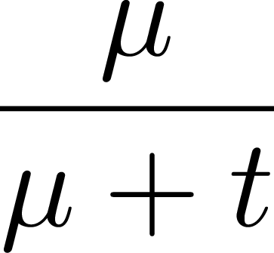
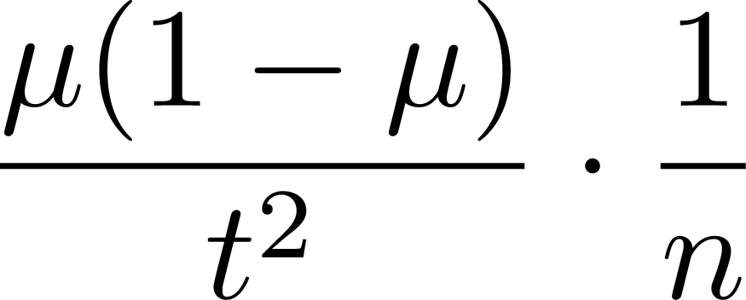
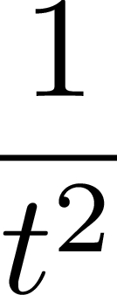
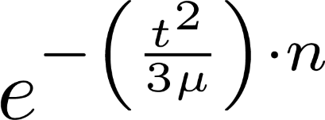
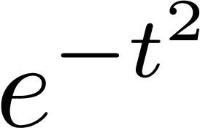
Comparison of Tail Inequalities
Common setting
Markov’s
Chebyshev’s
Chernoff’s
Exercise!!

Slide 20
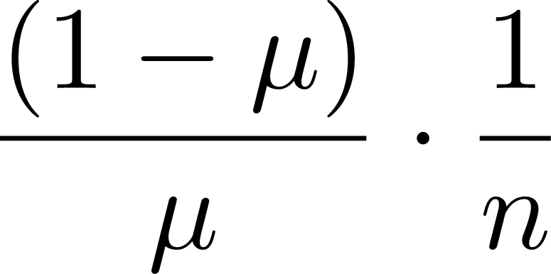
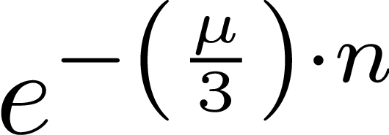
Comparison of Tail Inequalities
Common setting
Markov’s
Chebyshev’s
Chernoff’s

Slide 21
Statistical Estimation I
Back to Predicting Rain

Slide 22
Estimating the Probability of Rain
27/6/10 27/6/11 27/6/12 27/6/13 27/6/14
Let the divine bias be

Slide 23
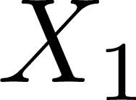
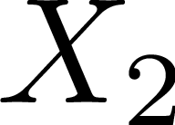
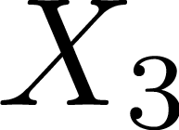
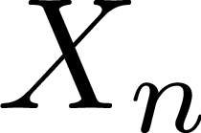
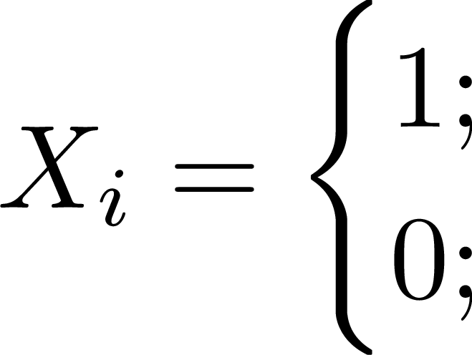
Estimating the Probability of Rain

Slide 24
Estimating the Probability of Rain
Exercise!!

Slide 25
Estimating the Expected Amount of Rain
Bangalore Urban Rainfall (July)
Year | 2004 | 2005 | 2006 | 2007 | 2008
Rain | 210.4 | 136.4 | 53.6 | 154 | 182.5
Year | 2009 | 2010 | 2011 | 2012 | 2013
Rain | 30.2 | 112.3 | 92.6 | 63.7 | 76.2
Assuming with 90% confidence
Is this a useful bound? Why or why not?
Exercise!!
http://www.indiawaterportal.org/sites/indiawaterportal.org/files/imd_district-wise_rainfalldata_2004-2010.xls
http://www.imd.gov.in/section/hydro/distrainfall/webrain/karnataka/bangaloreurban.txt
Notes:
High variance
Small variance
Upper bound bad
Weak modelling

Slide 26
Statistical Estimation II
Towards complex and powerful models
Notes:
So far, able to estimate general statistics
Unable to predict

Slide 27
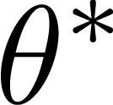
A Predictive Model for Rain
Model rain as arising from observable factors
The monthly rainfall in Bengaluru depends on the Humidity level and Wind speed in the previous month
Year | 2004 | 2005 | 2006 | 2007 | 2008 | 2009 | 2010 | 2011 | 2012 | 2013
Rain | 210.4 | 136.4 | 53.6 | 154 | 182.5 | 30.2 | 112.3 | 92.6 | 63.7 | 76.2
Hum. | 98.7 | 58.4 | 25.1 | 64.4 | 84.9 | 8.2 | 55.2 | 48.3 | 44.7 | 32.6
Wind | 18.9 | 9.9 | 4.6 | 11.9 | 15.7 | 1.5 | 10.2 | 8.9 | 8.1 | 6.0
Can we estimate ?
Notes:
Build models that link measurable quantities to the quantity of interest

Slide 28
Parametric Models for Prediction
Parametric Model
: Model Function (known)
: Observed Factors (known)
: Model Parameters (unknown)
Quadratic Model
: Observed Factors (known)
: Linear Parameters (unknown)
: Quadratic Params (unknown)
: Bias (unknown)
Linear Model
: Observed Factors (known)
: Linear Parameters (unknown)
: Bias (unknown)
Other stocks, Trends
Economic indicators
Scans, Tests, Patient history
Monitoring systems, Derived indicators
Demographics, Purchase Profile
Notes:
For simplicity, look at real valued prediction problems,
Regression problems – can cast classification problems as well
Non-parametric models – wont discuss them here

Slide 29
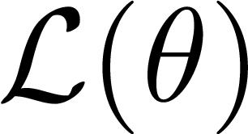
Estimating Parametric Models
Use a loss/penalty function to measure prediction accuracy
Goal: Minimize Population Risk/Test Error
Don’t have access to so cant minimize

Slide 30
Empirical Risk Minimization
Receive i.i.d. training samples from instead
New Goal: Minimize Empirical Risk/Training Error (recall SAA)
Choose the best-looking parameter on training data
Notes:
Regularization - handle later

Slide 31
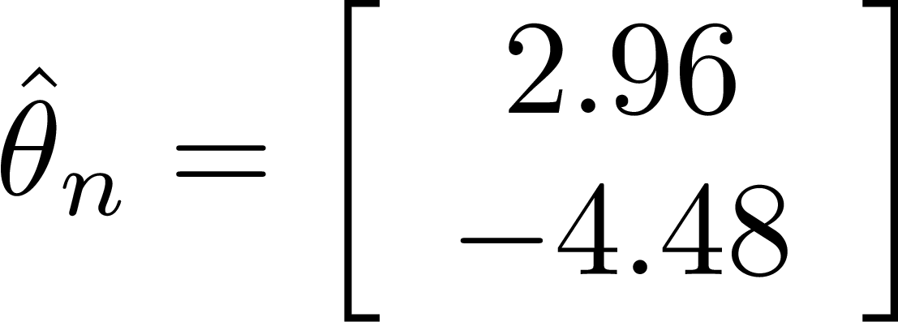
Empirical Risk Minimization at Work
Year | 2004 | 2005 | 2006 | 2007 | 2008 | 2009 | 2010 | 2011 | 2012 | 2013
Rain | 210.4 | 136.4 | 53.6 | 154 | 182.5 | 30.2 | 112.3 | 92.6 | 63.7 | 76.2
Hum. | 98.7 | 58.4 | 25.1 | 64.4 | 84.9 | 8.2 | 55.2 | 48.3 | 44.7 | 32.6
Wind | 18.9 | 9.9 | 4.6 | 11.9 | 15.7 | 1.5 | 10.2 | 8.9 | 8.1 | 6.0
Pred | 207.5 | 128.5 | 53.7 | 137.4 | 181 | 17.6 | 117.7 | 103.1 | 96.1 | 69.6
Average Error: $±9.65$ mm
Earlier Error: $±96.76$ mm

Slide 32
Video Break
“The Higgs Boson Explained” Jorge Cham http://www.phdcomics.com/comics.php?f=1489

Slide 33
What went on?
?
# Collisions
Higgs contribution
Energy
Notes:
Single most common phrase “we don’t know”
Contributions due to irrelevant reactions too large
Contributions due to Higgs-producing reactions not large enough

Slide 34
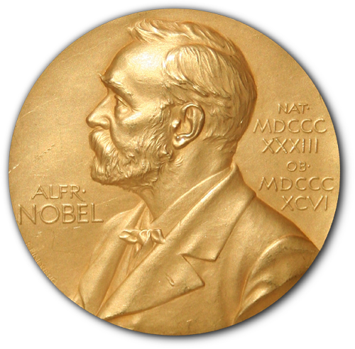
What went on?
# Collisions
Aha!!
Energy
https://en.wikipedia.org/wiki/Nobel_Prize
Notes:
Much closer approximations of their true rates
Deviations have to be smaller than the size of the bump
What is a deviation and what is a bump
Reveals the bump – smaller the bump-harder to detect

Slide 35
Empirical Risk Minimization - Recap
Receive i.i.d. training samples
Chose the best-looking model
What we really wanted
What is the guarantee that
Notes:
Training error of hat theta small – is its test error also small?
Cant apply Chernoff-Hoeffding to theta_hat anymore – samples are not i.i.d. correlated.

Slide 36
The Dangers of Love at First Sight
Pick Me
We can be safe only if no model fools us
No bad model appears good on the training data
No good model appears bad on the training data
Claim:
If the training set is such that , then
Pick Me
Nice!!
http://sweetclipart.com/silhouette-hands-air-970

Slide 37
The Dangers of Love at First Sight
Proof
Assumption
Uniform Convergence

Slide 38
Enter Uniform Convergence
We will show that
A large enough randomly chosen training set does not discriminate against or favor any particular model
Given an exam with enough questions and sufficient variety, no ill-prepared candidate would do well, nor would any well-prepared one suffer
All candidates take the same exam – infeasible to interview separately
Notes:
Uniform deviation for class
Empirical loss and true population loss should be close for all models
If \hat L -> L then we say that the model theta converges within error epsilon
Class Theta converges uniformly within error epsilon

Slide 39
Uniform Convergence – Singleton Hypothesis Class
Create an appropriate random variable
Proof
Notes:
On one hand an empirical average, on the other the true mean

Slide 40
Uniform Convergence – Singleton Hypothesis Class
Proof

Slide 41
Uniform Convergence – Finite Hypothesis Class
Proof We have already shown that for any
Now apply the union bound to get a uniform bound
Notes:
Individually empirical losses do converge to true population risks

Slide 42
Uniform Convergence – Finite Hypothesis Class
Proof
Notes:
Note that the uniform error grows with the size of the class

Slide 43
Uniform Convergence – Infinite Hypothesis Class
Earlier bounds useless since
Careful counting of the effective size of the class
Capacity Measures: VC Dimension, Dudley’s Integral, Covering Number, Natarajan Dimension, Fat-shattering Dimension, Rademacher Complexity …

Slide 44
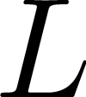
The Covering Argument
Lipschitz Functions
Claim 1: For an -Lipschitz loss, linear models
For any training set, we have
as well as
Least Squares Loss
Logistic Loss
Notes:
Nearby models incur similar losses – don’t need to count them again
non Lipschitz losses e.g. misclassification loss – VC Dimension

Slide 45
The Covering Argument
Proof

Slide 46
The Covering Argument
Proof
Exercise!!

Slide 47
The Covering Argument
✓
✓
Proof
Notes:
If convergence has taken place at a model, then it has taken place at all nearby models

Slide 48
The Covering Argument
✓
Convergence at a model ensures uniform convergence in its entire vicinity!!

Slide 49
The Covering Argument
✓
✓
✓
✓
✓
✓
✓
How to ensure convergence of empirical to population risks on these 8 models?
✓
Notes:
Note that these 6 models are fixed, can be decided apriori and not decided by data

Slide 50
Capacity Measure: Covering Number
-Cover ( -Net) for a Hypothesis Class
A set of members of the set such that
Covering Number of a Hypothesis Class
The size of the smallest - Cover for the set
Exercise!!

Slide 51
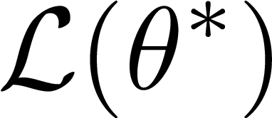
Bias-Variance Tradeoff
Implied Excess Risk Bound
Bias-Variance Tradeoff!!!
Large : smaller error but larger variance
Small : larger error but smaller variance

Slide 52
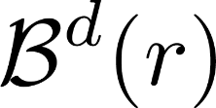
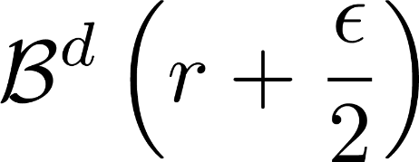
Covering Numbers: Examples
Bounded $L_{2}$ Norm Models :
Proof
(Maximal) $ε$-Separated Set
is an $ε$-Cover
Notes:
Recall Higgs video – smaller the bump – harder to detect

Slide 53
Covering Numbers: Examples
Bounded $L_{2}$ Norm Models :
Exercise!!
Notes:
Recall Higgs video – smaller the bump – harder to detect

Slide 54
Covering Numbers: Examples
Sparse Bounded Norm Models
Proof

Slide 55
Summary of the Argument
Pick Me
Pick Me
ERM on Training Data
Model choice Problem
Uniform Convergence
✓
✓
✓
✓
✓
✓
✓
✓
Volume Argument
Covering Numbers
Lipschitz Loss Functions

Slide 56
Remarks
Our bound
Tighter bounds possible – beyond scope of this talk
Chernoff-Hoeffding’s Inequality $↔$ McDiarmid’s Inequality
Covering Argument $↔$ Symmetrizationd
Covering Numbers $↔$ Rademacher Complexity
Volume Arguments $↔$ Convex Analysisd

Slide 57
Additional Resources
Introduction to Statistical Learning Theory, Bousquet, Boucheron, Lugosi http://www.kyb.mpg.de/publications/pdfs/pdf2819.pdf
Theory of Classification: a Survey of Some Recent Advances, BBL http://www.econ.upf.edu/~lugosi/esaimsurvey.pdf
A few notes on Statistical Learning Theory, Mendelson http://maths-people.anu.edu.au/~mendelso/papers/summer02.pdf
Statistical Learning Theory, Vapnik John Wiley and Sons.
Support Vector Machines, Steinwart, Christmann Information Science and Statistics , Springer.

Slide 58
Will It Rain Tomorrow?
Notes:
Started workshop – hope weather cordial
Not as if we are totally clueless about the physical world

