Slide 1
Optimal Execution of Co-analysis for
Large-scale Molecular Dynamics Simulations
Preeti Malakar¹, Venkatram Vishwanath¹, Christopher Knight¹, Todd Munson¹, Michael E. Papka¹²
¹Argonne National Laboratory
²Northern Illinois University

Slide 2
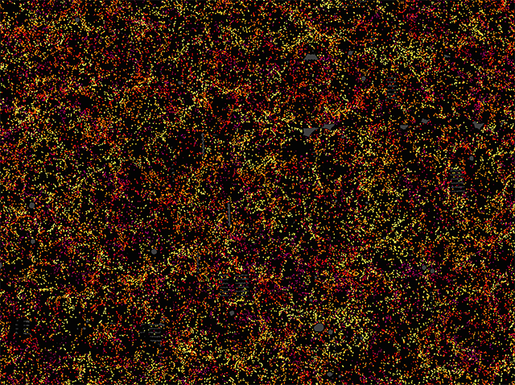
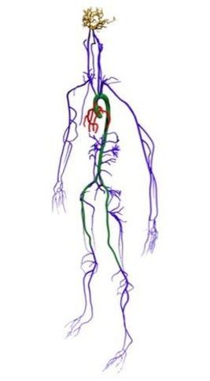
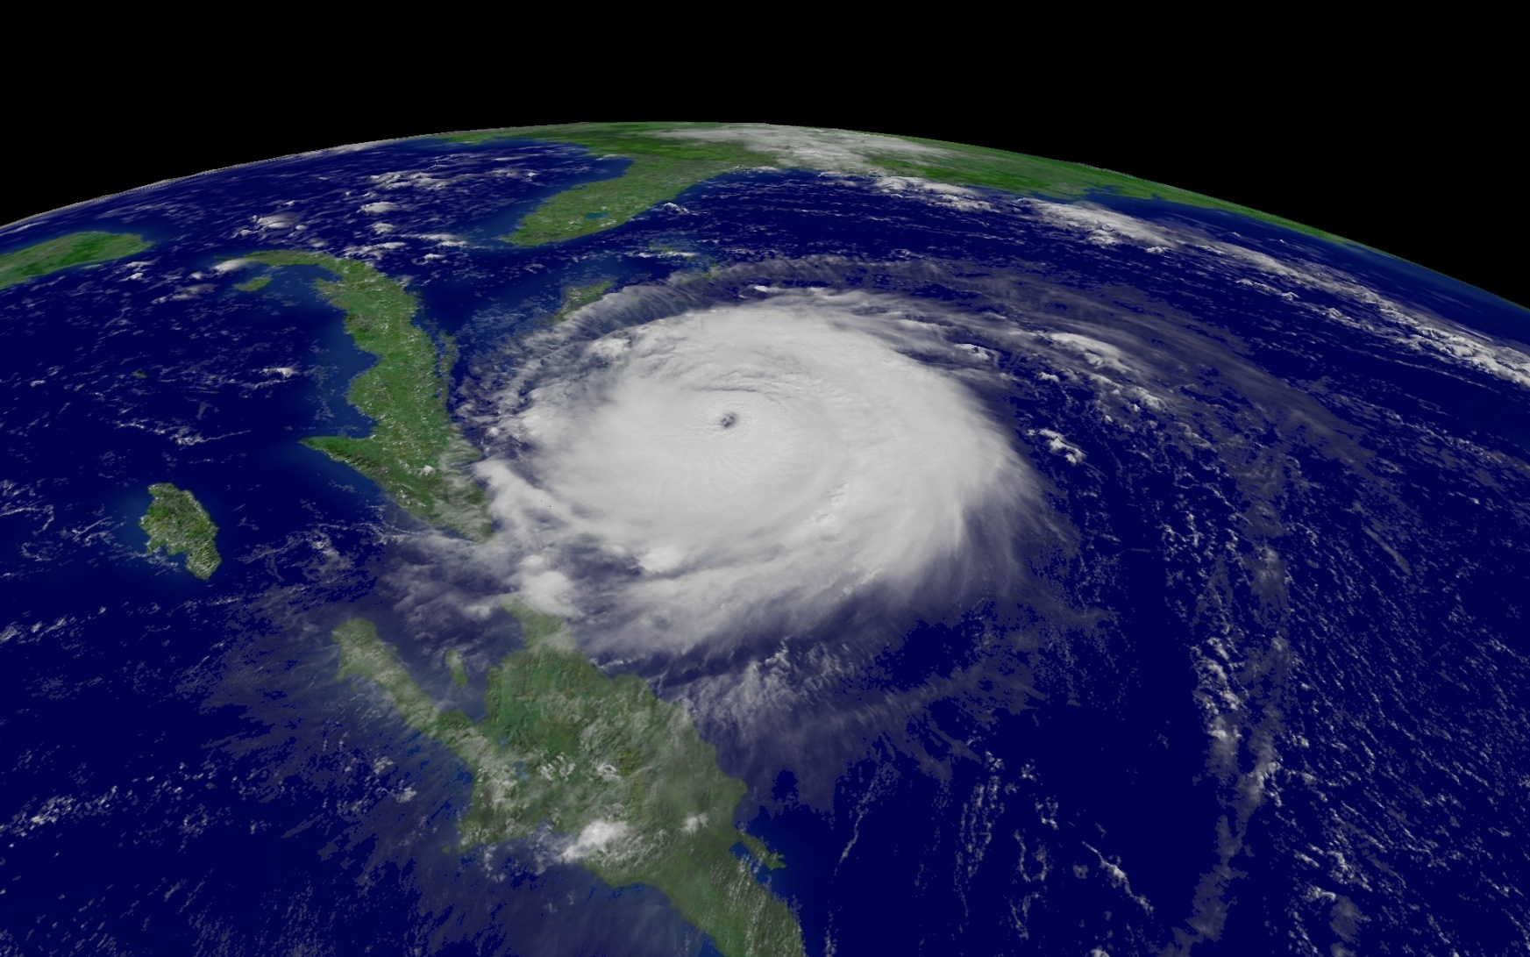
Large-scale Simulations
Cosmological Simulation
SDSS
Blood Flow Simulation
Randles Lab, Duke University
Weather simulation
NASA

Slide 3
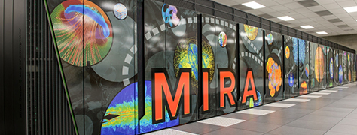
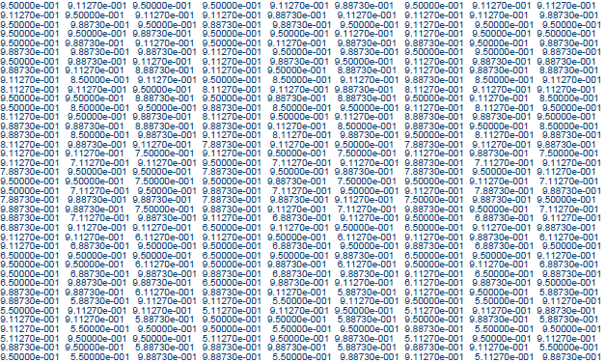
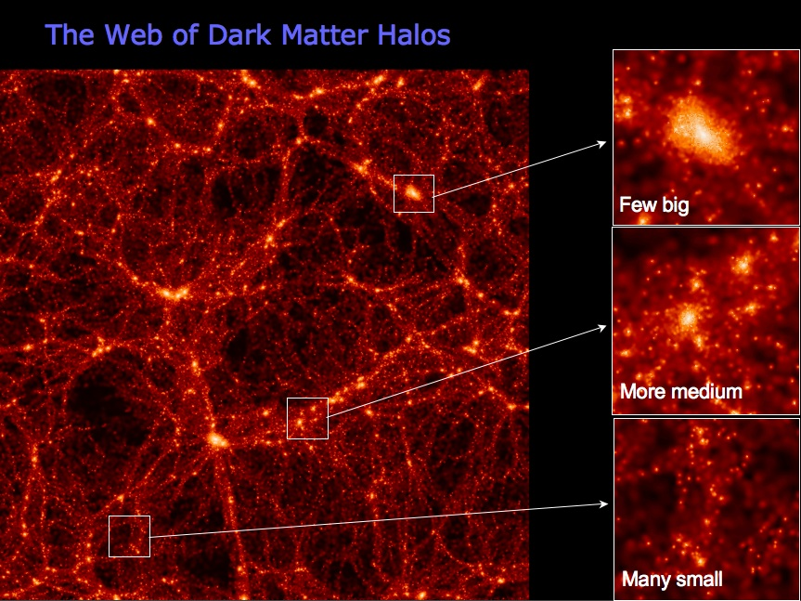
Simulations and Analysis
Output
Simulation
Data
Virgo Consortium
Simulations | Analysis
Molecular dynamics | Mean square displacement, center of gravity, FFT of atom velocities
Climate / Weather | Mean pressure, lowest pressure, wind velocity distribution
Cosmological | Dark matter halo finder, PDF of dark matter density

Slide 4
End-to-end Simulation-Analysis Time
Simulation
Analysis
Post-processing
Data Transfer
Simulation-time analysis
Simulation-time analysis preferable due to
Disparate compute rate and I/O bandwidth
Petabytes of simulation output

Slide 5
Simulation-time Analysis
In situ analysis
Simulation
Analysis
Time shared compute resources
Alternating simulation and analysis
Tightly coupled analysis
Co-analysis [this talk]
Distinct compute resources
Concurrent execution of analysis
Loosely coupled analysis

Slide 6
Maximize Scientific Output
How often can we analyze?
How many different analysis can be done?

Slide 7


Co-analysis Modes
Simulation processes
Analysis processes
Concurrent execution of analysis
Remote
Compute resource 1
Compute resource 2
Simulation
INTERMEDIATE STORAGE
Analysis
Local
Compute resource
Simulation
Analysis
Space shared

Slide 8
Co-analysis Modes
Concurrent execution of analysis
Features
Remote
Distinct compute resources
Execute at scale
Simulation not stalled
Compute resource 1
Compute resource 2
Simulation
INTERMEDIATE STORAGE
Analysis
Storage overhead
Limited intermediate storage
Local
Analyze data locally
Avoid storage overheads
Compute resource
Simulation
Analysis
Code changes required
Transfer overhead
Limited memory for analysis
Space shared

Slide 9
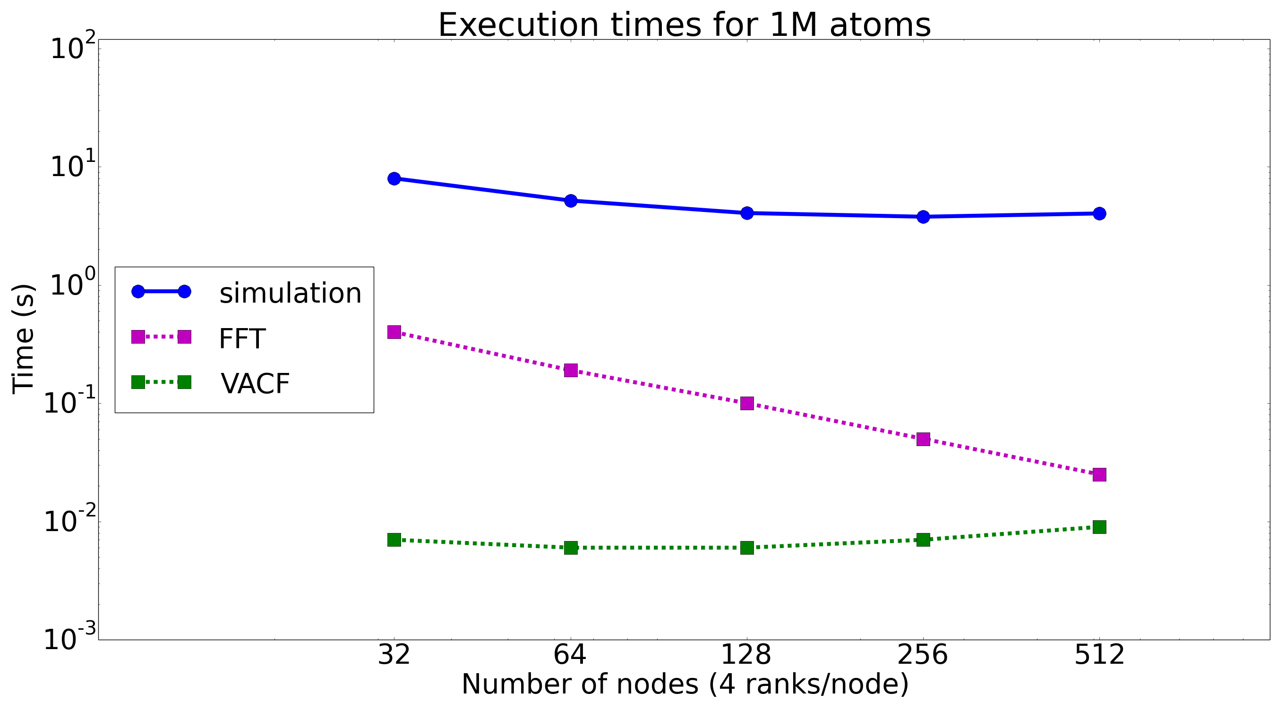
Scalability of Simulation and Analysis
Figure: Strong scaling miniMD simulation and its analysis
Computations exhibit different scaling characteristics
Number of optimal nodes for simulation and analysis vary

Slide 10
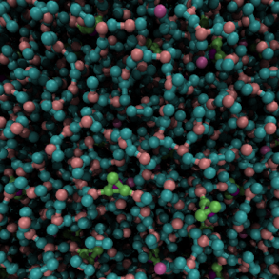
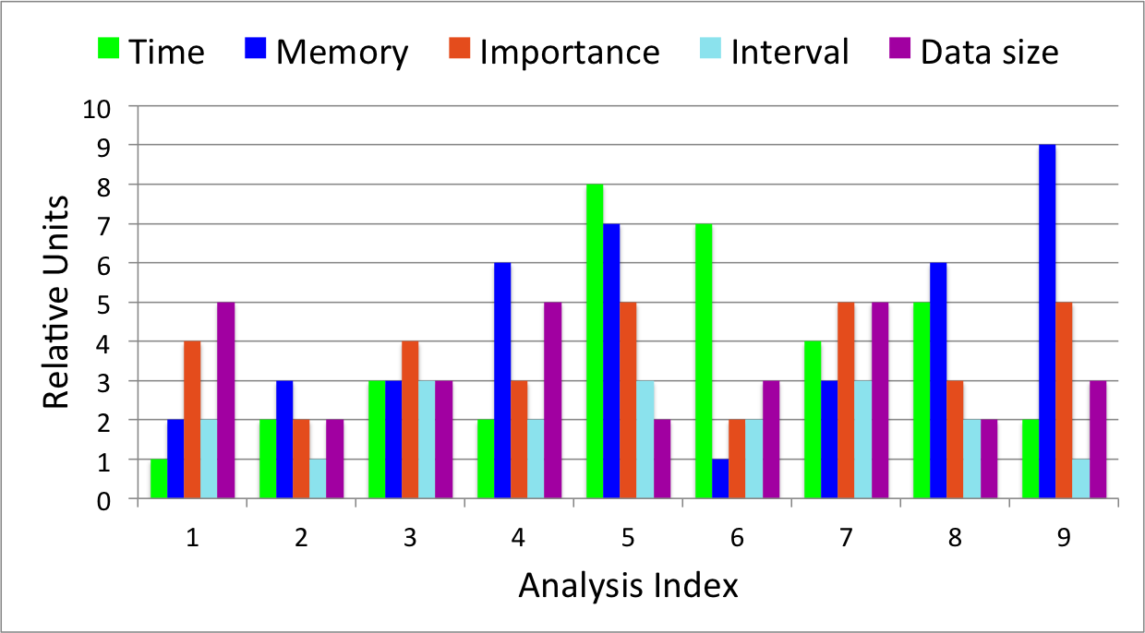
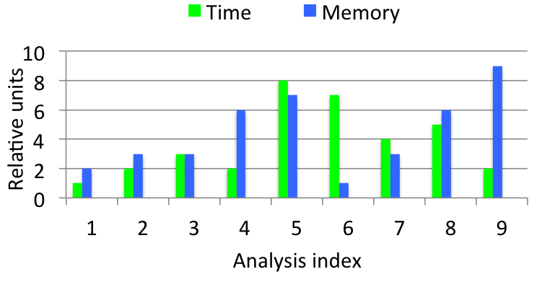
Challenges I - Multiple Analysis
MD analysis:
Mean-square displacement
Velocity auto-correlation function
Histogram of atom velocities
FFT of atom positions
Centre of mass
Centre of gravity
. . .
Trajectory output of MD simulation (a box of water molecules solvating two types of ions)

Slide 11
Challenges II - Analysis Execution
Time
High analysis frequency
Simulation
Analysis
Low analysis frequency
Simulation
Analysis
Increased analysis frequency → decreased simulation throughput
Low analysis frequency → slow insight or missed events
High analysis interval → more number of distinct analysis
Affects end-to-end simulation analysis time and science output

Slide 12

Challenges III – Application and System Features
Application features
Many desirable analysis (> 10)
Different analysis attributes
Optimal temporal resolution
Millions of simulation time steps
System features
Remote
Local
I/O bandwidth
Storage space
Rate of computation
Network bandwidth
Available memory
Rate of computation

Slide 13
Problem
Time
FOCAL
Available storage
Memory
Application parameters
I/O bandwidth
System parameters
Data size
Compute capacity
Model
Available memory
Importance
What are the co-analysis execution feasibilities and their optimal frequencies ?

Slide 14
Outline
FOCAL (Framework for Optimizing Co-analysis Executions)
  Remote model
  Local model
Application case study
Experiments and Results
Conclusions

Slide 15
System and Application Features – Remote Model
Remote
Simulation
Analysis
Considerations
I/O bandwidth
Storage space
Compute time threshold
Analysis attributes
Compute resource 1
Compute resource 2
Simulation
INTERMEDIATE STORAGE
Analysis
write time
write time
write time
write time
Simulation
Time
INTERMEDIATE STORAGE
Analysis
read time
read time
read time
Time

Slide 16
Solution – Integer Linear Program
Write Time
Time threshold
Available storage
Analysis time
Application parameters
I/O bandwidth
System parameters
Data size
Compute capacity
ILP
Importance
Analysis execution feasibilities
Analysis frequencies

Slide 17
Integer Linear Program Formulation – Remote
Input Parameters
Objective
Storage space
Output size per analysis
Write time per time step
Read time per time step
Analysis time per time step
Set of analyses
Importance of analysis
Upper bound on write time
Upper bound on analysis time
wsize_{i}
wtime_{i}
rtime_{i}
atime_{i}
Constraints
Storage availability
imp_{i}
WT_UB
AT_UB
Time thresholds
Output Parameters
Feasibility of each analysis
Analysis frequency
execute_{i}
na_{i}

Slide 18
System and Application Features – Local Model
Simulation
Analysis
LOCAL
Considerations
Stall time
Network bandwidth
Available memory
Compute time threshold
Analysis attributes
Compute resource
Simulation
Analysis
Space shared
transfer interval
transfer time
transfer time
transfer time
transfer time
Simulation
Time
Analysis
Time
Idle time

Slide 19
Solution – Integer Linear Program
Time threshold
Available memory
Analysis time
Application parameters
Network bandwidth
System parameters
Data size
Simulation time
ILP
Transfer time
Importance
Analysis execution feasibilities
Analysis interval

Slide 20
Integer Linear Program Formulation – Local
Input Parameters
Objective
Compute time of simulation time step
Compute time of analysis time step
Memory required for analysis
Output size for 1 analysis step
Transfer time for 1 analysis step
Available memory
Set of analyses
Simulation steps
Importance of analysis
Upper bound on transfer time
Lower bound on analysis interval
stime
atime_{i}
amem_{i}
wsize_{i}
xfer_{i}
Constraints
maxmem
Memory
steps
imp_{i}
Time
xfer_UB
n_UB
Output Parameters
Feasibility of each analysis
Analysis interval
execute_{i}
Interval
n

Slide 21
Outline
FOCAL (Framework for Optimizing Co-analysis Executions)
  Remote model
  Local model
Application case study
Experiments and Results
Conclusions

Slide 22
Molecular Dynamics Simulation
LAMMPS (Large-scale Atomic/Molecular Massively Parallel Simulator)
  C++ (1.6 M SLOC)
  In-built analysis functions
miniMD (Mantevo miniapp)
  C++ (5K SLOC)
  Extended to include functionalities to output and analysis
  Developed modalysis for parallel analysis
https://xgitlab.cels.anl.gov/fl/sc16

Slide 23
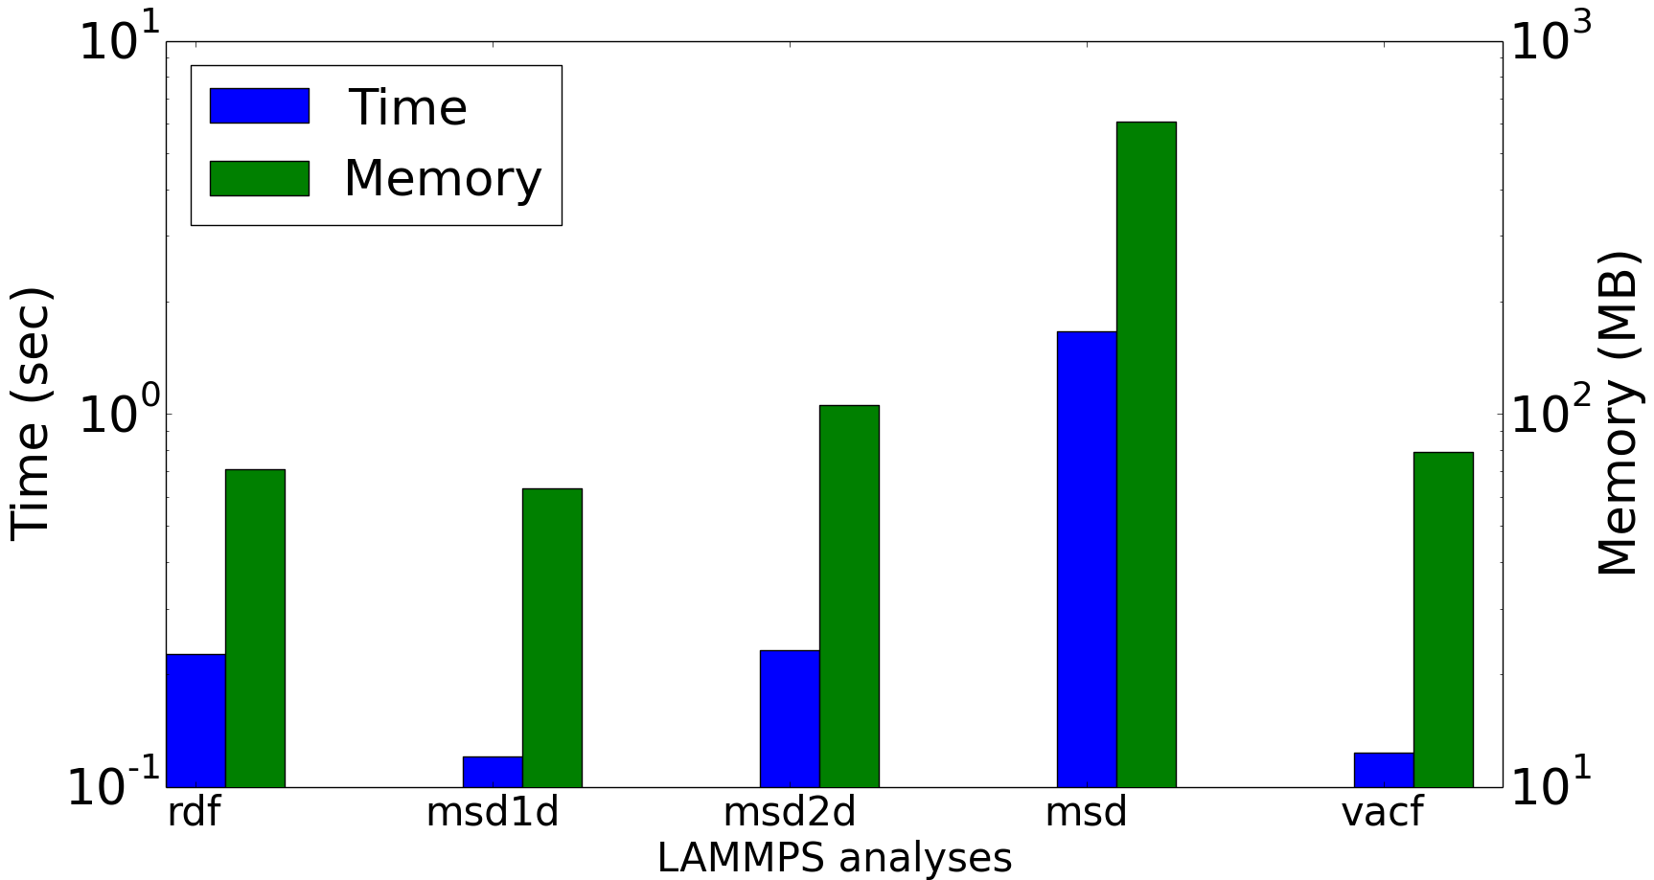
LAMMPS analysis
Radial distribution function (rdf)
Mean square displacement (msd)
Mean square displacement for 1D spatial bins (msd1d)
Mean square displacement for 2D spatial bins (msd2d)
Velocity auto-correlation function (vacf)
Time and memory requirements

Slide 24
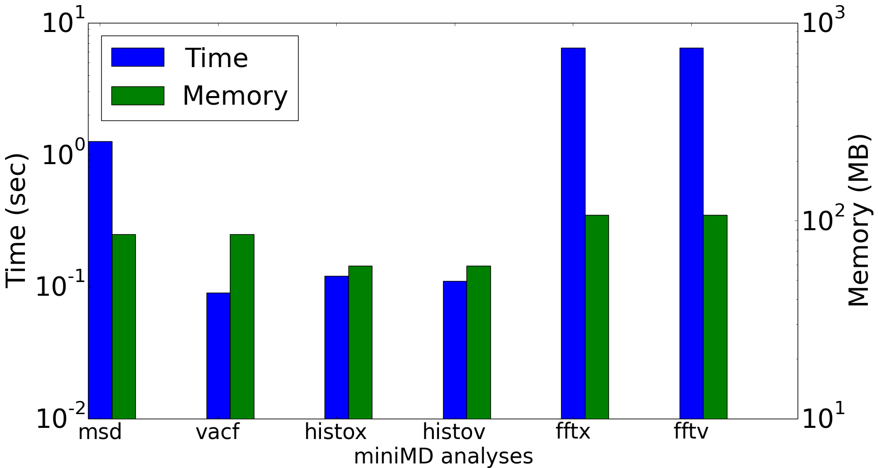
miniMD analysis
Mean-square displacement of atom positions (msd)
Velocity auto-correlation function (vacf)
1D Fourier transform of atom positions (fftx) and velocities (fftv)
Histogram of atom positions (histox) and velocities (histov)
Time and memory requirements

Slide 25
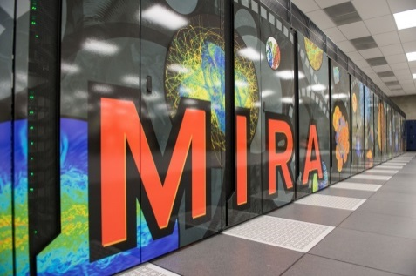
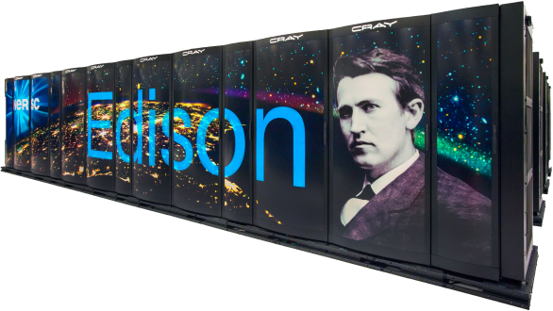
Systems
    Compute Resources
    IBM Blue Gene/Q, Mira, at Argonne National Laboratory
      Maximum of 16384 cores
      GPFS
    Cray XC30, Edison, at Lawrence Berkeley National Laboratory
      Maximum of 1080 cores
      Lustre file system

Slide 26
FOCAL Workflow
Determine the input parameters of the ILP
  Empirically measure application resource requirements
  Can use any performance model
Feed the inputs (estimates of time, memory, data size, read/write times, transfer times) to the ILP
Solve ILP
      AMPL modeling language, MINLP solver
      Time (maximum) to solve: 9 ms
https://xgitlab.cels.anl.gov/fl/sc16

Slide 27
Results - Remote
Maximum storage space = 4 TB
Minimum analysis interval = 50 time steps
Total #analysis
Increases from
26 to 84
WT_UB (write time upper bound) | AT_UB (analysis time upper bound) | vacf | msd | histox | histov | fftx | fftv
5% | 10% | 7 | 0 | 0 | 19 | 0 | 0
20% | 20% | 20 | 20 | 20 | 20 | 3 | 1
26
84
Feasibilities and frequencies of miniMD analysis of 500-million atom simulation 4096 processes for simulation and 2048 processes for analysis on Mira
Our formulation enables determining quickly the feasible analysis based on time thresholds

Slide 28
Results - Remote
Time- constrained
Available storage (TB) | vacf | msd | histox | histov | fftx | fftv | Total #analysis
WT_UB = AT_UB = 500 seconds
1 | 6 | 6 | 20 | 20 | 5 | 1 | 58
10 | 1 | 18 | 20 | 20 | 1 | 1 | 60
WT_UB = AT_UB = 1000 seconds
1 | 6 | 5 | 20 | 20 | 20 | 11 | 82
10 | 20 | 20 | 20 | 20 | 13 | 1 | 94
Space- constrained
Feasibilities and frequencies of miniMD analysis using 4096 processes for 1 billion atom simulation, and 2048 processes for analysis on Mira
Enables to determine best use of compute time and space

Slide 29
Results - Local
Objective
Simulation: 0.16 s (on 432) to 0.07 s (on 864)
msd: 1.61 s (on 144) to 1.29 s (on 216)
Analysis interval doubles with more cores!
w | rdf | msd | msd1d | msd2d | vacf | interval | #processes
0.1 | ✔ | ✔ |  | ✔ | ✔ | 50 | 432 (simulation) 144 (analysis)
0.01 | ✔ | ✔ | ✔ | ✔ | ✔ | 75
0.1 | ✔ |  |  | ✔ | ✔ | 58 | 864 (simulation) 216 (analysis)
0.01 | ✔ | ✔ | ✔ | ✔ | ✔ | 172
Feasibilities of LAMMPS analysis for 6 million atom simulation on Edison
Code scalability impacts end-to-end simulation-analysis time

Slide 30
Conclusions
Formulated remote and local co-analysis as ILP
Consider system and application features to maximize scientific throughput
FOCAL provides useful recommendations
  Feasible analysis and optimal analysis frequencies
  Impact of more storage and more cores for analysis
Future work
Extend to other co-analysis execution modes
Impact of code scalabilities

Slide 31
Acknowledgements
Argonne Leadership Computing Facility
National Energy Research Scientific Computing Centre
This research has been funded in part and used resources of the Argonne Leadership Computing Facility at Argonne National Laboratory, which is supported by the Office of Science of the U.S. Department of Energy under contract DE-AC02-06CH11357. This work was supported in part by the DOE Office of Science, Advanced Scientific Computing Research, under award number 57L38, 57L32, 57K07 and 57K50.

Slide 32
Thank You! https://xgitlab.cels.anl.gov/fl/sc16 pmalakar@anl.gov

