Slide 1


Route-aware Independent MPI I/O on the Blue Gene/Q
Preeti Malakar, Venkatram Vishwanath
Argonne Leadership Computing Facility
Argonne National Laboratory
15th November 2015

Slide 2

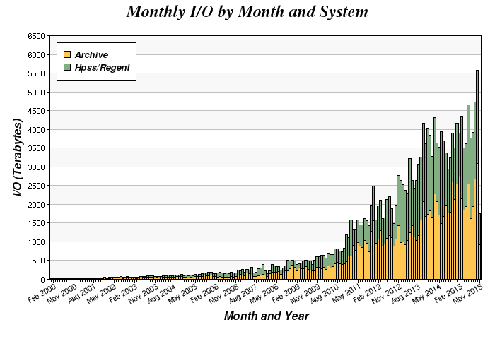
I/O trends
Large data
Low I/O bandwidth
Exponential
UCAR
Climate models
~1 TB / simulated hour
Expected
trend
NERSC I/O trends [Credit: www.nersc.gov]
Notes:
I/O bandwidth trend

Slide 3
Independent I/O
Many applications and benchmarks use independent I/O: HACC, FLASH, Energy2, Turbulence3, MADBench2, HOMME
More than 30% of jobs running on Mira do not use collective I/O
Performance of independent vs. collective I/O for burst buffers and NVRAM is yet to be seen

Slide 4
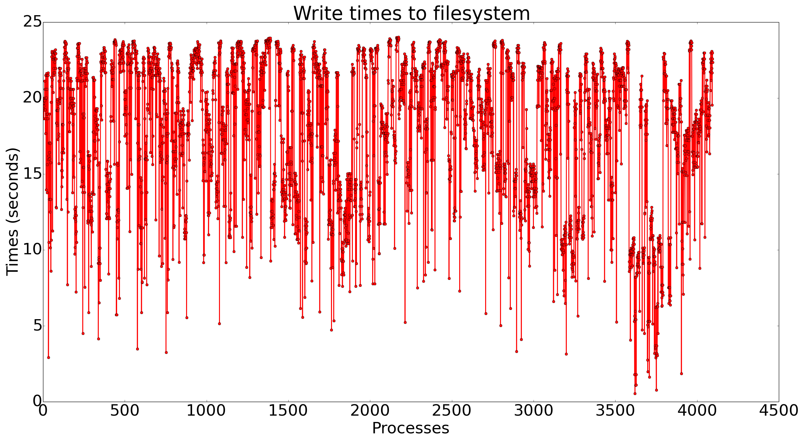
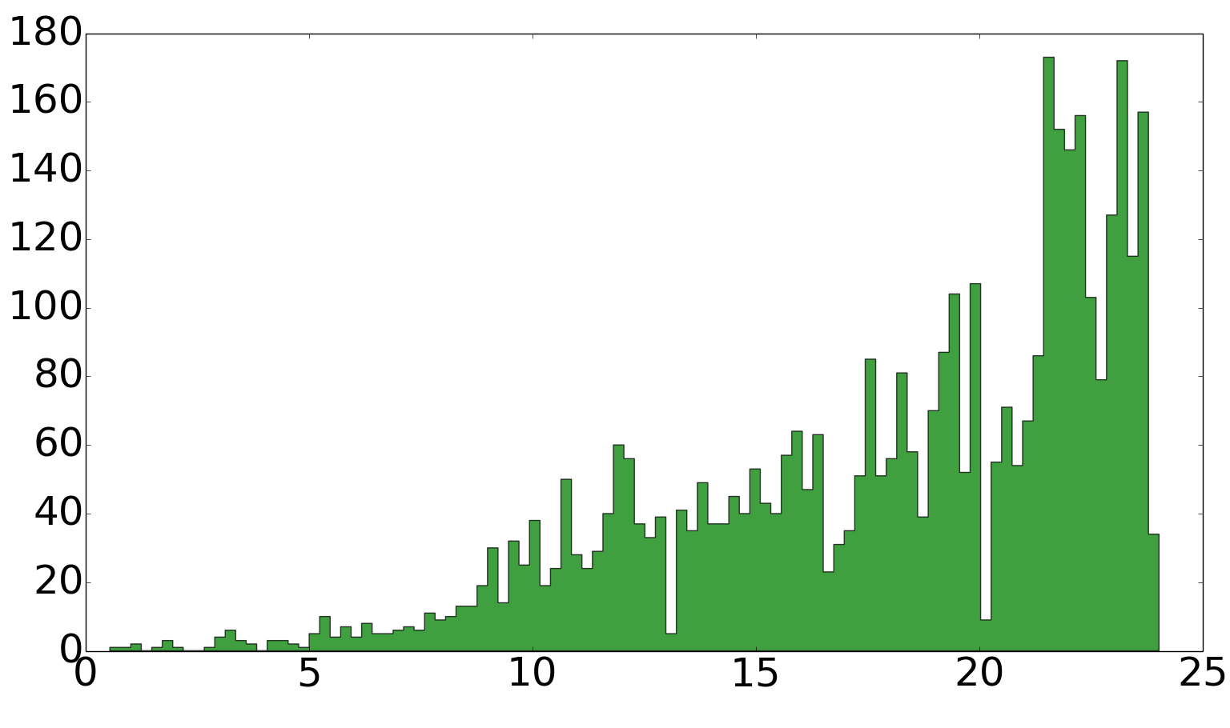
Filesystem I/O time variation
Statistic | Time (s)
Min | 0.54
Max | 24.02
Mean | 18.02
Std. dev. | 4.75
# Processes
Time to write 4 GB (independent I/O) from 4096 MPI processes (1 rank/node) on Mira, X-axis: Number of processes, Y-axis: Time to write
Time (s)
Histogram of time to write (independent I/O) from 4096 MPI processes (1 rank/node) on Mira
Notes:
4 GB file independent write from 4K processes

Slide 5
I/O node architecture on BG/Q
NOT SHARED
2 GB/s
SHARED
4 GB/s
BRIDGE NODES
IB NETWORK
128:1
Compute node rack
I/O nodes
GPFS filesystem
1024 compute nodes
16 bridge nodes
2 bridge nodes connect to 1 I/O node

Slide 6
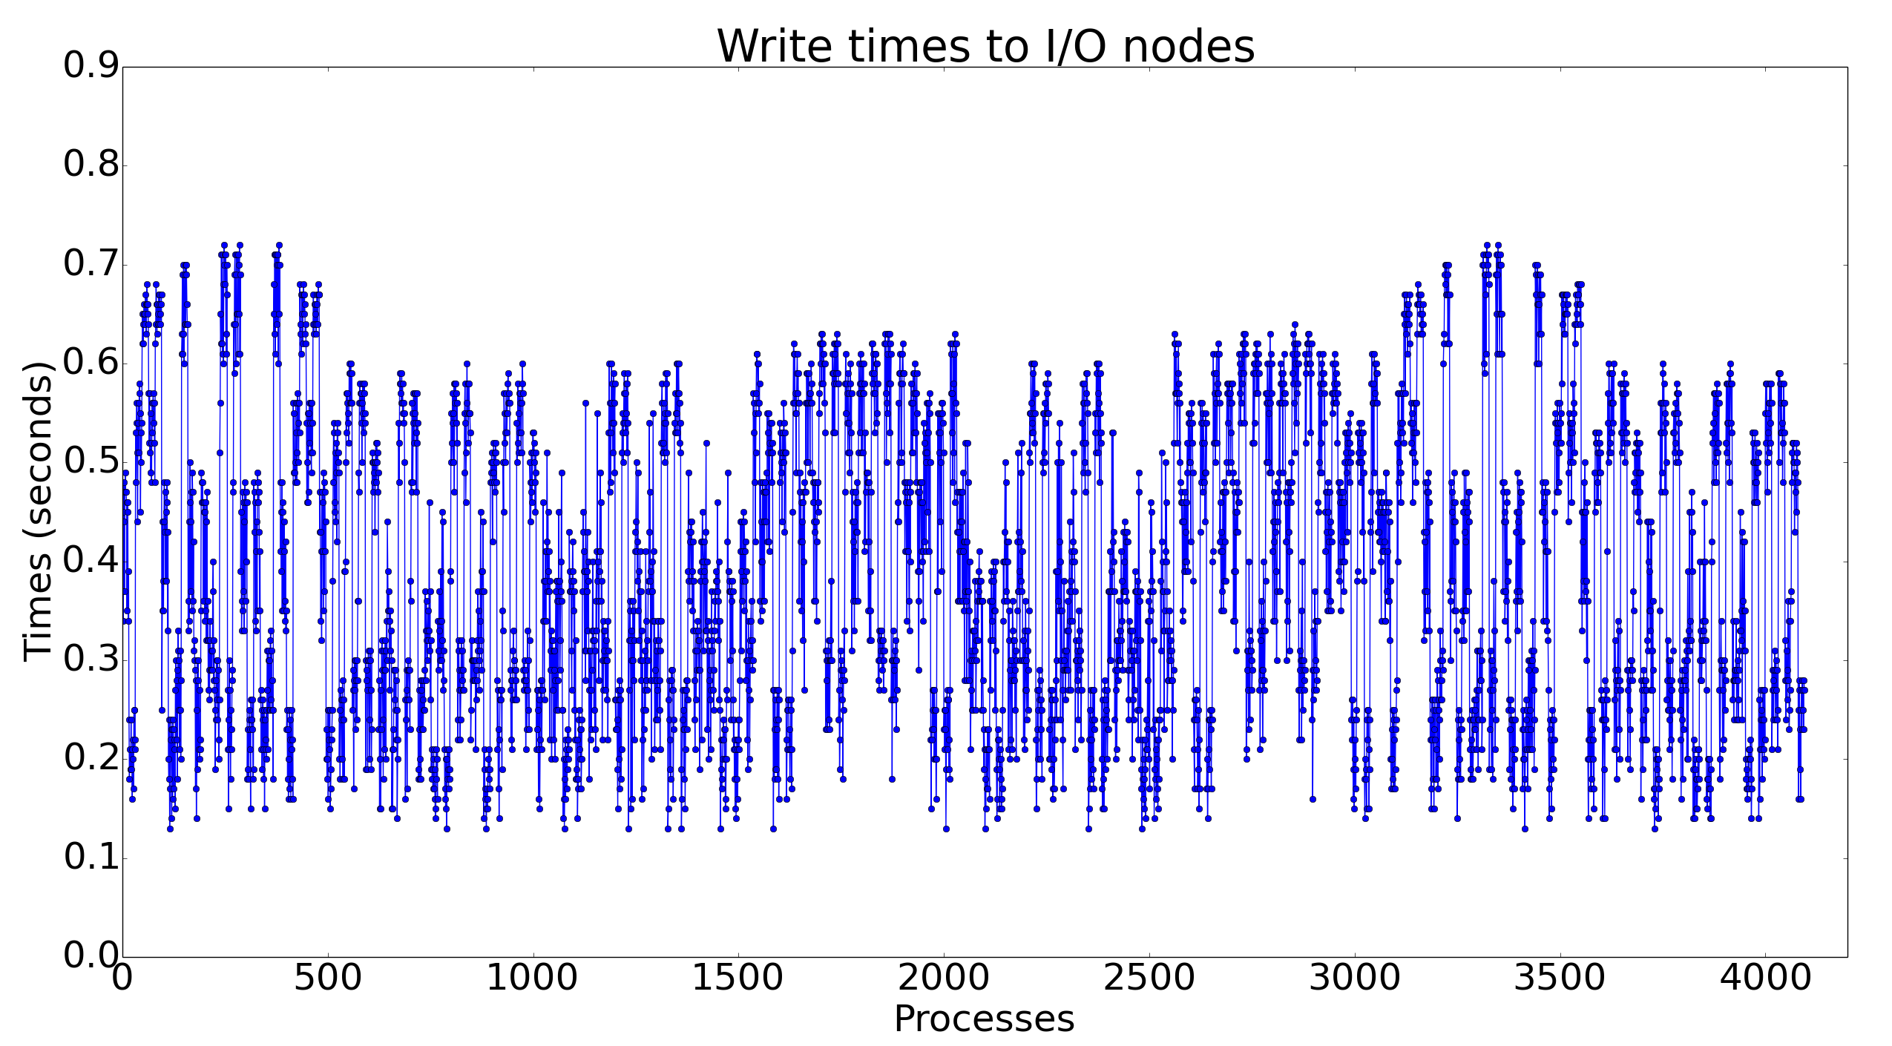
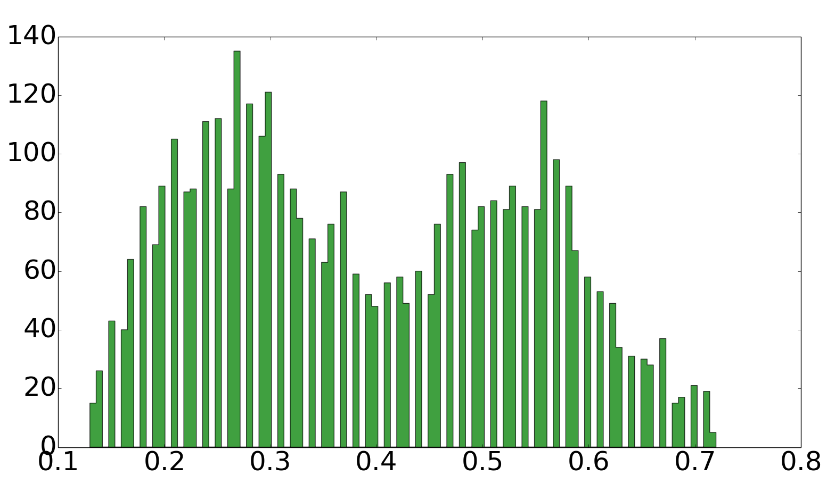
I/O node I/O time variation
Statistic | Time (s)
Min | 0.13
Max | 0.72
Mean | 0.39
Std. dev. | 0.15
# Processes
Time (s)
Time to write 4 GB to IONs (independent I/O) from 4096 MPI processes (1 rank/node), X-axis: Number of processes, Y-axis: Time to write
Histogram of time to write (independent I/O) from 4096 MPI processes (1 rank/node) on Mira
Notes:
4 GB file independent write from 4K processes

Slide 7
I/O path on BG/Q
2 bridge nodes for every 128 compute nodes, assigned at boot time
IB
Network
BRIDGE NODES
A (4)
Observations
Multiple hops
Few congested links
Static routing
Varying distance from bridge node
B (6)
C (7)
Compute node rack
I/O nodes

Slide 8
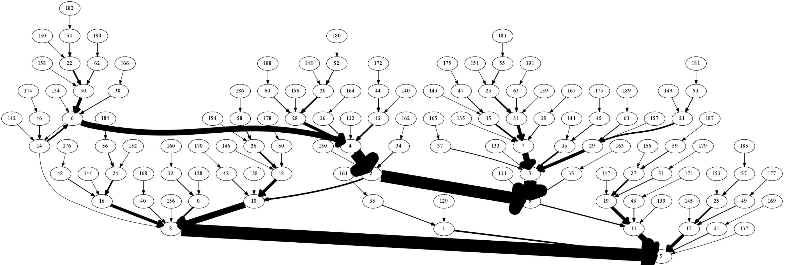
Network contention
2
1
4
15
31
4
3
33
9
Path for I/O messages from some of the compute nodes, whose assigned bridge nodes are either node 3 or node 9 on Mira.
Unbalanced load on the network
  Few heavily loaded links
Bridge nodes also route traffic to other bridge nodes
  Not routed to the closest bridge node

Slide 9
Network load balance
Bridge node
Bridge node
Can we reduce the I/O time by reducing the network congestion?

Slide 10
Prior work
Collective I/O optimizations
Physical data layout-aware reordering [IPDPS 2011]
Reorganizing I/O requests [Cluster 2014]
We focus on path of independent I/O data in the interconnect
I/O optimizations for Lustre [IPCCC 2011]
Improved routing algorithm
Modified pairing of client to storage servers
No control over system routing or I/O node pairing

Slide 11
Bridge node
Default bridge node assignment
I/O nodes and bridge nodes are decided at boot time
Every bridge node has equal assignment of compute nodes
  512-node partition: 8 bridge nodes, each assigned 64 nodes
A compute node is not always assigned its closest bridge node
Bridge node reassignment
Assign a node to a closer bridge node, if there exists one
Assign equal weights (new assignments) to all bridge nodes
Bridge node 1
Bridge node 2
x
Compute nodes to bridge node assignments

Slide 12
Algorithm
Construct paths to closer bridge node
Tree construction
Traverse and select bridge node
Tree traversal

Slide 13
Tree construction
b
Find neighbors
Path from node to root in the tree?
(3,1,1,1,1)
b
ABCDE routing
1
2
3
A
Y
(2,1,1,1,1)
1
4
(3,1,1,0,1)
Add node
4
5
6
B
AB routing order
2
3
BA routing order
7
8
9
(1,1,1,1,1)
(2,1,1,0,1)

Slide 14
Tree traversal
Traverse every node of a level in all trees
Distance = Number of hops
Weight = Number of new assignments
Average weight = 3
Current distance < default distance?
Weight = 4
1
Current distance = 2
Y
a
Weight < average weight?
Weight = 2
2
Y
Current distance = 2
a
Assign node
Trees rooted at bridge nodes

Slide 15
Implementation
User-space implementation
Facilitates easier deployment
Modified write
Compute nodes with default assignments
  No change
Compute nodes with new assignments
  Do not write directly
  Send data to their new bridge nodes
Bridge nodes
  Receive data from the newly assigned compute nodes
  Write on behalf of the new assignees
Overhead
Memory overhead at bridge nodes
Time overhead for sends/receives

Slide 16
Experimental setup
512 – 8192 nodes of Mira, 1 – 16 ranks per node
Contiguous data
8 KB – 4 MB writes per rank
  I/O nodes
  GPFS file system
Independent
Independent optimized
  Data per rank
  Data combined per node (coalesced)
Collective

Slide 17
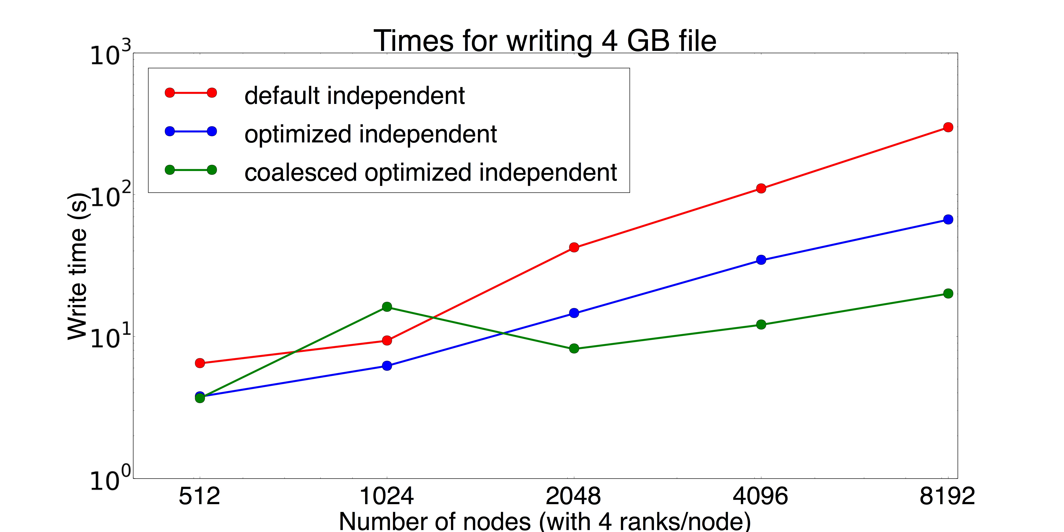
Results – Strong scaling
298.8 s
66.9 s
20.2 s
Time for independent writes to 4 GB file from 2048 – 32768 MPI ranks.
Mitigating interconnect contention improves performance by maximum of 15x
Notes:
Strong scaling – write 4 GB
2 MB per rank at 512 nodes
0.125 MB per rank at 8192 nodes

Slide 18
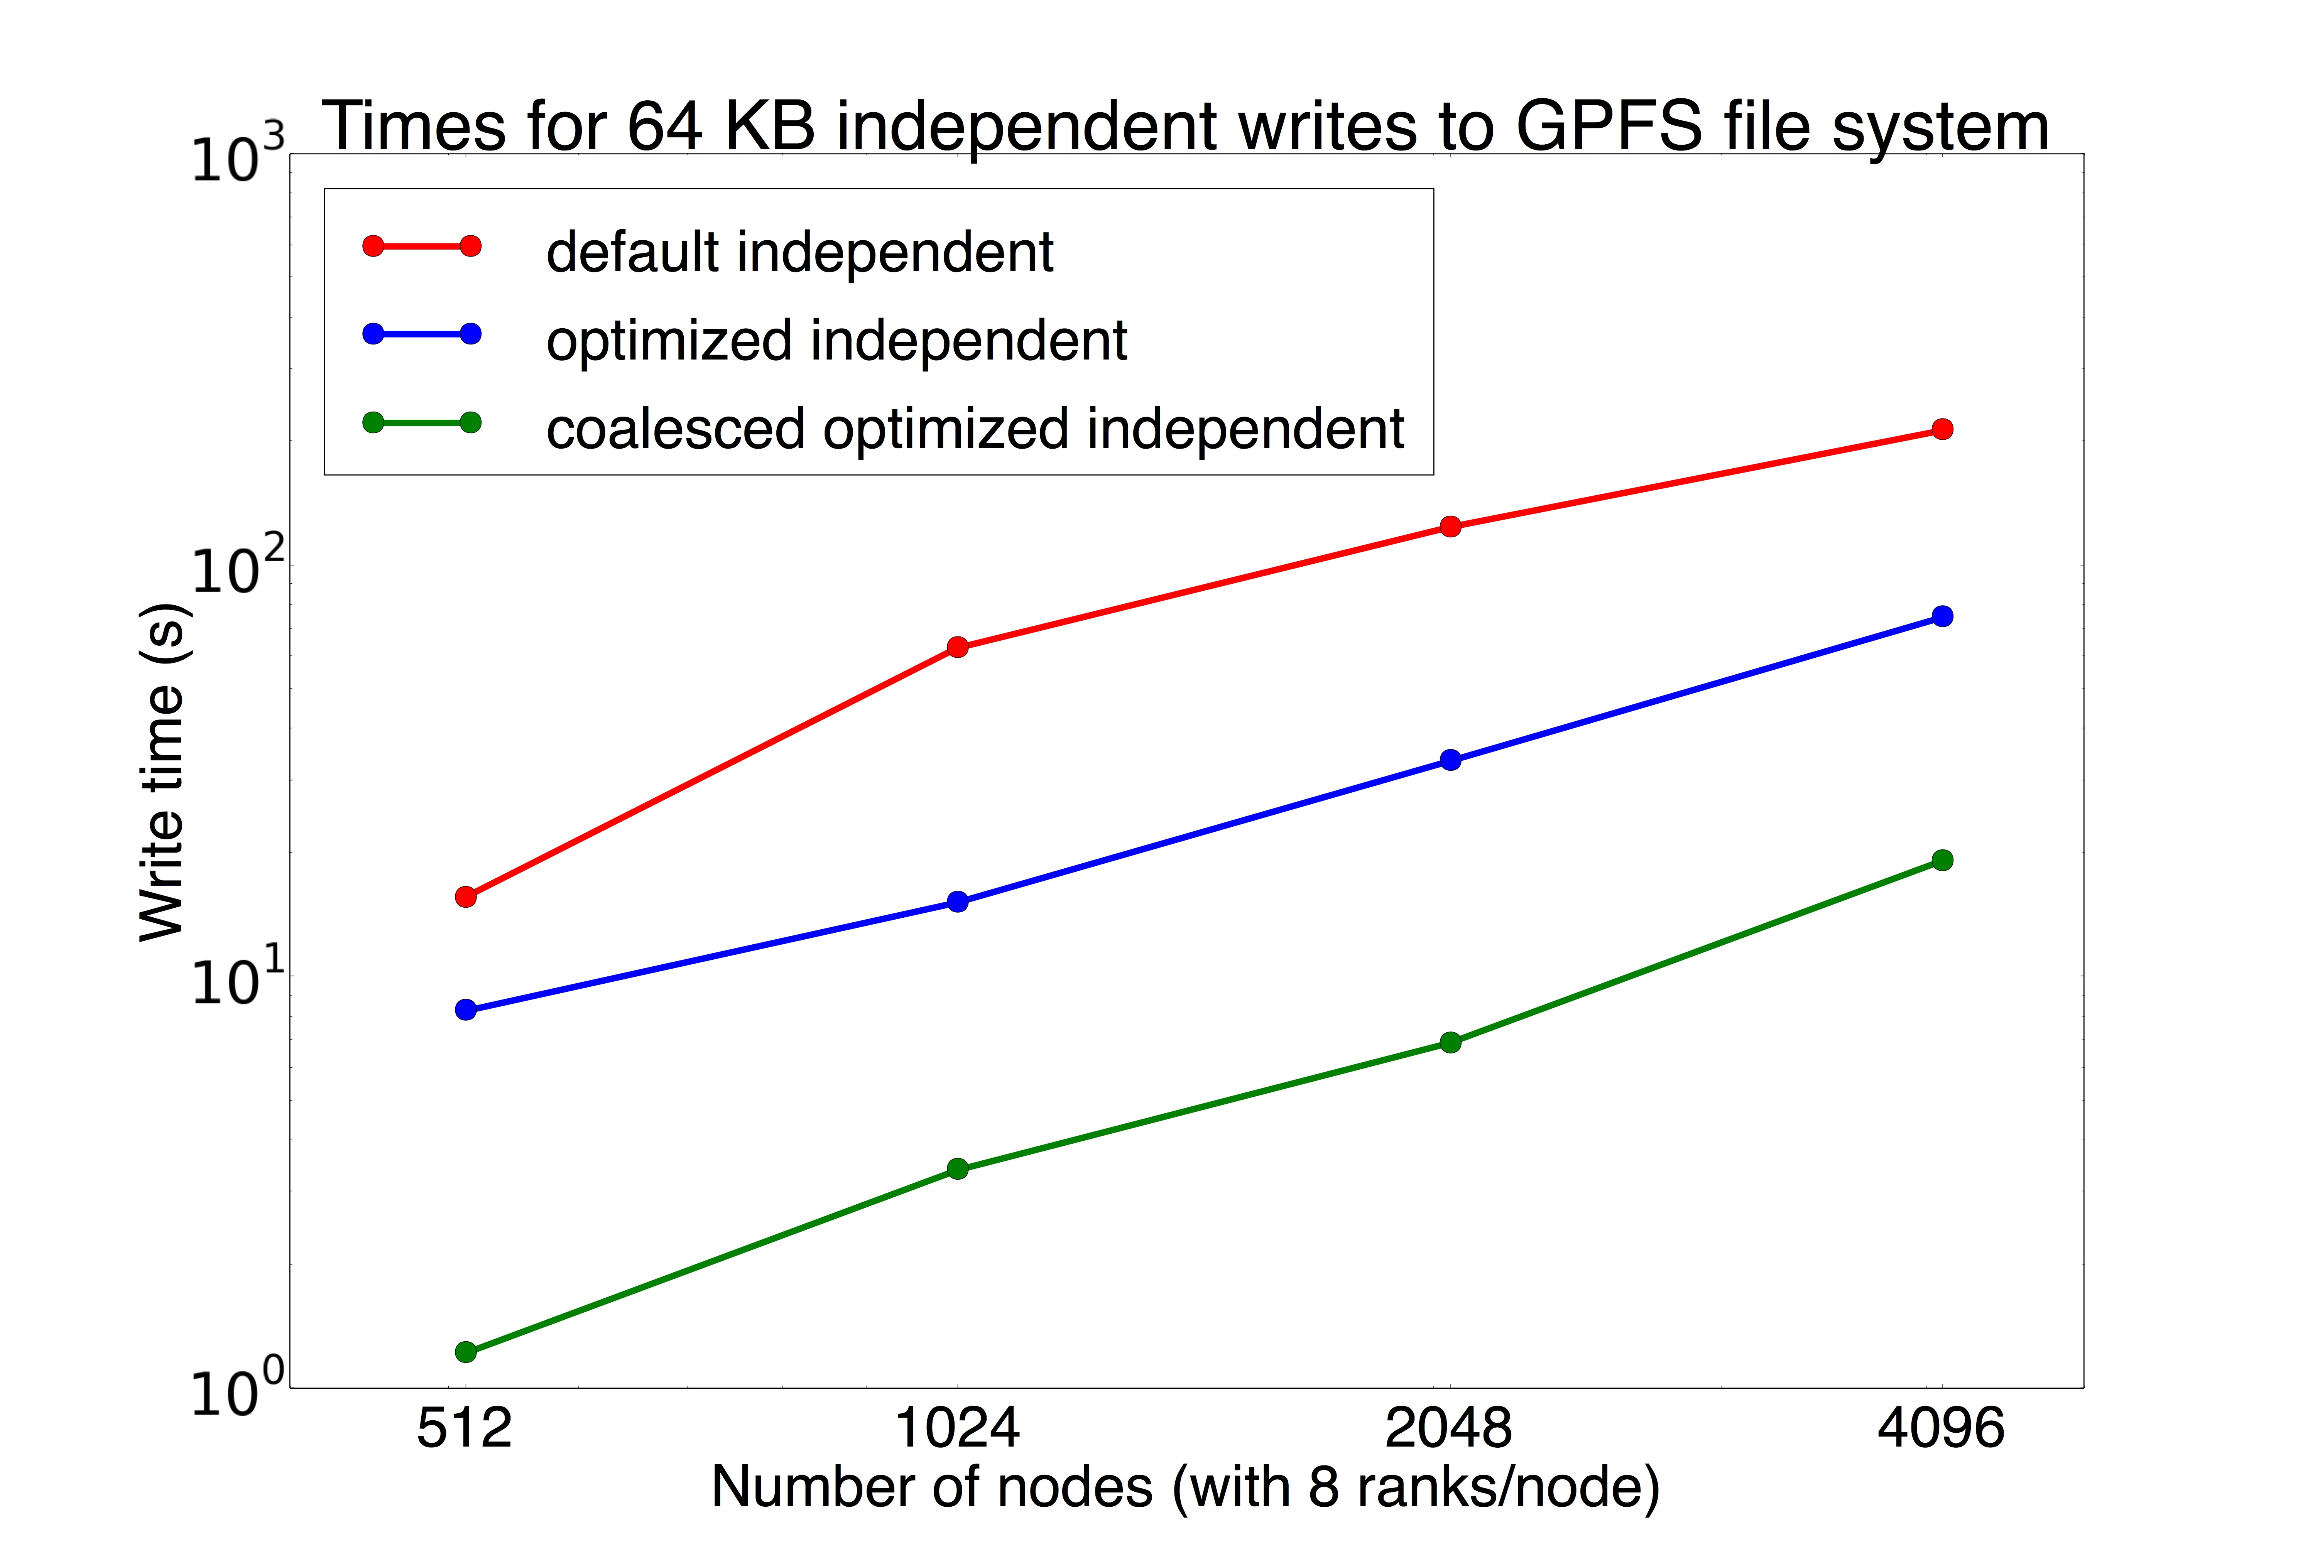
Results – Weak scaling
213 s
16 s
75 s
19 s
8 s
1 s
Independent writes (0.25 – 2 GB) from 4096 – 32768 MPI ranks.
Our algorithm reduces independent write times (64 KB) on average by 15x and 3x with and without combining data per node.

Slide 19
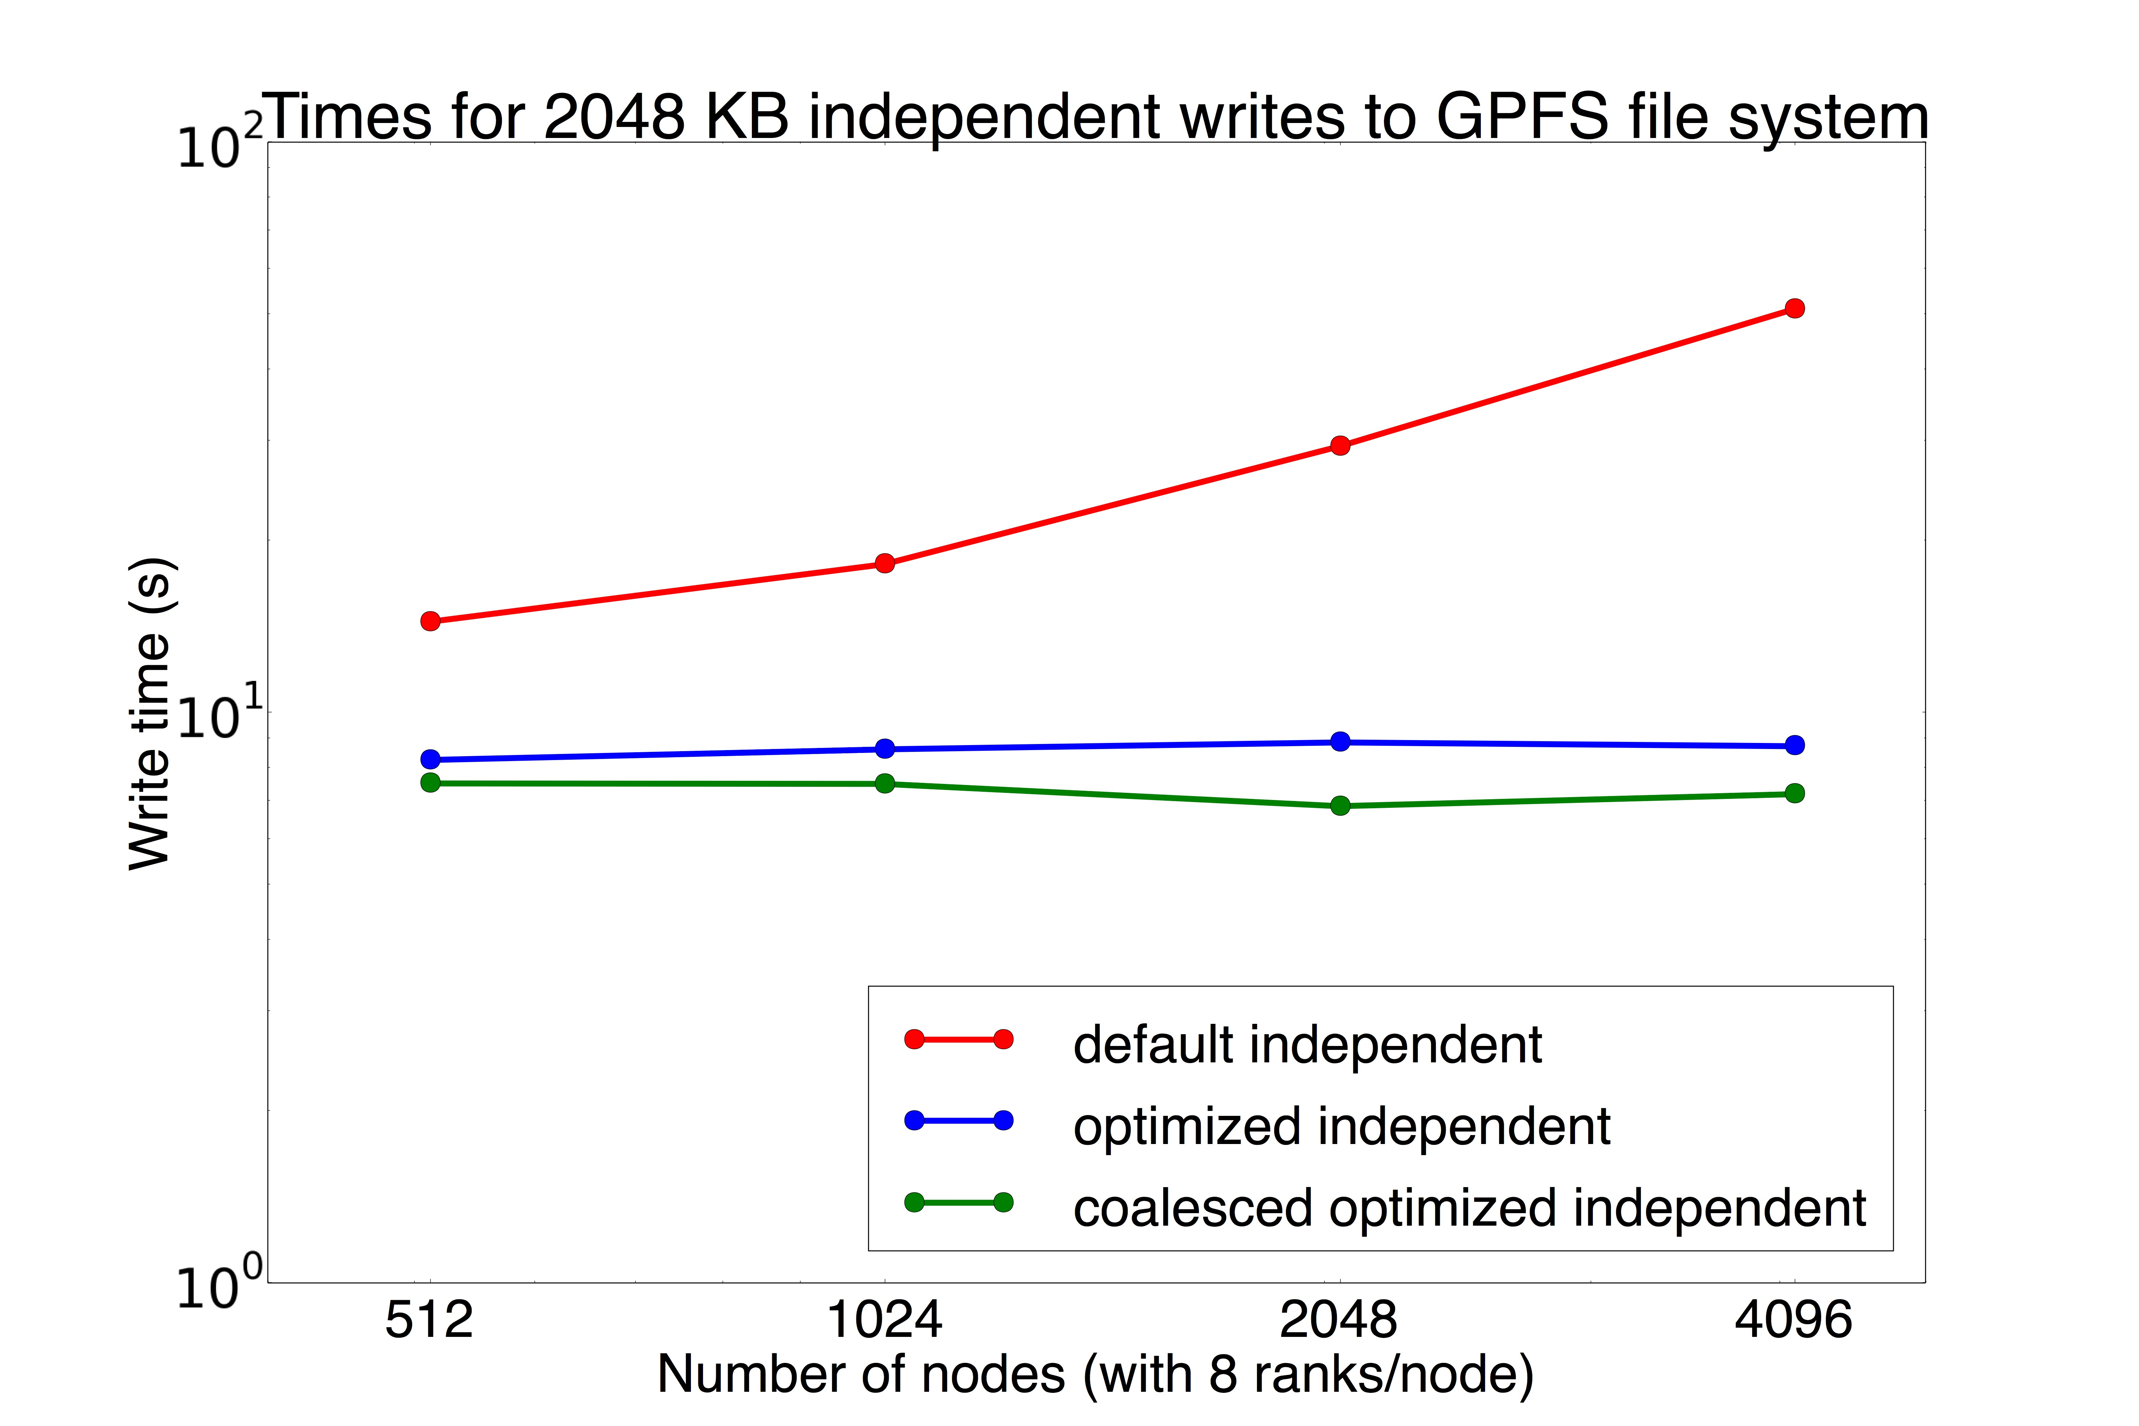
Results – Weak scaling (Big data)
51 s
15 s
7 s
8 GB
64 GB
Independent writes from 4096 – 32768 MPI ranks.
Our algorithm scales linearly with increasing number of processes.

Slide 20
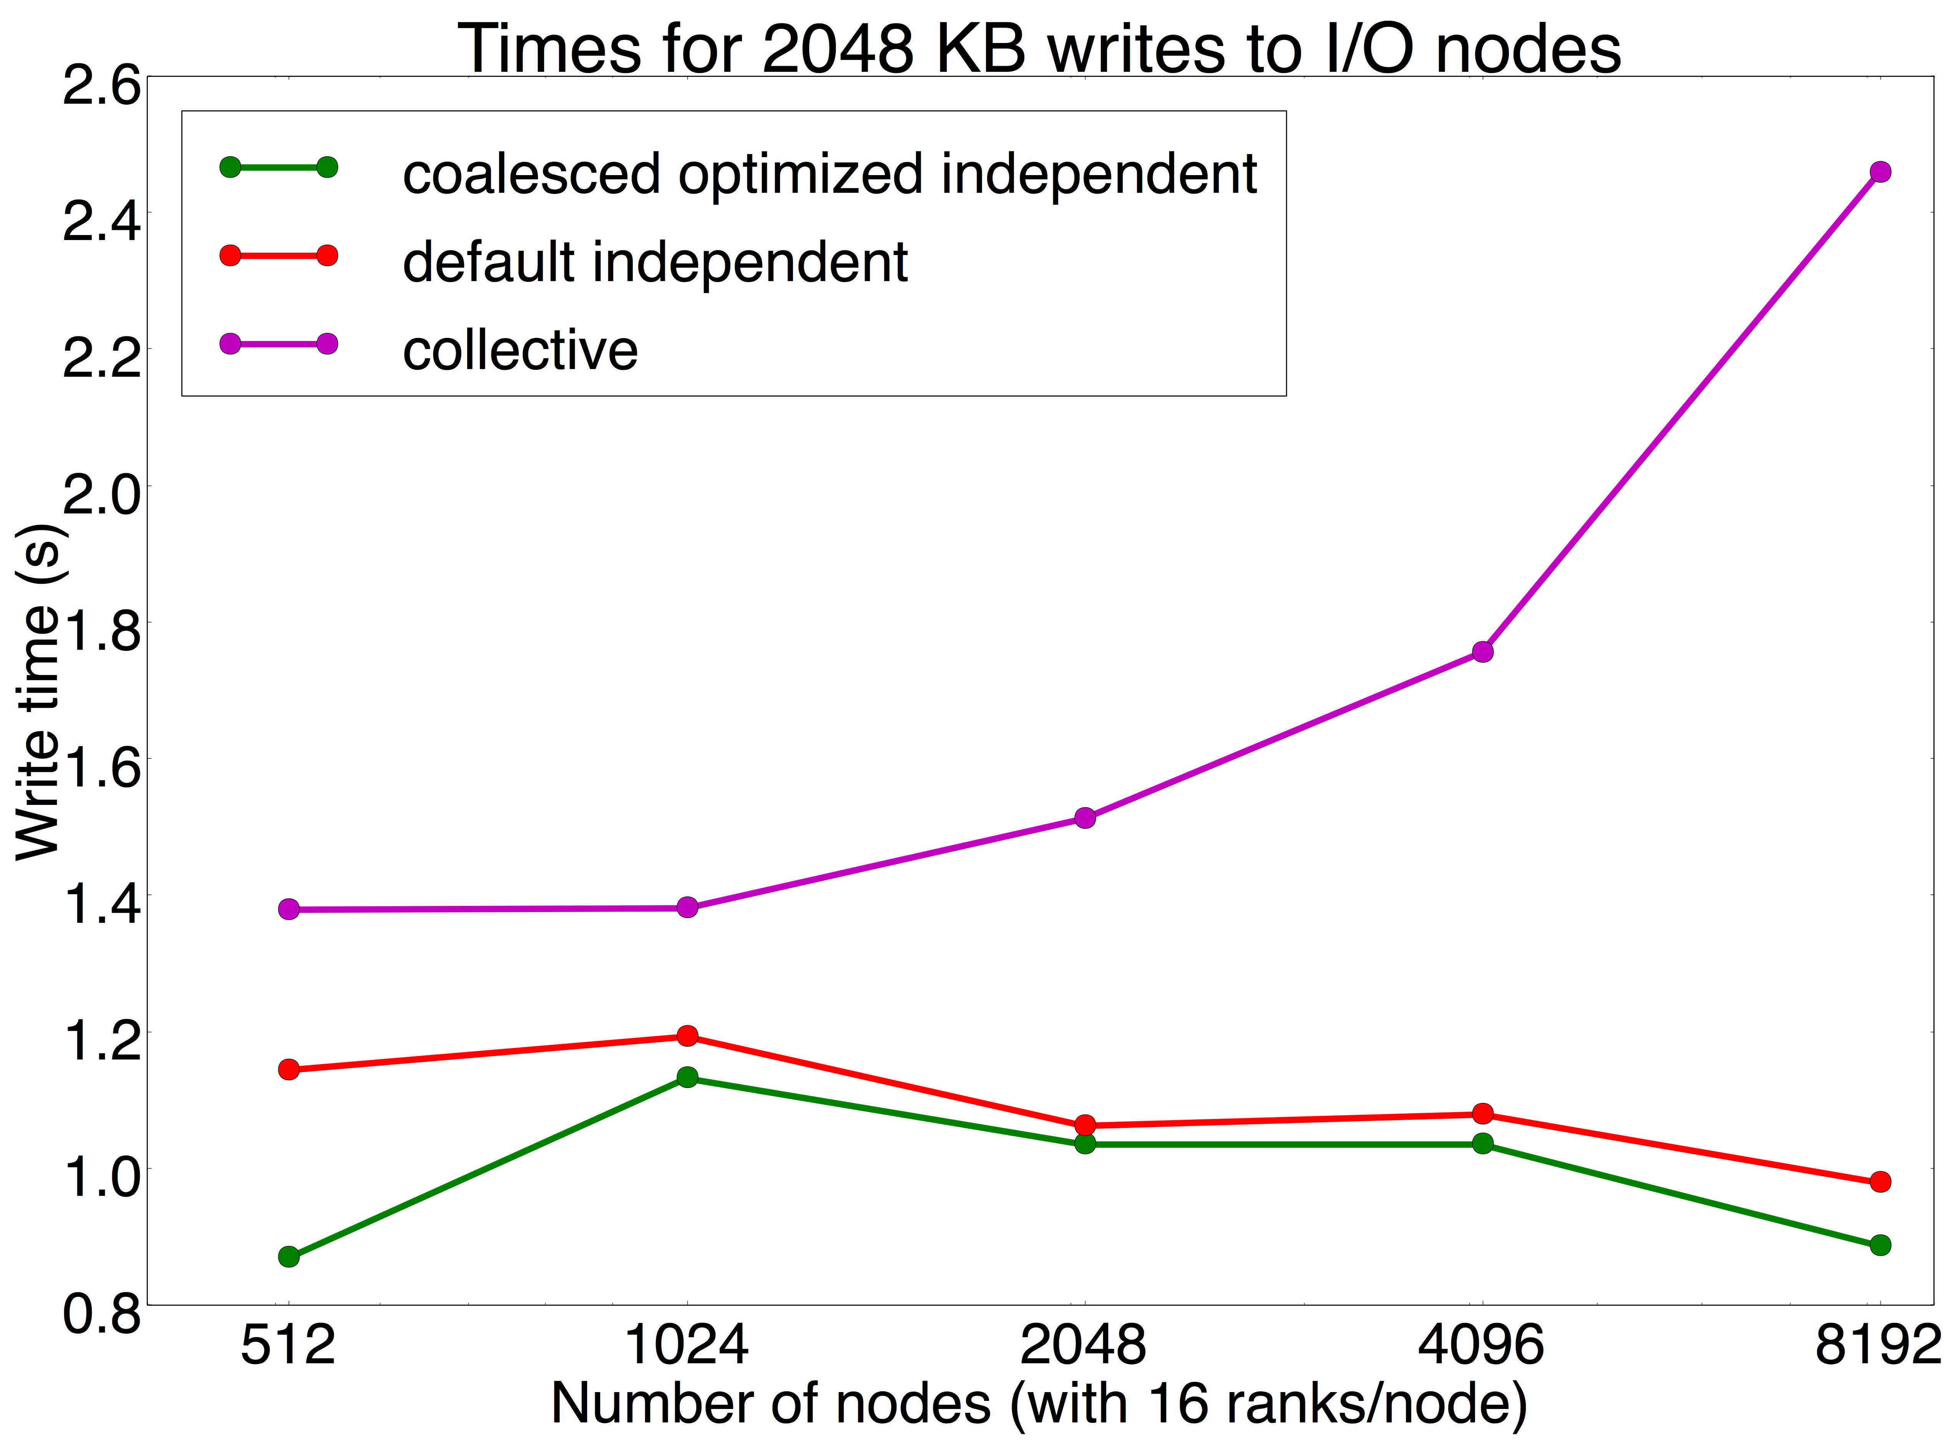
Results – I/O node writes
3x gain
Collective and Independent 2 MB writes to I/O nodes.
Improved write times over collective MPI writes to I/O nodes.

Slide 21
Conclusions
Presented a network load-aware and route-aware algorithm, implemented in user-space
Combining data per node improves performance
Improved performance of file system writes by an average of 60% over default MPI independent I/O on BG/Q
Improved performance of I/O node writes by an average of 20% over default MPI collective I/O

Slide 22
Acknowledgements
This research has been funded in part and used resources of the Argonne Leadership Computing Facility at Argonne National Laboratory, which is supported by the Office of Science of the U.S. Department of Energy under contract DE-AC02-06CH11357. This work was supported in part by the DOE Office of Science, Advanced Scientific Computing Research, under award number 57L38, 57L32, 57K07 and 57K50.
Philip Heidelberger, IBM T. J. Watson Research Center
Adam Scovel, Argonne National Laboratory

Slide 23
pmalakar@anl.gov
THANK YOU
QUESTIONS?
SUMMARY
Our network load-aware and route-aware algorithm improved performance of file system writes by an average of 60% over default MPI independent I/O, and of I/O node writes by an average of 20% over default MPI collective I/O on BG/Q.

Slide 24
BACKUP

Slide 25
Results – Network counter
Average number of messages routed through a bridge node while writing 64 KB and 2 MB from 2048 nodes with 4 ranks/node (columns 2 – 3) and 8 ranks/node (columns 4 – 5).

Slide 26
Results – Network counter
Standard deviation in number of messages sent from bridge nodes while writing 64 KB (first three rows) and 2 MB (last three rows) data from 512, 1024 and 2048 nodes with 1 rank/node.

