Slide 1
Active Learning-based Automatic Tuning and Prediction of Parallel I/O Performance
Megha Agarwal
Divyansh Singhvi
Preeti Malakar
Suren Byna
PDSW @ SC'19
November 18, 2019

Slide 2
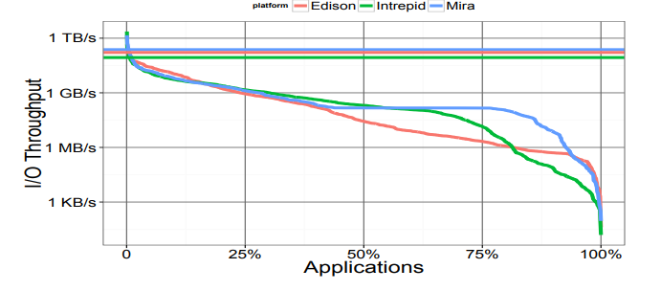
I/O Performance Statistics
Few applications achieve less than 1% of maximum I/O throughput
Source: Huong Luu, et al., “A Multiplatform Study of I/O Behavior on Peta-scale Supercomputers”. HPDC '15

Slide 3
Parallel I/O – Challenges
Exponential growth in compute rates as compared to I/O bandwidths
Depends on interaction of multiple layers of parallel I/O stack (I/O libraries, MPI-IO middleware, and file system)
Each layer of I/O stack has many tunable parameters
I/O parameters are application-dependent
A typical HPC application developer (expert in their scientific domain) resorts to default parameters ☹
Notes:
A normal HPC application developer (expert in their scientific domain) resorts to default parameters resulting in poor performance.

Slide 4
Parallel I/O stack – Complexity
Tunable parameters: cb_nodes, cb_buffer_size, …
Tunable parameters: stripe size, stripe count, …

Slide 5
Our Contributions
An auto-tuning approach based on active learning that improves both read and write performance.
ExAct: An execution-based auto-tuner for I/O parameters (achieves up to 11x speedup over default).
PrAct: A fast prediction-based auto-tuner for I/O parameters (can tune I/O parameters in 0.5 minutes).
Notes:
Contibution : 2 active learning models - one execution based (ExAct) and other prediction based auto-tuning(PrAct)

Slide 6
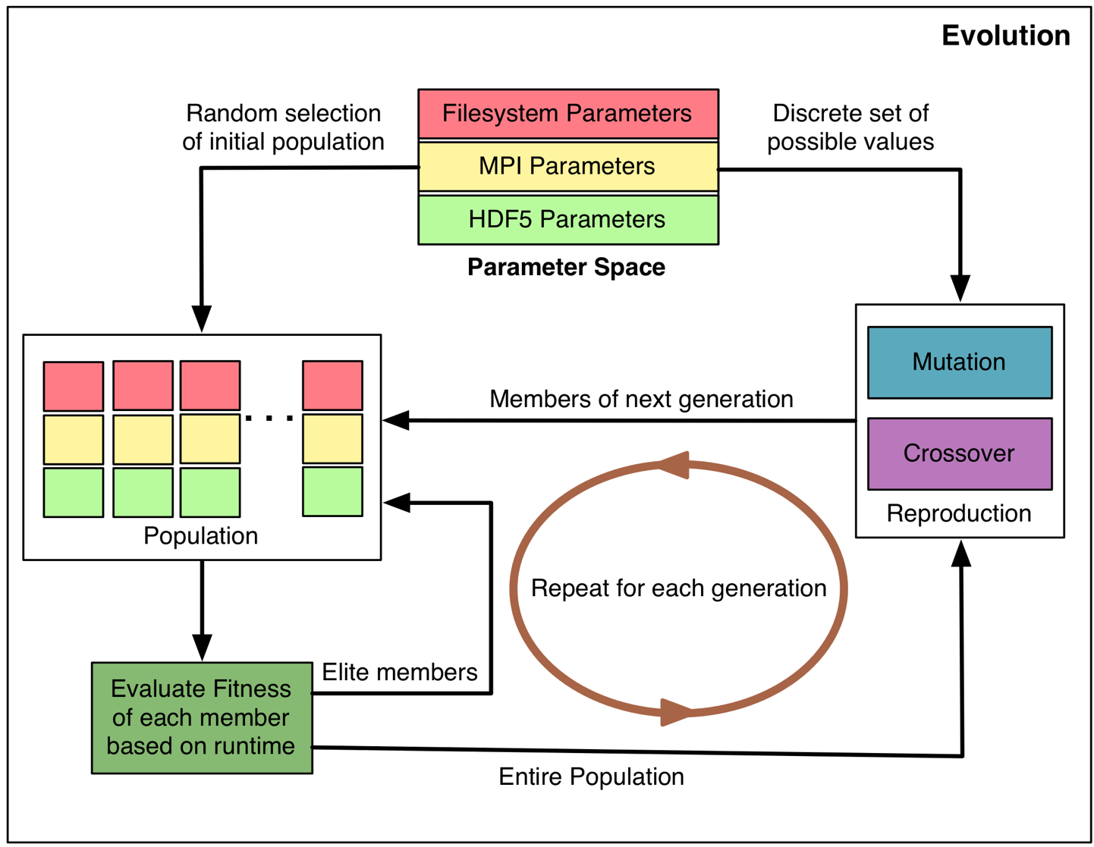
Prior Work
Heuristic-based search with a genetic algorithm to tune I/O performance
Analytical models
  Disk arrays to approximate their utilization, response time, and throughput
  Application-specific models
Herbein et al. use a statistical model, called surrogate-based modeling, to predict the performance of the I/O operations
Notes:
Behzad et al. used a heuristic-based search with a genetic algorithm to tune I/O performance
Lee and Katz developed analytical models of disk arrays to approximate their utilization, response time, and throughput
Barker et al. used analytical performance models for two applications to test their performance for new storage system deployment
Herbein et al. use a statistical model, called surrogate-based modeling to predict the performance of the I/O operations

Slide 7
Prior Work
Heuristic-based search with a genetic algorithm to tune I/O performance
Analytical models
  Disk arrays to approximate their utilization, response time, and throughput
  Application-specific models
Herbein et al. use a statistical model, called surrogate-based modeling, to predict the performance of the I/O operations
Notes:
Behzad et al. used a heuristic-based search with a genetic algorithm to tune I/O performance
Lee and Katz developed analytical models of disk arrays to approximate their utilization, response time, and throughput
Barker et al. used analytical performance models for two applications to test their performance for new storage system deployment
Herbein et al. use a statistical model, called surrogate-based modeling to predict the performance of the I/O operations

Slide 8
Parameter Tuning – Challenges
Large number of I/O parameters inter-dependent on each other.
Real valued parameters do not allow brute forcing the parameter space to find optimal parameters.
Application-specific models are limited to specific I/O patterns
Notes:
Large number of combinations and auto-tuning becomes very time consuming.

Slide 9
Bayesian Optimization
Limit expensive evaluations of the objective function by choosing the next input values based on those that have done well in the past
Mathematically we can represent our problem as :
x* = argmax _{x∈X} f(x)
f(x) represents our objective function to minimize which in our case is run time of application,
x is the value of parameters
x* is best value found for each of parameters in sample space X.

Slide 10
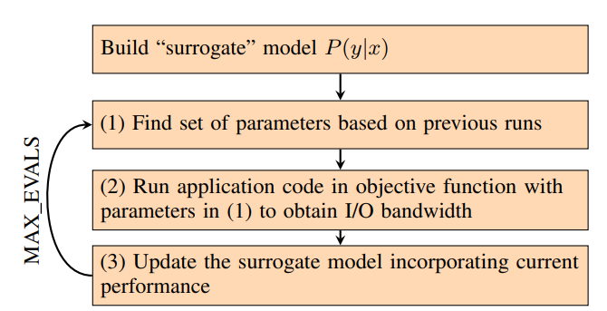
Execution-based Auto-tuning (ExAct) Model

Slide 11
Prediction-based Auto-tuning (PrAct) Model
Developed a performance prediction model using Extreme Gradient Boosting (XGB).
PrAct uses predicted runtimes in the objective function in Bayesian Optimization model.
This reduces the time to obtain the best I/O parameters.
Notes:
Section IV
Around 40x improvements in training time

Slide 12
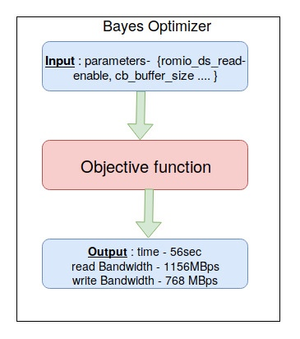
Summary of Approaches
ExAct - Objective function obtains output by running the application on input parameters
Predict is an offline model trained on dataset that predicts I/O bandwidth for given set of input parameters.
PrAct- Objective function obtains output by running Predict on input parameters
Notes:
Predict is trained by xgboost

Slide 13
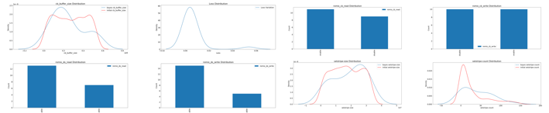
Bias and Learning Plots
Collective I/O is disabled in S3DIO, i.e. with 50% prob, it has no impact
Cb-buffer size distribution
Loss distribution
Romio cb_read
Romio cb_write
Romio ds_read
Romio ds_write
stripe size distribution
Stripe count distribution
Red - Initial probability distribution
Blue - After training prob. distribution
Configuration: 200X400X400 on 4X4X8 processes S3DIO
Notes:
Bias increases in the range where optimal value lies.

Slide 14
Application I/O Kernels for benchmarking
S3D-IO
  40 input configurations
BT-IO
  19 input configurations
IOR
Generic I/O
  45 input configurations

Slide 15
System Configurations
HPC2010 (464-node supercomputer) at the Indian Institute of Technology (IIT), Kanpur
  Used a maximum of 128 processes.
CrayXC40 at NERSC, LBNL
  Used a maximum of 512 processes.

Slide 16
Results

Slide 17
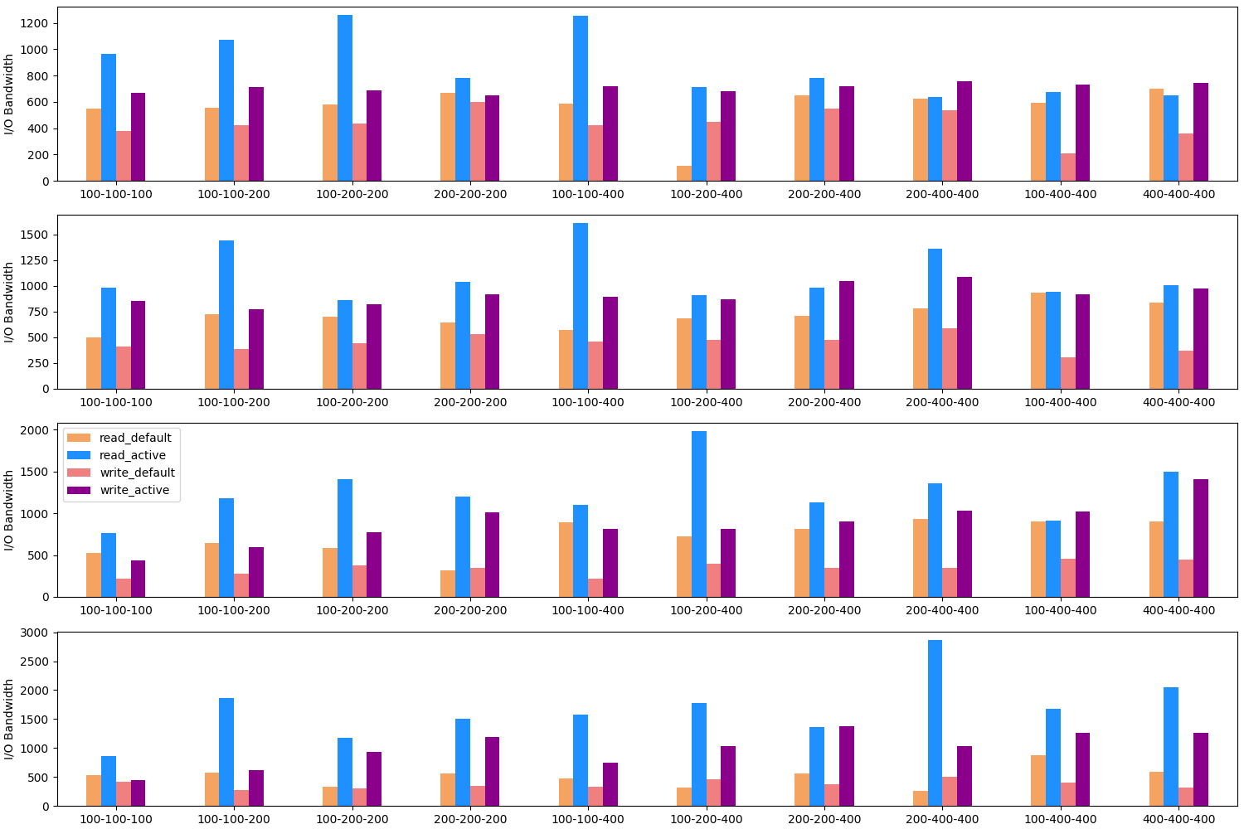
S3D-IO default vs. ExAct on HPC2010 (16 – 128 processes, 8 ppn)
X-axis: Increasing
data sizes
Y-axis:
I/O bandwidths in MBps
Notes:
Default vs. best bandwidth from ExAct for various configurations of S3D-IO on 16, 32, 64 and 128 processes of HPC2010. X-ticks of each plot (of the form x-y-z) represents the 3D grid size of the input data.

Slide 18
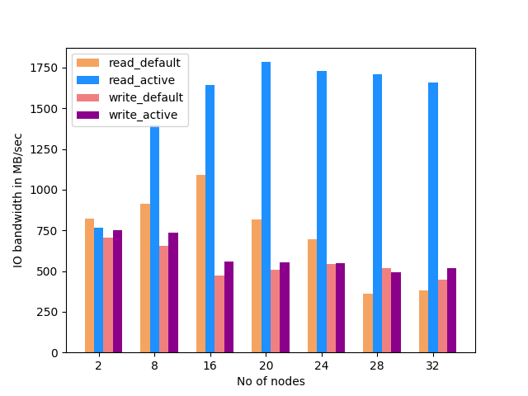
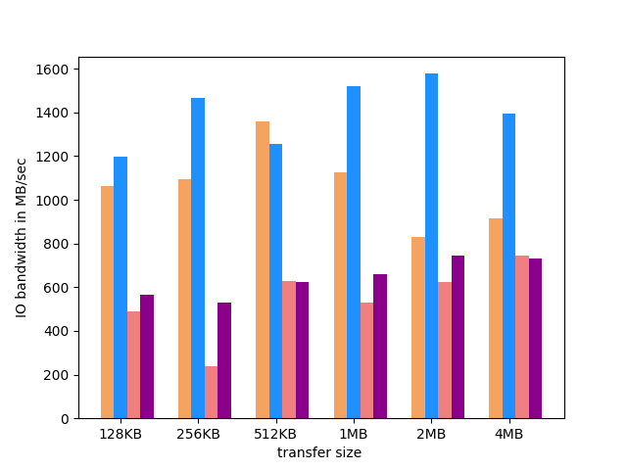
IOR I/O bandwidths for varying node counts.
Strong scaling on 16 – 256 processes.
  IOR I/O bandwidths for varying transfer sizes.
  Data scaling on 64 cores with 100 MB block size.
87% read and 20% write improvements
Default vs. ExAct I/O bandwidths using IOR on HPC2010
Notes:
Fig. 3: Default vs. ExAct I/O bandwidths using IOR on HPC2010. (a) Strong scaling on 16 – 256 processes, 100 MB block size and transfer size (b) Data scaling on 64 cores with 100 MB block size.

Slide 19
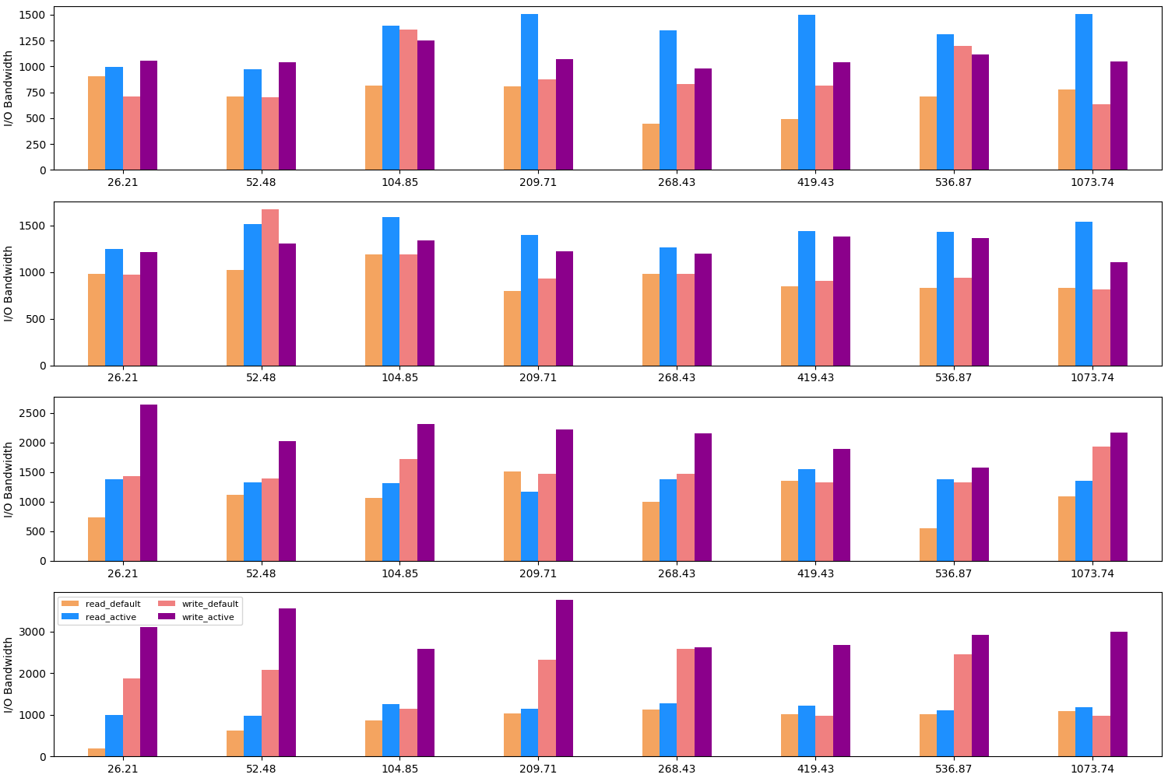
Generic-IO default vs. ExAct on HPC2010 (2, 4, 16, 28 nodes)
X-axis:
number of particles (in millions)
Y-axis:
I/O bandwidths in MBps
Significant improvement on large data size
Notes:
ExAct gives higher improvements for the larger data size since more nodes/tasks are able to drive the concurrency achieved with more OSTs.

Slide 20
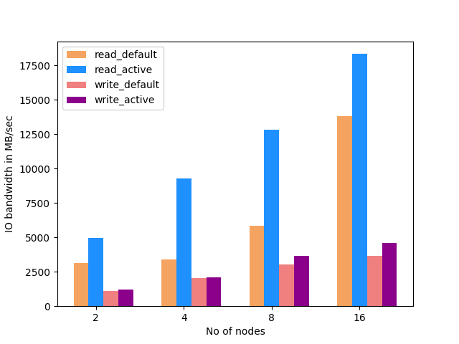
S3D-IO default vs. ExAct on Cori (2 – 16 nodes, 32 processes per node)
X-axis:
Number of nodes
Y-axis:
I/O bandwidths in MBps
Weak scaling results for S3D-IO

Slide 21
ExAct Result Summary
Benchmark | Read(Avg) | Write(Avg) | Read(Max) | Write(Max)
S3D-IO | 1.97X | 2.21X | 11.14X | 4.03X
IOR | 2.1X | 1.0X | 4.73X | 2.23X
BT-IO | 1.07X | 1.76X | 2.93X | 4.86X
GenericIO | 1.44X | 1.51X | 3.04X | 3.06X

Slide 22
Results – Analysis
Benchmark | S3D-IO (200 x 200 x 400) on 4 x 4 x 8 processors (16 nodes) on HPC2010
Default parameters | stripe_size = 1 MB, stripe_count = 1, cb read/write = enable, ds read/write = disable, cb_buffer_size = 16 MB, cb_nodes = 16
Read/write | 3002 /1680 MBps
ExAct parameters | stripe_size= 4 MB, stripe_count = 21, cb read/write = disable/disable, ds read/write = enable/disable, cb_buffer_size = 512 MB, cb_nodes = 13
Read/write | 1198 / 293 MBps
Time | 12.65 minutes
Notes:
Verify the active parameters:

Slide 23
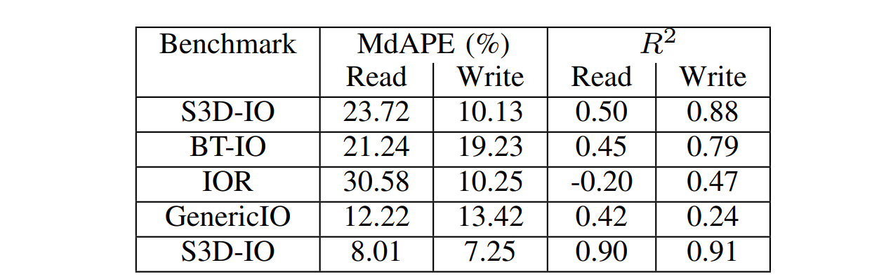
Performance Prediction Model (Predict) Accuracy
Median absolute percentage error and R² measure for various benchmarks on HPC2010 (rows 1 – 4) and Cori (last row) using XGB model-based prediction
Notes:
MdAPE (Median Absolute Percentage Error) 10 fold cross validations were done.
Poor results due to fewer sample size (from the ExAct runs)

Slide 24
Prediction Model Accuracy
Scatter plots of XGB-predicted values vs. measured values of write bandwidths for all benchmarks on HPC2010
(30/70 split of train/test data)
Notes:
The ideal graph should be dashed black line

Slide 25
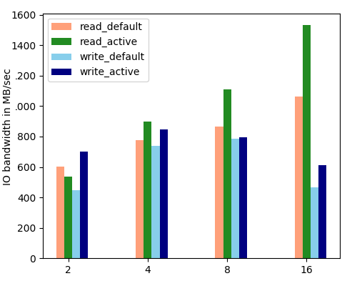
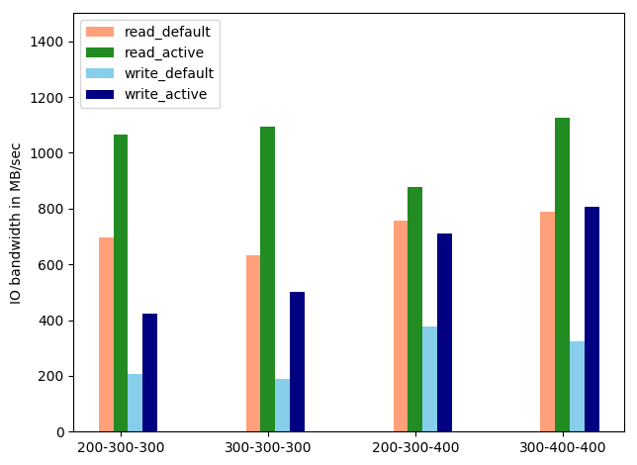
Results – PrAct
S3D-IO weak scaling on unseen configurations
BT-IO with unseen configurations.

Slide 26
Results – PrAct
PrAct was also evaluated for configurations that were not present in the training data
Maximum of 1.6x and 1.2x performance improvement in reads and writes in S3D-IO
Maximum of 1.7x and 2.5x performance improvement in reads and writes in BT-IO
Observed degradation in read bandwidths in case of IOR, especially at high node counts. This is expected as the R² scores were low

Slide 27
ExAct vs. PrAct – Time vs. Performance Tradeoff
Average training time of PrAct is 18 seconds whereas that of ExAct is 13 minutes (varies with the run time of application)
PrAct achieves a maximum performance improvement of 2.5x whereas ExAct achieves 11x improvement

Slide 28
Automation
def RunTheBenchmark(hyperparameters):
os.chdir(project_dir+'active/../')
storeinfile(hyperparameters)
out=subprocess.Popen(["python3","read_config_general.py","-n 2","-c200 200 400 2 2 4 1"], shell=False, stdout=subprocess.PIPE)
logging.basicConfig(level=logging.DEBUG)
output=out.stdout.read().decode('utf-8')
Just change the script (input parameters to an application) to run any new benchmark

Slide 29
Conclusions
Presented execution-based (ExAct) and prediction-based (PrAct) auto-tuners for selecting MPI-IO and Lustre parameters
        ExAct runs the application and learns, whereas PrAct uses predicted values from analytical model to learn
The only system-speciﬁc inputs to the model is the range of stripe counts
Upto 11x improvement in read and write bandwidths
ExAct is able to improve write performance of large data sizes (e.g., 1 billion particles in GenericIO) by 3x
Predict model uses XGBoost, and obtains less than 20% median prediction errors for most cases, even with 30/70 train/test split
Notes:
#3: since the maximum number of OSTs vary per system

