Slide 1
A Maximum Entropy Based Honorificity Identification for Bengali Pronominal Anaphora Resolution
Apurbalal Senapati and Utpal Garain
Presented by Samik Some

Slide 2
Introduction
Pronomial anaphora resolution is important for several NLP tasks such as question answering, summarization etc.
In English pronouns carry gender information such as he/she/it which is helpful when resolving them to find the nouns they refer to.
In Bengali pronouns do not have gender information however there is honorificity information embedded in pronouns. eg. Three forms of the verb খাওয়া; খা, খাও and খান.
Such honorific information is present in both written and spoken forms, and may be used for resolving pronoun references.
There are multiple features which contribute to determining noun honorificity in Bengali which led to the selection of a maximum entropy model.
Such a model offers better performance than earlier methods.

Slide 3
Honorific Information in Bengali
Three types of honorificity exist in Bengali language both in written and spoken form.
The highest degree (SUP class) refers to people who are of higher status or generally respectable people such as doctors, teachers, elders, etc.
Next is the neutral form (NEU class) which is used when referring to close family members, children, younger family members, etc.
The lowest level (INF class) is used for very close friends, very close relations, or people who are presumed to be of lower social status such as rickshaw pullers, housemaids, etc.
Such honorific information can be extracted from several sources such as the title placed before or after a name.
It can also be obtained by observing the inflection of the main verb.
Pronouns also conform with such honorificity and there are different forms for different levels.

Slide 4
Maximum Entropy Modelling
A training sample is summarized in terms of its empirical probability distribution. Here x is the context and y is the corresponding class.
$$\tilde{p}\left(x,y\right)=\frac{1}{N}×number of times \left(x,y\right) occurs in the sample$$
We define events in terms of binary values feature functions which gives 1 if the context x contains some particular information and the corresponding class is y.
$f\left(x,y\right)=1/0 depending on context and class$
The statistic we are interested in is the expected value of the feature function with respect to the empirical distribution p~(x,y).
$$\tilde{p}\left(f\right)≡\sum_{x,y}{\tilde{p}\left(x,y\right)f\left(x,y\right)}$$

Slide 5
Maximum Entropy Modelling (contd.)
The expected value that the model p(y|x) assigns to f is given as…
$$p\left(f\right)≡\sum_{x,y}{\tilde{p}\left(x\right)p\left(\left.y\right|x\right)f\left(x,y\right)}$$
We require that our model conforms to the following restriction.
$$p\left(f\right)=\tilde{p}\left(f\right)$$
Thus the solution space for our model is…
$$C=\left\{p∈\left.P\right|p\left(fⅈ\right)=\tilde{p}\left(f_{i}\right) for i∈\{1,2,…,n\}\right\}$$
We can find the most uniform model in this space by maximizing the following entropy function.
$$H\left(p\right)≡−\sum_{x,y}{\tilde{p}\left(x\right)p\left(\left.y\right|x\right)\log{p\left(\left.y\right|x\right)}}$$

Slide 6
Feature functions
A 10-dimensional feature vector is used.
f1(x, y) = 1 when y is SUP and x is the person and honorific addressing term is in the left position; 0 otherwise.
f2(x, y) = 1 when y is SUP and x is the person and honorific addressing term is in right position; 0 otherwise.
f3(x, y) = 1 when y is SUP and x is the person and honorific addressing terms are both in left and right positions; 0 otherwise.
f4(x, y) = 1 when y is SUP and x is the person and honorific addressing term is in left position and the main verb associated with x is in SUP class; 0 otherwise.
f5(x, y) = 1 when y is SUP and x is the person and honorific addressing term is in right position and the main verb associated with x is in SUP class; 0 otherwise.

Slide 7
Feature functions (contd.)
f6(x, y) = 1 when y is SUP and x is the person and honorific addressing terms are both in left and right positions and the main verb associated with x is in SUP class; 0 otherwise.
f7(x, y) = 1 when y is SUP and x is the person and the main verb associated with x is in SUP class; 0 otherwise.
f8(x, y) = 1 when y is NEU and x is the person and the main verb associated with x is in NEU class; 0 otherwise.
f9(x, y) = 1 when y is NEU and x is the person and there is neither left honorific terms nor right honorific terms and the main verb is absent; 0 otherwise.
f10(x, y) = 1 when y is INF and x is the person and no honorific term is either in left or in right position and the main verb is in INF class; 0 other-wise.

Slide 8
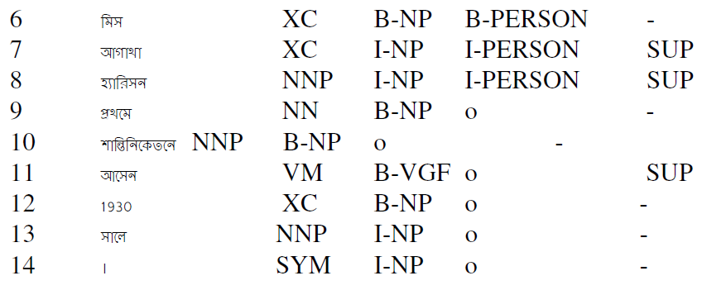
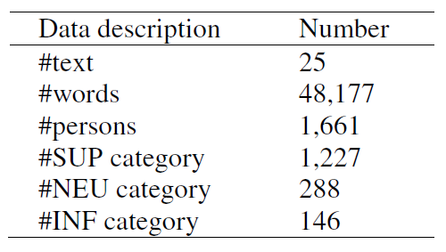
Training
The feature functions are computed locally within a sentence and the model was trained using a large Bengali corpus (35 million words)
The data was defined in the form (x,y) where x is the sentence or phrase containing a person with context information and y is the honorific information.
Format of training data
Coverage

Slide 9
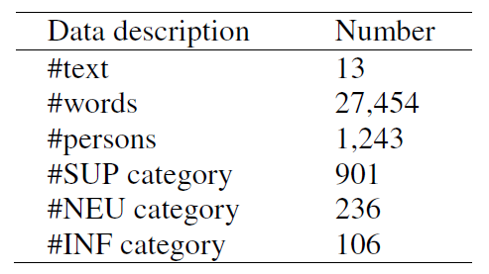
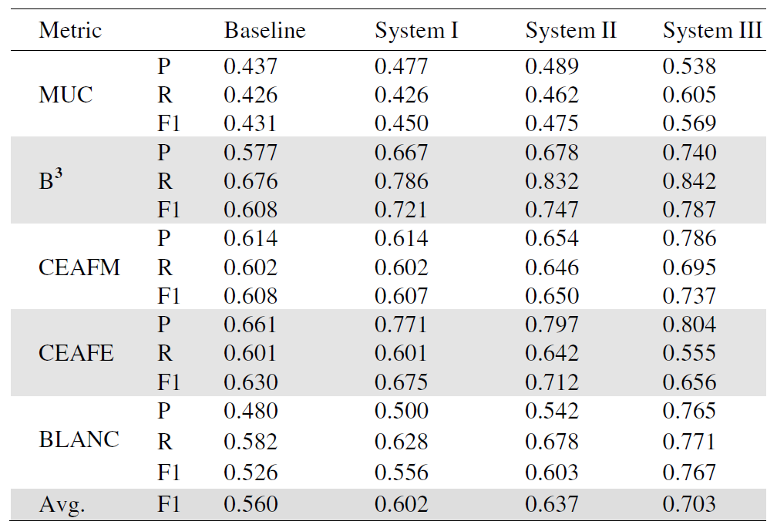
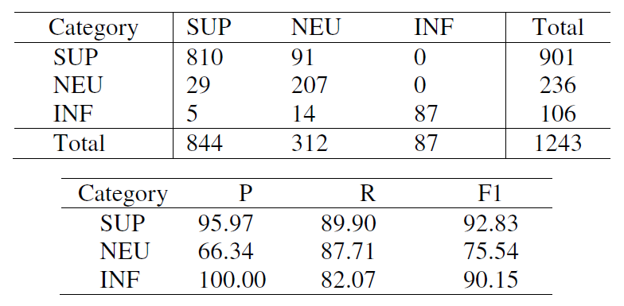
Results
Tested on an extended version of ICON 2011 annotated data for anaphora resolution in Bengali. The results are as shown.
Coverage
Honorificity detection
Pronomial anaphora resolution

Slide 10
Thank you

