Slide 1
Identifying Landmarks and Relations in grounded route descriptions of IITK
‘Smart Maps’
Project Presentation
-mohit gupta & Shubham modi

Slide 2
Objective
“First level of spatial understanding for humans is by landmarks”
To create “Smart Maps” that will:
Learn automatically from natural language
Compute not the shortest path but the most cognizable one.
Output the route in natural language

Slide 3
Steps to implement
Route description to user
OUTPUT
Cost – Blend of distance as well as popularity of roads/landmarks
TRAINING
Mapping parsed output
on the IITK Map graph
Parsing and NLP
Training Data

Slide 4
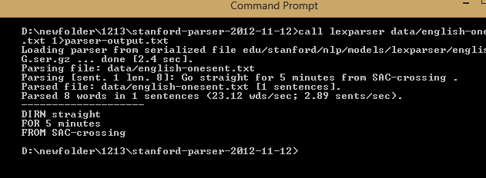
Steps to implement parsing and nlp
Input
Go straight for 5 minutes from SAC-crossing
PCFG and CKY Algorithm.
Using dependency parser for parsing and extraction of keywords.
Output from
Stanford Parser
root(ROOT-0, Go-1) advmod(Go-1, straight-2) num(minutes-5, 5-4) prep_for(Go-1, minutes-5) prep_from(minutes-5, SAC-crossing-7)
Extracting the keywords
for further use.

Slide 5
Steps to implement simulation
Source:
Airstrip
Destination:
Health-Center
IIT-gate
Hall-9
After entering IIT-gate, go straight for 1.2km. Take a left from the T-junction at Hall-2. Turn right after tennis-court and go straight for 100 m. Take a left from the T-junction. Follow the road and on reaching the T-junction, take a right. Go straight for 100 m and take the first left. Hall-9 will be on the right.
From the airstrip, go straight and take the left before the NCC-Camp. Go straight till you reach Hall-3. Take the road oppossite to Hall-3 and go straight until you reach GH-1. Take right from GH-1 and go straight. Health-Center would be on your left.
Route descriptions are fed in natural language, as a part of training
DO entering
WHAT IIT-gate
DIRN straight
FOR 1.2 km
DO Take
WHAT left
FROM T-junction
AT Hall-2
DIRN right
AFTER tennis-court
DIRN straight
FOR 100 m.
DO Take
WHAT left
FROM T-junction
DO reaching
WHAT T-junction
DO take
WHAT right
DIRN straight
FOR 100 m
DO take
WHAT left
WHICH first
WHAT Hall-9
WHERE right
Hall-2
IIT-GATE
Keywords are extracted and input is chunked into simple instructions
Tennis-Court
T-Junction
The path is mapped and the roads(edges) encountered are recorded
T-Junction
Now the user enters a source and a destination
Hall-9
T-Junction

Slide 6
Steps to implement Route description to user
Searching input on the IITK graph.
Concluding most effective route using modified
minimum cost finding algorithm.
User Input
Source : Auditorium
Destination : Hall-2
Output will be almost similar to description taken for training of data.
Framing it into a
human language.
Output
Go 100m straight till SAC-Circle. Take right from SAC-Circle. Go 200m straight till T-junction. Hall-2 is on your front.

Slide 7
Thank you!
Please help us in collecting the corpus! Fill out the form @home.iitk.ac.in/~smodi/cs365/project/index.html

