Slide 1
CS365 Artificial Intelligence
SEMANTIC IMAGE SEGMENTATION
USING
RANDOM FOREST CLASSIFIER
Mentor: Amitabha Mukerjee
Rohan Jingar
Mridul Verma

Slide 2
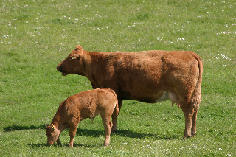
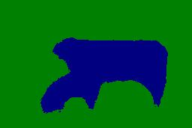
Problem Statement
What is Segmentation?
To group together the connected regions of an image which have the same semantic meaning and label them accordingly. A color is assigned to each pixel to indicate which object class it belongs to.
Original Image
GroundTruth Image
Computed Segmentation
Notes:
The Most Important thing while we are segmenting the image is that we are segmenting the image BOTTOM TO UP . Means for each pixel we are assigning it’s class. So during Testing each pixel is passed through the Random Forest and assigned it’s class.

Slide 3
Semantic Segmentation
As a Supervised Learning Problem:
Training Images
Extract features
Train classifier
Classifier
test Image
Extract features
Segmented image
Notes:
The classifier in this case is random forest. In random forest ,we construct many decision trees which in their leaf nodes contain the posterior probability for each of the classes.

Slide 4
Data set used
MSRC (Microsoft Research Cambridge)
21 object-classes
airplane, bicycle, bird, boat, body, book, building, car, cat, chair, cow, dog, face, flower, grass, road, sheep, sign, sky, tree, water.
276 training, 256 test images.

Slide 5
Random Forest
A random forest is a set of n independently trained decision trees.
Since they are independent they can be trained in parallel.
Bagging: We inject randomness and independance into training by randomly sub-sampling the the training data for each tree.
The classification by a tree results in class posterior distribution of the test data point. We can combine the results of all the independent trees as:
Product of Experts: take product of the individual probabilities. Here each tree can veto a class by assigning low a probability.
Mixture of Experts: take average of the individual probabilities.

Slide 6
Random Forest: Training
Image taken from D.Phil. Thesis of F. Schroff[09]
Notes:
For training each decision tree:
Sub-sample the training data from the pool of all training data.
Set P contains all the possible node tests to consider.
For training a specific node #nf number of node tests is sub-sampled from P.
Out of these #nf node tests the one that maximizes the information gain i.e. which maximally separates the classes is selected as node test for that node.
That node test will split the feature space into regions primarily containing data points of one class.

Slide 7
Random Forest: Parameters
Number of decision trees: Performance increases if more trees are added to the classifier. However not much improvement is shown after ~20 decision trees.
Pool of Node tests:
#nf: No. of node tests randomly selected from P for each node. It influences the randomness. If #nf = 1, then no optimization.
Type of low-level features used: texton histogram, RGB, HOG. This constitute the domain D for node test tp.
Max. Depth of Each Tree: Deeper tree have better performance. But more depth can also lead to overfitting.

Slide 8
Schematic representation of Node test
Every tree training set is subsampled from the training data from each class
Pool of features Present
Extracting Random K features out of M features
Set Of Images come at a node
(this is while training)
K Features'
Tp < λ
False
True
Pool of features comprises of:
RGB
HOG
F 17 filter bank
Texton

Slide 9
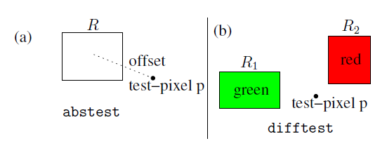
RGB Features
The node-tests are simple differences of responses computed over rectangles in one of the three channels (R, G, or B).
Abstest
Difftest
There are two types of RGB feature test
Image taken from D.Phil. Thesis of F. Schroff[09]

Slide 10
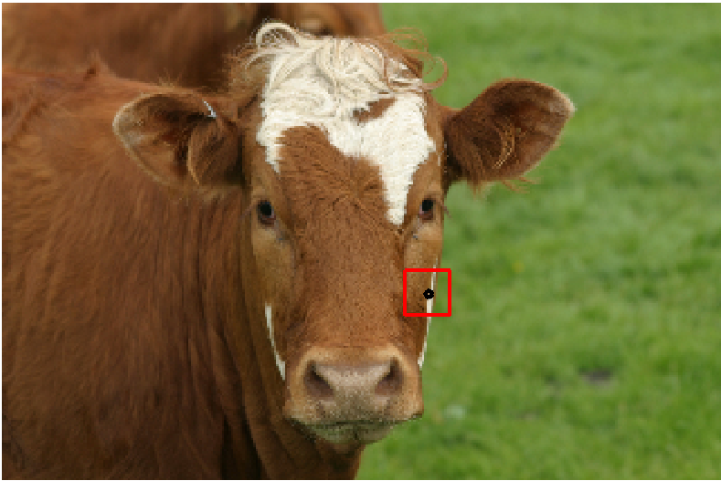
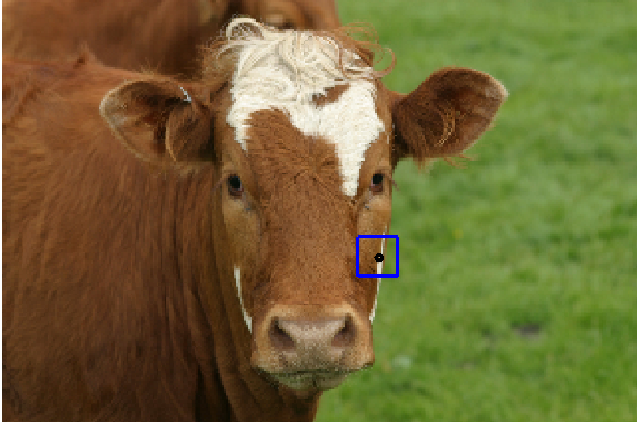
In this only one rectangle is chosen and the red channel is chosen so in this the response over the red channel is summed over his window
In this only one rectangle is chosen and the green channel is chosen so in this the response over the green channel is summed over his window
In this only one rectangle is chosen and the blue channel is chosen so in this the response over the blue channel is summed over his window
In this simple differences over two chosen rectangles over any two channels (in this case red and green)is computed and compared against λ
Image taken from D.Phil. Thesis of F. Schroff[09]

Slide 11
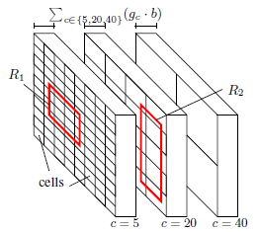
HOG feature descriptor
The HOG descriptor is computed for the whole image using various cell sizes c in pixels, block sizes b in cells, and number of gradient bins g. This leads to a g b dimensional feature vector for each cell (see Figure 5.5). The stacked HOG consists of c = {5; 20; 40} and g = {6; 6; 12} oriented gradient bins for each of the c values (with b = 4 cells in each block), resulting in 6. 4 + 6 .4 + 12 .4 = 96 channels for each pixel p.
In this, this summation is our node test and we select the threshold to maximize the info. Gain.
Image taken from D.Phil. Thesis of F. Schroff[09]

Slide 12
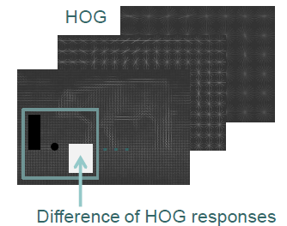
In this we compute the difference of HOG responses over different rectangles in the image and then compare it with λ.
Image taken from D.Phil. Thesis of F. Schroff[09]

Slide 13
F17 filter bank
Filter bank made by combinations of Gaussians, first and second derivative of Gaussians and laplacian of Gaussians.
3 G with  = [1,2,4] applied to each CIE Lab channel resulting in 9 filters.
4 LOG with  = [1,2,4,8] applied to L channel only resulting in 4 filters.
4 G’ divided into two x and y aligned sets each with  = [2,4]. These are also applied to L channel only resulting in 4 filters.
We use them as an additional cue in the same manner as the RGB features.

Slide 14
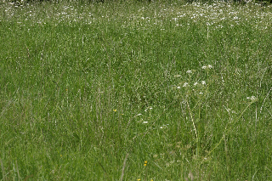
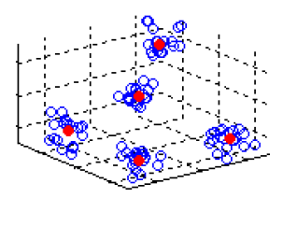
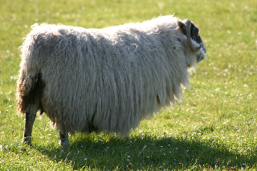
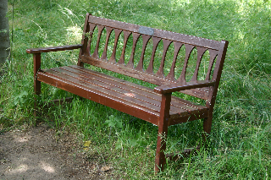
Texton features
3*3*3 window
These red dots are the V textons and they comprise the texton vocabulary.
In this way we plot all the 3*3*3 window in the training set and with the help of K-means we find the V textons.
All the training Images
27 dimensional vector representing each image pixel
Image taken from D.Phil. Thesis of F. Schroff[09]

Slide 15
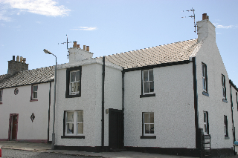
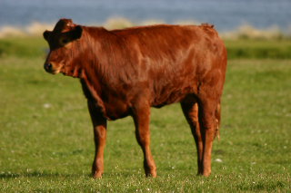
Now when the V texton dictionary has been made, we make the texton map (for the purpose of image segmentation) of various images with the help of this V texton dictionary.
For each of the 3*3*3 ( 27 dimensional vector) we find out to which cluster does it belongs and we assign that PIXEL the color for that particular TEXTON.
Each of the Texton represent a Cluster center.
Number of textons in the dictionary is 30 or in other words the value of k in k-means is 30.
Notes:
Important point in this is that as the value of k in k-means goes on increasing the result automatically improves
We have tried for various values of K in k-means
30
50
100
200
400

Slide 16
Node test using texton without shcm
We have trained the Image dataset. To test we compute the texton map of this test image using the dictionary of visual words.
Now I would make the texton map of a test image(image segmentation has to be done) by making 3*3*3 window and mapping each point to its respective cluster center.
The straight forward way of using textons corresponds to the usage
of the previously introduced feature channels, i.e. each texton is treated as a “feature
channel” and the accumulated response in one rectangle defines tp and is compared to a
threshold . This method is used in Shotton et al. (2006, 2008).
Test Image
Texton map of the test image
The feature channel (Texton ) and λ are chosen such that it maximizes the information gain.

Slide 17
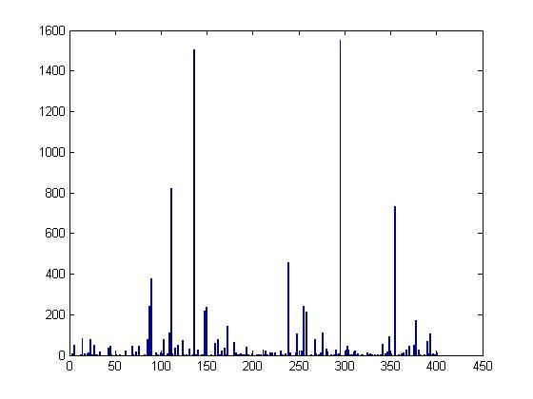
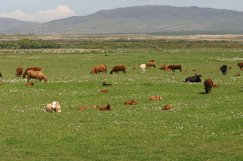
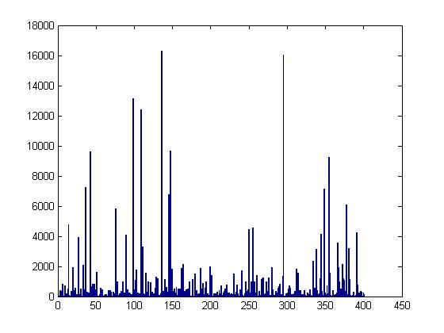
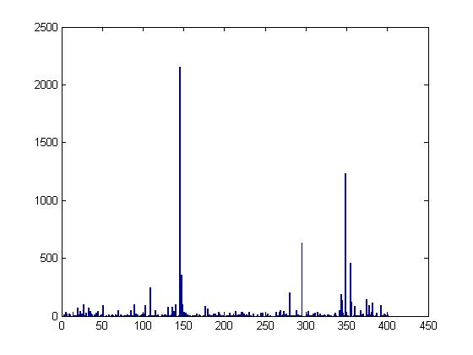
SHCM
SHCM are Single class histogram models. They help us to represent a whole class with the help of a histogram. In this we model each class with a single model.
Then we combine these histograms to make SHCM
SHCM is for grass
First the texton map is made then we count the number of occurrences of each texton and then plot the histogram

Slide 18
SHCM with Random forest
Sliding window around a pixel
Find $q^{\hat{i}} s.t.$
Compute hist. h
$q^{\hat{i}}$ = arg $\min_{q^{i}}$ (KL(h||$q^{i}$))
KL(h||q) = $\sum{h_{i}} log⁡(\frac{h_{i}}{q_{i}})$
Texton Map of a Building
if KL(h|| $q^{i}$) < KL(h|| $q^{j}$) => class i is more likely to explain window s
than class j

Slide 19
Node test for SHCM
$w^{i,j}$ = log($\frac{q^{i}}{q^{j}}$)
$t_{p}$ = $w^{i,j}.h$
if KL(h|| $q^{i}$) < KL(h|| $q^{j}$) => $w^{i,j}$ < 0
$w^{i,j}$ is defined as tp and we compare this against 0 as a node test
When using SHCM we take any two SHCM’s(of any two classes) at a node and compare it with the query histogram(h) and apply Kullback-Leibler to evaluate the node test.

Slide 20
DEcision Tree Classifiers
grass
cow
grass
tree
cow
tree
sheep
sheep
tree
tree
grass
sheep
cow
grass
grass
sheep
sheep
tree
tree
grass
sheep
cow
In this the node test has been done using SHCM.As you can see that at first node the classes (i,j) are (grass ,cow ) and so on…..
Notes:
To classify a pixel into one of the given object classes is a complex decision to make. So we break it into a series of small and simple tests.
A tree based structure is used having a set of tests/rules at each level to make a decision at the end
We consider only binary trees.
Internal Node: contains a test condition to classify/separate
Leaf Node: contains one classification. In case of pixel classification it contains the class probability

Slide 21
What we are doing??
The code available does not have Texton and SHCM implemented.
Till Now we have been able to successfully implement the algorithm for calculating the Texton map of various images and have also computed the SHCM model for each of the class.
Currently we are fusing SHCM into training of the Random Forest and soon will be using them for testing also.

Slide 22
Results
No. of trees = 30
Max Depth = 20
Total features per tree = 30000
no. of features drawn from pool = 200
pixels correctly labeled overall: 67.670%

Slide 23
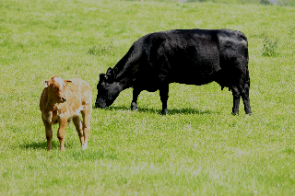
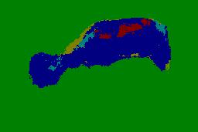
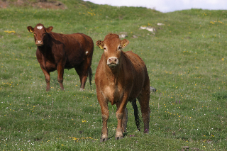
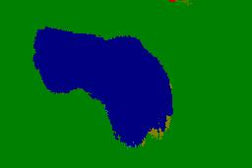
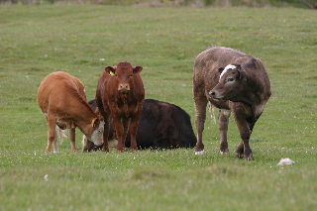
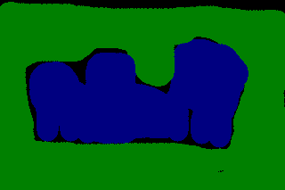
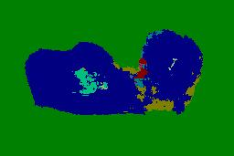
original
Ground truth
segmented

Slide 24
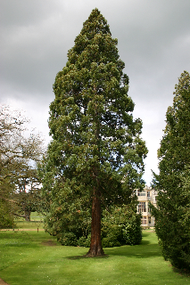
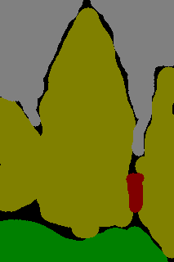
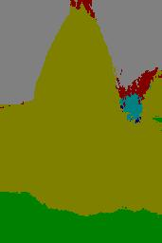
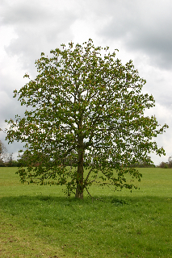
original
Ground truth
segmented

Slide 25
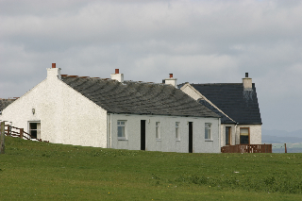
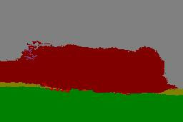
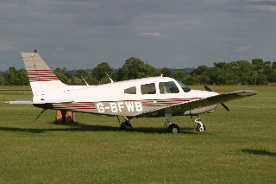
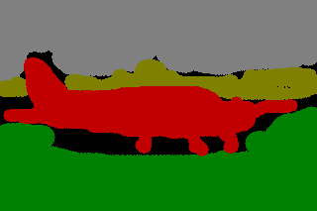
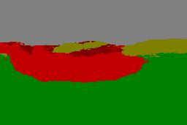
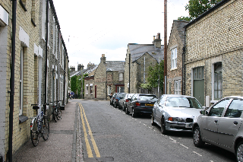
original
Ground truth
segmented

Slide 26
references
[1] F. Schroff, A. Criminisi, and A. Zisserman. Object Class Segmentation using Random Forest, Proceedings of the British Machine Vision Conference (2008).
[2] J. Shotton, M. Johnson, and R. Cipolla, Semantic texton forests for image categorization and segmentation, in Proceedings of the IEEE Computer Society Conference on Computer Vision and Pattern Recognition, pp. 1-8, Anchorage, USA, 2008.
[3] Matlab code by F. Schroff for training and computing the final segmentations.

